Slide 1
Siberian Tiger
By: Connor McInnes
Kendall Dentlinger

Slide 2
General Information
Panthera tigris altaica
Their coat is striped, yellow-orange in color and has white on its tail, underside, back and legs. The males have ruffs of fur around their cheeks.
Males are about 700lbs and about ten feet long from nose to tail. Females on the other hand weigh about 450lbs and average a length of eight feet.
Warm Blooded
Siberian tigers only come together to mate, and then the female is left to raise the cubs by herself.
In the wild, Siberian tigers live for about fifteen years, but in captivity they live longer, to about twenty-five years.

Slide 3
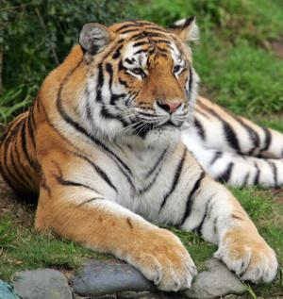
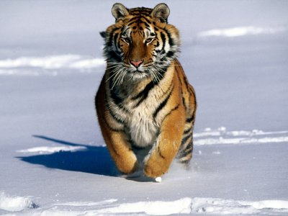
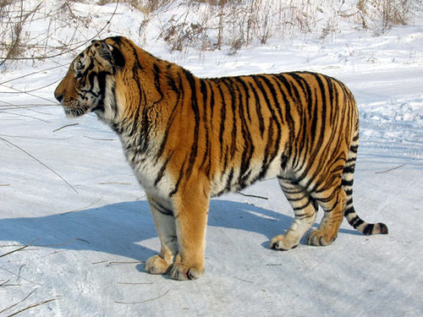
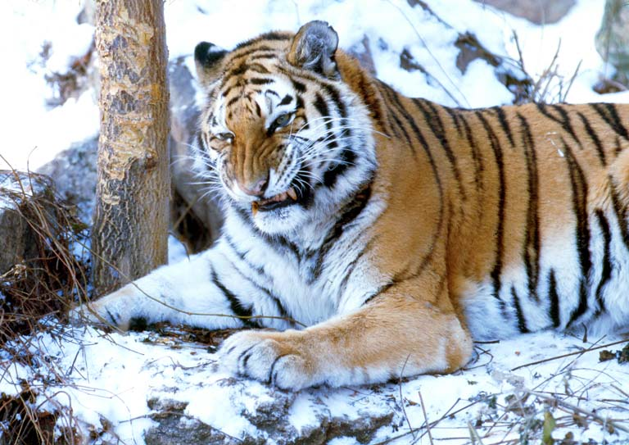

Slide 4
Habitat
Siberian tigers live in eastern Russia, northeastern China and northeastern Manchuria. They also live along the coastline of Siberia where they can withstand temperatures of up to -40°F, but usually stay around -4°F. Siberian tigers prefer cool temperatures.
They live in both coniferous and deciduous forests, but prefer areas with tall grass for hunting. These tigers are native to the Amur-Ussuri region of Russia.
Siberian tigers have an average of 10-30sq. miles of territory each.

Slide 5
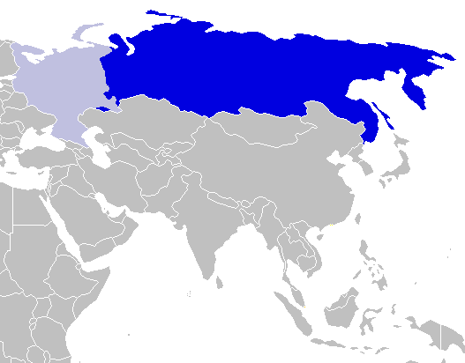

Slide 6
Diet
Siberian tigers spend much of their waking time hunting. They are nocturnal therefore they prefer to hunt during the night.
Only about one in every ten attempts to kill prey is successful.
It will then drag its prey to a spot to eat it. It can drag prey that would take over a dozen men to move!
Siberian tigers mainly hunt wild boar, elk and deer, but if food is short, they will eat pretty much anything. They will even go closer to town to hunt dogs and cats, but this poses a threat to the tiger because it could be killed by humans. They can usually eat 100lbs in one sitting.

Slide 7
Endangered Statistics
Siberian tigers, along with the other tigers, are an endangered species. Only six of these species are still around and three others have become extinct. This means that these other six species are near extinction also. Only about 350-500 Siberian tigers are left in the wild, and about 500 are captive. The 500 that are captive are part of conservation programs such as the Species Survival Program (SSP) which breeds the tigers to make their population size grow and keep them from becoming extinct.

Slide 8
Threats
Poaching- Siberian tigers are killed for their parts. China and Taiwan believe that tiger parts hold cures for many different deadly diseases. The poachers kill the tigers and sell them to China and Taiwan for around $30,000 each.
Habitat loss- Because of forest destruction the tigers have less forests to live in and fewer prey. These tigers need a lot of area to hunt in and destroying their habitat confines them into smaller areas. Not only is destroying the forests taking away their habitats, but it is also killing and taking away homes for the tigers' prey. Because the tigers have less prey, they will go near towns to eat things like chickens and dogs, where they are usually killed.
Isolation- As humans move further into the forests, they separate the tigers' habitat. This leads to the separation of tiger populations which causes interbreeding within isolated groups. This reduces the genetic diversity of the Siberian tigers.

Slide 9
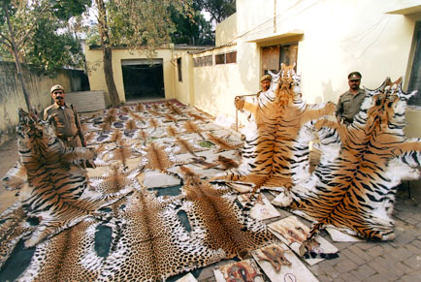

Slide 10
What is Being Done
In the 1970's the Soviet Union made efforts to protect the tigers' territory in far east Siberia. Eventually Russia took over, and began to cut down some of the trees in the area. Tigers are also protected by the Convention on International Trade of Endangered Species (CITES). The law under CITES prohibits the trade of tigers and their parts between countries. There are also many organizations that people can donate to that offer help to save the tigers.

Slide 11
Sources
http://animals.nationalgeographic.com/animals/mammals/siberian-tiger/
http://www.wcsrussia.org/Projects/SiberianTigerProject/tabid/1222/language/en-US/Default.aspx
http://bioweb.uwlax.edu/bio203/s2007/salus_crys/characteristics.htm
http://www.huffingtonpost.com/2011/03/07/siberian-tiger-population_n_829348.html
http://www.wonderclub.com/Wildlife/mammals/SiberianTiger.htm
http://www.panthera.org/species/tiger/subspecies

