Slide 1
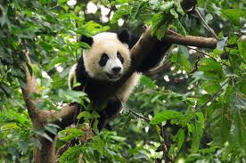
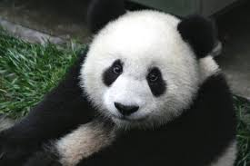
The Giant Panda
Els Reuvekamp

Slide 2
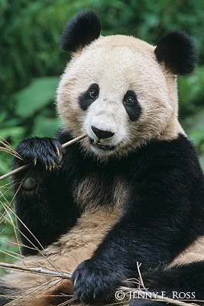
What is a panda?
A black and white bear
Large
Lives in China
Distinct black spots on eyes
Mammal, sexual reproduction

Slide 3
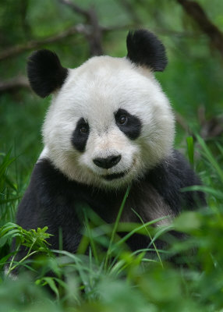
How do pandas live?
Live in isolation, not in groups
Seem cuddly, actually furious
Sharp teeth and powerful jaws
Raises its young
No lifetime partners
Reproduce slowly
Warm blooded
No migration or hibernation

Slide 4
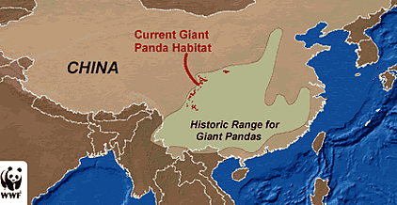
Where do pandas live?

Slide 5
Bamboo
Pandas eat 20-30 lbs. of bamboo daily
Bamboo is a panda’s main source of nutrition
Bamboo deforestation has led to panda decline

Slide 6
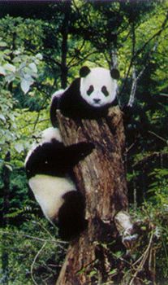
Why are pandas endangered?
Pandas became endangered in 1984
Habitats were destroyed by deforestation
Habitat fragmentation
Many pandas were killed by poachers for their fur

Slide 7
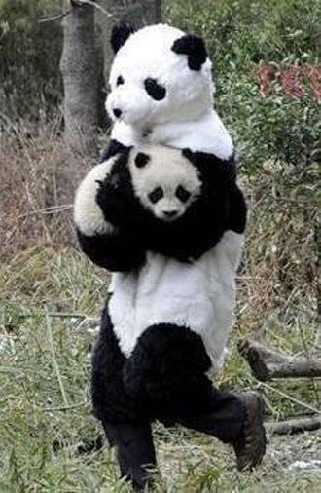
How endangered are pandas?
As of 2004, only 1600 pandas left in the wild
Expected to go extinct within 70 years or 3 generations
Captive breeding has increased panda numbers

Slide 8
What’s currently being done?
Captive breeding has increased panda numbers
Over 50 panda reserves exist in China
WWF has raised panda awareness

Slide 9
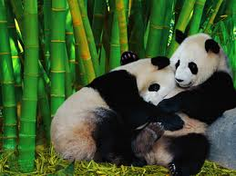
What can you do?
Donate to WWF
Stop using bamboo products
Oppose illegal panda poaching
Travel to safe regions where pandas wont be affected

Slide 10
Websites Used:
http://wwf.panda.org/what_we_do/endangered_species/giant_panda/whatyoucando/
http://wwf.panda.org/what_we_do/endangered_species/giant_panda/solutions/protectedareas/
http://worldwildlife.org/species/giant-panda
http://nationalzoo.si.edu/Animals/GiantPandas/pandaFacts/default.cfm

