Slide 1
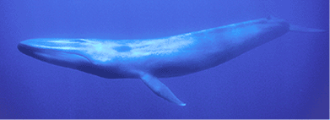
The Blue Whale
By: Tasnim Hamad & Kalani Perry
period: 1

Slide 2
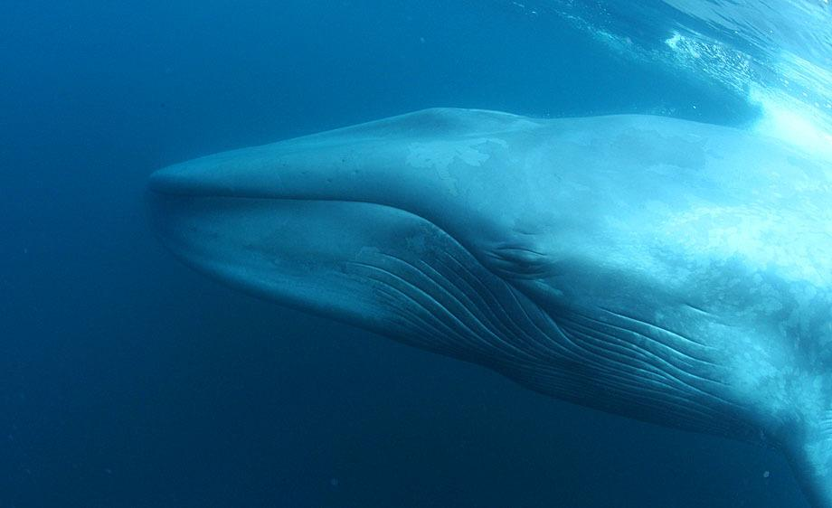
information
The Blue Whale is the largest animal on the planet, weighing about 200 tons(about 33 elephants).
Their tongue alone weighs more than an elephant and their hearts weigh about an automobile.
They’re 80-100 feet long.
Their population is about 10,000-25,000 individuals.
They’re also the loudest animal on the planet, louder than a jet engine .

Slide 3
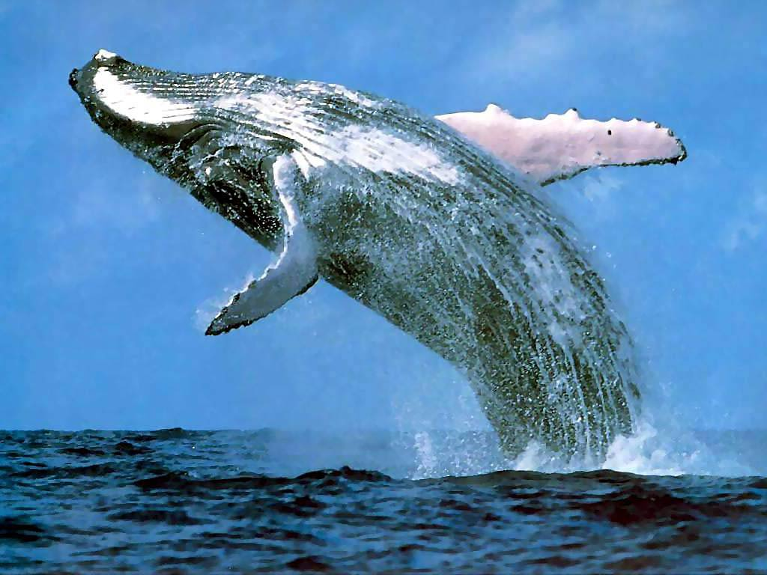
Facts
Their habitat is in the ocean.
Known as the Giants of the Oceans.
They’re on top of the food chain.
Blue whales are threatened by environmental change including habitat loss and toxics.
Blue whales can also be harmed by ships strikes and by becoming entangled in fishing gear.
Blue whales look blue underwater, but on surface, they are a blue-grey color.

Slide 4
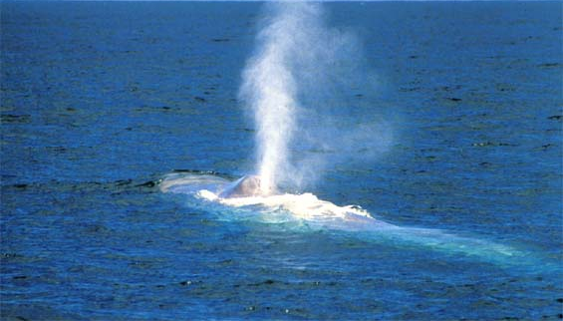
Facts (Breathing)
They breathe air out their blow hole like most other whales which means they must be near the surface.
The blue whales can hold their breath for many hours however if they can’t reach the surface because of the ice, they can drown like any breathing animal.

Slide 5
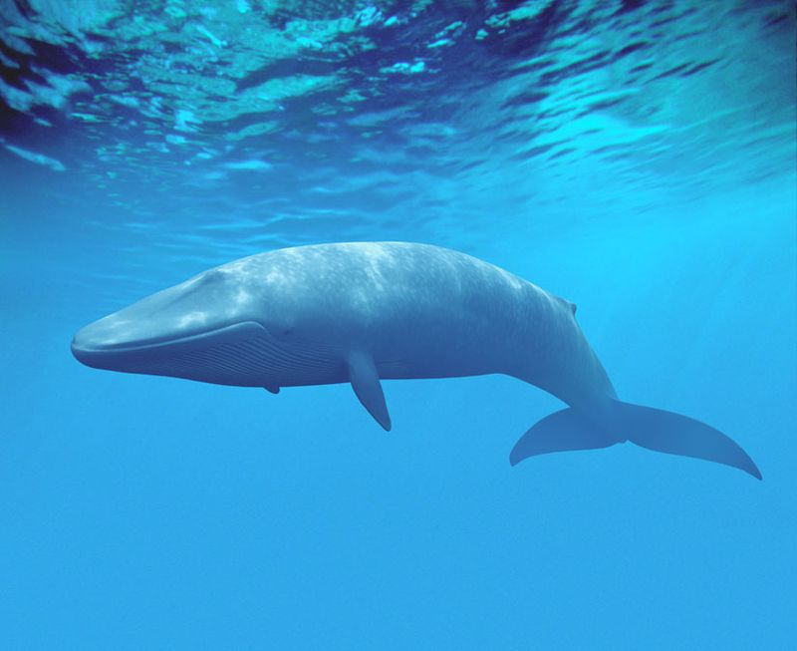
Facts (birth)
The Blue Whale is a marine mammal which means that it gives birth to live whales and doesn't lay eggs like other fish.
All Whales give birth to live young otherwise their eggs would be in danger because they’re huge.
A baby whale weighs four or five times the size of an average car.
A baby can be measured to about 25 ft, which is as big as a killer whale.

Slide 6
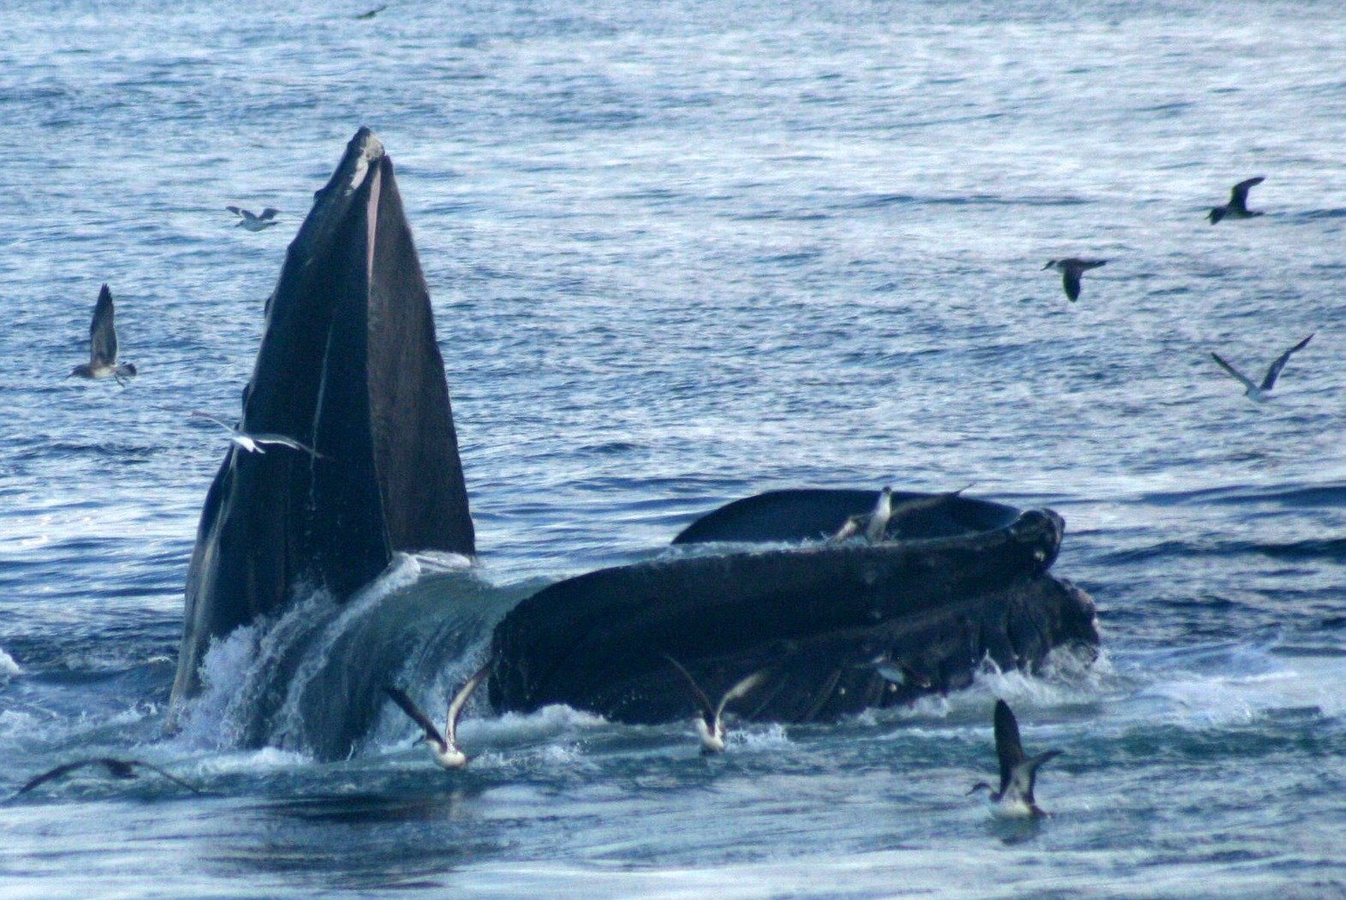
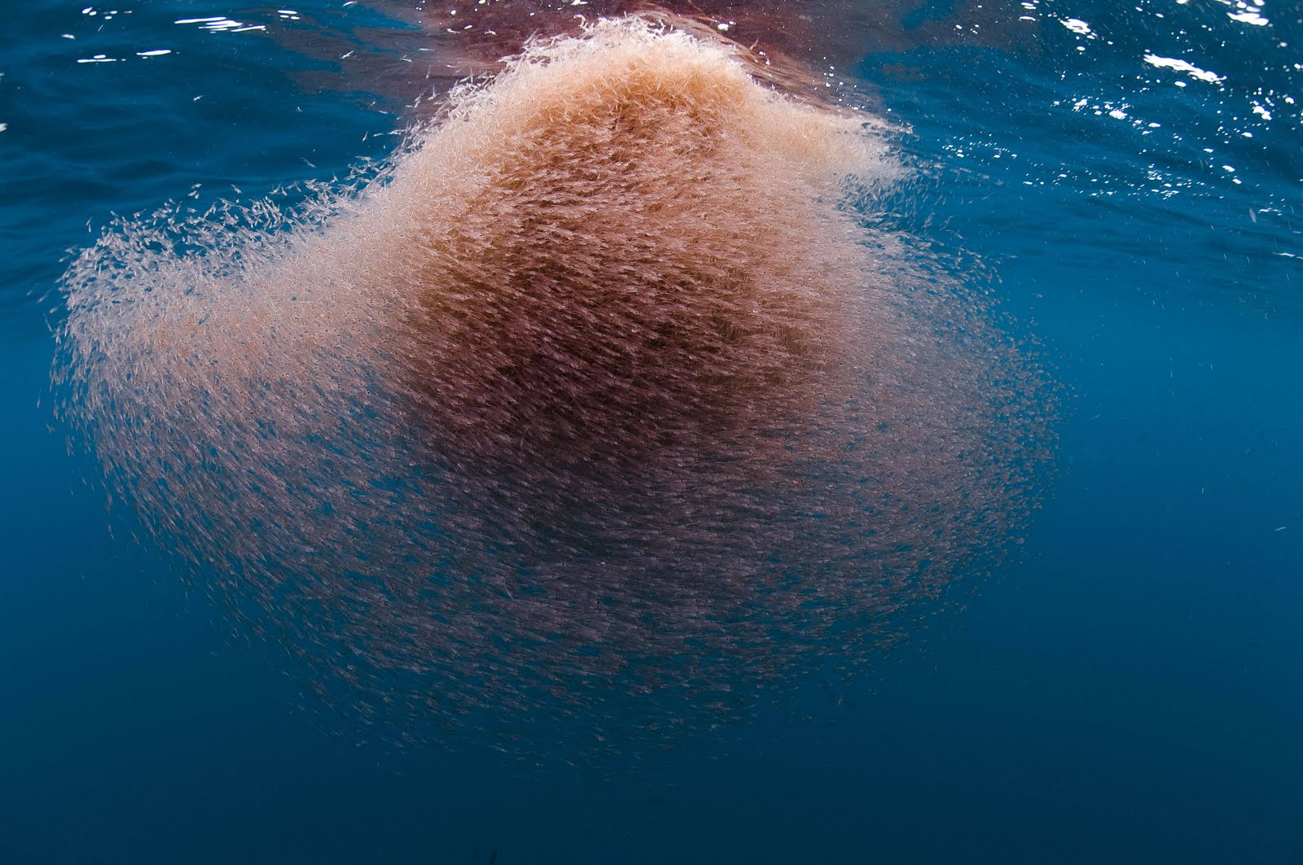
Facts (Eating)
During times of the year, an adult blue whale consumes about 4 tons of krill a day.
They eat up to 8,000 pounds of food on a daily basis.
Instead of krill, baby whales consumes milk during its first 6-18 months of birth, and can drink up to 150 gallons of milk a day, until the baby can be able to hunt for food and survive alone.
While consuming krill, they may coincidentally swallow fish or squid that happens to be swimming near the school of krill.

Slide 7
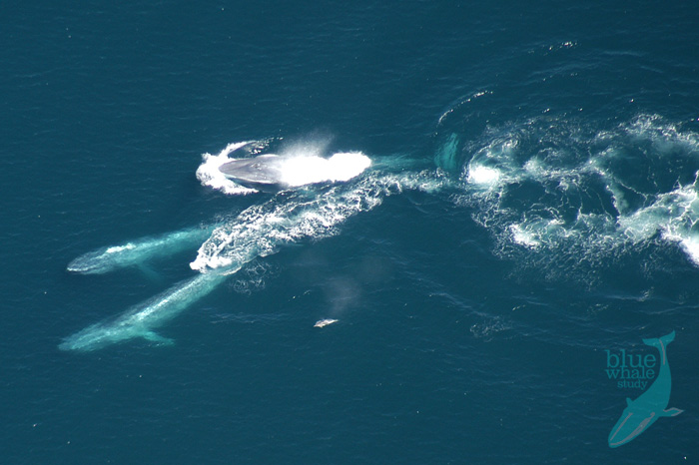
Facts (communication)
Blue whales often travel during migration alone or in small groups.
They communicate with loud low-pitched moans and whines which can be heard many miles away.
They communicate with loud moans for calling other whales to mate with or locate other pod members and even express sorrow when a pod member is sick or dies.
They tend to prefer to travel in small pods during periods of feeding, mating or migrating.

Slide 8
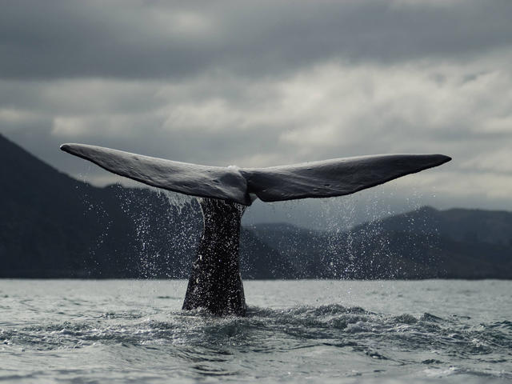
Facts (Threats)
During the whaling era, the blue whale faced frequent threats from whalers and poachers using their oil to make various products.
excessive hunting eventually led to huge declines in the blue whale population.
Eventually the act of commercial whaling making it illegal to hunt them.
Aside from hunting, the blue whale may also face threats like pollution, global warming and incidents of fishing gear and other aquatic equipment.

Slide 9
Resources
https://www.youtube.com/watch?v=KQQ9MjKo-qc
https://www.worldwildlife.org/species/blue-whale
http://www.bluewhales.org/
http://animal-kid.com/blue-whale-size-comparison-to-human.html
http://animals.nationalgeographic.com/animals/mammals/blue-whale/
http://www.whalefacts.org/what-do-blue-whales-eat/

