Slide 1
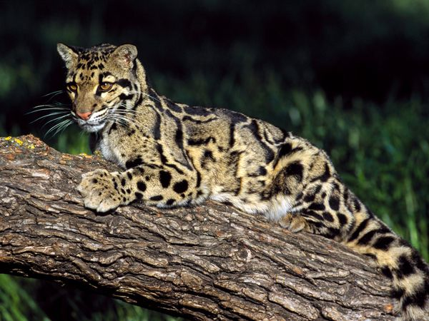
Clouded Leopard
By Joey Daly and
Paul Otterson

Slide 2
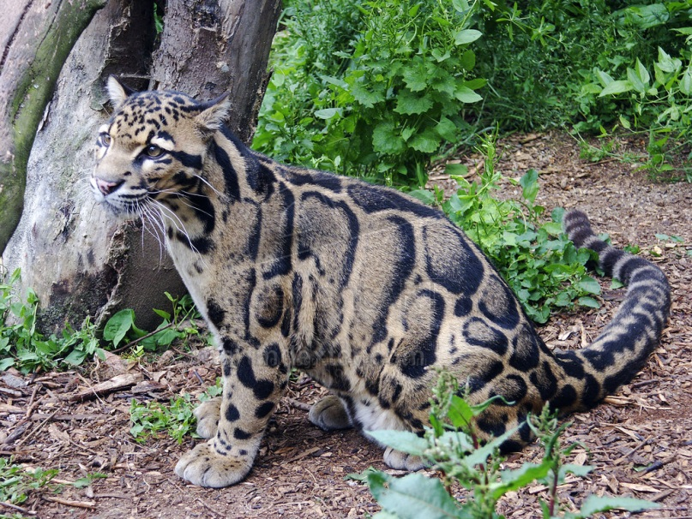
Clouded Leopard Facts
Part of the Leap Group of leopards
Not much is known about their habits because they are rarely seen in the wild.

Slide 3
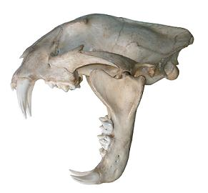
Stats
Usually weigh about 30 pounds, 36 inches long. (without tail, which is usually about 30 inches)
Relatively short legs and large paws.

Slide 4
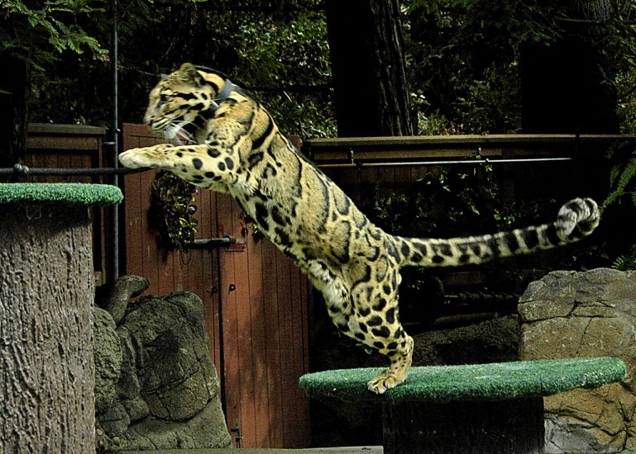
Abilities
Known for great eyesight, exceptional leaping distance, and skill at climbing.
Despite being adept at climbing, they usually hunt on the ground and feast on deer.

Slide 5
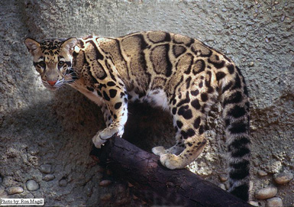
Poaching
Clouded Leopards are often killed for their beautiful thick fur coat.
This is why they are on the Endangered Species List, ranked Vulnerable.

Slide 6
Species Split
Around 2006 a decision was made to split up the species based on habitat. N. nebulosa live in Southeastern Asia. Whereas N. diardi resides in Indonesia and Malaysia.

Slide 7
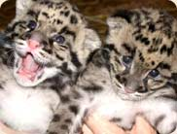
Breeding
Clouded Leopards are fully mature in 2 years.
Breeding can occur at any time and gestation period is about 90 days.
A litter of 1 to 5 cubs are born, but two is the most common number.

Slide 8
Thanks for Watching!
NSA

