Slide 1
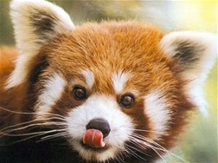
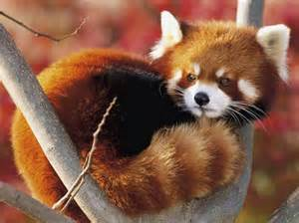
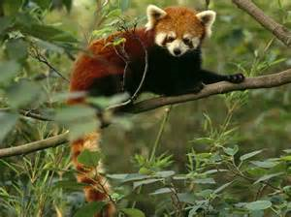
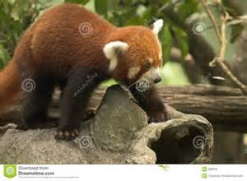
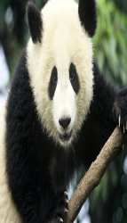
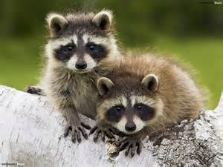
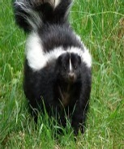
Red Panda
Red Panda
Lives in China, foothills of Himalayas, Nepal and Bhutan, and northern Myanmar.
Clouded Leopard
Watch where you’re going next time, or less I will be there to put you in
your endangered place.
WWF
Glad we got the help out Ailurus A. Fulgens and conserve the forests of its habitat.
Friends
Nepal
Hey there firefox. We love having you in our natural ecosystem! We are trying to educate our people about your endangerment. Best wishes, Nepal.
Giant Panda
Giant Panda
Hey, cousin! Haven’t seen you in awhile. Hope everything is going well. We just moved to a zoo for a better life.
Raccoon
Wild “DAWG”
I had a fun time chasing you around in the forest. Happy my owner let me out to
follow your warm blooded body.
Skunk
Buddy, we should hang out sometime. You could learn a thing or two of survival
From my stinky good looks.
Skunk

Slide 2
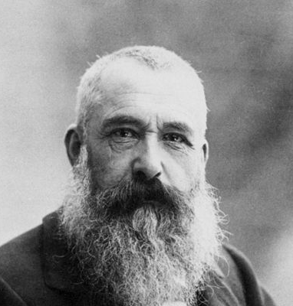
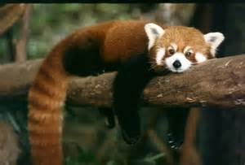
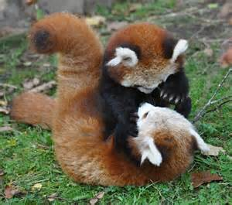
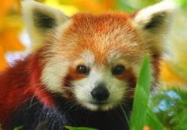
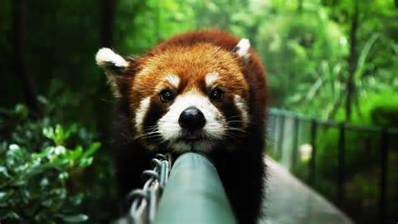
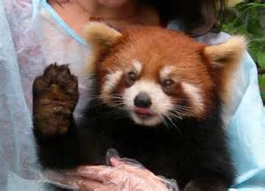
Claude Monet
Red Panda
Red Panda
Lives in China, foothills of Himalayas, Nepal and Bhutan, and northern Myanmar.
Basic Info
About Red Pandas
Commonly referred to as the firefox, this endangered animal is birthed in groups of 1-4 cubs at one time. The mother will typically care fro the cubs for 1 year, up to 2. The red panda is the size of a large rat, but has markings like a panda or raccoon. It can weigh eight to twelve pounds, living anywhere from 10 to 14 years. Fully grown, the cuddly creature can grow to lengths of 56-63 centimeters. Naturally solitary and confined with its mother, the panda does not remain in groups with others. It will have multiple reproducing partners throughout its life.
Networks
China, foothills of Himalayas, Nepal and Bhutan, and northern Myanmar.
Friends
Activities & Interests
Activities
Eating bamboo, rodents, birds, and insects and fruits in warm months.
Giant Panda
Interests
Forest Conservation, Laws Against Poaching
Arts & Entertainment
Music
Raccoon
Mother Nature's Son
Beetles
Songs of Nature
Force of Nature
Books
Skunk
Pandas
Television
The Crocodile Hunter
Nature

Slide 3
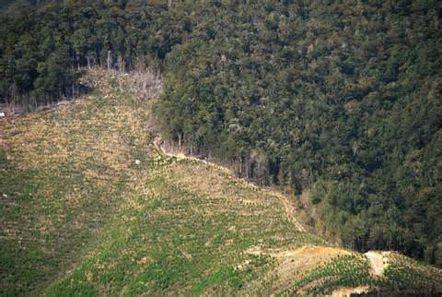
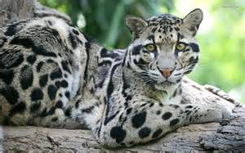
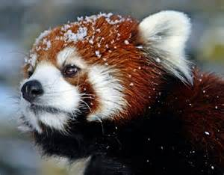
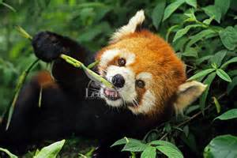
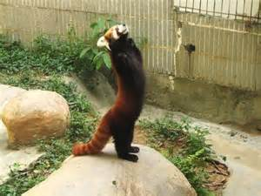
Red Panda
More Information
By Red Panda (Albums) * Updated 1 day ago
The main attribute of the red panda endangerment is deforestation or loss of its forestry habitat. Also, humans have impacted the species by setting traps for other animals and in the end killing them. Firefox numbers have been reduced to less than 10,000.
Human prosper from killing this animal, by getting soft fur.
Predators of the red panda include the clouded leopard, snow leopard, wild dogs, and human hunting. These pandas, being killed by humans aren’t even being totally used. Only put down for the fur.
Preservation efforts and increasing the population of the red panda comes from captive breeding in over 80 zoos, but that doesn’t replace them at the same rate to increase the population. Laws are being set in Nepal, to stop killing all red pandas and get rid of traps. Estimations of time of extinction are unknown.
The red panda’s omnivore diet varies of many species of smaller rodents. Bamboo is a consistent source of energy for the animal. Fruits in warmer growing moths are consumed at those times.
Although typically peaceful and conservative animals, if attacked they can use their razor sharp claws and muscular jaws equipped with sharp canines. Many of it’s defenses are similar to a skunk’s.

Slide 4
Bibliography
http://wwf.panda.org/what_we_do/endangered_species/giant_panda/panda/kung_fu_panda_enemies_defences/
http://www.pressconnects.com/story/entertainment/2015/03/03/zoos-red-pandas-help-boost-species-numbers/24334069/

