Slide 1
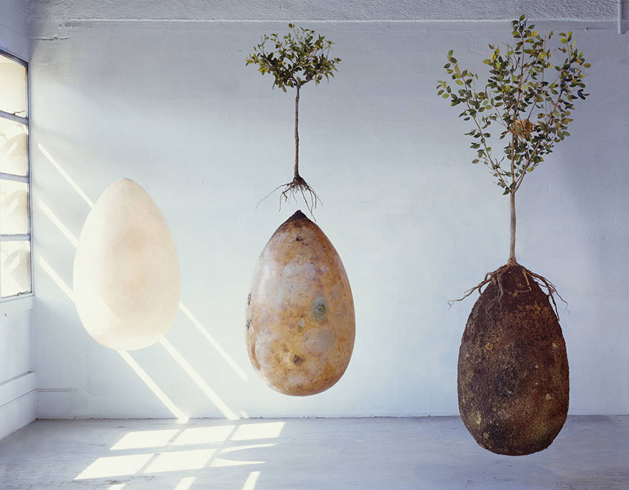
Capsula Mundi project involves an organic, biodegradable burial capsule that will allow the deceased to function as nutrients for a tree that will grow out of their remains. The deceased is enclosed in the capsule, buried, and a tree seed (or entire tree) is planted right above them.
http://deadstate.org/forget-about-coffins-now-you-can-turn-into-a-tree-when-you-die/

