Slide 1
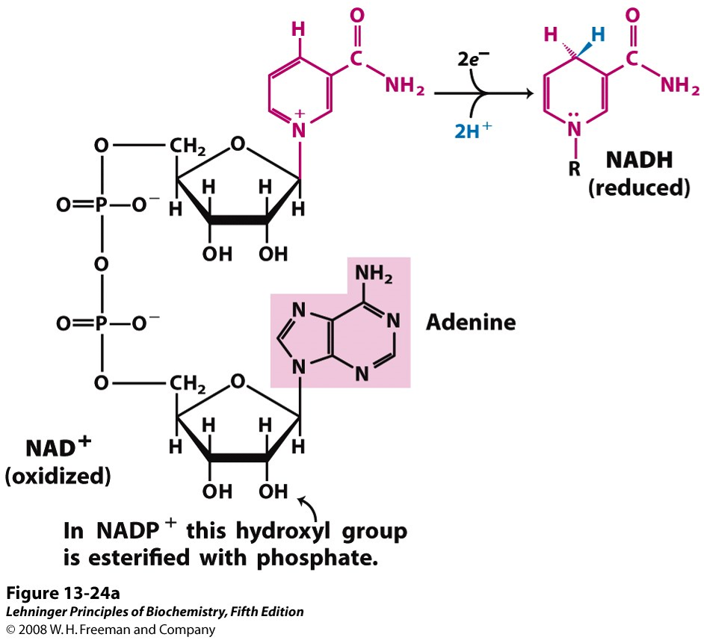
https://amit1b.files.wordpress.com/2013/11/figure-6.png
NAD⁺ NADH NADP⁺ NADPH

