Slide 1
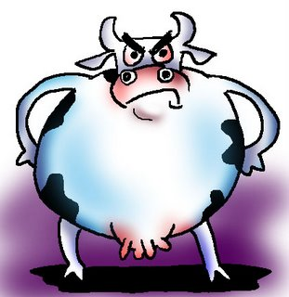
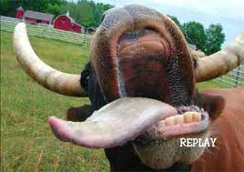
Mad Cow Disease
http://www.google.com/imgres?q=crazy+cow&um=1&hl=en&sa=N&biw=1280&bih=823&tbm=isch&tbnid=SBeGwN-sN8InuM:&imgrefurl=http://s298.photobucket.com/albums/mm247/xonistica/%3Faction%3Dview%26current%3Dcrazy_cow.jpg%26newest%3D1&docid=D9F7hhzYihDjnM&imgurl=http://i298.photobucket.com/albums/mm247/xonistica/crazy_cow.jpg&w=400&h=284&ei=nFG2T7_mIIOy2wW76pGfCQ&zoom=1
http://www.google.com/imgres?q=crazy+cow&um=1&hl=en&sa=N&biw=1280&bih=823&tbm=isch&tbnid=bDXEoYMSgpyoGM:&imgrefurl=http://autismjabberwocky.blogspot.com/2010/06/shh-restricted-diet-might-help.html&docid=OcUH1Ruk9mPS1M&imgurl=http://3.bp.blogspot.com/_WoSi1HFMqsc/TBbBfpBgiNI/AAAAAAAAAPQ/LzdQwaKqroQ/s1600/mad_cow_cartoon.jpg&w=311&h=320&ei=nFG2T7_mIIOy2wW76pGfCQ&zoom=1&iact=hc&vpx=633&vpy=322&dur=915&hovh=228&hovw=221&tx=148&ty=134&sig=112640781873971852861&page=1&tbnh=139&tbnw=135&start=0&ndsp=26&ved=1t:429,r:10,s:0,i:148
Caitlin Brandt

Slide 2
ΩΩ Incurable, fatal brain disease
ΩΩ Unusual transmissible agent called a prion
ΩΩ Normal protein changes to a harmful protein
ΩΩ Gradually damages central nervous system of cattle
ΩΩ Loses ability to do normal things, such as walking
ΩΩ First cases of infected people in 1970’s in Britain
ΩΩ Rare brain condition: vCJD (not MCD!)
ΩΩ Cells in brain die, until it has sponge like appearance
ΩΩ Gradual loss of mental and physical abilities

Slide 3
ΩΩ Very rare, most cases in Britain
ΩΩ Not contagious
ΩΩ Eating contaminated meat
ΩΩ Takes years, if not decades, from the time someone is exposed to the disease until the first signs appear
ΩΩ No known treatment
ΩΩ BSE not destroyed through cooking or processing meat
ΩΩ U.S. Gov. removes parts of cow at highest risk (brain and spinal chord)
ΩΩ FDA says there is no evidence that the disease is transmitted through cow's milk and milk products
ΩΩ The good news is that it's highly unlikely that a person will contract vCJD from eating beef

Slide 4
http://www.cdc.gov/ncidod/dvrd/bse/
http://kidshealth.org/teen/infections/bacterial_viral/mad_cow_disease.html

Slide 5
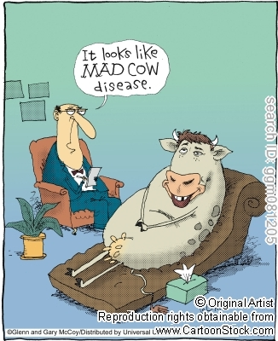

Slide 6
THE END…OR IS IT?

