Slide 1
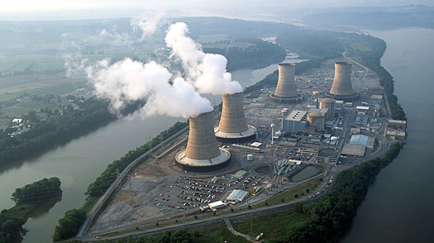
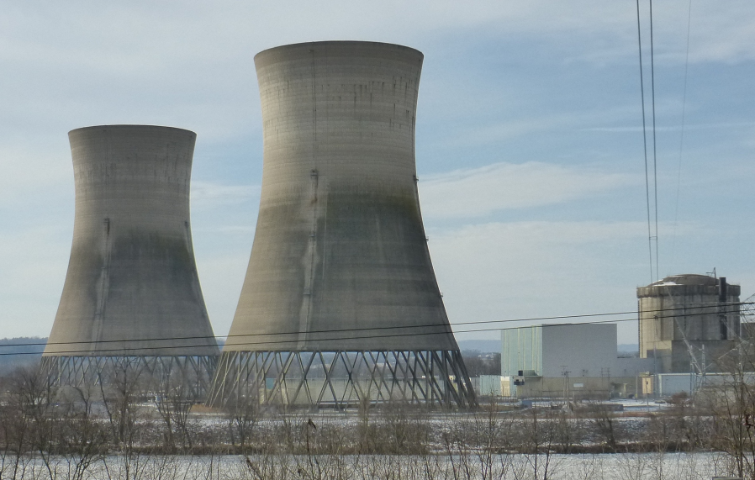
3 Mile Island
Derek Venhuizen
http://topics.time.com/Three-Mile-Island
http://commons.wikimedia.org/wiki/File:Three_Mile_Island_Nuclear_Generating_Station_Unit_2.jpg

Slide 2
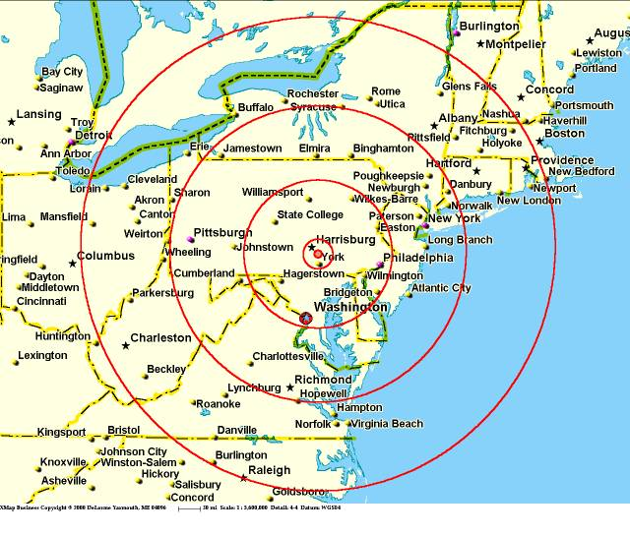
Location
An island located on the Susquehanna River near Middletown Pennsylvania.
http://www.ki4u.com/three_mile_island.htm

Slide 3
What happened
The accident began with failures in the non-nuclear secondary system, followed by a stuck-open pilot-operated relief valve in the primary system, which allowed large amounts of nuclear reactor coolant to escape. The mechanical failures were compounded by the initial failure of plant operators to recognize the situation as a loss-of-coolant accident due to inadequate training and human factors, such as human-computer interaction design oversights relating to ambiguous control room indicators in the power plant's user interface...

Slide 4
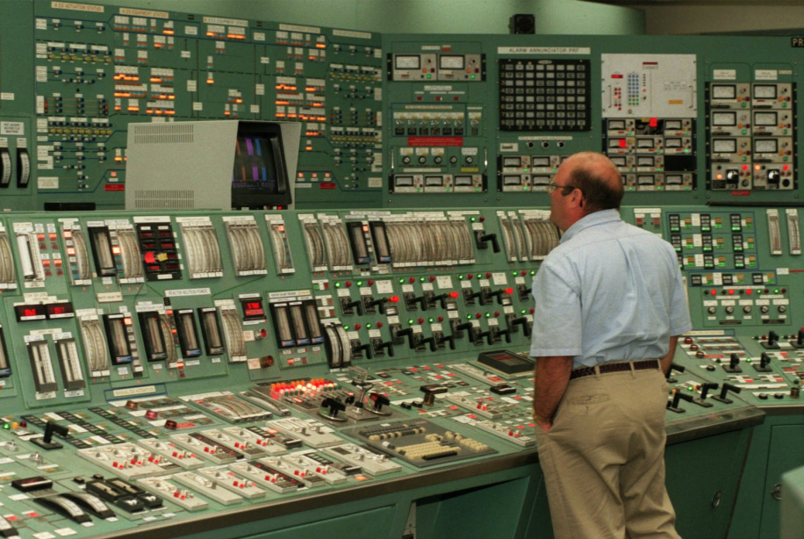
What happened
…In particular, a hidden indicator light led to an operator manually overriding the automatic emergency cooling system of the reactor because the operator mistakenly believed that there was too much coolant water present in the reactor and causing the steam pressure release
http://darkroom.baltimoresun.com/2014/03/three-mile-island-nuclear-disaster-pennsylvania/tmi-d-lam/

Slide 5
Aftermath
Twenty-eight hours after the accident began, William Scranton the third, the lieutenant governor, appeared at a news briefing to say that Metropolitan Edison, the plant's owner, had assured the state that "everything is under control". Later that day, Scranton changed his statement, saying that the situation was "more complex than the company first led us to believe." There were conflicting statements about radioactivity releases. Schools were closed and residents were urged to stay indoors. Farmers were told to keep their animals under cover and on stored feed

Slide 6
Aftermath
Governor Dick Thornburgh, on the advice of NRC chairman Joseph Hendrie, advised the evacuation "of pregnant women and pre-school age children...within a five-mile radius of the Three Mile Island facility." The evacuation zone was extended to a 20-mile radius on Friday March 30. Within days, 140,000 people had left the area. More than half of the 663,500 population within the 20-mile radius remained in that area. According to a survey conducted in April 1979, 98% of the evacuees had returned to their homes within three weeks.

Slide 7
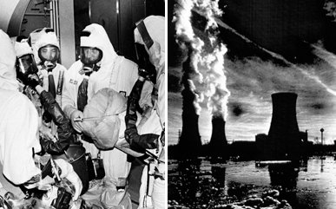
Lesson Learned
The Three Mile Island accident inspired Charles Perrow's Normal Accident Theory, in which an accident occurs, resulting from an unanticipated interaction of multiple failures in a complex system. TMI was an example of this type of accident because it was "unexpected, incomprehensible, uncontrollable and unavoidable"
http://www.thedailybeast.com/articles/2011/03/17/three-mile-island-worker-on-how-he-survived-nuclear-catastrophe.html

Slide 8
sources
http://www.nrc.gov/reading-rm/doc-collections/fact-sheets/3mile-isle.html
http://en.wikipedia.org/wiki/Three_Mile_Island_accident
http://www.threemileisland.org/science/what_went_wrong/
http://www.pbs.org/wgbh/amex/three/

