Slide 1
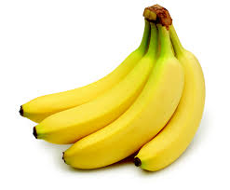
The Issue Behind Bananas
By Matt H and Cain L

Slide 2
The Gros Michel
The Gros Michel, or “Big Mike”, was the country’s most popular and widely grown banana up until the 1960’s
It was then wiped out by Panama disease, and it can no longer be grown on a large scale
This made the producers switch to another banana type called the Cavendish

Slide 3
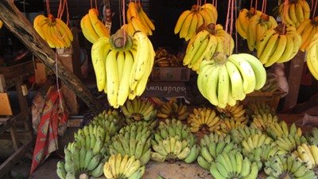
The Gros Michel
The Gros Michel is known to have a much better taste than the widely exported Cavendish
Places that can grow this banana do not grow the Cavendish because it ………………….. is very bland when compared ……….. to other “sweet” bananas

Slide 4
Why Bananas Can’t Reproduce Sexually
Bananas originally had larger seeds to reproduce but people began producing them to have smaller seeds for better consumption
The smaller seeds made it harder for the plants to reproduce
Bananas need the help of humans to reproduce because of these factors.

Slide 5
Diseases destroying bananas
Because the bananas cannot reproduce sexually their genes are all the same
Because all of their genes are the same they have no defense against diseases and populations can get wiped out very easily like the Gros Michel Banana

Slide 6
Bibliographry
http://www.raw-food-health.net/Gros-Michel.html
http://io9.com/debunking-the-myth-of-the-fake-banana-flavor-1629459201

