Slide 1
Can Your Cell Phone Give You Cancer?
By: Erik Boulware

Slide 2
Why is There a Concern?
Cell phones emit radio energy waves, which is a form of radiation
The number of cell phone users has increased rapidly. As of 2010, there were more than 303 million subscribers to cell phone service in the United States.
The overall amount of phone calls per day and the length of these calls.

Slide 3
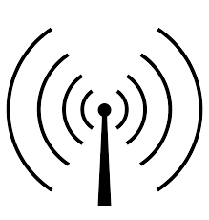
The Facts
Cells phones emit radiofrequency energy, which is a form of electromagnetic radiation.
This type of radiation has been known to increase the risk of cancer.

Slide 4
Recent Studies
A recent study showed that when people used a cell phone for 50 minutes, brain tissues on the same side of the head as the phone’s antenna metabolized more glucose than did tissues on the opposite side of the brain.
Researchers noted possible health outcomes from this increase in glucose metabolism are still unknown.

Slide 5
What You Need to Know
Cell phones are good, to date there is no evidence from studies of cells, animals, or humans that radiofrequency energy can cause cancer.
Radiofrequency energy, unlike electromagnetic radiation, does not cause DNA damage in cells like many types of cancer would.

Slide 6
Sources
http://www.cancer.gov/about-cancer/causes-prevention/risk/radiation/cell-phones-fact-sheet
http://www.cancer.org/cancer/cancercauses/othercarcinogens/athome/cellular-phones

