Slide 1
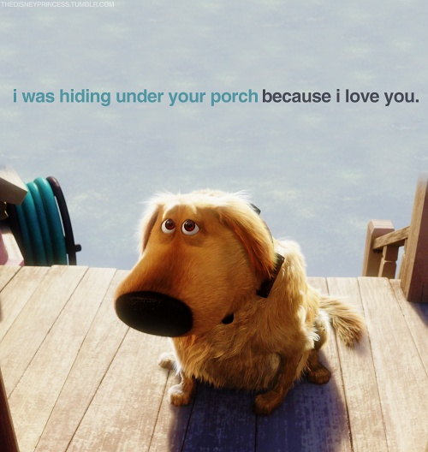
Can we Learn to talk to animals?
Rebecca and Hannah

Slide 2
How
People monitor emotions of the acupuncture meridians and communication through telepathic energy.
Animal whispering is having a very good knowledge of animal behavior.
Animal whisperers pay close attention to the animals behavior and must interpret it correctly.

Slide 3
How
Animals that scientists believe we can learn to talk to have something they call vocal learning
Vocal learning is the ability to imitate different sounds and produce an outcome.

Slide 4
When
People hire animal whisperers when there is a behavior, health, or relationship need that one would like the input from the animal.

Slide 5
where
Animal whisperers usually go to the house of the animal to see it in its home environment.

Slide 6
How Does it help?
Solve behavior Problems
Enhance training
Improve relationships
Find lost animals
Get assistance during illness and death
Get help introducing animals to each other

Slide 7
Future
Experts say that in the future, different types of animals will learn to understand our facial expressions, eye movements, and other body language. These animals include monkeys and cats.

Slide 8
Sources
http://www.animalwhispering.com/drb.htm
http://www.quora.com/How-does-animal-whispering-work
http://www.thenakedscientists.com/HTML/questions/qotw/question/3584/
http://www.martawilliams.com/WhatIsAnimCom.htm
http://pixgood.com/dug-from-up-quotes.html

