Slide 1
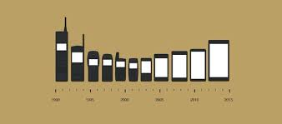
Do Cell Phones Cause Cancer?
By: Tasnim Hamad & Kalani Perry.

Slide 2
What we Know
Cell phones emit radiofrequency energy (radio waves), a form of non-ionizing radiation.
The number of cell phone users has increased rapidly. As of 2010, there were more than 303 million subscribers to cell phone service in the United States.
Even if cell phones didn’t cause cancer, they do cause other heath problem. There have been many accidents, that led to death from the use of cellphones, for example walking while texting has caused many injuries.

Slide 3
The Facts
Exposure to ionizing radiation is known to increase the risk of cancer. However, although many studies have examined the potential health effects of non-ionizing radiation from radar, microwave ovens, and other sources, there is currently no consistent evidence that non-ionizing radiation increases cancer risk
It is generally accepted that damage to DNA is necessary for cancer to develop. However, radiofrequency energy, unlike ionizing radiation, does not cause DNA damage in cells
The primary concern with cellphones and cancer seems to be the development of brain tumors associated with cellphone use.

Slide 4
The Facts
The waves from cell phones come from the antenna, which is part of the body of a hand-held phone. The waves are strongest at the antenna and lose energy quickly as they travel away from the phone. The phone is usually held against the side of the head when you’re using it.
The closer the antenna is to your head, the greater a person’s expected to get exposed to the energy. The body tissues closest to the phone absorb more energy than tissues farther away.

Slide 5
Resources
http://www.cancer.gov/about-cancer/causes-prevention/risk/radiation/cell-phones-fact-sheet
http://www.mayoclinic.org/healthy-lifestyle/adult-health/expert-answers/cell-phones-and-cancer/faq-20057798
http://www.cancer.org/cancer/cancercauses/othercarcinogens/athome/cellular-phones

