Slide 1
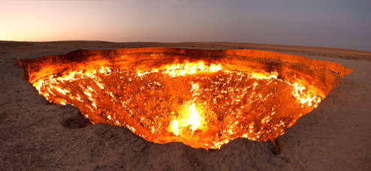
Door to hell Tate Coon & Jack Hansen
http://www.huffingtonpost.com/2013/11/20/door-of-hell_n_4311694.html

Slide 2
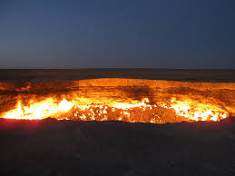
How it started
On an expedition to find more resources, Soviet engineers discovered what they thought to be an oil field.
After attempting to collect and store the natural gas, the ground beneath them collapsed, leaving a wide crater.
Because it was releasing poisonous gases into the air, they were ordered to set the crater on fire.
It was expected to burn out within
a few weeks, but it is still burning today.
http://theomniscienteye.blogspot.com/2012/01/door-to-hell.html

Slide 3
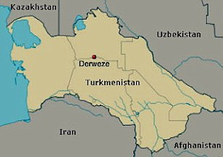
Facts
Located in Derweze, Tukministan
Gases it burns: sulfur and natural gas
Size: 230 feet wide, 100 feet deep
The largest deposit of natural gas in the world
Also known as “Gas Crater of Darvaza”
http://i.dailymail.co.uk/i/pix/2012/07/27/article-2179622-143B9084000005DC-129_306x216.jpg

Slide 4
Sources
http://news.nationalgeographic.com/news/energy/2014/07/140716-door-to-hell-darvaza-crater-george-kourounis-expedition/
http://tenrandomfacts.com/door-to-hell/
https://mostodd.wordpress.com/2011/02/06/door-to-hell/
http://en.wikipedia.org/wiki/Door_to_Hell

