Slide 1
Can Ebola Remain in the Body After You’ve been ‘Cured’?
By: Alex Wakeman

Slide 2
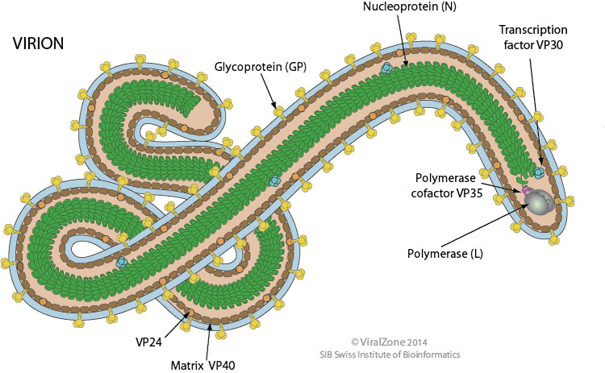
What we Know
Ebola is a virus that is spread through contact with bodily fluids.
After 21 days, a person is considered to be ‘cured’.
Symptoms include fever, fatigue, muscle pain, and sore throat.
We are still gathering information about this disease, as it is relatively ‘new’, and first appeared in the 1970s.

Slide 3
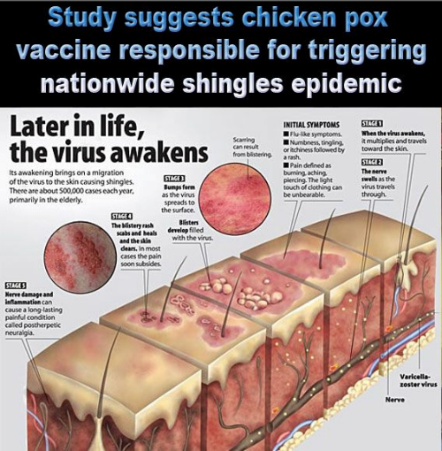
Remain in the body? How?
As of now, there is little data available to the public, but we know it is possible.
Right now, we know that it can remain in male seminal fluids for up to 82 days. According to the World Health Organization, or WHO, there is no data after 82 days.
We do know it is possible for a pathogen to remain in the body, as it is how chicken pox returns as shingles.
It can hide in cells, completely undetected by the body.

Slide 4
Ebola: More Dangerous than Before
The Ebola virus was found in the eye of one of the American survivors.
He was tested for many different eye problems before he was tested for the Ebola virus.
The virus was not found in the patient’s tear fluid or conjunctiva.
Interestingly, an effect of the virus was turning the man’s eyes from blue to green.

Slide 5
It’s in the Eye, so What?
This means that the virus can transmit to doctors during optical surgery.
If someone with Ebola needs eye surgery, doctors will have to take preventative measures in order to stop transmission of the disease.
Early studies have show it still cannot be passed through casual contact, and you can’t pass it through tears either.

Slide 6
So, in Conclusion
The Ebola virus, similar to chicken pox, remains in the body, even after you’re considered ‘cured’.
Optometrists have to take special precautions while dealing with people who’ve had Ebola.
This is still new, there is still much more to learn about this, and the whole of the Ebola virus.

Slide 7
Sources
http://www.who.int/mediacentre/factsheets/fs103/en/
http://optometrytimes.modernmedicine.com/optometrytimes/news/5-things-you-need-know-eyes-harbor-ebola-virus-after-cure?page=0,0

