Slide 1
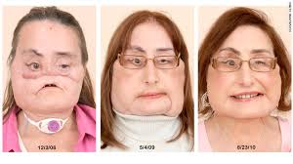
Face Transplants
By Carissa Metzger

Slide 2
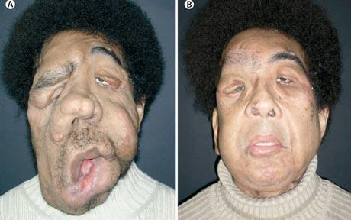
Who can receive a face Transplant?
Most face transplants deal with people who have a bone disease or an accident that left their face deformed

Slide 3
What Happens?
The skin on the patient’s face is removed
The bones underneath are reconstructed
The skin and blood veils are reattached

Slide 4
Most Famous Case
In 2012 the University of Maryland Medical Center did the most complete facial reconstruction on Richard Norris
The Surgery lasted 36 hours

Slide 5
Sources Used
http://umm.edu/health/video/face-transplant/university-of-maryland-performs-most-comprehensive-full-face-transplant-to-date
http://www.foxnews.com/health/2012/03/27/virginia-man-37-receives-first-comprehensive-face-transplant/

