Slide 1
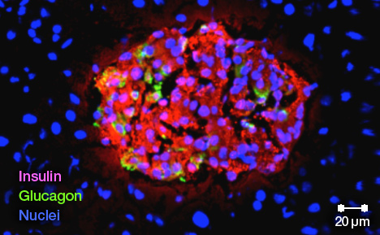
Gene Therapy for Diabetes
Lindsey Rowbotham
Period 7

Slide 2
Diabetes
Type 1-the inability to produce insulin
Type 2-the body’s inability to receive the signal made from the insulin
To control-monitor blood sugar, eat properly, exercising regularly, and maintaining a healthy weight
1 in 3 adults, 1 in 6 children
Kills 70,000 people in the U.S. a year

Slide 3
Gene therapy
Replacing a mutated gene with a healthy copy
In the case of diabetes: Where the gene for making or using insulin is broken, this gene would be replaced by a healthy gene to make or recognize insulin

Slide 4
Gene therapy in Diabetes
Targeted towards liver cells
Liver cells transform into beta cells (cells that make the insulin)
Could eventually eliminate need for daily insulin injections
One dose keeps the glucose in the blood stream at a healthy level for up to six weeks at a time
Could potentially cure a patient with diabetes completely

Slide 5
Sources
http://www.med.wisc.edu/news-events/gene-therapy-for-type-1-diabetes-aims-to-eliminate-daily-insulin-injections/41450
http://www.mayo.edu/research/discoverys-edge/gene-therapy-regenerative-medicine-lend-hope-diabetes-treatment
http://ghr.nlm.nih.gov/handbook/therapy/genetherapy

