Slide 1
Henrietta Lacks & Her HeLa Cells
Bastienne Baggett

Slide 2
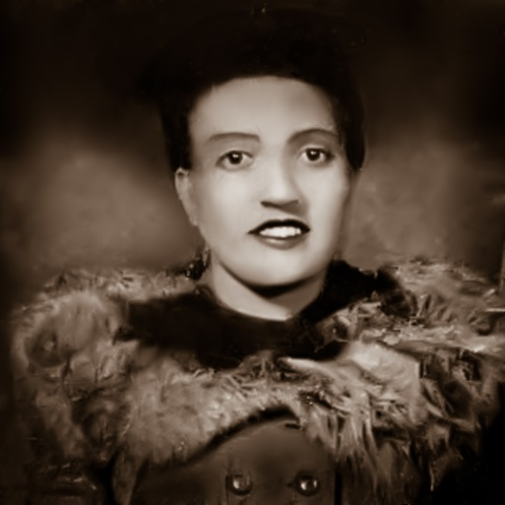
Henrietta Lacks’ Life
Born in 1920
Had 5 children (first one at age 14)
Tumor found in her cervix in 1951
She was treated with radium tube inserts.
During her radiation, two samples of her cervix were removed without her permission or knowledge.
Died in 1951 at Johns Hopkins at the age of 31

Slide 3
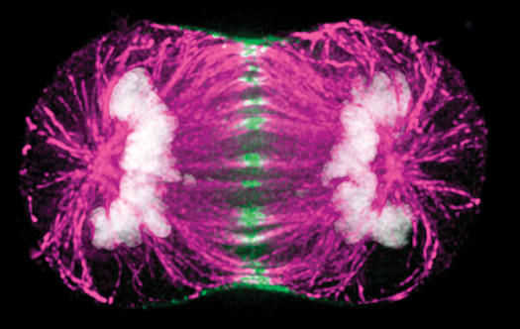
HeLa Cells
The cells taken from Lacks were taken because they were doing something that the researcher who took the cells, George Gey, had never seen: they could be kept alive and grow.
Cells were donated to any scientist who wanted them for the benefit of science

Slide 4
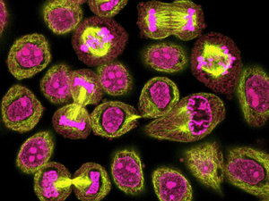
HeLa Cells
Oldest and most commonly used human cell line
Used to test the first polio vaccine in the 1950s
First human cells to be successfully cloned
Have been used in testing how parvo virus infects cells of humans, HeLa, dogs, and cats
Derived for use in cancer research

Slide 5
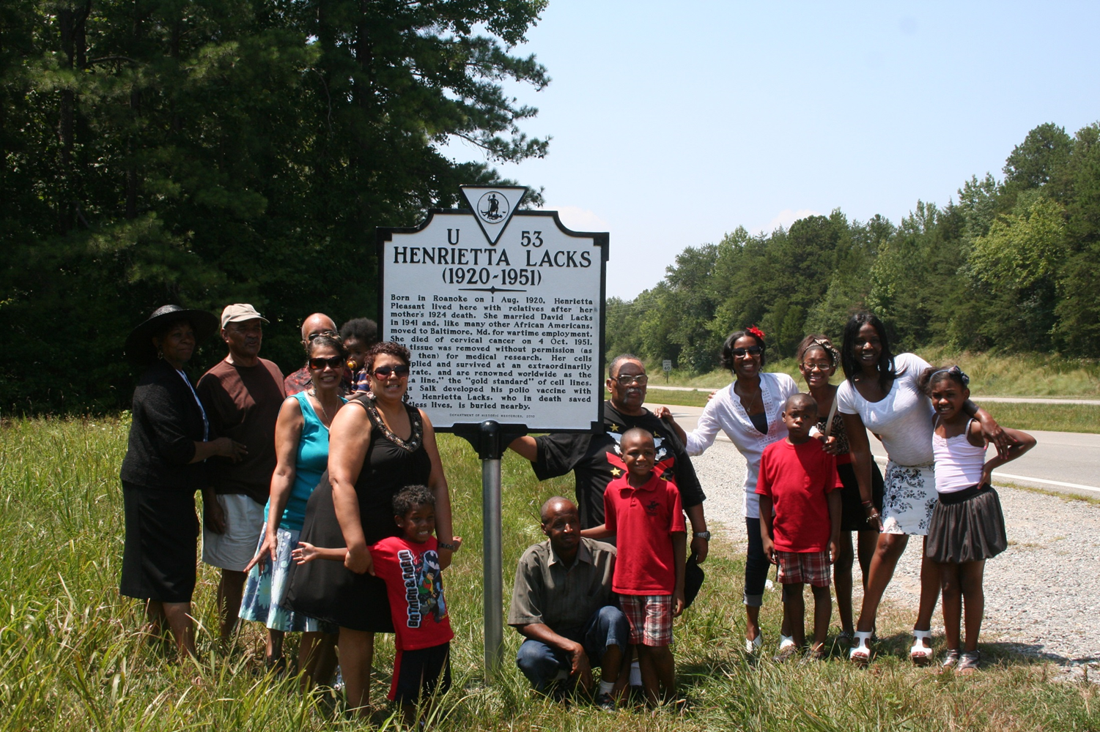
HeLa Cells
One scientist estimates that if you could pile all the HeLa cells ever grown onto a scale, they'd weigh more than 50 million metric tons—the equivalent of at least 100 Empire State Buildings
Lacks’ family didn’t know about the HeLa cells until the early 1970s, which created legal issues

Slide 6
Sources
http://www.oprah.com/world/Excerpt-From-The-Immortal-Life-of-Henrietta-Lacks_1
http://en.wikipedia.org/wiki/Henrietta_Lacks
http://thesnapper.com/wp-content/uploads/2015/04/Henrietta-Lacks-2-thumb-400xauto-7959-Edit.jpg
http://urbanintellectuals.com/wp-content/uploads/2015/01/henriettalacksfamily.jpg
http://www.rense.com/general89/divideandconquer.jpg
http://en.wikipedia.org/wiki/HeLa

