Slide 1
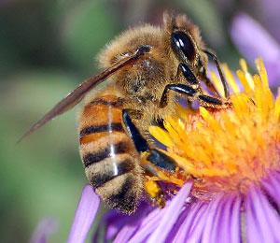
Honey Bee Disaster
By Carolyn B and Kiana C

Slide 2
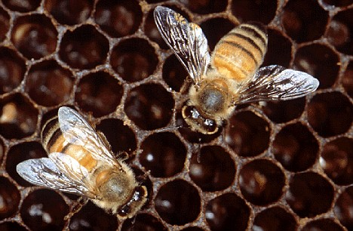
What’s Happening?
It’s being called the Colony Collapse Disorder or CCD. A syndrome with a dead colony containing no adult bees but has a queen with immature bees and honey still present. However the exact cause is still unknown.

Slide 3
Repercussions
In recent years colonies death rates have risen to 30% annually. Over the past six years CCD have wiped out some 10 million beehives. In 1947 there were 6 million honey bee colonies in the US, 3 million in 1990 and now we are down to 2.5 million colonies in the US.
“Currently, the survivorship of honey bee colonies is too low for us to be confident in our ability to meet the pollination demands of U.S. agricultural crops,” the report states.

Slide 4
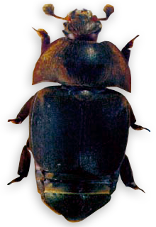
Possible Causes
For the last 30 years honey bees and beekeepers have been dealing with new viruses and pest including: hive beetles
and nutrition disorders because of the lacking of diversity in pollen/nectar sources. These lead to weakening of hives over the years.

Slide 5
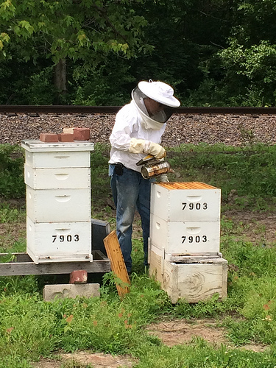
What’s being done to prevent and help stop?
The Agricultural Research Service, ARS, is trying several studies to find solutions but for now the ARS is urging farmers and beekeepers to improve bee management. Also study
bee diseases and pest and how to best
control them.

Slide 6
Bibliography
http://www.huffingtonpost.com/2013/05/06/honey-bees-dying-food-disaster_n_3225599.html
http://www.ars.usda.gov/News/docs.htm?docid=15572#bk
http://www.brushymountainbeefarm.com/Resources/SmallHiveBeetle.asp
http://www.dailymail.co.uk/sciencetech/article-1044233/Honeybee-population-collapses-UK-hives-wiped-year.html
http://blogs.usda.gov/2014/06/18/honeybee-operation-gets-chance-to-rebuild-following-disaster/
http://www.ccbh.net/beekeeping-apiary-inspection/

