Slide 1
Mad Cow Disease
Anna Hoffmann

Slide 2
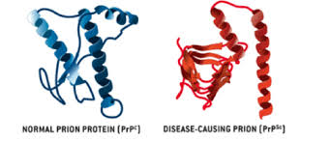
What is it?
Mad cow disease, or bovine spongiform encephalopathy (BSE), is a transmissible, slowly progressive fatal disease affecting the central nervous system of adult cattle. It also causes spongy degeneration of the brain.
https://www.google.com/search?q=mad+cow+disease&espv=2&biw=1366&bih=667&source=lnms&tbm=isch&sa=X&ei=OPxZVczfNYfToASyl4GgCQ&ved=0CAYQ_AUoAQ#tbm=isch&q=mad+cow+disease+prion&revid=1982353247

Slide 3
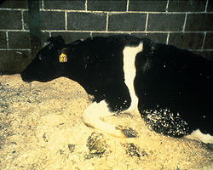
Cow Statistics
In the United Kingdom, the country worst affected, more than 180,000 cattle have been infected and 4.4 million slaughtered during the eradication program.
Cows with this disease are unable to stand

Slide 4
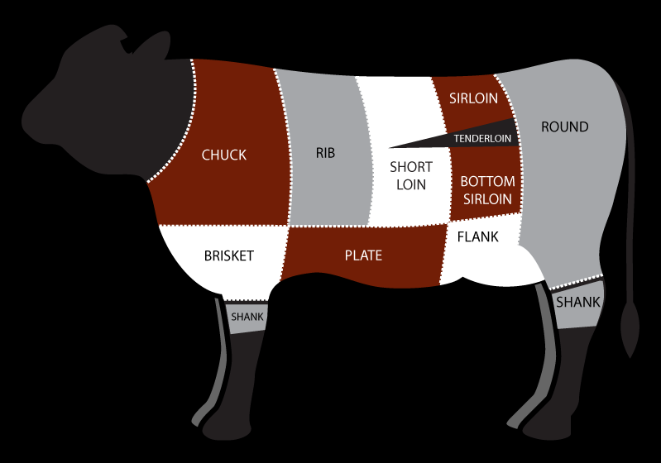
Can Humans get this?
The disease may be most easily transmitted to human beings by eating food contaminated with the brain, spinal cord or digestive tract of infected carcasses.

Slide 5
Human Statistics
by June 2014 it had killed 177 people in the United Kingdom, and 52 elsewhere.

Slide 6
Sources
http://www.webmd.com/brain/mad-cow-disease-basics#1
http://en.wikipedia.org/wiki/Bovine_spongiform_encephalopathy
https://www.google.com/search?q=mad+cow+disease&espv=2&biw=1366&bih=667&source=lnms&tbm=isch&sa=X&ei=OPxZVczfNYfToASyl4GgCQ&ved=0CAYQ_AUoAQ#tbm=isch&q=mad+cow+disease+prion&revid=1982353247
https://www.google.com/search?q=beef&espv=2&biw=1366&bih=667&tbm=isch&source=lnms&sa=X&ei=h2FbVZPPC5KqogTj8oDgCw&ved=0CAcQ_AUoAg#tbm=isch&q=beef+cow+parts&revid=2047421777&imgrc=k0Nq362t90uieM%253A%3BElbIIb-XrdXJNM%3Bhttp%253A%252F%252Fwww.stubbsbbq.com%252Fwp-content%252Fuploads%252F2012%252F06%252Fcow-diagram2.png%3Bhttp%253A%252F%252Fwww.stubbsbbq.com%252Fcow-cuts-101%252F%3B799%3B560

