Slide 1
PET THERAPY
By: Aarushi Rohila & Sheila Cochrane

Slide 2
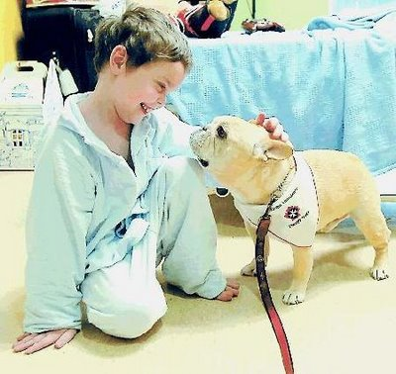
What is pet therapy?
Pet therapy is another name for “animal assisted therapy”
Helps people recover from or deal with health problems like heart disease, cancer, and mental health problems.
The animal doesn’t necessarily have to be specially trained; any pet will do (ex: dogs, cats, rabbits).

Slide 3
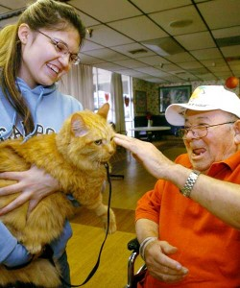
How does pet therapy work?
Pets, dogs in particular:
reduce loneliness and depression
ease stress
make a person be more social
provide unconditional love and important friendship

Slide 4
Examples…
Petting animals is proven to calm people down. Humans naturally have the need to touch, and petting fulfills that.
Playing with dogs and cats increase dopamine levels, which relaxes a person.
Having a dog encourages you to exercise more because you must take them out on walks
more exercise means a healthy heart, so there are less chances of heart disease.
Friendship reduces loneliness and therefore chances of depression.

Slide 5
Sources
http://www.mayoclinic.org/healthy-lifestyle/consumer-health/in-depth/pet-therapy/art-20046342
http://www.helpguide.org/articles/emotional-health/the-health-benefits-of-pets.htm
http://4.bp.blogspot.com/_OyJ1kv96Rgg/TTCclrggajI/AAAAAAAAB4A/2dwZviBXcjM/s1600/pet-therapy.jpg
http://psicologaonlinesalerno.it/wordpress/wp-content/uploads/2012/04/Pet-therapyù.jpg

