Slide 1
STEM Cells →Organs
Kyle Sorbe
Braydon Mallet

Slide 2
STEM Cells?
Regeneration
Specified into tissues
Can be anything they want to be
Nerve
Blood
Brain
Liver
Etc.

Slide 3
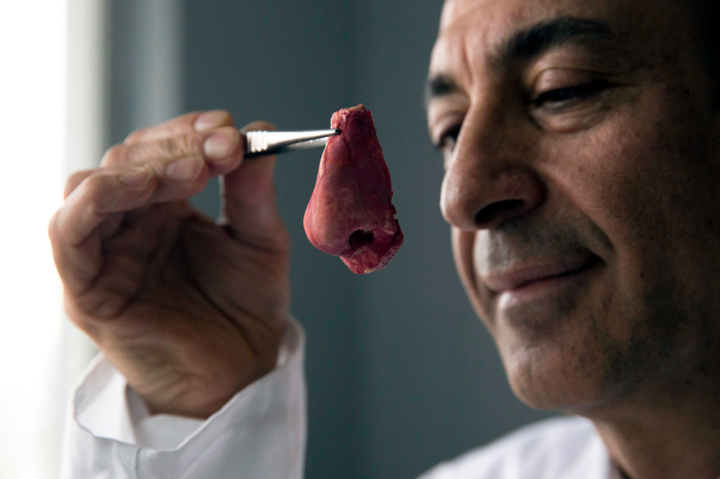
Stem Cells → Organs?
University of Edinburgh
Working Thymus (Nerve for Immune System)
University College London
Ears and Noses and Blood Vessels
Yokohoma University (Japan)
Mini-Livers

Slide 4
What’s All the Fuss?
Harvested from 8-cell embryos
Destroys Human Embryos
BUT…
...research involving human pluripotent stem cells...promises new treatments and possible cures for many debilitating diseases and injuries, including Parkinson's disease, diabetes, heart disease, multiple sclerosis, burns and spinal cord injuries. The NIH believes the potential medical benefits of human pluripotent stem cell technology are compelling and worthy of pursuit in accordance with appropriate ethical standards
– National Institution of Health

Slide 5
Pro’s
New Organs
In the United States, more than 84,000 men, women and children are waiting for organ transplants
Organ Transplant List
Potential Cures
Parkinson's disease, diabetes, heart disease, multiple sclerosis, burns and spinal cord injuries

Slide 6
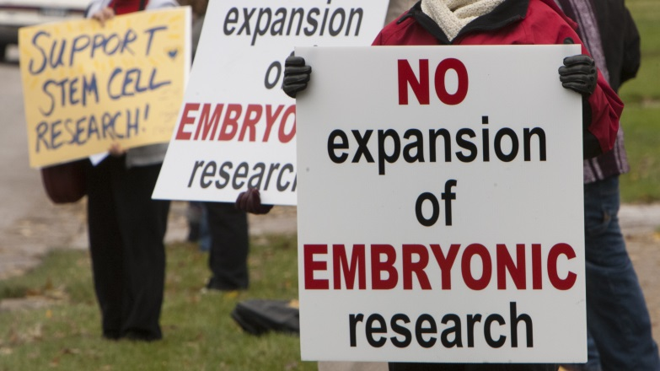
Con’s
Religion
“A life is a life no matter how small”
Considered murder of babies
Harvesting
Human Embryos
“Baby Killers”

Slide 7
Sources
http://stemcells.nih.gov/info/basics/pages/basics2.aspx
http://discovermagazine.com/2014/jan-feb/05-stem-cell-future
http://www.cbsnews.com/news/ears-noses-grown-from-stem-cells-in-petri-dishes/
http://www.theguardian.com/science/2014/aug/24/lab-grown-cells-create-functioning-organ

