Slide 1
Tuskegee Syphilis Study
Did doctors really let patients die without treating them?
By Megan Gilk

Slide 2
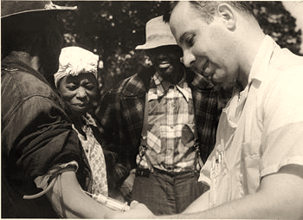
Syphilis Study
syphilis [sif-uh-lis] : a chronic infectious disease, caused by a spirochete, Treponema pallidum, usually venereal in origin but often congenital, and affecting almost any organ or tissue in the body, especially the genitals, skin, mucous membranes, aorta, brain, liver, bones, and nerves
The study of the natural history of syphilis began in 1932 in hope to treat black people. The study was called, “Tuskegee Study of Untreated Syphilis in the Negro Male.”
The study involved 600 black men, 399
with syphilis, and 201 without it. The
researchers told them that they were
being treated for “bad blood.”

Slide 3
The Treatment
Actually, they were not being treated,
but the black men didn’t know it.
The study continued on for forty more
years. Penicillin, the drug choice for syphilis, came out in 1947. The researchers did not offer this treatment to the Negro men.
The researchers said that the men agreed to the study. However, they were not informed about what the study was.

Slide 4
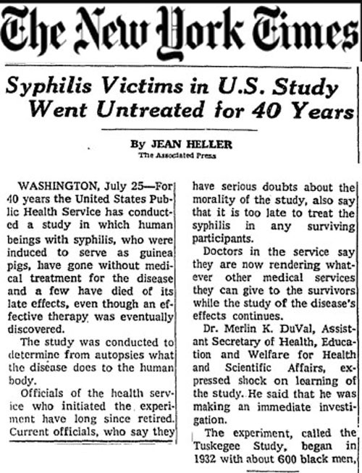
Ad Hoc Advisory Panel
This panel found that the men had agreed to be examined and treated. There was no evidence of what the researchers had told them about the study.
They were never given correct treatment for their disease. The panel found that the men were never given the choice to quit the study.
New York Times article about the syphilis study.

Slide 5
Advisory Panel
Concluded that the study was “ethically unjustified”
October 1972 – panel stopped the study and one month later, the end of the Tuskegee Study was announced
In 1974, a $10 million out-of-court settlement was reached – promised to give all living participants of the study lifetime medical benefits and burial services
Later on, wives, widows, and offspring were added. The last study participant died in January of 2004, and the last widow died in January 2009. There are currently fifteen offspring receiving the medical benefits.

Slide 6
Review of Major Points
1932 – Study began including 322 with the disease and 201 without
1940 – efforts made to delay men from receiving treatment
1945- Penicillin accepted as treatment choice for syphilis
1972 – Study ends
1974 – Tuskegee Health Benefit Program (THBP) was established to provide health benefits for participants of study, and families

Slide 7
Sources
http://www.cdc.gov/tuskegee/timeline.htm
http://dictionary.reference.com/browse/syphilis?s=t
http://en.wikipedia.org/wiki/Tuskegee_syphilis_experiment
https://alondranelson.wordpress.com/2012/07/25/tuskegee-and-the-black-panther-party/
http://www.usrf.org/uro-video/Tuskegee_2004/Article_Header.jpg

