Slide 1
Yucca Mountain
Bella Kappenman

Slide 2
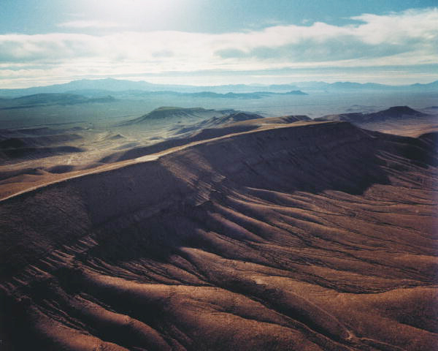
What is it?
Yucca Mountain is a site in Nevada designed for the permanent storage of nuclear waste. The Department of Energy (DOE) is studying Yucca Mountain to see if this would be a safe storage plan.
If approved, the site would be the nation's first storehouse for permanent disposal of this high-level radioactive waste and spent nuclear fuel.
Yucca mountain is located in Nye county, Nevada, 100 miles northwest of Las Vegas on federally-owned land on the edge of the Nevada Test Site.

Slide 3
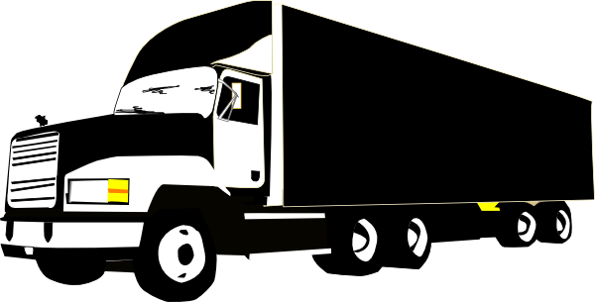
What is the Problem?
The DOE is finding more and more problems with the “natural barrier” system at Yucca Mountain. They appear to be scrambling to piece together an engineered barrier system that delay but not prevent leakage into the groundwater.
The Department of Energy’s own studies show that if the groundwater is contaminated, people will be harmed by drinking this water, eating produce grown with the contaminated water, and drinking milk from cows that have been exposed to the contamination through their feed and drink.
Another problem is transportation. The waste from 104+ separate sites around the U.S. would have to be relocated here, this would take hundreds of trips by truck (with the waste encased in specially made containers. Most shipments would run through one or more major metropolitan areas. The casks do not leak radiation in harmful amounts, but if an accident were to happen, it could result in massive radioactive contamination of an American city.

Slide 4
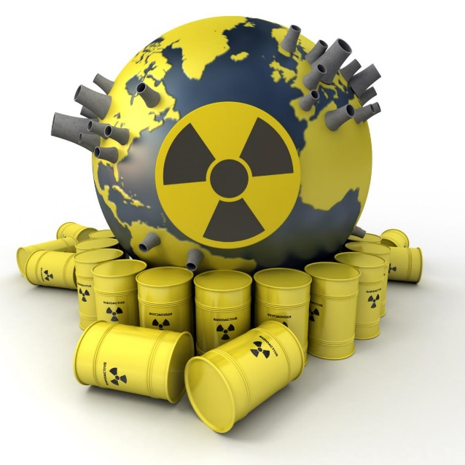
What are the Effects of Nuclear Waste?
Ionizing radiation is powerful enough to alter cellular chemicals and disrupt normal cell functioning. Ionizing radiation is potentially harmful to humans by causing damage to tissue. The level of damage depends on the amount of radiation. The effects of low levels of radiation range from being insignificant to the start of cancer or genetic effects.

Slide 5
Why isn’t it being used?
As of right now Yucca Mountain sits empty and unused. The answer in one word: politics. Under the 1982 Nuclear Waste Policy Act, the feds were supposed to find a place to bury the old fuel for good. They picked Yucca Mountain. But there is a problem: Almost everybody in Nevada hates the project. In a 2008 campaign speech in Las Vegas, President Obama promised to find “some place other than right here at Yucca Mountain" for the nation's nuclear waste. He went on to win the state. There's only one problem: The 1987 law specifically names Yucca Mountain as the U.S. site for the nation's first nuclear waste dump. Legally, there is no other option.

Slide 6
Sources
http://www.slate.com/articles/health_and_science/nuclear_power/2013/01/nuclear_waste_storage_why_did_yucca_mountain_fail_and_what_next.html
http://lobby.la.psu.edu/066_Nuclear_Repository/Agency_Activities/EPA/EPA_Yucca_Mountain_Frequently_Asked_Questions.htm
http://tisdelstirades.blogspot.com/2011/06/yucca-mountain-is-bad-idea-redux.html
http://www.nirs.org/factsheets/yucca.pdf

