Slide 1
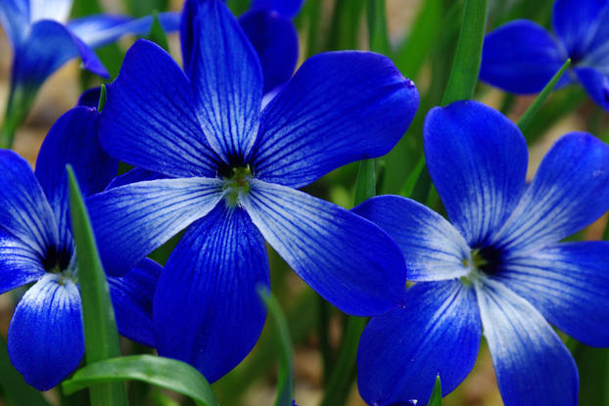
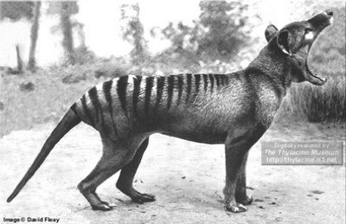
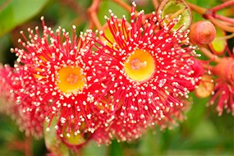
Should we Clone Extinct Species?
By: Morgan Logue and Piper Schulz

Slide 2
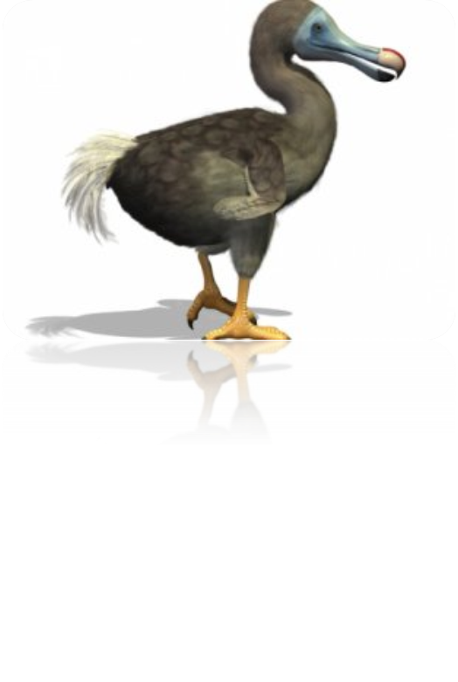
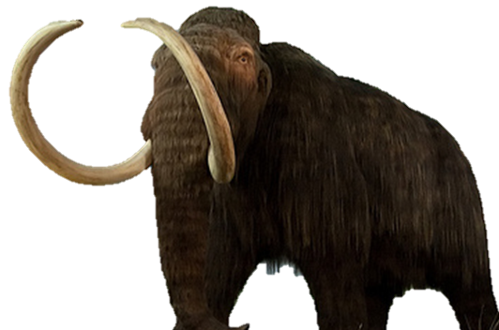
Pros
Preserve Biodiversity
Restore ecosystems
Learn how to prevent extinction
Undo the harm humans have caused

Slide 3
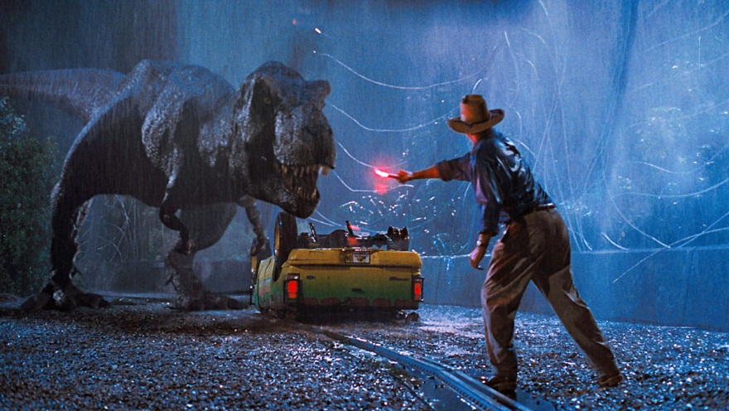
Cons
Expensive
Time consuming
Won’t always work
Jurassic Park
Not the right foods available
Environments have changed
People won’t care about endangered species because we can take their DNA and bring them back if we want

Slide 4
Bibliography
http://news.nationalgeographic.com/news/2013/03/130312--deextinction-conservation-animals-science-extinction-biodiversity-habitat-environment/

