Slide 1
What is Happening to the Honey Bees?
Cassie Brallier and Brianna Larson

Slide 2
Introduction
A large group of honey bees that pollinate $30 billion worth of crops in the US died off.
Scientists had struggled to find out more about the Colony Collapse Disorder (CCD) that wiped out the estimated 10 million beehives worth $2 billion.
This die-off happened over six years

Slide 3
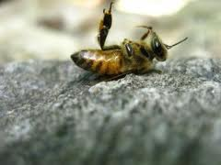
Possible Cause
Scientists at the University of Maryland and the US Department of Ag discovered a mix of fungicides and pesticides that contaminated the pollen the bees collected.

Slide 4
Information About Samples
In one sample from hives on the east coast, scientists discovered 21 chemicals.
These chemicals and pesticides can slow a bees neurological functions, including behavior and memory.

Slide 5
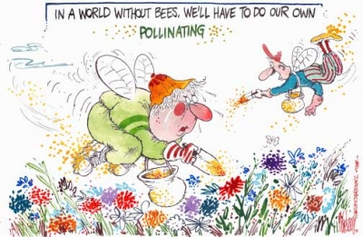

Slide 6
Sources
http://qz.com/107970/scientists-discover-whats-killing-the-bees-and-its-worse-than-you-thought/
http://www.cbsnews.com/news/are-pesticides-killing-off-honey-bees/

