Slide 1
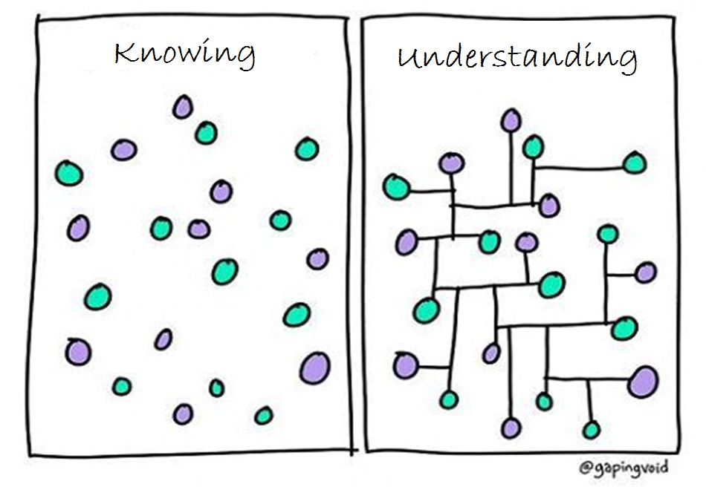
Image modified from: https://www.pinterest.com/pin/50313720815813086/

Slide 2
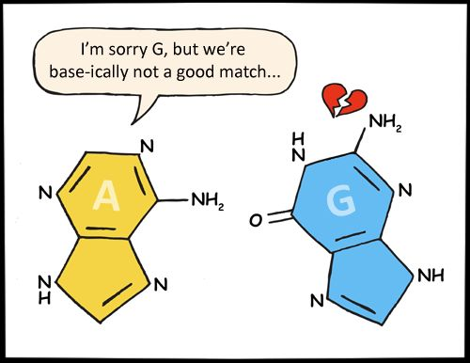
http://www.kappit.com/img/235305/im-sorry-g-but-were-base-ically-not-a-good-match/

Slide 3
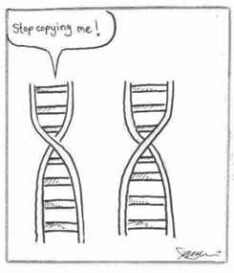
https://www.pinterest.com/pin/50313720815906551/

Slide 4
https://www.pinterest.com/pin/469218854912084693/?utm_campaign=bprecs&e_t=033208929d04402992350c0c5d9654ae&utm_content=469218854912084693&utm_source=31&utm_term=1&utm_medium=2004

Slide 5
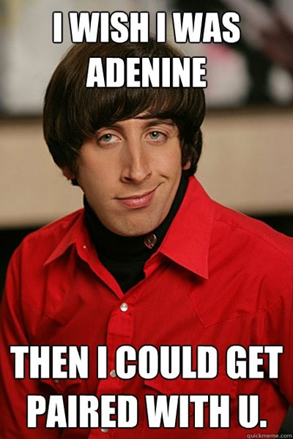
http://themetapicture.com/geeky-pick-up-line/

Slide 6
http://www.asbmb.org/uploadedImages/ASBMBToday/Content/Issues/201512/Content/Features/_Images/clothes_uaa_shirt.jpg

Slide 7
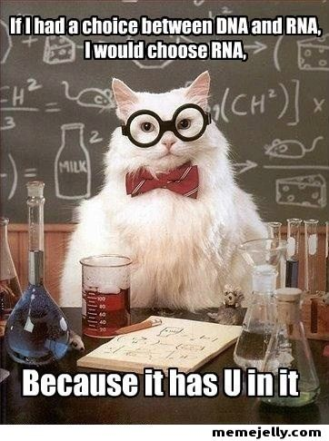

Slide 8
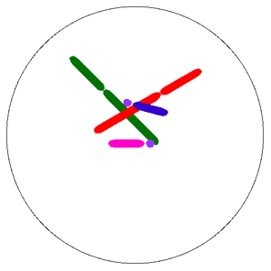
Nondisjunction
http://www.tokyo-med.ac.jp/genet/anm/domov.gif

Slide 9
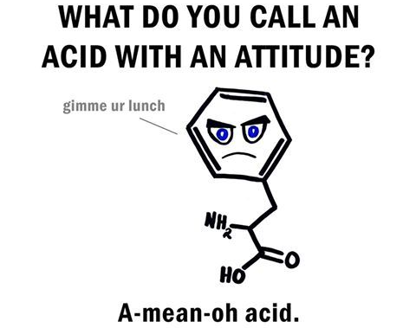
https://pics.onsizzle.com/Instagram-Science-puns-doyoueven-b0349c.png

Slide 10
https://www.pinterest.com/pin/50313720817083952/

Slide 11
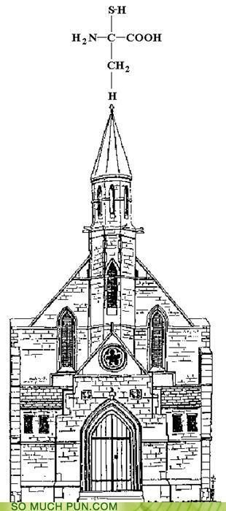
https://www.pinterest.com/pin/50313720816820314/

Slide 12
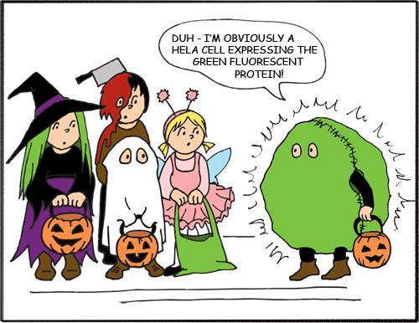
https://www.facebook.com/NotAnExactScienceShow/photos/ms.c.eJwzNDA0NTYzMTC2NDQ3MjW2NNAzRIiYmaOLWJgaoIlYmoLUAAD~;hw4~;.bps.a.10152750589635390.1073741842.137553580389/10153640391725390/?type=3&theater

Slide 13
https://www.pinterest.com/pin/AchZDwm4IYPJsQLESVYqBjGVYNNxDEGYeE_rHaOisGZfy_lQHZmOCuA/

Slide 14
https://www.pinterest.com/pin/50313720816788943/

Slide 15
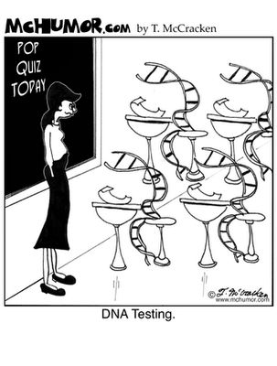
https://www.pinterest.com/pin/50313720816820344/

Slide 16
https://www.pinterest.com/pin/50313720816545645/

Slide 17
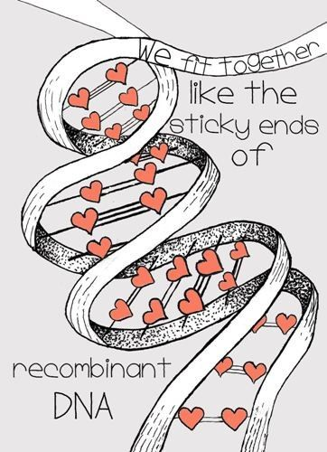
https://www.pinterest.com/pin/50313720815906890/

Slide 18
http://love-life-science.blogspot.com/2014/09/bacterial-gifts.html?spref=pi

Slide 19
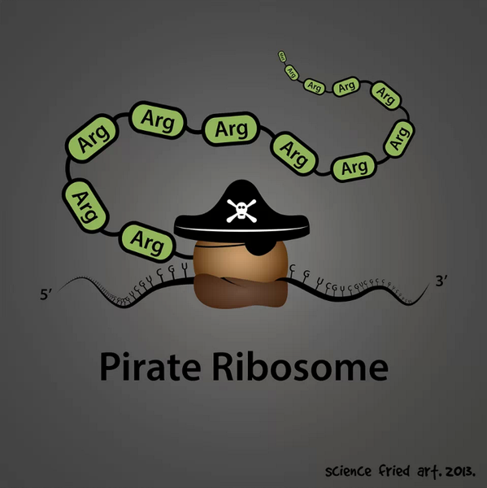
https://s-media-cache-ak0.pinimg.com/originals/50/21/4a/50214a01e2ab00337d5c684d23d544ff.jpg

Slide 20
http://vadlo.com/Research_Cartoons/Then-Crick-asked-me-Watson-should-we-name-them-.gif

Slide 21
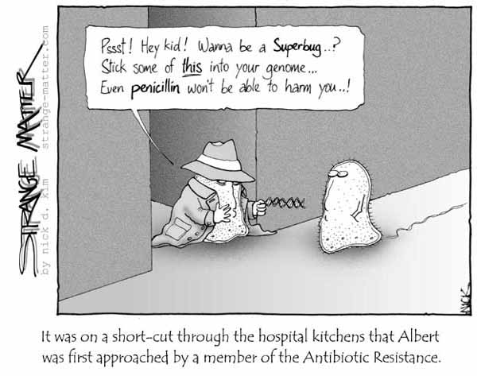
http://content.science20.com/files/images/li163.jpg

Slide 22
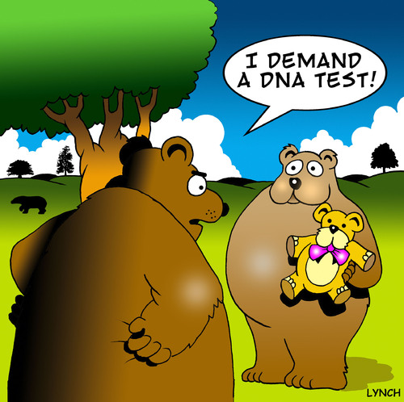
http://www.toonpool.com/user/589/files/dna_984145.jpg

Slide 23
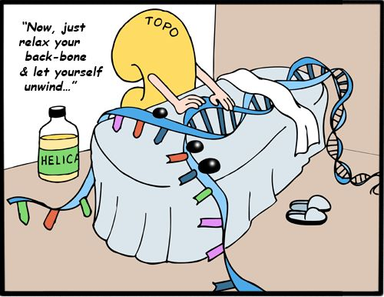
https://s-media-cache-ak0.pinimg.com/564x/78/fd/74/78fd74a45fad9c3d9fb5d75f729ac679.jpg

Slide 24
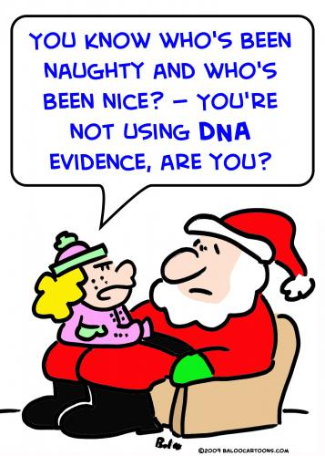
http://www.toonpool.com/user/997/files/santa_dna_evidence_497055.jpg

Slide 25
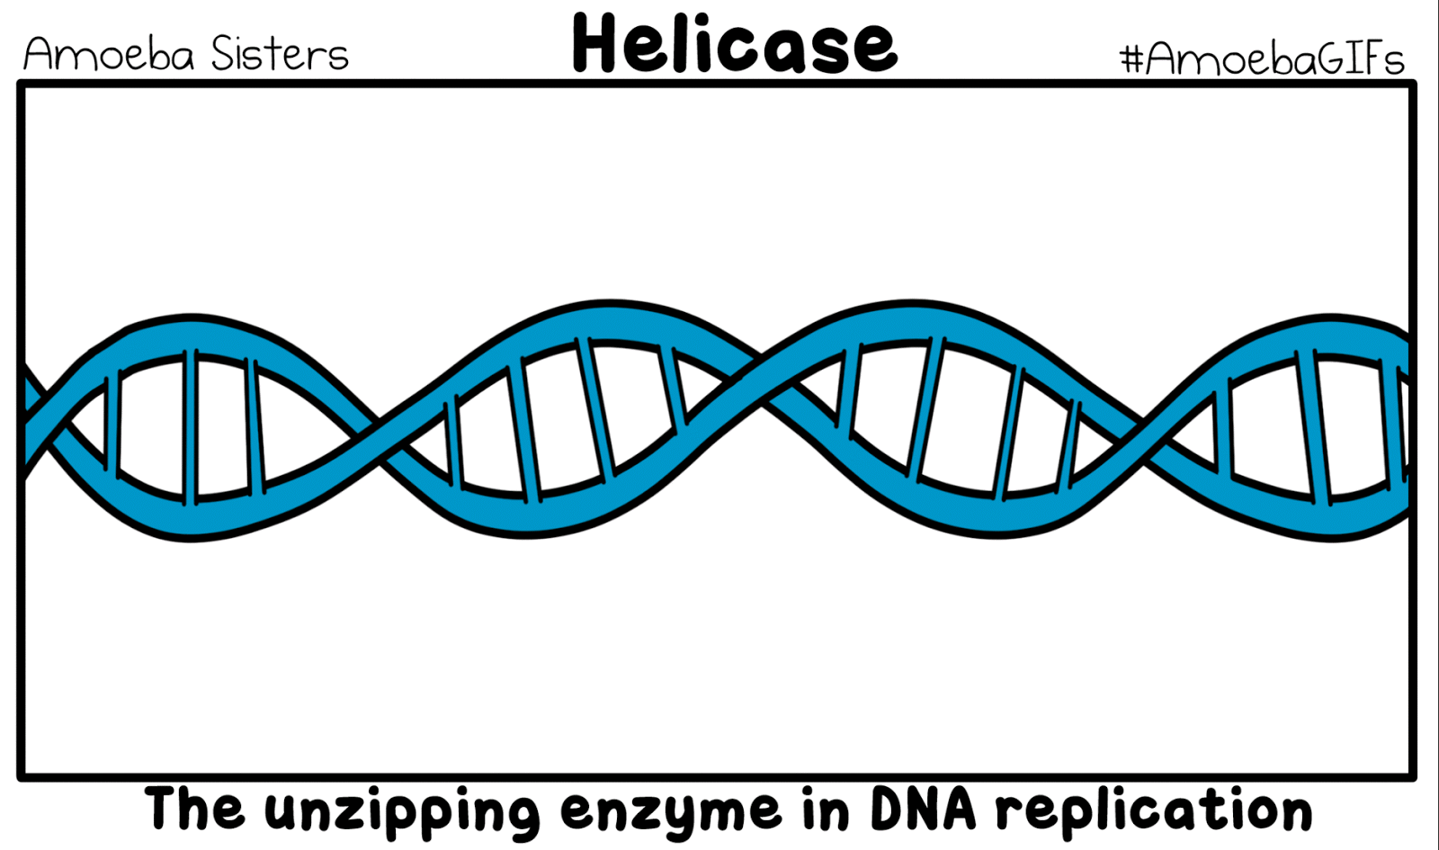
https://amoebasistersgifs.blogspot.com/

Slide 26
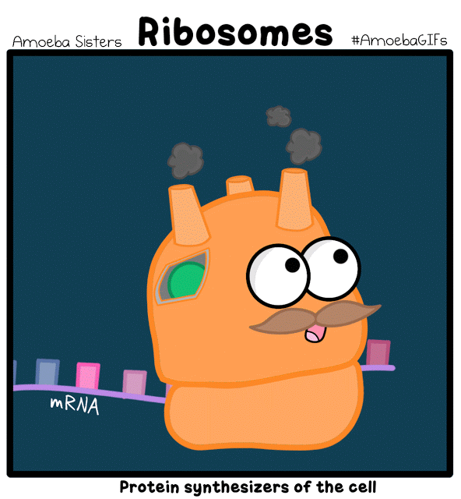
https://amoebasistersgifs.blogspot.com/

Slide 27
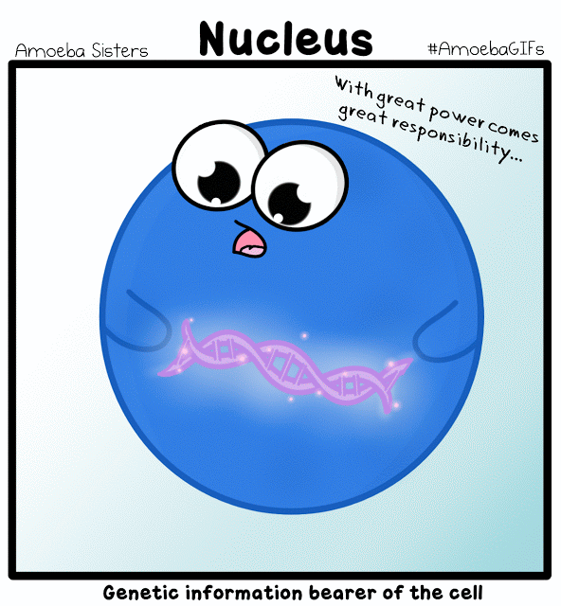
https://amoebasistersgifs.blogspot.com/

Slide 28
https://amoebasistersgifs.blogspot.com/

Slide 29
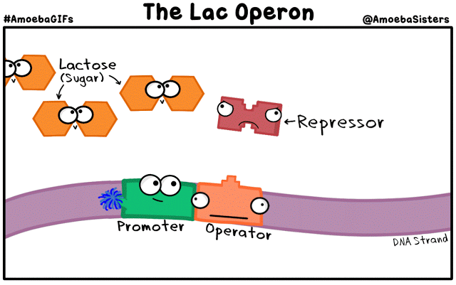
https://amoebasistersgifs.blogspot.com/

Slide 30
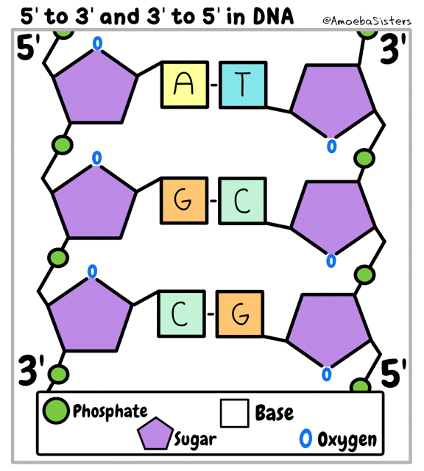
https://amoebasistersgifs.blogspot.com/

Slide 31
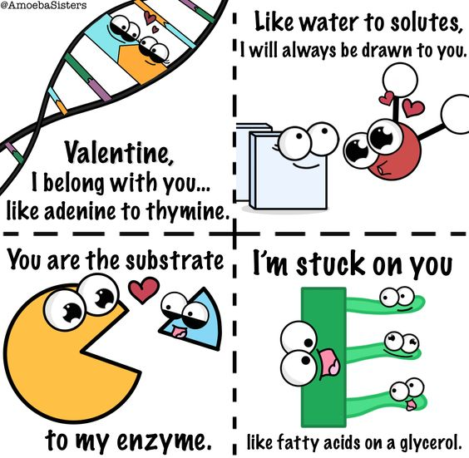
https://s-media-cache-ak0.pinimg.com/originals/6b/19/13/6b19136b658d454f593013393b80e96b.png

Slide 32
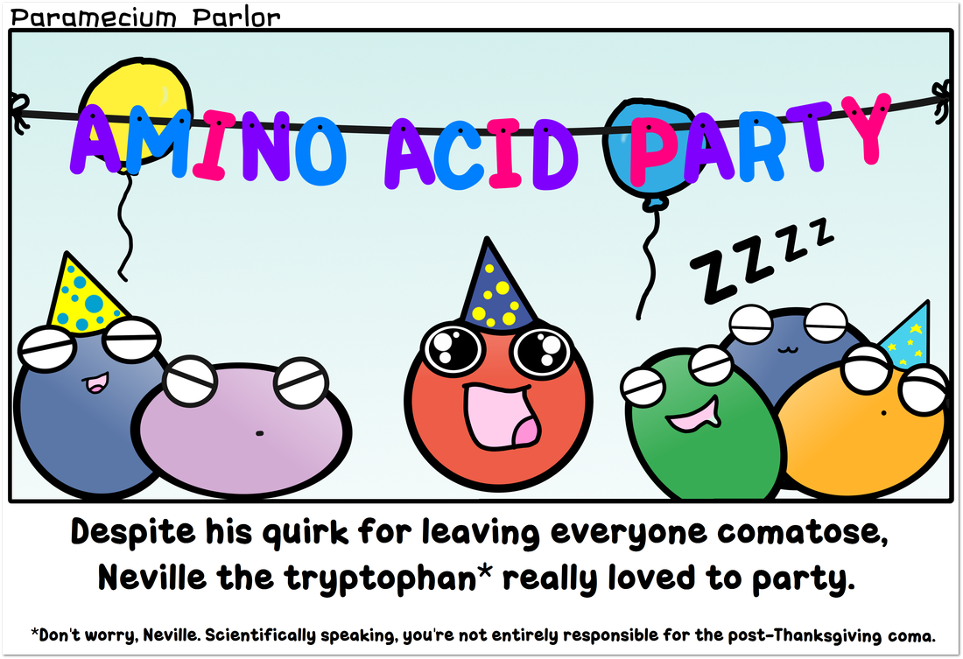
http://www.amoebasisters.com/parameciumparlorcomics/tryptophan-thanksgiving

Slide 33
https://amoebasistersgifs.blogspot.com/

Slide 34
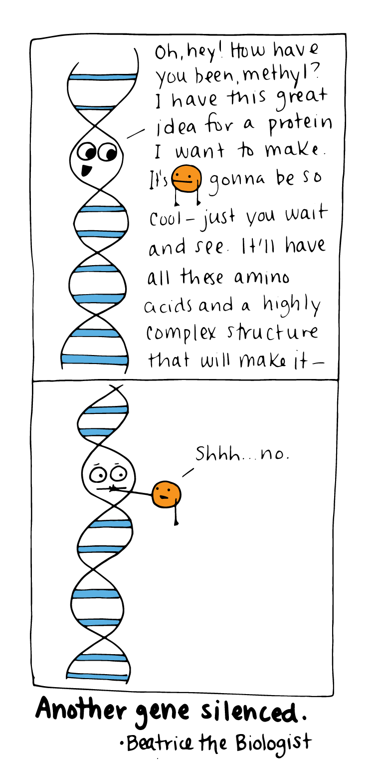
http://www.beatricebiologist.com/2016/06/gene-silencing/

Slide 35
http://www.amoebasisters.com/parameciumparlorcomics

Slide 36
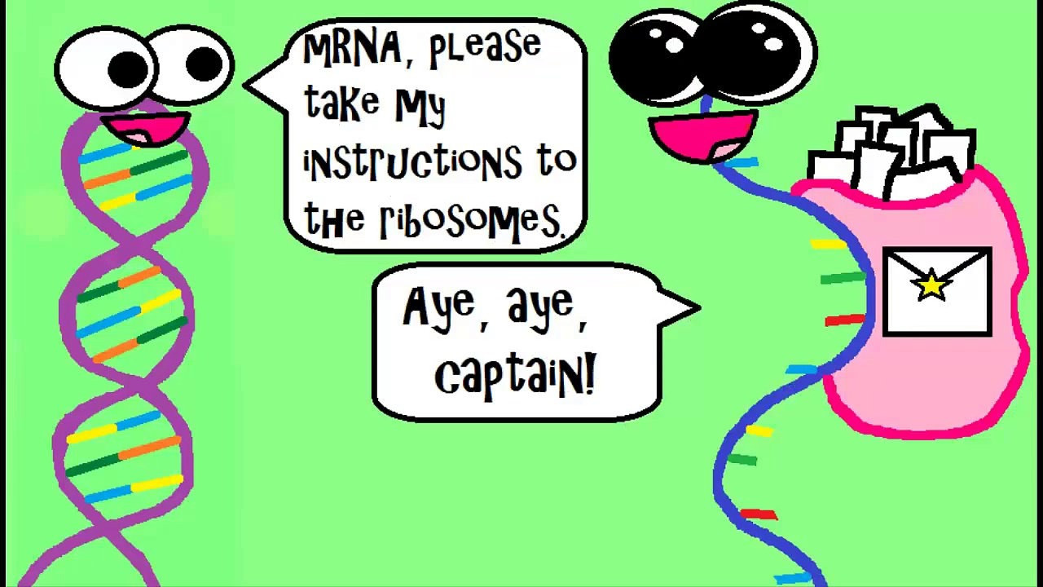
http://www.amoebasisters.com/parameciumparlorcomics

Slide 37
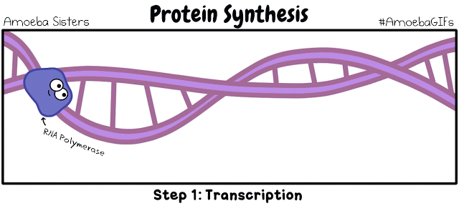
https://amoebasistersgifs.blogspot.com/

Slide 38
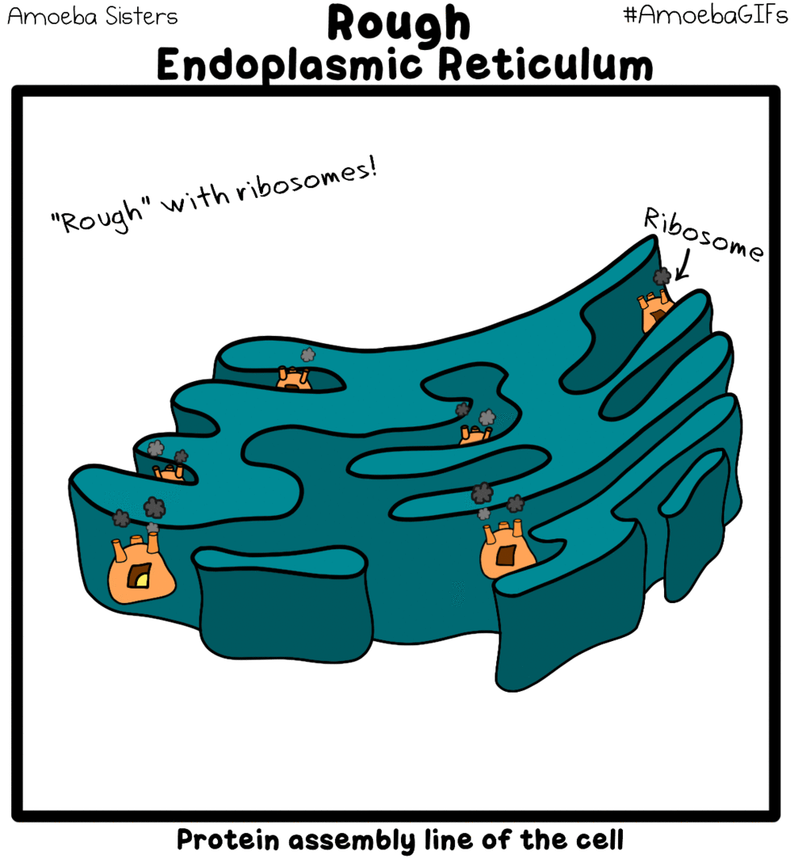
http://amoebasisters.tumblr.com/post/131822918987/resist-the-road-rage-on-the-protein-super-highway

Slide 39
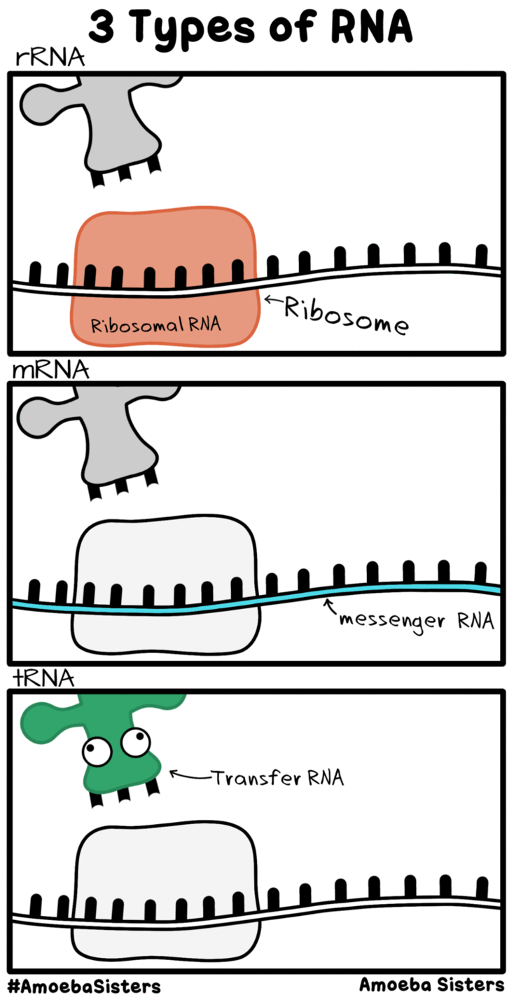
https://s-media-cache-ak0.pinimg.com/originals/45/38/c8/4538c8face7459cbe99b3e714dff6051.gif

Slide 40
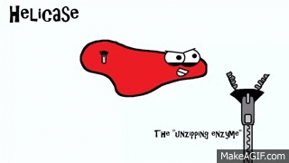
https://i.makeagif.com/media/11-22-2015/ghSMm1.gif

Slide 41
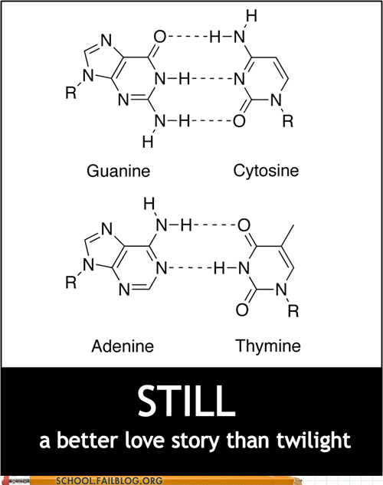
https://www.quora.com/Is-there-a-reason-for-the-DNA-being-made-of-A-T-C-G-and-not-any-other-nucleotides

Slide 42
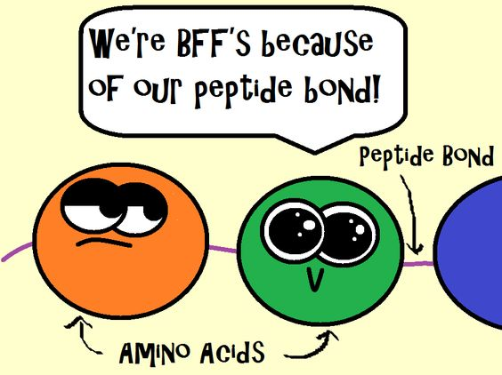
https://www.pinterest.com/pin/50313720817088807/

Slide 43
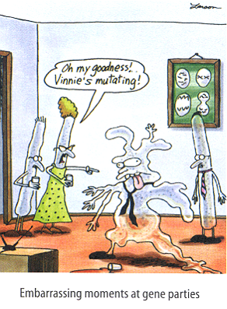
https://s-media-cache-ak0.pinimg.com/originals/34/c8/0c/34c80c189815f7a8d1989e890ff01f28.jpg

Slide 44
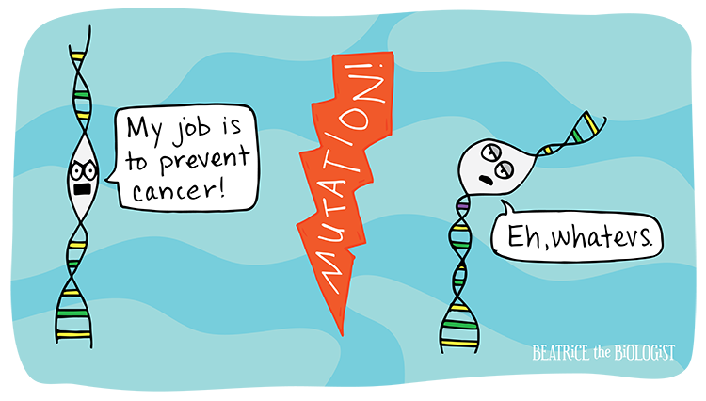
http://www.beatricebiologist.com/2014/10/cancer-gene/

Slide 45
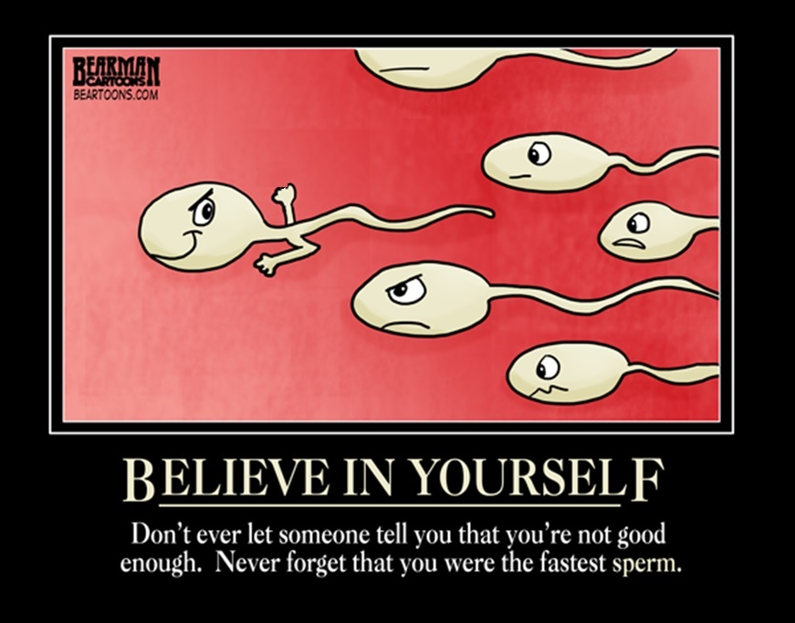
Image edited from: https://s-media-cache-ak0.pinimg.com/originals/b3/48/68/b348680b5573528b0472c3c0fad01362.jpg

Slide 46
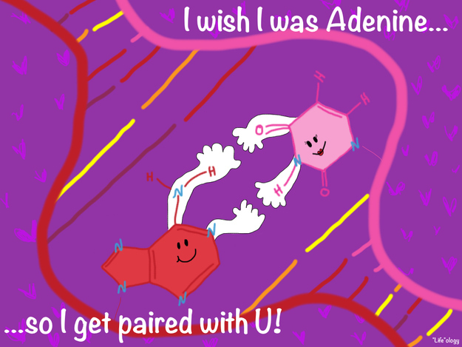
https://www.buzzfeed.com/babymantis/20-more-spectacularly-nerdy-science-jokes-1opu

Slide 47
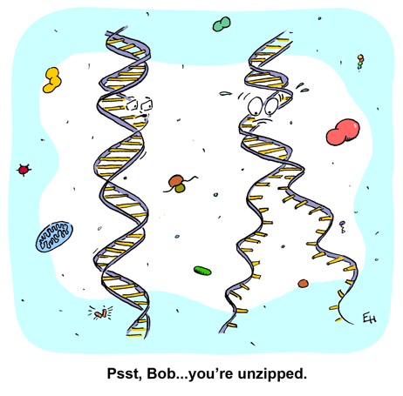
http://www.himelblog.com/2015/06/unzipped.html?spref=pi

Slide 48
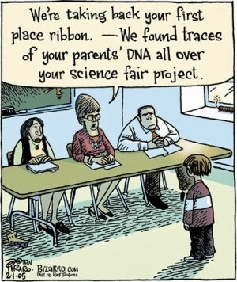
http://bestlifemistake.blogspot.com/2014/02/middle-school-science-teacher-humor.html

Slide 49
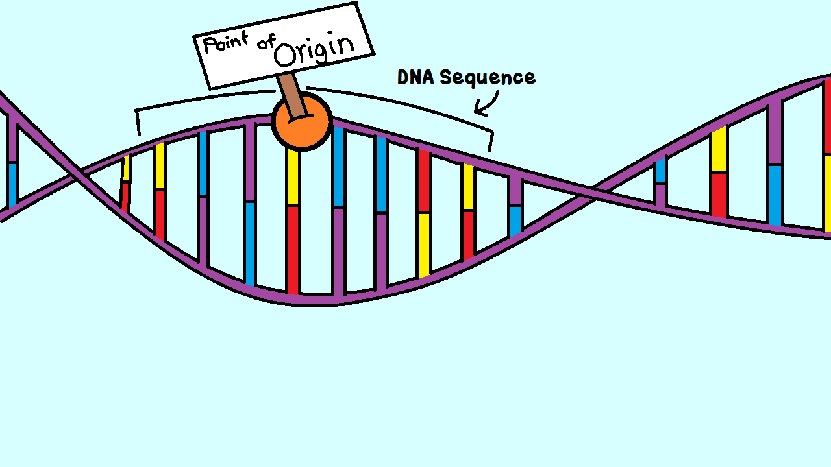
https://s-media-cache-ak0.pinimg.com/originals/26/78/a1/2678a1baacb000fc165741869dc80d66.jpg

Slide 50
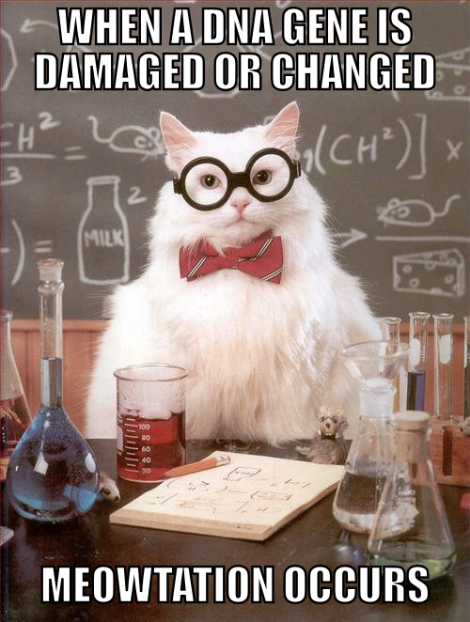
http://knowyourmeme.com/photos/284244-chemistry-cat

Slide 51
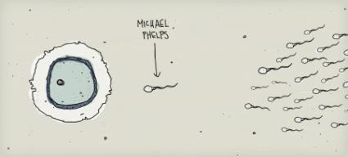
http://notaniche.com/wp-content/uploads/2008/08/michael-helps-baby-picture.jpg

Slide 52
https://amoebasistersgifs.blogspot.com/

Slide 53
RANDOM FERTILIZATION
Average male between ages 15-30 makes 200,000,000-300,000,000 sperm/day
Females born with 1-2 million immature eggs Releases 400-500 mature eggs in lifetime
Egg 2²³ = 8.4 million possible combinations
Sperm 2²³ = 8.4 million possible combinations
2²³ X 2 ²³ ~ 70 trillion diploid combinations
(This doesn’t include crossing over!)
Odds of one particular egg getting together with one particular sperm is astronomical. EVERYONE IS UNIQUE!

Slide 54
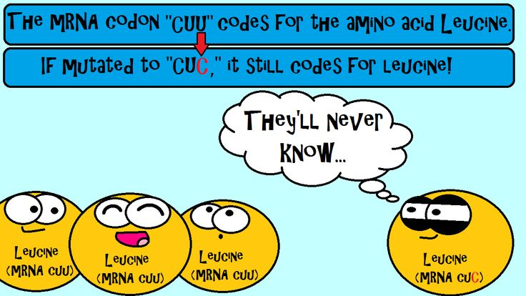
https://s-media-cache-ak0.pinimg.com/736x/02/5f/87/025f877f5c0e80b2b6c4dc680ff580c3.jpg

Slide 55
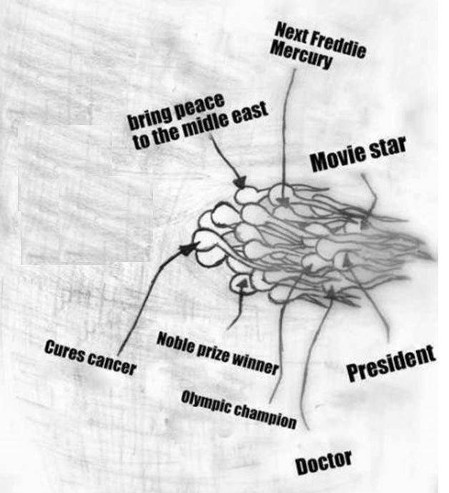
Image modified from: http://images1.tickld.com/live/183591.jpg

Slide 56
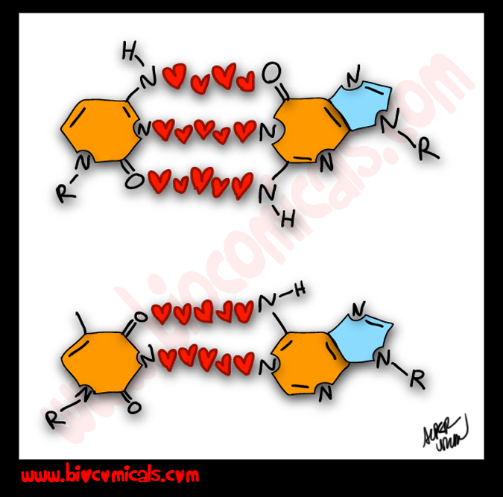
http://www.biocomicals.com/categocartoons.php?id=20150213.8

Slide 57
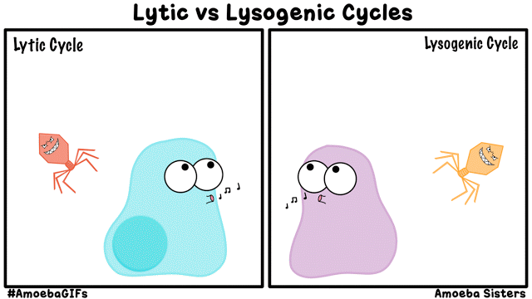
https://amoebasistersgifs.blogspot.com/2015/12/lysogenic-and-lytic-cycles.html

Slide 58
http://www.amoebasisters.com/parameciumparlorcomics

Slide 59
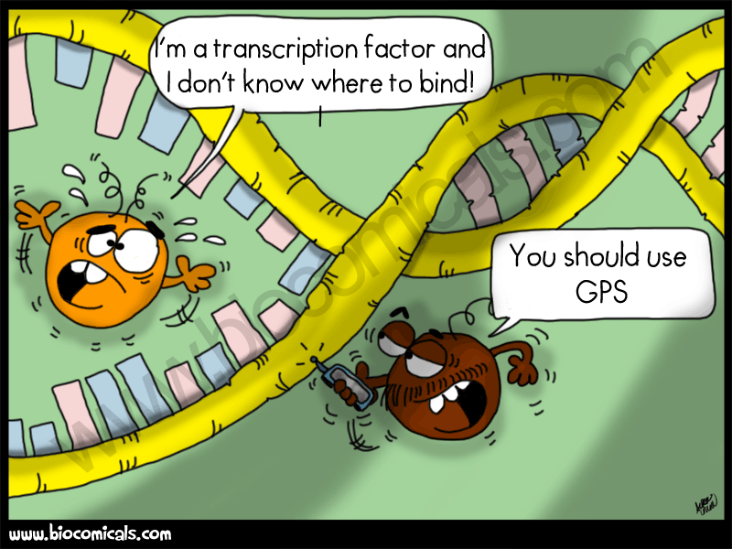
http://www.biocomicals.com/comicspage2.php?id=11

Slide 60
Images from: http://www.bbc.co.uk/scotland/education/bitesize/higher/img/biology/genetics_adaptation/mutations/02gene_mutation.gif

Slide 61
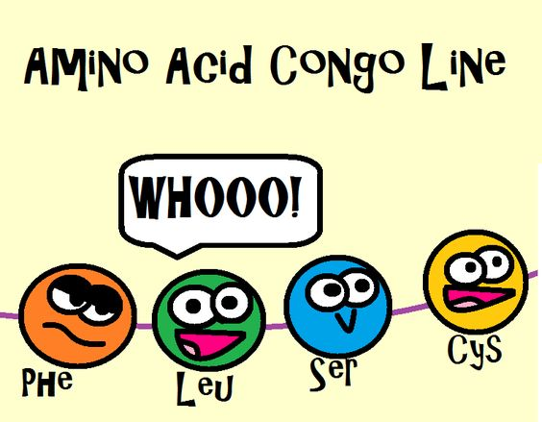
https://www.pinterest.com/pin/50313720817130182/

Slide 62
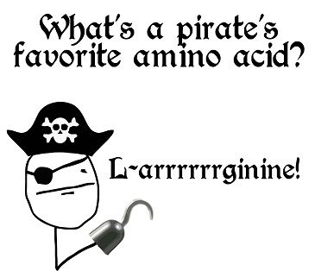
https://www.pinterest.com/pin/50313720817130181

Slide 63
http://notaniche.com/wp-content/uploads/2008/08/michael-helps-baby-picture.jpg

Slide 64
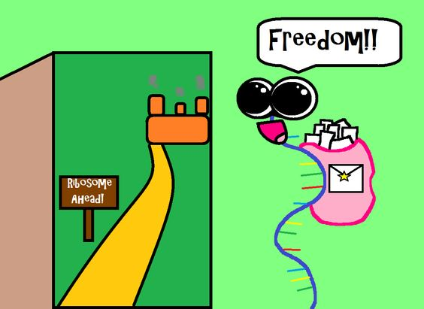
https://www.pinterest.com/pin/AdfYJcS2vSqHKdPR9-bLT2xtUz8nP7eIU32zXYV5ZXoPN2_Vhfwp3EA

Slide 65
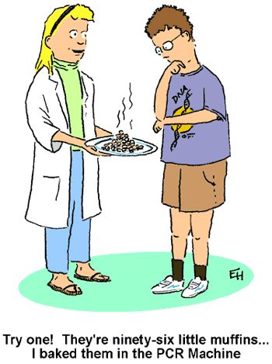
https://www.pinterest.com/pin/50313720817085039/

Slide 66
Images from: http://www.bbc.co.uk/scotland/education/bitesize/higher/img/biology/genetics_adaptation/mutations/02gene_mutation.gif

Slide 67
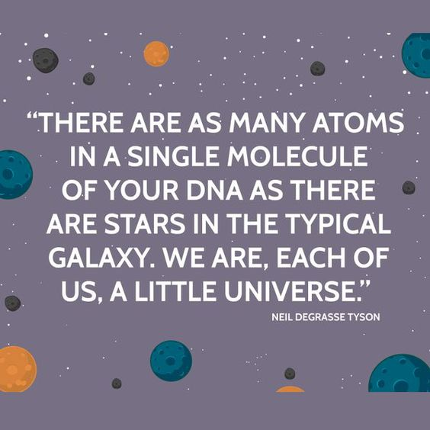
https://www.pinterest.com/pin/50313720817084918/

Slide 68
https://www.pinterest.com/pin/50313720817088823/

Slide 70
http://www.teachwithfergy.com/science-jokes-and-funnies/

Slide 71
https://pbs.twimg.com/media/CiN_f0CXAAAsgCW.jpg

Slide 72
https://www.pinterest.com/pin/50313720809187170/

Slide 73
http://amoebasisters.tumblr.com/image/154443612911

Slide 74
Image edited from: https://s-media-cache-ak0.pinimg.com/originals/b3/48/68/b348680b5573528b0472c3c0fad01362.jpg

Slide 75
RANDOM FERTILIZATION
Average male between ages 15-30 makes 200,000,000-300,000,000 sperm/day
Females born with 1-2 million immature eggs Releases 400-500 mature eggs in lifetime
Egg 2²³ = 8.4 million possible combinations
Sperm 2²³ = 8.4 million possible combinations
2²³ X 2 ²³ ~ 70 trillion diploid combinations
(This doesn’t include crossing over!)
Odds of one particular egg getting together with one particular sperm is astronomical. EVERYONE IS UNIQUE!

Slide 76
https://www.pinterest.com/pin/536772849322383541/

Slide 77
https://s-media-cache-ak0.pinimg.com/originals/d8/bf/8e/d8bf8ed86d6fe84325ca5da5e770a16a.jpg

Slide 78
http://www.brainlesstales.com/2011-08-16/pickle-cell-anemia

Slide 79
http://amoebasisters.tumblr.com/image/154226822230

Slide 80
https://s-media-cache-ak0.pinimg.com/originals/2e/d6/14/2ed614055e67ad2f04c29a31c0c0b212.gif

Slide 81
https://s-media-cache-ak0.pinimg.com/originals/a3/1a/5e/a31a5e0fed5c645903d3600aa208e3a9.gif

Slide 82
https://www.pinterest.com/pin/50313720817171839/

Slide 83
https://www.pinterest.com/pin/50313720817171844/

