Slide 1
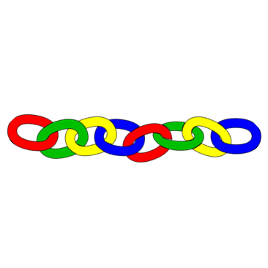
Make a connection Kelly Riedell
Image from: https://tse1.mm.bing.net/th?id=OIP.7_EQFnf-Y_Mm5fRhmQTvTAHaHZ&pid=Api&P=0&w=300&h=300
2020 CED -ESSENTIAL KNOWLEDGE SYI-1.B.2c. Complex carbohydrates comprise sugar monomers whose structures determine the properties and functions of the molecules.
SP 1.C Explain biological concepts, processes, and/or models in applied contexts.

Slide 2
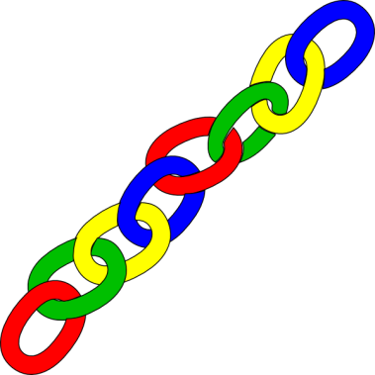
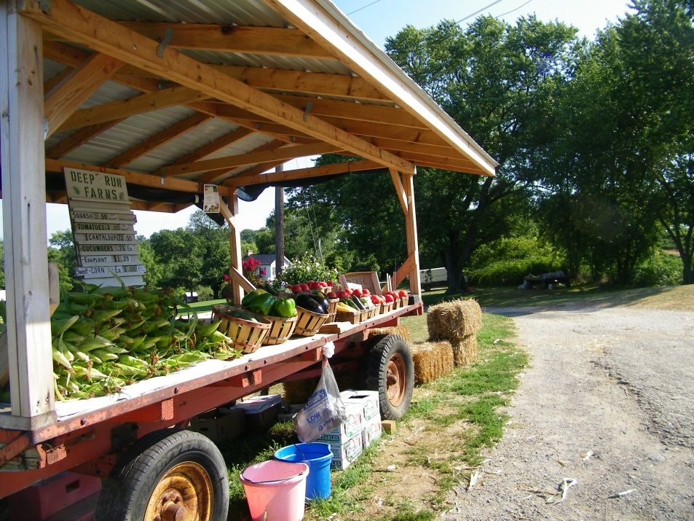
http://www.gurneys.com/product/kandy_korn_se_sweet_corn/vegetables
MAKE A CONNECTION
“Candy Corn” is a variety of sweet corn enjoyed by many people. These corn plants have been modified by geneticists to produce corn that tastes sweeter than other varieties because Candy Corn lacks an enzyme that “field” corn plants have. What do you think is the function of this missing enzyme in other corn plants? EXPLAIN YOUR ANSWER.
http://www.deeprunfarmsmaryland.com/wp-content/uploads/2012/07/101_0368.jpg
BILL- MAKE A CONNECTION Candy Corn- By Kelly Riedell

