Slide 1
Modeling ISOMERS Slide show by Kelly Riedell

Slide 2
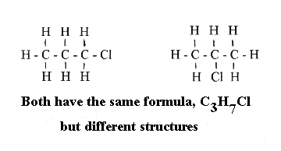
STRUCTURAL ISOMERS
http://homepages.ius.edu/DSPURLOC/C122/images/structure.gif

Slide 3
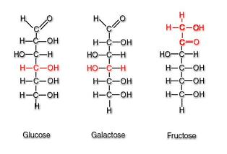
STRUCTURAL ISOMERS
http://kel-tay-lii.wikispaces.com/file/view/liner_glucose_galactose_and_fructose.jpg/296693972/314x214/liner_glucose_galactose_and_fructose.jpg

Slide 4
Make a model of a MOLECULE WITH 4 CARBONS
Make a model of a STRUCTURAL isomer for this molecule.
Show your neighbor. Are these structural isomers?
DRAW a picture of your isomers in your BILL.

Slide 5
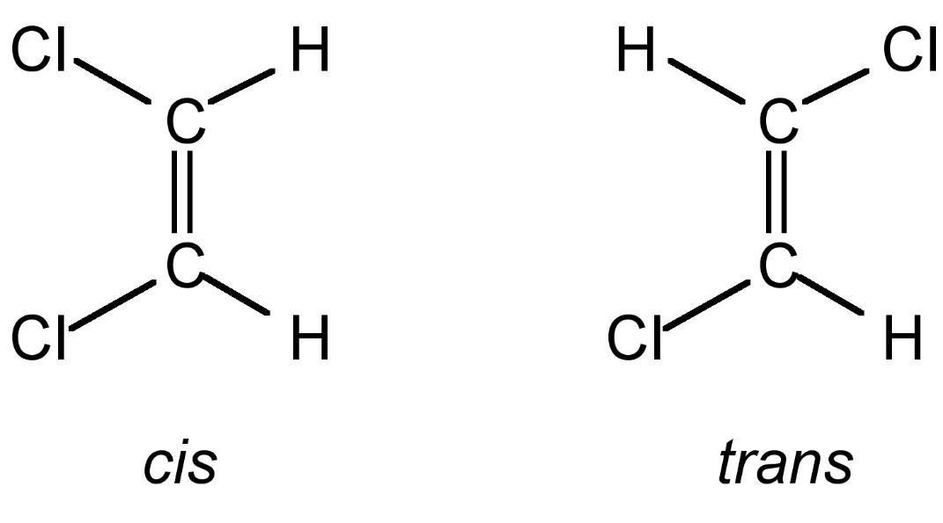
GEOMETRIC ISOMERS
http://cnx.org/resources/f3e046c6759f35392adfb71267acaa03/Fig2.jpg

Slide 6
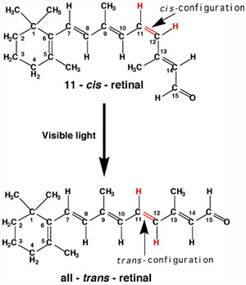
RHODOPSIN in rod cells made of SCOTOPSIN & RETINAL molecules RETINAL = derived from vitamin A (which is why a lack of vitamin A causes vision problems).
INACTIVE form
ACTIVATED FORM
Breaks down into another chemical that causes electrical impulses to
Be transmitted to brain and interpreted as light
http://www.chemistry.wustl.edu/~edudev/LabTutorials/Vision/images/Isomerization.jpg

Slide 7
Make a model of a MOLECULE WITH 1 double bond between CARBONS
Make a model of a GEOMETRIC isomer for this molecule.
Show your neighbor. Are these geometric isomers?
DRAW a picture of your isomers in your BILL.

Slide 8
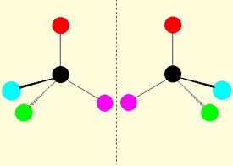
ENANTIOMERS
http://www2.lbl.gov/Science-Articles/Archive/assets/images/2002/Apr-22-2002/Enantiomers.jpg

Slide 9
ENANTIOMERS
http://www.avogadro.co.uk/organic/enantio.gif

Slide 10
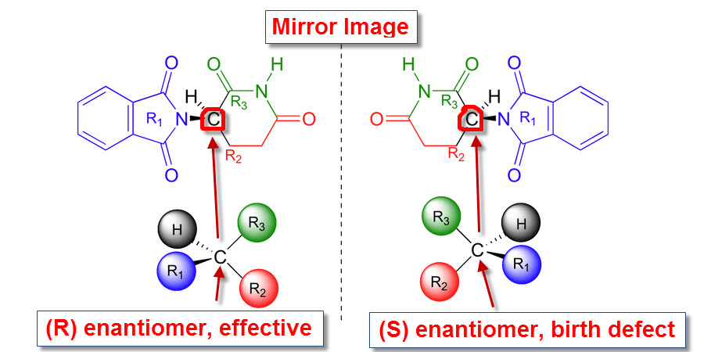
Thalidomide
http://2.bp.blogspot.com/-5hOytpGZBzg/Tfi6vUcyxgI/AAAAAAAAJnM/Lu0YT3yC8dA/s1600/optical+isomers+2.jpg

Slide 11
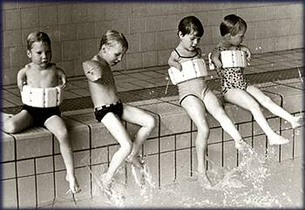
Thalidomide
http://www.chm.bris.ac.uk/motm/thalidomide/first_pic.jpg

Slide 12
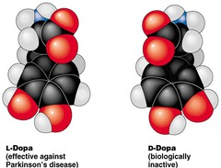
L-Dopa vs D-Dopa
http://o.quizlet.com/olaHF4dORR8vnqzIABRD1Q_m.jpg
http://cp91279.biography.com/1120330742/1120330742_1713651343_bio-michaeljfox-parkinsons-97481438001.jpg?pubId=1120330742

Slide 13
Make a model of a 1 carbon molecule that has an ASYMMETRIC CARBON.
Make a model of a ENANTIOMER isomer for this molecule.
Show your neighbor. Are these enantiomers?
DRAW a picture of your isomers in your BILL.
Give an example of enantiomer isomers with different properties

Slide 14
Does this molecule have an asymmetric carbon? If so, which one is asymmetric?
Would you expect this molecule to exist as enantiomer isomers?

