Slide 1
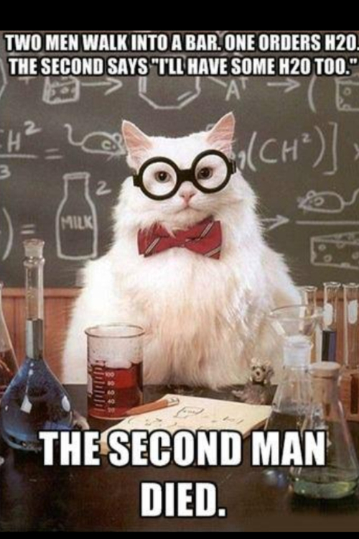
http://www.tumblr.com/tagged/h2o2

Slide 2
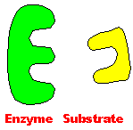
CATALASE FLOATING DISC LAB
http://www.biologie.uni-hamburg.de/b-online/library/cat-removed/enzyme_.gif

Slide 3
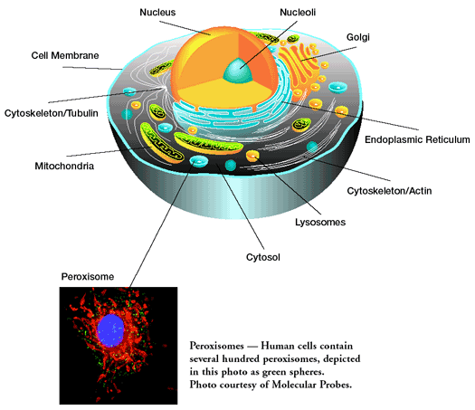
PEROXISOMES
digest fatty acids
digest ethanol (alcohol)
cholesterol synthesis
digest amino acids
Digestion produces hydrogen peroxide (H₂O₂ )
http://middletownhighschool.wikispaces.com/file/view/peroxisome.gif/43868337/peroxisome.gif

Slide 4
H₂O₂ HYDROGEN PEROXIDE
In aerobic organisms
Toxic byproduct of metabolism
Strong oxidizer
(grabs electrons from other molecules)
2 H₂O₂ → 2 H₂O + O₂
Substrate Products
DECOMPOSITION reaction happens spontaneously (slowly)

Slide 5
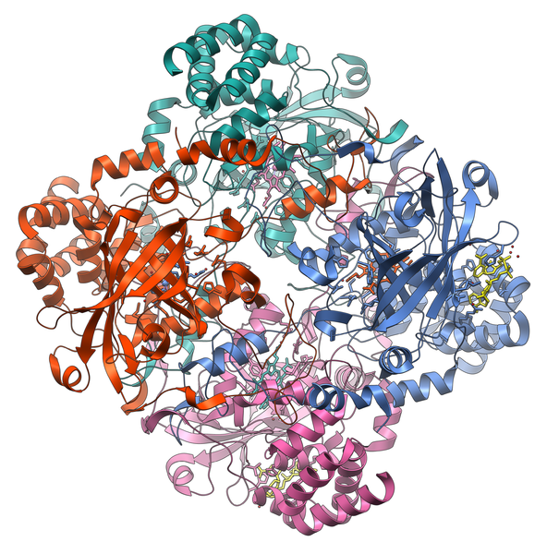
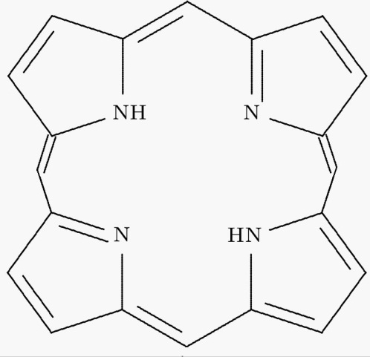
Catalase
ENZYME
Speeds up reaction to break down hydrogen peroxide
Tetramer (4 polypeptide subunits)
Contains Porphyrin groups with iron cofactors = HEME
ANTI-OXIDANT
http://en.wikipedia.org/wiki/File:Catalase_Structure.png
http://semicrystalline.wordpress.com/2007/05/

Slide 6
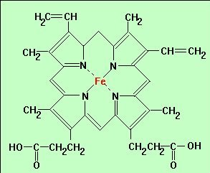
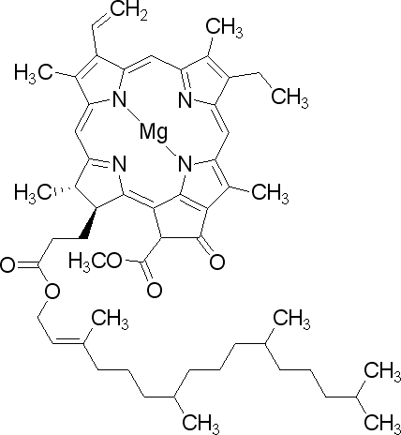
Other molecules with porphyrin rings
Hemoglobin
Chlorophyll
http://drvsrs.com/spimgs/HEMOGLOBIN.jpg
http://www.fkp.jku.at/fkp/forschung/PorSil.aspx

Slide 7
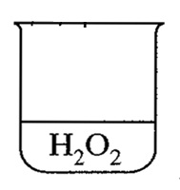
Enzyme Catalyzed Rate of H₂O₂ Decomposition
+ 40 mL H₂O₂ to each beaker
3 beakers of each concentration
0%
1.5%
3%

Slide 8
Fill 3 beakers with each of the solutions below.
Use a marker to label the beakers.
Final Quantity Needed | Hydrogen Peroxide Concentration | Quantity of Peroxide (mL) | Quantity of Water (mL)
30 mL | 3% | 30 mL | 0 mL
30 mL | 1.5% | 15 mL | 15 mL
30 mL | 0% | 0 mL | 30 mL

Slide 9
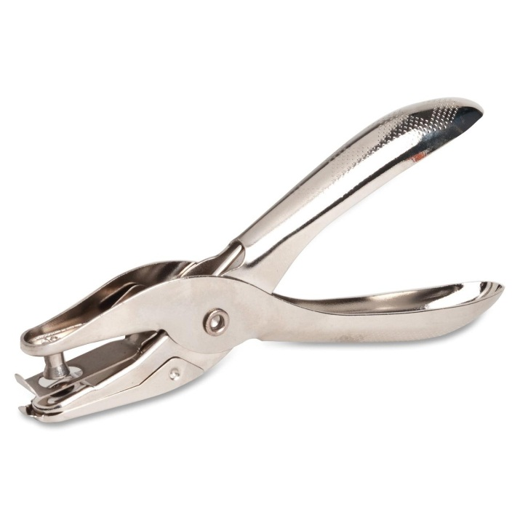
http://www.theofficedealer.com/mm5/graphics/product_images/1300/seo/Business-Source-62895-Ticket-Hole-Punch.jpg
Use hole punch to punch 12 discs.
Use forceps to dip disc into catalase for 5 seconds. Blot dry.
Drop disc into peroxide solution and start timer.
Stop when disc reaches top.
Repeat 3 times for each concentration
Complete class data table

Slide 10
DESIGN YOUR OWN EXPERIMENT
You looked at SUBSTRATE CONCENTRATION

