Slide 1
Human Systems
AP Biology Project
February 2012
Alex Wiemann

Slide 2
Digestive System
What Is Digestion?
Digestion is the complex process of turning the food you eat into the energy you need to survive. The digestion process also involves creating waste to be eliminated.

Slide 3
The Organs of the Digestive System
Stop 1: The Mouth: The mouth physically breaks down food through chewing. It also excretes saliva to chemically break down food.
Stop 2: The Pharynx and Esophagus: The pharynx is where the partially voluntary act of swallowing receives food from the mouth and passes it on to the esophagus, a muscular tube extending from the pharynx which carries food to the stomach.
Stop 3: The Stomach and Small Intestine: The stomach, a strong sac-like organ with muscular walls, breaks down food through the secretion of enzymes. The small intestine continues the breaking down process as well as taking in nutrients through the blood stream.
Stop 4: The Colon, Rectum, and Anus: What’s left of the food (waste) goes to the colon, which processes the waste so defecation is easy and convenient. When the colon is full, it empties into the rectum and is pushed out of the body through the anus.

Slide 4
Accessory Digestive Organs
Pancreas: The pancreas is the main place where enzymes are produced for breaking down lipids, proteins, and carbohydrates.
Liver: The liver makes and secretes bile and purifies blood that has taken in new nutrients.
Gallbladder: Excess bile is stored in a storage sac called the gallbladder. Here, it waits for the signal of incoming food.
Sphincters: The sphincters provide control of stool (waste). Until stool enters the rectum, the internal sphincter remains tight so we don’t constantly release stool. The external sphincter keeps in the stool when we get the urge to defecate until we finally choose to release it.

Slide 5
Large Food Molecule Digestion & Enzymes
Food needs to be broken down and reassembled.
Large food molecules need to be broken down into smaller ones.
Digestion is important so absorption can occur.
Enzymes break down large food molecules into smaller ones.
Enzymes speed up the process of digestion by lowering the activation energy for the reaction.
Enzymes work at body temperature.

Slide 6
Physical vs. Chemical
Physical digestion is the chewing of the food and breaking it down in your mouth
Chemical digestion is adding enzymes and acids from saliva and in the stomach. This is also where the body gets the nutrients.

Slide 7
Carbohydrate, Protein, and Lipid Digestion
 | Amylase | Protease | Lipase
Enzyme | Salivary Amylase | Pepsin | Pancreatic Lipase
Source | Salivary Glands | Chief cells in stomach lining | Pancreas

Slide 8
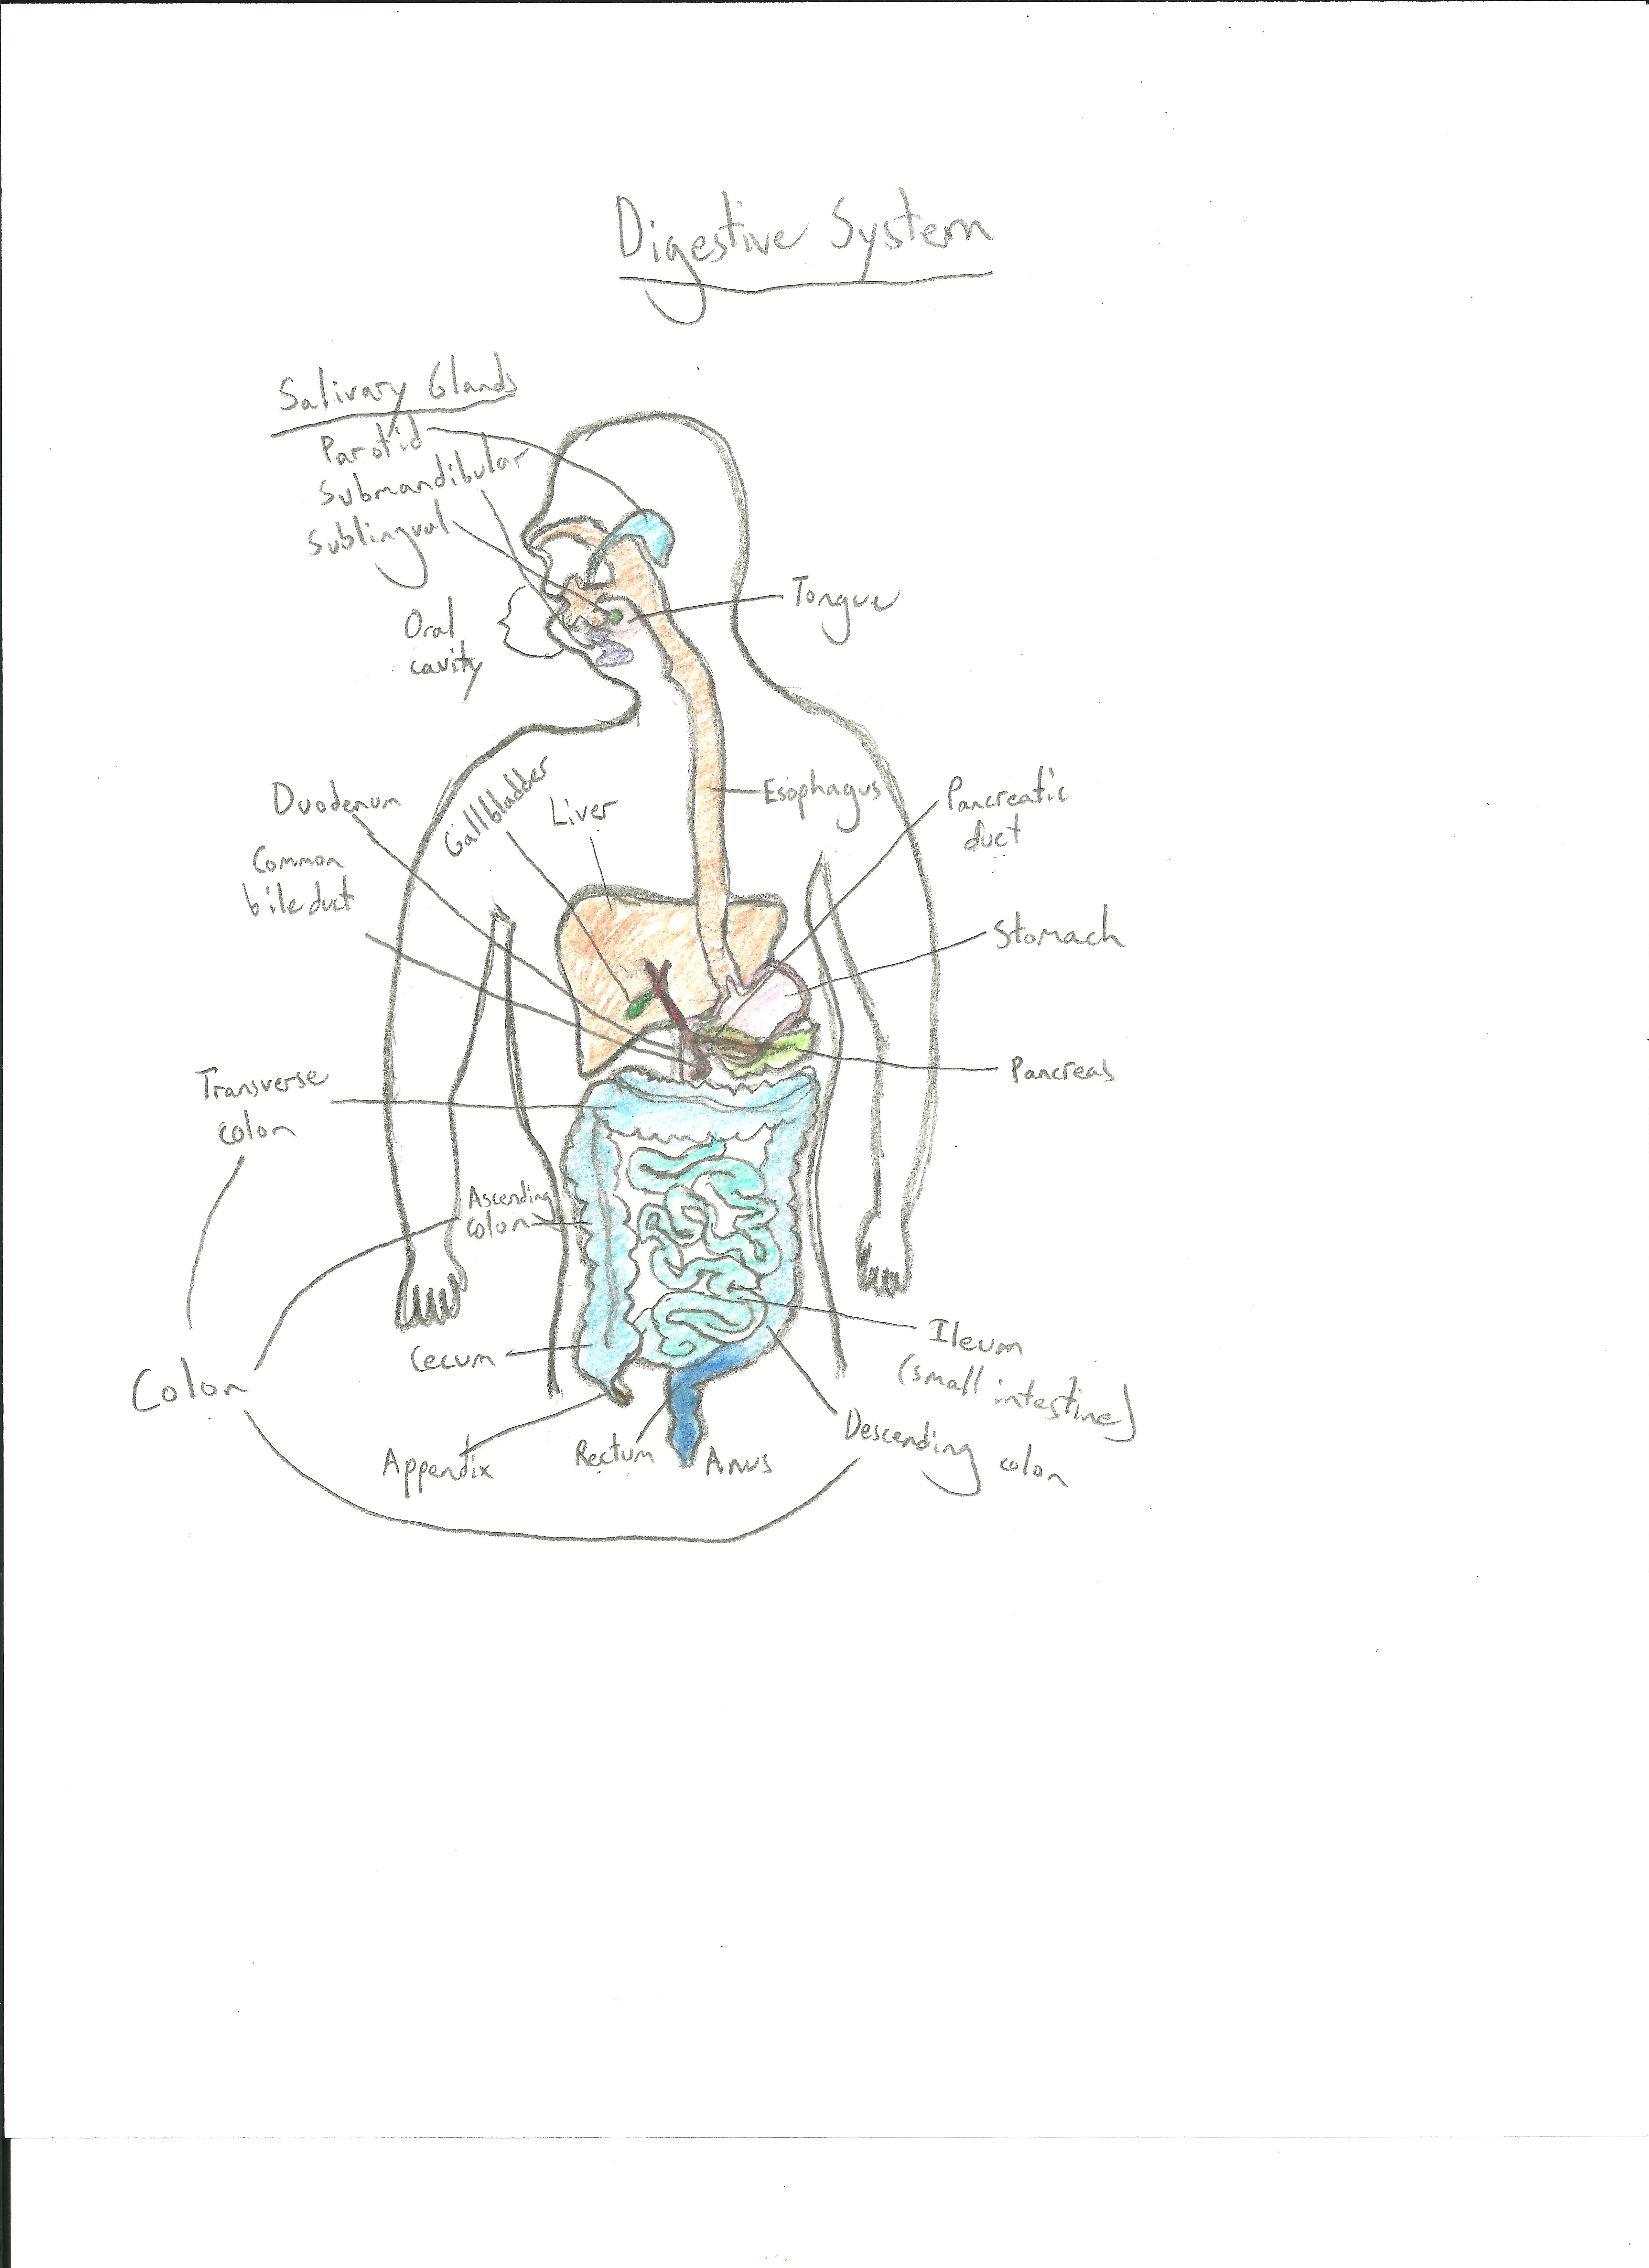
Digestive System Drawing

Slide 9
Heartburn
Heartburn is the regurgitation of gastric acid.
Heartburn is associated with a burning sensation in the chest.
Heartburn’s triggers include certain foods and medications, obesity, or even stress.
One in ten Americans experiences heartburn symptoms at least once a week.
Heartburn treatment may include medications, home remedies, or diet changes.

Slide 10
Colon Cancer
Colon cancer and cancer of the rectum usually begin as a small polyp.
While most colon polyps are benign, some do become cancerous.
Colon cancer is often symptomless, but it can cause a change in bowel habits or bleeding.
It’s important to get a colonoscopy to check for cancer.
The doctor can use surgery, radiation, and/or chemotherapy to treat the cancer if it is found early.

Slide 11
References
http://www.webmd.com/colorectal-cancer/default.htm
http://answers.yahoo.com/question/index?qid=20071015011808AAQZKER
http://www.ibguides.com/biology/notes/digestion
http://www.webmd.com/digestive-disorders/digestive-system
http://upload.wikimedia.org/wikipedia/commons/c/c5/Digestive_system_diagram_edit.svg

