Slide 1
Excretory System
Alex Wiemann

Slide 2
Function of the Excretory System
The excretory system gets rid of nitrogenous (and other) wastes.
It also regulates the amount of water and ions in body fluids.

Slide 3
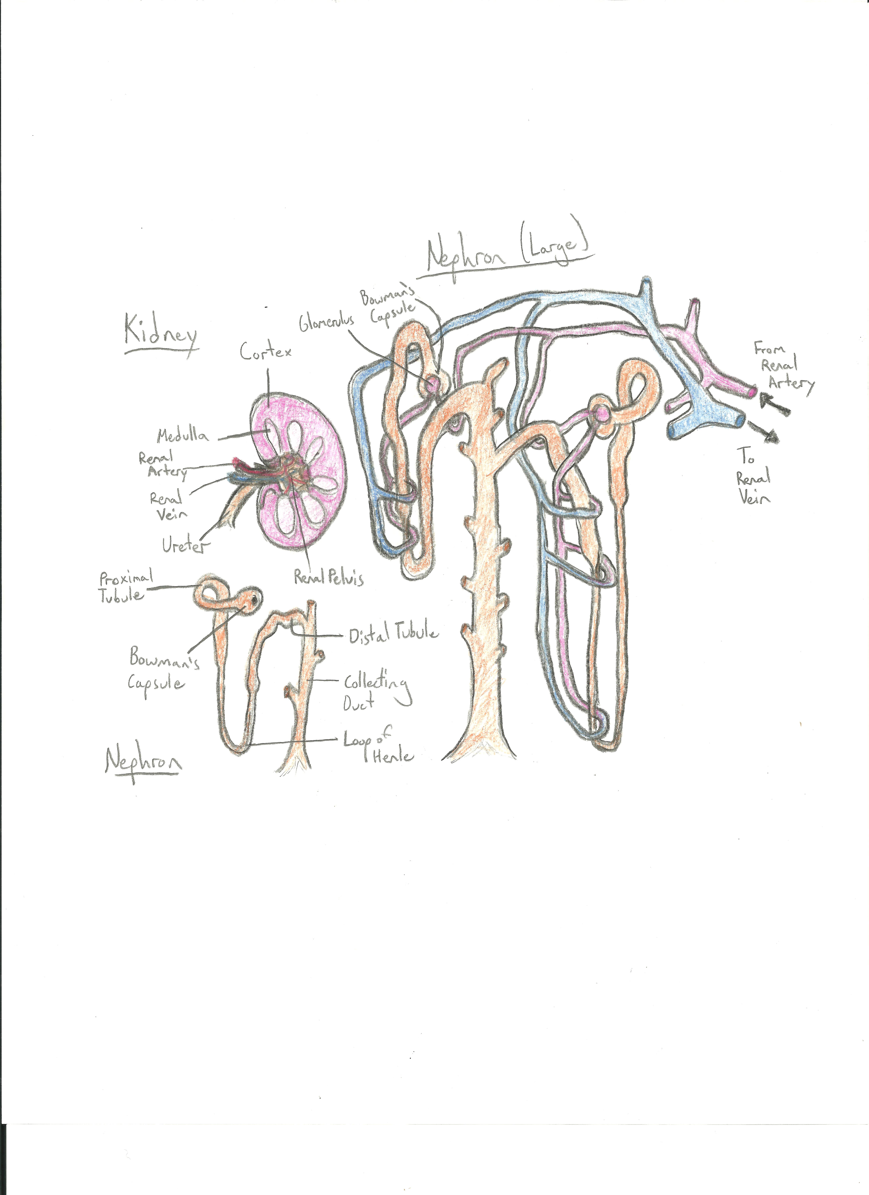

Slide 4
Categories of Nitrogenous Waste
Ammonia
  Ammonia is formed after the amino group is removed from an amino acid.
  Ammonia is highly soluble in water but very toxic.
  Aquatic animals such as bony fishes, aquatic invertebrates, and amphibians excrete ammonia because it is easy to get rid of in the water.
Urea
  Terrestrial amphibians and mammals use urea because it is less toxic than ammonia and can be somewhat concentrated to conserve water.
  Urea is produced in the liver.
Uric Acid
  Insects, reptiles, birds, and some dogs (Dalmatians) excrete uric acid. Reptiles and birds dispose of uric acid with their feces.
  The white material seen in bird droppings is uric acid.
  It is not very toxic and is not very soluble in water.
  Uric acid waste conserves water, since it can be produced in a concentrated form due to its low toxicity.

Slide 5
Processes of a Nephron
Filtration: Approximately 20 percent of the blood is filtered through the walls of the glomerular capillaries and Bowman's capsule (due to pressure).
Reabsorption: Necessary materials are removed from the filtrate and returned to the blood.
Secretion: Materials are transported directly into the renal tubules from the capillaries.
Excretion: Waste products are eliminated.

Slide 6
Kidney Stones
Kidney stones are crystals of acid salts formed around particles of foreign material (such as bacteria).
Pain in the side or back and during urination is the most common symptom. Other symptoms include urine that is cloudy or smelly, nausea, and needing to urinate often.
People that do not drink enough water are more likely to get kidney stones.
May require medical removal if bad enough.

Slide 7
Urethritis
Urethritis is an inflammatory condition that affects the urethra and is caused by a bacterial infection.
Urethritis is much more common among men than women.
Symptoms may include burning while urinating or during an erection, pain and a discharge from the urethra.
Fluids and anti-inflammatory medicines can help reduce pain.

Slide 8
Sources
http://faculty.clintoncc.suny.edu/faculty/michael.gregory/files/bio%20102/bio%20102%20lectures/excretory%20system/excretor.htm
http://science.howstuffworks.com/environmental/life/human-biology/kidney1.htm
http://science.jrank.org/pages/2626/Excretory-System-Excretion-in-humans.html
http://cikgurozaini.blogspot.com/2010/03/nephron.html
http://www.ehow.com/about_5497170_excretory-system-disorders.html

