Slide 1
Muscular System
Alex Wiemann

Slide 2
Muscular System Function
Stabilize the body and produce movement

Slide 3
Types of Muscle Tissues
Cardiac:
Located in heart
Has striations of alternating light and dark bands.
Contraction is subconscious.
Smooth:
Located in blood vessels, stomach, intestines, and bladder
Not striated
Contraction is subconscious.
Skeletal
Attaches to bones
Has striations
Contraction is controlled consciously.

Slide 4
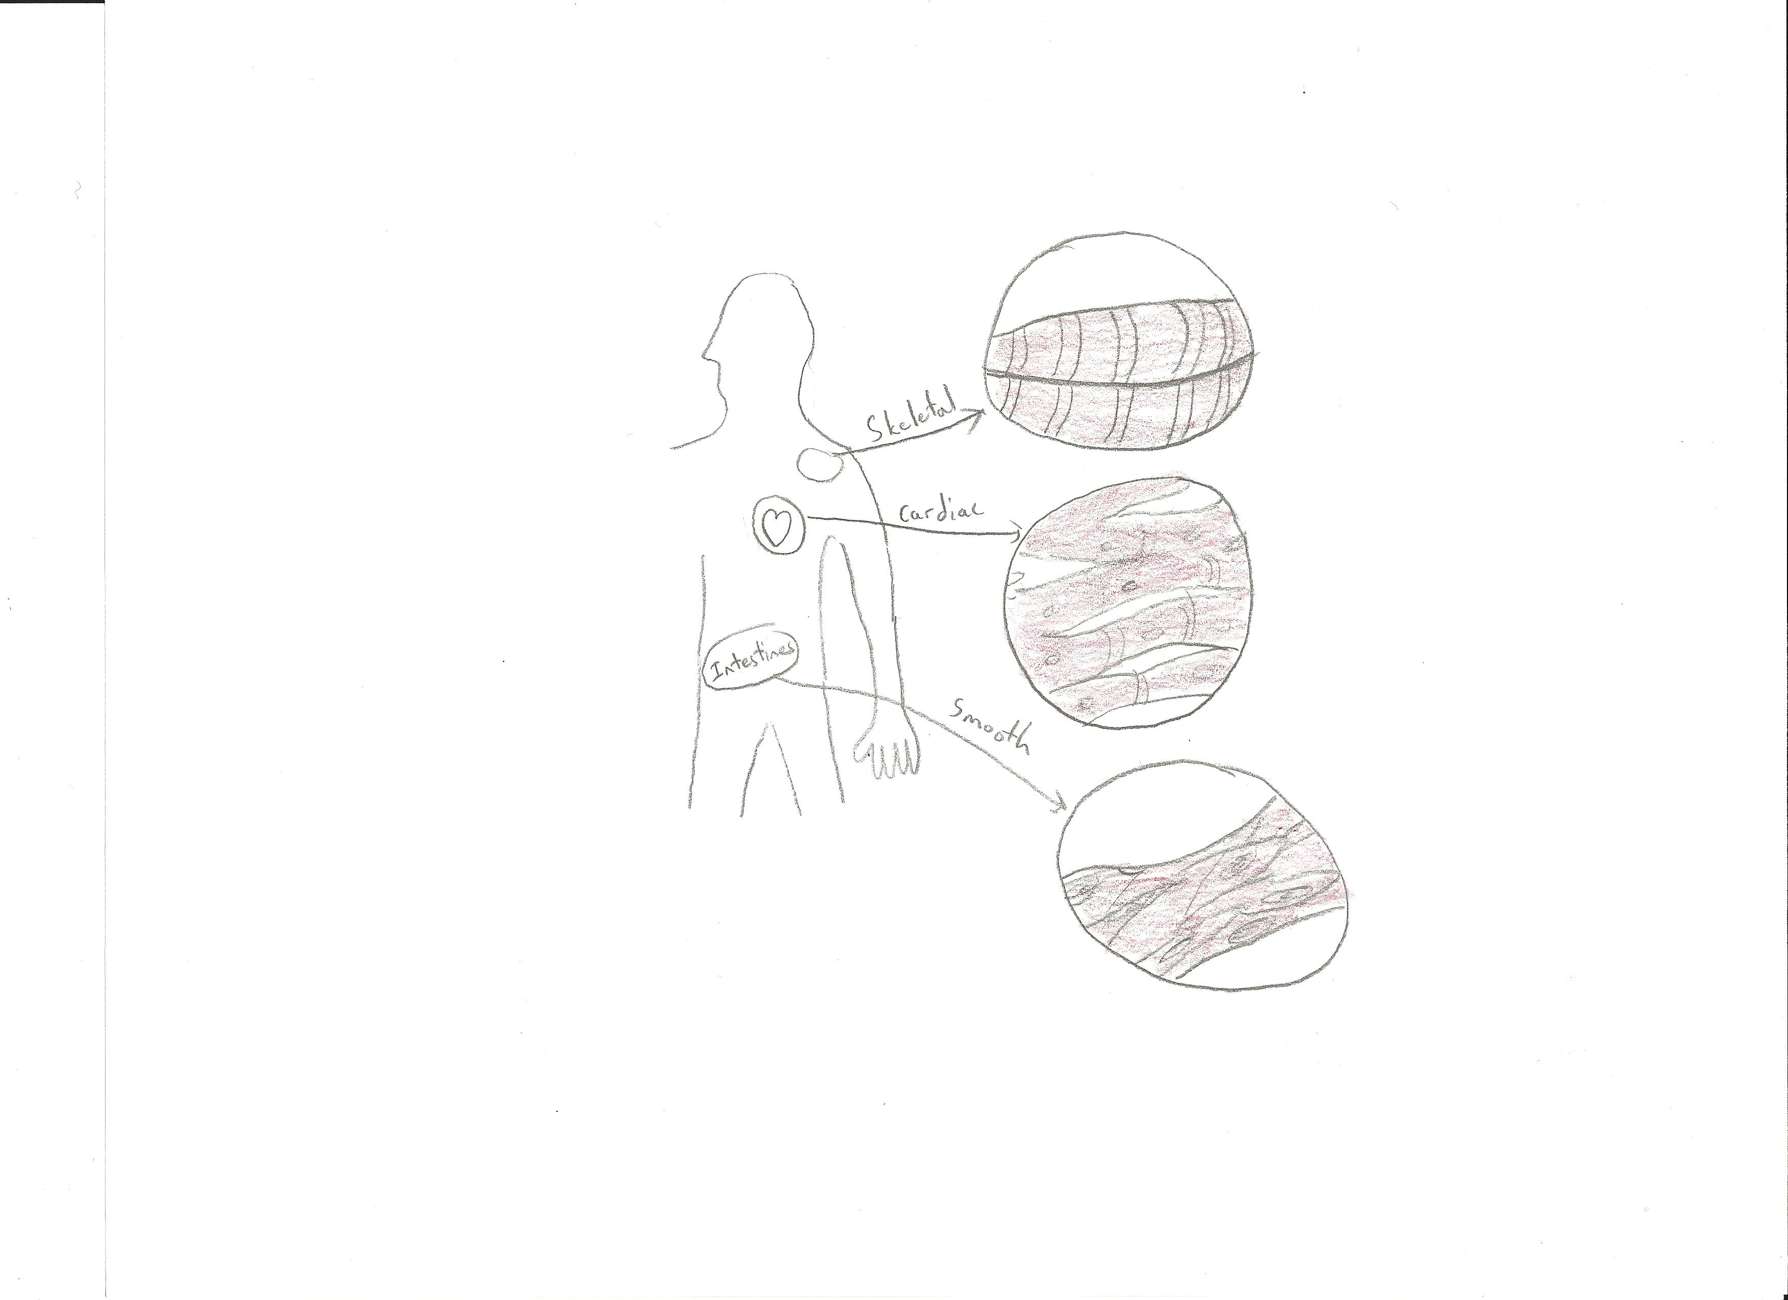
Types of Muscle Tissues

Slide 5
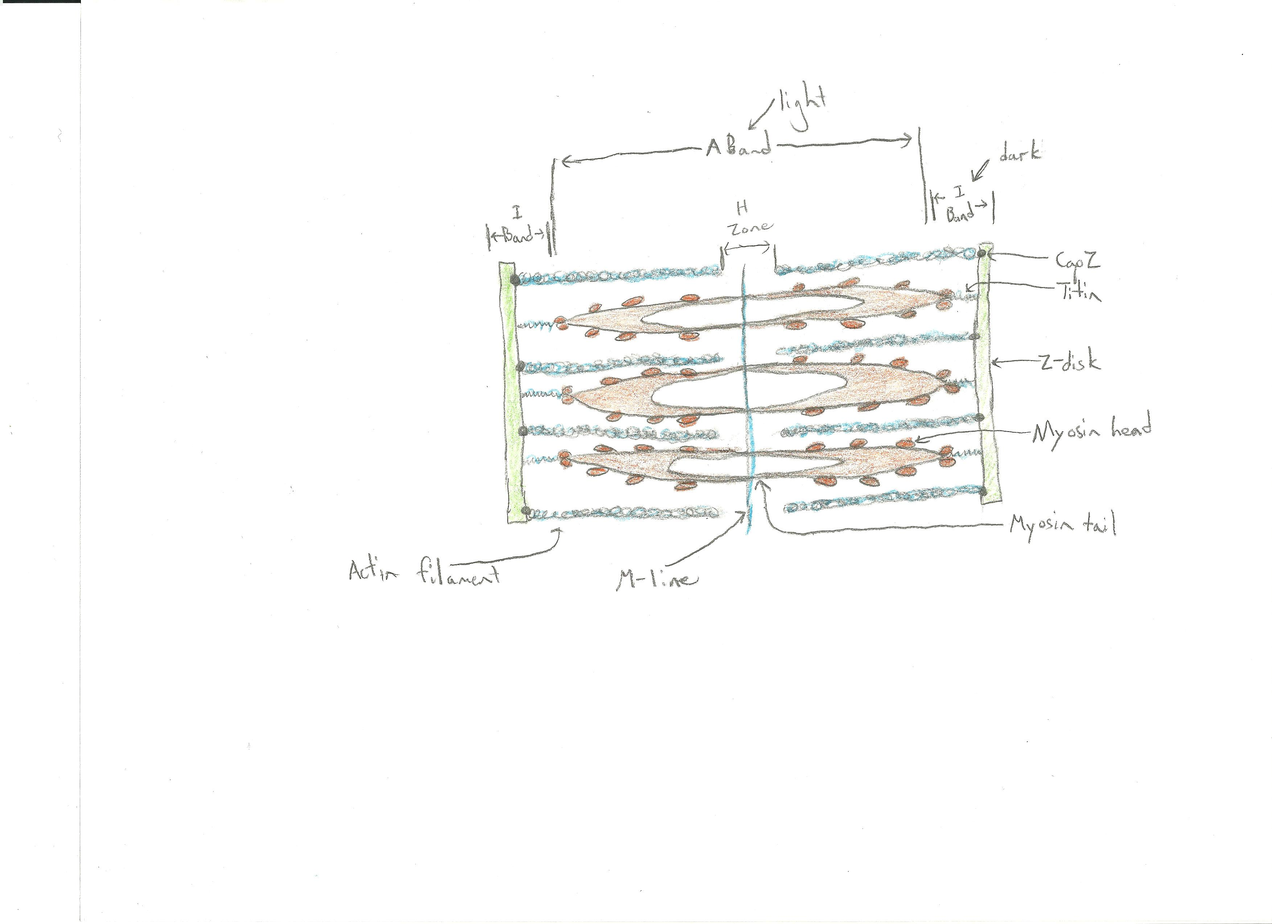
Structure of Saromere

Slide 6
Sliding Filament Model
Nervous impulse arrives at NMJ
Ach is released and causes depolarization
Ca++ is released from sarcoplasmic reticulum
Ca++ binds to Troponin allowing myosin filaments to attach to actin, forming a cross-bridge
ATP breaks down and releases energy which enables myosin to pull actin filaments inward to shorten the muscle

Slide 7
Duchenne Muscular Dystrophy
Definition: X-linked genetic disorder caused by a defective gene for dystrophin – a muscle protein
Signs and symptoms: fatigue, muscle weakness which begins in legs and pelvis, frequent falls, difficulty walking-especially by age 12
Prevalence: 1 out of 3600 male infants
Treatment: no cure, treatment aims to control symptoms to maximize quality of life, encourage activity to strengthen muscles

Slide 8
Myasthenia Gravis
Definition: neuromuscular/autoimmune disorder where the immune system produces antibodies that block the muscle cells from receiving messages from nerves
Signs and symptoms: Breathing difficulty, difficulty climbing stairs/talking/maintaining steady gaze, fatigue, double vision, eyelid drooping
Prevalence: 14-20/100,000
Treatment: no known cure, medications to improve nerve communication and/or suppress the immune system

Slide 9
Resources
http://shs.westport.k12.ct.us/mjvl/anatomy/MandalaWeb/muscular.htm
http://www.brianmac.co.uk/muscle.htm http://163.16.28.248/bio/activelearner/38/ch38c1.html
http://www.teachpe.com/anatomy/sliding_filament.php
http://www.ehow.com/facts_5525134_diseases-disorders-muscular-system.html
http://www.ncbi.nlm.nih.gov/pubmedhealth/PMH0001724/
http://www.ncbi.nlm.nih.gov/pubmedhealth/PMH0001731/

