Slide 1
Human Body Systems Part II
Alyssa Larson

Slide 2
Table of Contents
Section 1 – The Endocrine System
Endocrine System Introduction and Function 1-2
Homeostasis 3
Negative Feedback Mechanism 4
Endocrine Glands of the Human Body 5-6
Diabetes Types I and II 7-8
Hypothyroidism 9-10
Endocrine System Reference Pages 11-12

Slide 3
Table of Contents
Section 2 – The Reproductive System and Development
Introduction and Functions of the Reproductive System 13-14
Sexual and Asexual Reproduction in Animals 15
Spermatogenesis 16-17
Oogenesis 18-19
Menstrual Cycle and Estrous Cycle 20
Menstrual Cycle in Humans and Primates 21-23
Development 24
Ovarian Cysts 25-26
Prostate Gland Enlargement 27-28
Reproductive System Reference Pages 29-30

Slide 4
Table of Contents
Section 3 – The Nervous System
Introduction and Function of the Nervous System 31-32
Central and Peripheral Nervous System 33
Simple Reflex Arc 34-35
Parts of the Brain and Functions 36-40
The Neuron 41
Nerve Impulses 42-46
Role of Neurotransmitters 47
Parkinson’s Disease 48-49
Migraine Headaches 50-51
Nervous System Reference Pages 52-53

Slide 5
Table of Contents
Section 4 – The Senses System
Introduction and Types of Sensory Receptors 54-59
The Eye 60
Rhodopsin and Cell Signaling 61
Senses System Reference Page 62

Slide 6
Table of Contents
Section 5 – The Muscular System
Introduction and Function of the Muscular System 63-64
Types of Muscle Tissue 65-68
The Sarcomere 69
The Sliding Filament Model 70-74
Duchenne Muscular Dystrophy 75-76
Chronic Compartment Syndrome 77-78
Muscular System Reference Pages 79-80

Slide 7
Table of Contents
Section 6 – The Skeletal System
Introduction and Function of the Skeletal System 81-82
Roles of Bones, Ligaments, Muscles, and Tendons in Movement 83
Types of Skeletons 84
The Long Bone 85
Rickets 86-87
Osteoporosis 88-89
Skeletal System Reference Pages 90-91

Slide 8
The Endocrine System
1

Slide 9
Function of the Endocrine System
Endocrine System
Regulates metabolic processes, growth of the body and sexual development
The endocrine system consists of hormones and glands
Hormones secreted by the endocrine system influence the body to react according to:
Changes in the balance of fluids and minerals in blood
Stress
Infection
Organs of the endocrine system:
Pineal gland
Pituitary gland
Parathyroid gland
Thyroid gland
Adrenal glands
Pancreas
Ovaries (in females)
Testes (in males)
Thymus
2

Slide 10
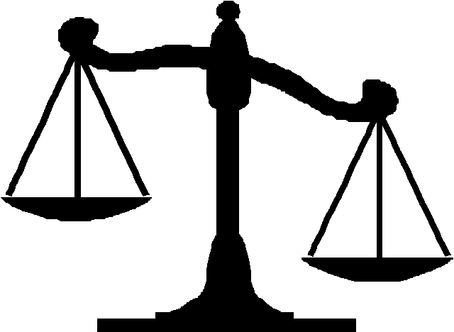
Homeostasis
Endocrine System
Homeostasis is the ability of an organism to maintain stable internal conditions by regulating its physiological processes
The endocrine system helps maintain homeostasis by releasing hormones
The endocrine system works by using a feedback system – when the chemical level of a certain substance is abnormally high or low, the endocrine system secretes hormones to reach an internal equilibrium
3

Slide 11
Negative Feedback Mechanism
Endocrine System
The negative feedback mechanism is one of the most important features of the endocrine system
Means that the a gland within the endocrine system will stop producing a hormone to avoid a hormone imbalance
Example:
The hypothalammus secretes TRH, which causes the pituitary gland to release TSH
TSH causes the thyroid gland to secrete T4 (thyroid hormone)
When thyroid hormone accumulates in the blood, it causes the hypothalamus and pituitary gland to slow the secretion of TRH and TSH.
The negative feedback mechanism is also used by the ovaries, testes and adrenal glands
4

Slide 12
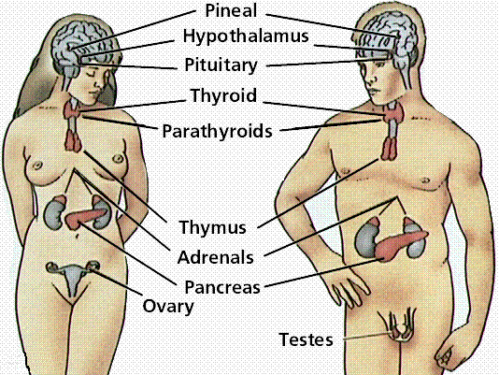
<endocrine glands drawing>
Endocrine System
5

Slide 13
The Endocrine Glands and Hormones
Endocrine System
Gland | Hormone & Action of Hormone
Pineal gland | Melatonin – communicates information about environmental lighting to various parts of the body
Pituitary gland | Growth hormone – promotes growth in children. In adults, helps maintain muscle and bone mass
Parathyroid gland | Parathyroid hormone – regulates calcium and phosphorus concentration in extracellular fluid
Thyroid gland | Thyroxine – controls metabolism
Adrenal glands | Norepinephrine – activates fight or flight mechanism. Greater muscle strength and enhanced senses
Pancreas | Insulin – takes glucose out of the blood, maintains blood glucose levels
Ovaries (females) | Estrogen – development of female sexual characteristics
Testes (males) | Testosterone – development of male sexual characteristics
Thymus | Thymopoietin – regulates immune function
6

Slide 14
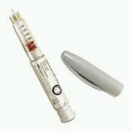
Diabetes Types I and II
Endocrine System
Marked by persistent or recurring elevated levels of blood sugar because of the absence of blood sugar or the inability of the body cells to react to insulin
Can be treated with changes in diet, exercise, or the injection of insulin
NOT curable
Can lead to coma, heart disease, kidney failure, blindness, amputation
Diabetes Type I shortens life expectancy by about 15 years
Diabetes type II shortens life expectancy by about 5-10 years
7

Slide 15
Diabetes
Endocrine System
Type I
Type II
“juvenile onset diabetes” – usually begins in childhood or adolescence
Body destroys the pancreatic cells that create insulin, the hormone that removes glucose from the blood
High blood sugar damages body tissues
Treated with insulin injections
About 95% of diabetes cases in America are Type II
“slow onset diabetes” – appears over the course of several years
The body produces insulin, but the cells don’t respond to it correctly
Treated with a change in diet and exercise habits, and weight loss
Affects the sedentary, obese, and elderly
Can usually be controlled without insulin therapy
8

Slide 16
Hypothyroidism
Endocrine System
Signs and Symptoms:
Fatigue and sluggishness
Increased sensitivity to cold
Constipation
Pale, dry skin
A puffy face
Hoarse voice
An elevated blood cholesterol level
Unexplained weight gain
Muscle aches, tenderness and stiffness
Pain, stiffness or swelling in your joints
Muscle weakness
Heavier than normal menstrual periods
Brittle fingernails and hair
Depression
a condition in which the thyroid gland is underactive – doesn’t produce enough of certain important hormones
Upsets the normal balance of chemical reactions in the body
More likely in women especially over the age of 50
9

Slide 17
Hypothyroidism
Endocrine System
Prevalence:
It is estimated that 20 million Americans have hypothyroidism
Treatment:
Synthetic thyroid hormone
T4 replacement hormone
Taken in the morning and 30 minutes before eating
10

Slide 18
Endocrine System Reference Page
Endocrine System
Hole’s Human Anatomy & Physiology Textbook (Chapter 13 – Endocrine System)
http://www.hormone.org/Endo101/page3.cfm
http://www.mentalfloss.com/difference/type-1-vs-type-2-diabetes/
http://www.mayoclinic.com/health/hypothyroidism/DS00353
http://www.medicinenet.com/hypothyroidism/page4.htm
http://www.icnr.com/articles/hypothyroidism-causes-symptoms-and-remedies.html
http://www.vivo.colostate.edu/hbooks/pathphys/endocrine/otherendo/pineal.html
http://www.hormone.org/pituitary_gland.cfm
http://www.vivo.colostate.edu/hbooks/pathphys/endocrine/thyroid/pth.html
11

Slide 19
Reference Page (continued)
Endocrine System
http://www.livestrong.com/article/226152-norepinephrine-vs-epinephrine/
Pictures:
http://www.berkeleyrunningcompany.com/Tips/NutritionConcepts/tabid/2242/Default.aspx
http://catalog.bd.com/bdCat/listProducts.doCustomer?categoryID=R21&priority=25&categoryName=Insulin%20Pens%20and%20Pen%20Needles&categoryImgPath=/ecat/images/f95/insulin-pen.jpg&sortByField=Product%20Number&viewPageNum=0
http://www.tutorvista.com/biology/human-anatomy-diagram
12

Slide 20
The Reproductive System & Development
13

Slide 21
The Reproductive System
Reproductive System
Function:
The reproductive system functions in procreation and survival of species
Produce egg and sperm cells, transport and sustain cells
Develop and nurture offspring (females)
14

Slide 22
Sexual and Asexual Reproduction
Reproductive System
Sexual Reproduction
Asexual Reproduction
The haploid gametes of two individuals (male and female) join to create a diploid organism (fertilization)
The offspring receives genes from each parent
Offspring varies genetically from its parents
One individual produces offspring that are genetically identical to itself
Produced by mitosis
Examples:
Budding – an offspring grows out of the body of the parent (seen in hydras)
Gemmules - a parent releases a specialized mass of cells that can develop into offspring (seen in sponges)
Fragmentation - the body of the parent breaks into distinct pieces, each of which can produce an offspring (seen in planaria)
15

Slide 23
Spermatogenesis
Reproductive System
The process of sperm cell formation
Begins with spermatogenic cells, which give rise to sperm cells (spermatozoa)
Undifferentiated cells called spermatogonia have 46 chromosomes. Hormones stimulate the spermatogonia to become active. Some of the cells undergo mitosis. Each cell division gives rise to two new cells
One is type A, maintains the supply of undifferentiated cells
One is type B, enlarges to become a primary spermatocyte
At puberty, new spermatogonia form. Testosterone secretion increases, and the primary spermatocytes begin to reproduce by meiosis
Each primary spermatocyte divides to form two secondary spermatocytes. The secondary spermatocytes then divide to form two spermatids, which mature into sperm cells
Product is four spermatids with 23 chromosomes each
16

Slide 24
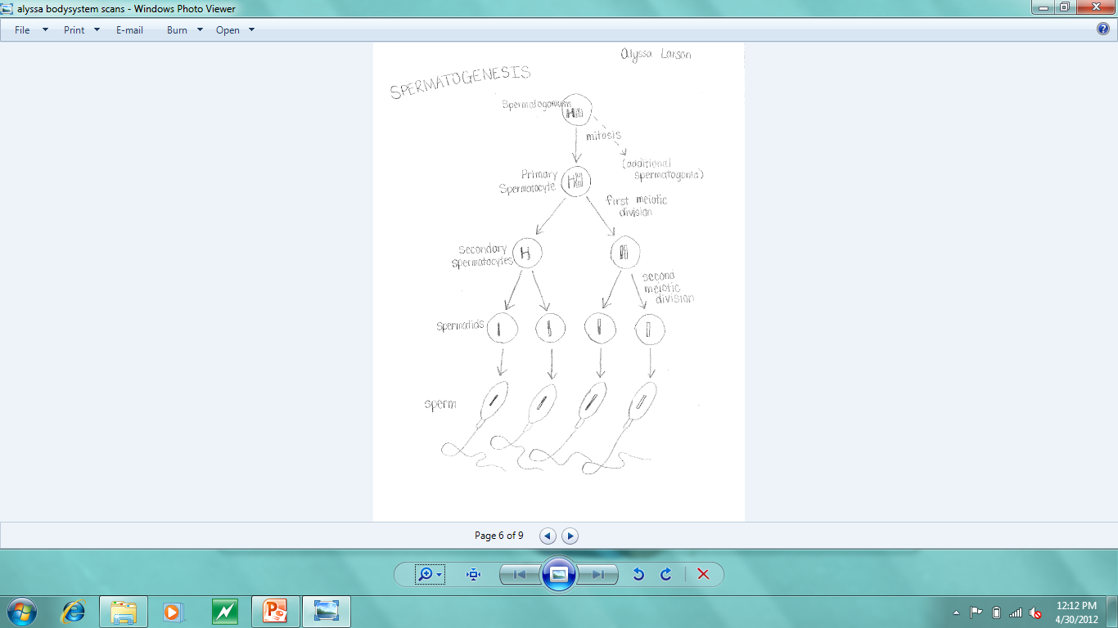
<spermatogenesis drawing>
Reproductive System
17

Slide 25
Oogenesis
Reproductive System
The process of egg cell formation
Early in development, primary oocytes begin to undergo meiosis. The process soon stops and does not continue until puberty
At puberty, some primary oocytes are stimulated to continue mitosis
The resulting cells have 23 chromosomes in their nuclei
Unlike a primary spermatocyte, when a primary oocyte divides, the cytoplasm is distributed unequally
The secondary oocyte, one of the resulting cells, is large
The other resulting cell, the first polar body, is very small
The secondary oocyte represents a future egg cell that can be fertilized. If this happens, the oocyte divides unequally to produce a second polar body and a zygote that can become an embryo
Polar bodies allow for the production of an egg cell with the massive amounts of cytoplasm and abundant organelles, but still with the right number of chromosomes
Also provide food for the oocyte
18

Slide 26
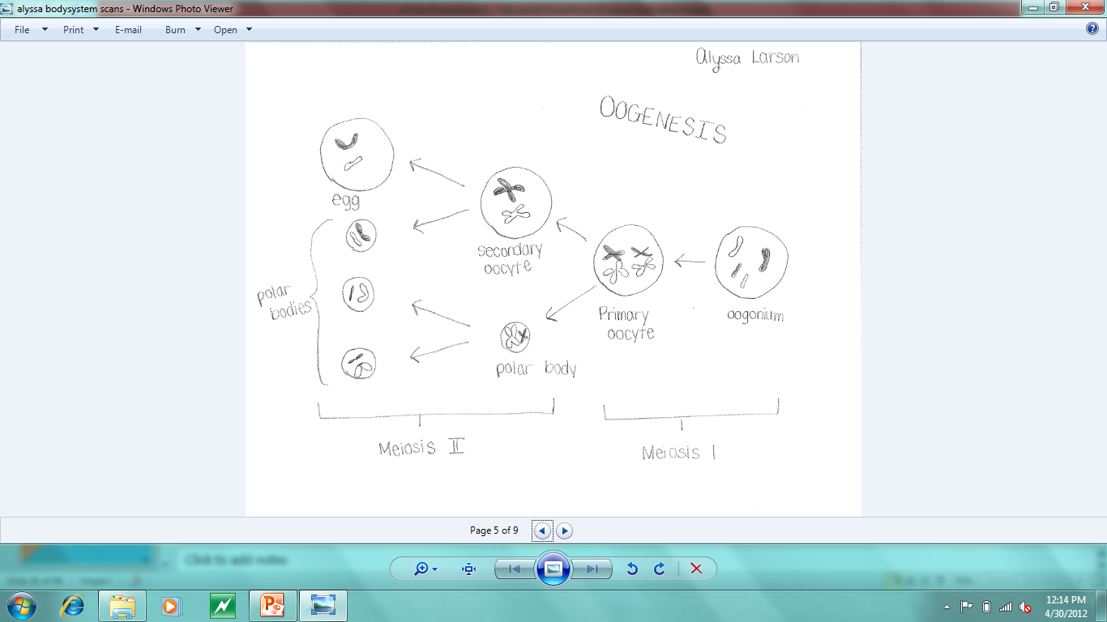
<oogenesis drawing>
Reproductive System
19

Slide 27
Menstrual Cycle Vs. Estrous Cycle
Reproductive System
Menstrual Cycle
Estrous Cycle
Involves menstruation, the shedding of the lining of the uterus accompanied by bleeding
Takes place approximately once a month in women
Starts during puberty and stops at menopause, also stops during pregnancy
Has three phases
Follicular – before egg is released
Ovulatory – egg release
Luteal – after egg is released
The period in the sexual cycle of female mammals (except higher primates including humans) during which they are in heat – ready to accept a male and to mate
One or more estrous periods may occur during the breeding season of a species
Prior to ovulation the uterine lining thickens in preparation for holding the fertilized egg. When this reaches its peak, receptivity is the highest
20

Slide 28
The Menstrual Cycle
Reproductive System
Menstrual cycle refers to the hormonal and reproductive tissue changes that occur in adult female humans and primates during their reproductive years
Menstrual cycles vary in length among different species – a typical length of time is about 30 days
A female can conceive only during a certain time, that is when her ovaries release an egg. This happens once during the menstrual cycle and is a part of the ovarian cycle. The menstrual cycle and ovarian cycle are tightly coordinated.
Menstrual Cycle:
The female’s body prepares for ovulation
The lining of the uterus grows thicker to prepare for implantation
If no implantation occurs, then the body breaks down the endometrium and discharges it through menstruation
21

Slide 29
The Menstrual Cycle
Reproductive System
The menstrual cycle is controlled by hormones
Estrogen and progesterone, produced by the ovaries
Estrogen and progesterone stimulate the formation of the endometrium lining in the uterus
When the amounts of estrogen and progesterone decrease, the lining of the uterus breaks down and causes menstruation
Follicle stimulating hormone (FSH) and lutenizing hormone (LH) produced by the pituitary gland
FSH and LH control and stimulate the unripe eggs in the ovaries to ripen and to be released
The hormones that regulate the menstrual cycle are controlled by negative feedback mechanisms
22

Slide 30
Negative Feedback Mechanism of the Menstrual Cycle
Reproductive System
A negative feedback mechanism is a self-regulating system
Increased output from the system inhibits future production by the system = the system controls how much of a hormone it makes by stopping production when the amount of the hormone gets too high
The feedback mechanism:
The hypothalamus releases a hormone (GnRH) that tells the pituitary gland to produce follicle stimulating hormone (FSH). In turn, FSH tells the ovaries to produce estrogen
High levels of estrogen and progesterone inhibit the production of GnRH, so the pituitary gland will make less FSH, and the ovaries will make less estrogen
23

Slide 31
Development
Reproductive System
After fertilization, cleavage takes place. Cleavage is characterized by a succession of rapid cell divisions during early embryonic development
Becomes a morula, a solid ball that consists of about sixteen cells
The solid ball of cells hollows out and becomes a blastula, a hollow ball of cells
The three germ layers begin to form, and at this time the embryo is called a gastrula.
Gastrulation involes the formation of a 3-layered embryo stage with a blastopore beginning to form. Gastrulation progresses to organogenesis.
During organogenesis, the organs begin the form from the primary germ layers – germ layers are the primitive tissues from which all organs form
The ectoderm, or outermost layer, forms the outer layer of the skin and the nervous system
The mesoderm, or middle layer, forms the muscular system as well as the circulatory system
The endoderm, or innermost layer, forms the digestive and respiratory systems
24

Slide 32
Ovarian Cysts
Reproductive System
Ovarian cysts are fluid-filled sacs or pockets within or on the surface of an ovary
Most ovarian cysts are harmless – some, especially those that have ruptured, sometimes produce serious symptoms
Symptoms:
Menstrual irregularities
Pelvic pain – a constant dull ache, pain before the period begins or just before it ends, pain during intercourse
Pain or pressure on bowels during bowel movements
Nausea, vomiting, or breast tenderness
Frequent urination
Difficulty emptying the bladder completely
25

Slide 33
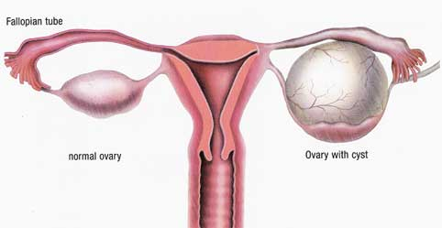
Ovarian Cysts
Reproductive System
Prevalence:
Ovarian cysts can be found in nearly all premonopausal women, though most of them are benign
Found in up to 18% of postmenopausal women
Treatment:
Most go away on their own
May need to be removed by laparoscopy, in which a laparoscope is inserted through a small incision in the abdomen and the ovarian cyst is located and removed
26

Slide 34
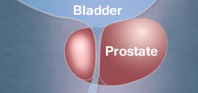
Prostate Gland Enlargement
Reproductive System
Prostate gland enlargement is a very common condition among aging men
It is also called benign prostatic hyperplasia (BPH) and prostatic hypertrophy
When left untreated, a prostate gland enlargement can block the flow of urine out of the bladder and can cause bladder, urinary tract, or kidney problems
The prostate gland closes off the urethra and may cause a change in shape of the urinary bladder
Symptoms tend to worsen over time, and include:
Weak urine stream
Difficulty urinating
Stopping and starting while urinating
Dribbling at the end of urination
Frequent or urgent need to urinate
Not being able to completely empty the bladder
Urinary tract infection
Reduced kidney function
27

Slide 35
Prostate Gland Enlargement
Reproductive System
Prevalence:
50% of men ages 51-60 years have BPH
90% of men over 80 years of age have BPH
Only 25% of 55-year-old men and 50% of 75-year-old men will have bothersome symptoms related to prostatic enlargement
Treatments:
There are several effective treatments for prostate gland enlargement. Treatments are based on symptoms, the size of the prostate, and other health problems that may be present. Common treatments include:
Medication
Lifestyle changes
Surgery
28

Slide 36
Reproductive System Reference Page
Reproductive System
Hole’s Human Anatomy & Physiology Textbook (Chapter 22 – Reproductive System)
Hole’s Human Anatomy & Physiology Testbook (Chapter 23 – Pregnancy, Growth, and Development)
http://www.livestrong.com/article/37137-reproductive-system-functions/
http://biology.about.com/od/genetics/ss/Asexual-Reproduction.htm
http://www2.hu-berlin.de/sexology/ATLAS_EN/html/the_menstrual_cycle.html
http://www.mayoclinic.com/health/ovarian-cysts/DS00129
http://emedicine.medscape.com/article/255865-overview#a0199
http://www.mayoclinic.com/health/prostate-gland-enlargement/DS00027
29

Slide 37
Reference Page (continued)
Reproductive System
Pictures:
http://www.ovariancysttreatmentsite.com/ovarian-cyst-treatment-options
http://www.jalyn.com/understand-bph-symptoms.html
30

Slide 38
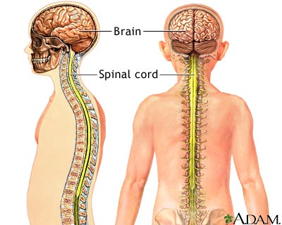
The Nervous System
31

Slide 39
The Nervous System
Nervous System
Functions of the nervous system:
Sends signals from one cell to other cells, or from one part of the body to the others
Sensory neurons receive information from sensory receptors
Neurons transfer and interpret impulses
Motor neurons send appropriate impulses or instructions to muscles or glands
Ultimately, the nervous system allows us to control our bodies by receiving and responding to stimuli
32

Slide 40
Two parts of the Nervous System
Nervous System
Central Nervous System
Peripheral Nervous System
The CNS is made up of the brain and spinal cord
Receives sensory information and controls the body’s responses.
Includes all of the nerves outside of the brain and spinal cord
Sensory division carries information from sensory cells to the CNS
Motor division carries information from the CNS to organs, muscles, and glands (motor)
Other divisions of the PNS include:
Somatic Nervous System – controls muscles under voluntary control (skeletal muscle)
Autonomic Nervous System – controls involuntary muscles (smooth and cardiac muscle)
Sympathetic – activated when the body is under stress
Parasympathetic – controls normal, everyday activities
33

Slide 41
Simple Reflex Arc
Nervous System
Helps an organism avoid injury by providing a means for immediate withdrawal from dangerous stimuli
Can process the rapid, protective response directly in the spinal cord without the need to wait for instructions from the brain
Specialized cells in the skin detect a painful stimulus and relay the information to nerve cells in the spinal cord
The sensory fibers enter the spinal cord and synapse with interneurons within the spinal cord gray matter
The interneurons synapse with motor neurons that control the skeletal muscles
Stimulates muscles to contract and remove the body part from the painful stimulus
34

Slide 42
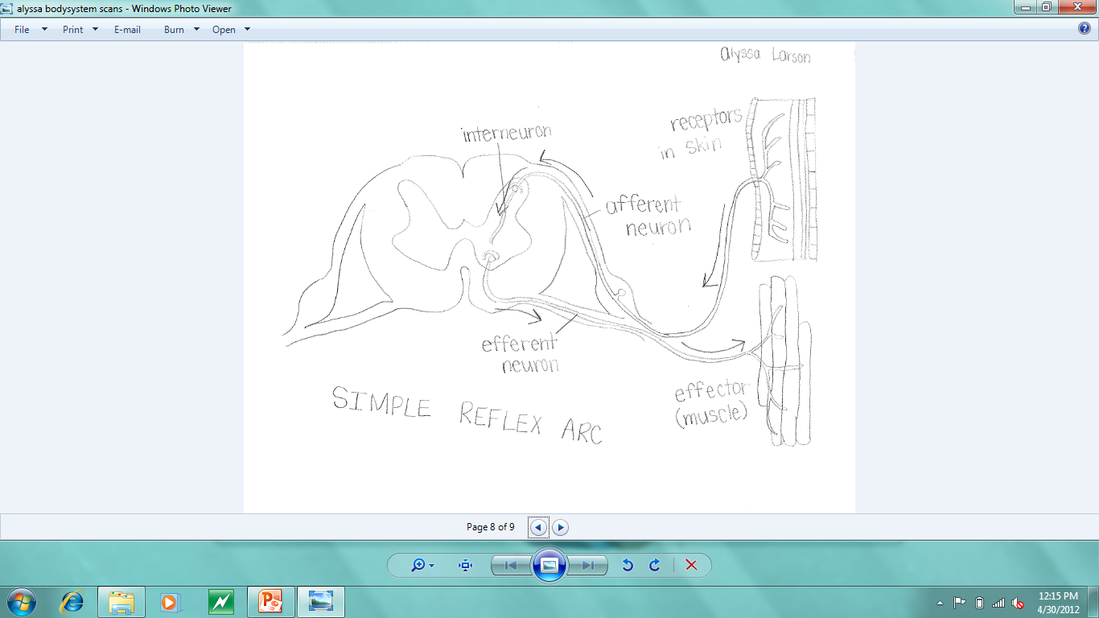
<simple reflex arc drawing>
Nervous System
35

Slide 43
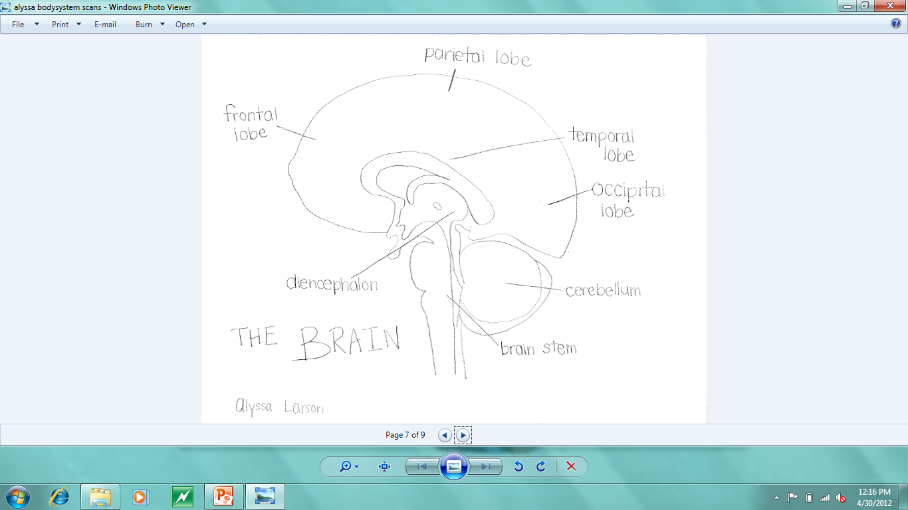
<BRAIN Drawing>
Nervous System
36

Slide 44
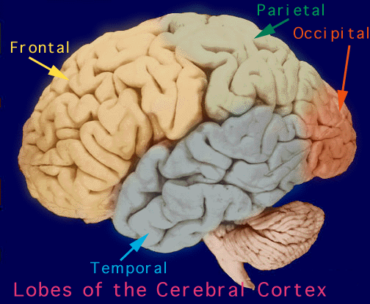
Lobes of the Cerebrum
Nervous System
Frontal lobe – associated with reasoning, planning, parts of speech, movement, emotions, and problem solving
Parietal lobe – associated with movement, orientation, recognition, perception of stimuli
Occipital lobe – associated with visual processing
Temporal lobe – associated with perception and recognition of auditory stimuli, memory, and speech
37

Slide 45
Diencephalon
Nervous System
The diencephalon is the general area in the middle of the brain above the brain stem. It includes the:
Thalamus – channels sensory impulses (except olfactory) into the cerebral cortex for interpretation and channels motor impulses from the cerebral cortex to the brain stem
Hypothalamus – links the nervous and endocrine systems by commanding the pituitary gland, so it indirectly regulates metabolic functions
Limbic system – an interconnected complex lying in various parts of the cerebral cortex, cerebrum, and diencephalon, that allows us to feel emotion
38

Slide 46
Brain Stem
Nervous System
Connects the cerebrum to the spinal cord
Midbrain
contains visual and auditory tracking reflex centers
Pons
relay station for impulses going from the medulla oblongata to the cerebrum, and from the cerebrum to the cerebellum
Medulla oblongata
crosses over sensory and motor impulses, so the left cerebral hemisphere controls the right half of the body and the right cerebral hemisphere controls the left half of the body
control center for vital functions (heart rate, blood pressure, and breathing)
Reticular formation
complex network scattered throughout the brain stem. Stimulates the cerebral cortex into wakefulness – decreased activity leads to sleep, ceased activity leads to coma
Filters 99% of all sensory input as unimportant
39

Slide 47
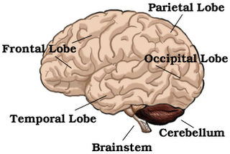
cerebellum
Nervous System
Integrates sensory information on body position and coordinates body movements
Injury leads to loss of muscular coordination and balance
40

Slide 48
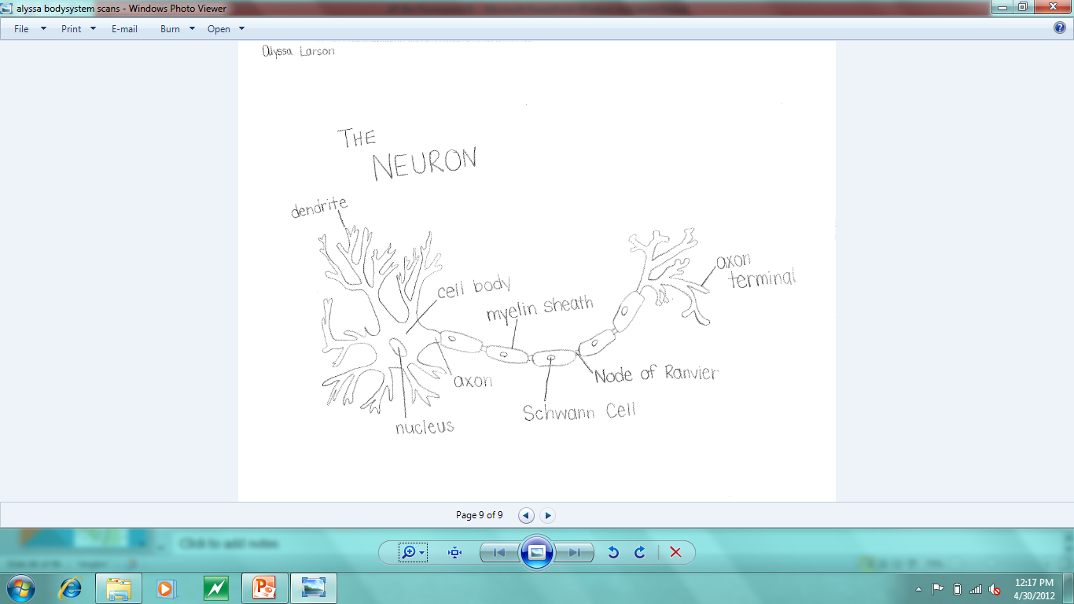
<neuron drawing>
Nervous System
41

Slide 49
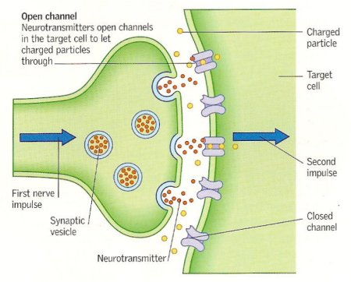
Nerve Impulses and Neurotransmitters
Nervous System
Sensory neuron receives stimulus
The nerve impulse passes from neuron to neuron (or to muscle cell or gland) at synapses
A nerve impulse travels along the axon to the axon terminal
When a nerve impulse reaches a synaptic knob, voltage-sensitive calcium channels open, and calcium diffuses into the cell from the extracellular fluid
The increased calcium concentration inside the cell begins a series of events that cause the synaptic vesicles to fuse with the cell membrane
Cell releases neurotransmitters by exocytosis
42

Slide 50
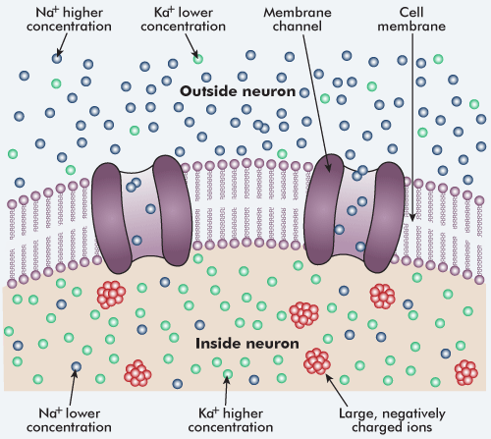
Membrane Potential
Nervous System
A cell membrane is usually electrically charged, or polarized, so that the inside is negatively charged with respect to the outside – creates a membrane potential
Polarization is due to an unequal distribution of positive and negative ions on either side of the membrane
Potassium ions (K+) are the major intracellular cations
Sodium ions (Na+) are the major extracellular cations
Distribution of K+ and Na+ is largely created by the sodium-potassium pump, which actively transports sodium ions out of the cell and potassium ions into the cell
43

Slide 51
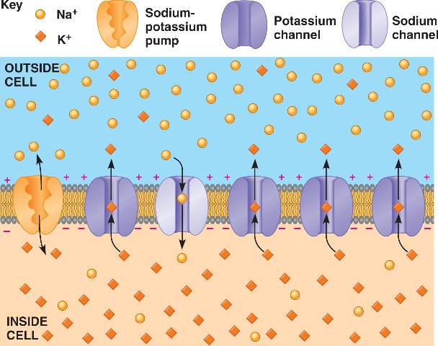
Resting Potential
Nervous System
A resting nerve cell is not being stimulated to send a nerve impulse
Under resting conditions, nongated channels determine the membrane permeability to sodium and potassium ions
A resting cell membrane is only slightly permeable to K+ and Na+, but it is more permeable to K+ than it is to Na+
The resting potential has a value of -70 millivolts, meaning that there is a negative charge on the inside of the cell membrane
The resting potential provides the energy for sending a nerve impulse down an axon
Once the resting potential is established, a few sodium ions and potassium ions continue to diffuse across the cell membrane. The negative membrane potential helps Na+ enter the cell but hinders K+ from leaving the cell
44

Slide 52
Depolarization and Action Potential
Nervous System
An environmental change affects the membrane potential by opening a gated ion channel
If the membrane potential becomes more positive than the resting potential, the membrane is depolarized
The greater the stimulus, the greater the depolarization
If neurons are sufficiently depolarized, the membrane potential reaches a level called the threshold potential, which is approximately -55 millivolts in a neuron
If threshold is reached, an action potential results. An action potential is the basis for a nerve impulse
When threshold potential is reached, sodium channels in the trigger zone open for an instant, briefly increasing sodium permeability
Sodium ions diffuse inward and down the concentration gradient. The membrane potential changes from its resting value and momentarily becomes positive on the inside
45

Slide 53
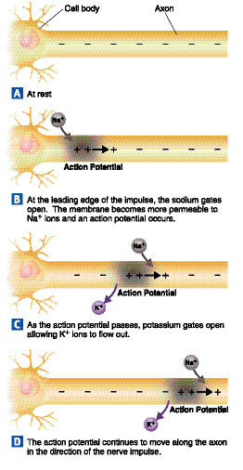
Depolarization and Action Potential
Nervous System
The voltage-gated sodium channels close quickly, and slower voltage-gated potassium channels open and briefly increase potassium permeability
This continues as the nerve impulse moves along the axon
Potassium ions diffuse outward, and the inside of the membrane becomes negative again. The membrane is repolarized
The potassium channels close again and the resting potential is reestablished. It remains in the resting state until it is stimulated again
For a short time following the passage of an impulse, a threshold stimulus will not trigger another impulse on an axon. This period is called the refractory period
46

Slide 54
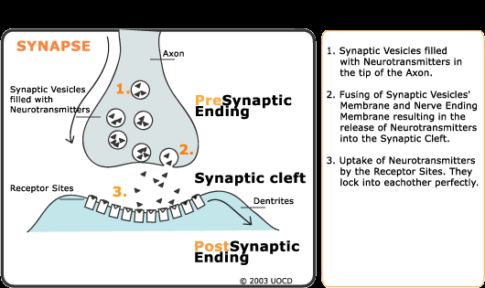
neurotransmitters
Nervous System
Neurotransmitters are released by exocytosis and travel across the synapse to the postsynaptic cell
The action of a neurotransmitter is either:
Excitatory – turning a process on. Causes a muscle to contract or a gland to release secretions
Inhibitory – turning a process off. Causes muscles to cease contraction or a gland to stop releasing secretions
The net effect of the neurotransmitters on a postsynaptic cell depends on the combined effect of the excitatory and inhibitory inputs from as few as one and as many as 100,000 presynaptic neurons
47

Slide 55
Parkinson’s Disease
Nervous System
Progressive disorder of the nervous system that affects movement
Develops gradually, often starting with a barely noticeable tremor in one hand
The exact cause of Parkinson’s disease is unknown
Symptoms:
Tremor
Slowed motion
Rigid muscles
Impaired posture and balance
Loss of automatic movements
Speech changes
Dementia
48

Slide 56
Parkinson’s Disease
Nervous System
Prevalence:
It is estimated that 6.3 million people have Parkinson’s worldwide
Treatment:
There is no cure for Parkinson’s Disease, but medication can be used to treat its symptoms
Surgery may be an option in some cases
49

Slide 57
Migraine Headaches
Nervous System
Severe headache that can cause intense throbbing or pulsing in one area of the head and is often accompanied by many other symptoms
Migraine attacks can cause significant pain for hours to days
Symptoms:
Pain on one side of the head
Pain that is pulsing or throbbing
Sensitivity to light, sounds, and sometimes smells
Nausea and vomiting
Blurred vision
Diarrhea
Lightheadedness, sometimes followed by fainting
50

Slide 58
Migraine Headaches
Nervous System
Prevalence:
About 8.7 million females and 2.6 million males in the US suffer from moderate to severe migraine headaches
3.4 million females and 1.1 million males suffer from one or more attacks per month
Treatment:
Medications can help reduce the frequency and severity of migraines
The right medicines combined with self-help remedies and lifestyle changes may help reduce the frequency and severity of migraine attacks
51

Slide 59
Nervous System Reference Page
Nervous System
Hole’s Human Anatomy & Physiology Textbook (Chapter 10 – Nervous System I)
http://biology.clc.uc.edu/courses/bio105/nervous.htm
http://www.news-medical.net/health/Function-of-the-Nervous-System.aspx
http://biology.about.com/od/organsystems/a/aa061804a.htm
http://www.sumanasinc.com/webcontent/animations/content/reflexarcs.html
http://serendip.brynmawr.edu/bb/kinser/Structure1.html
http://www.mayoclinic.com/health/parkinsons-disease/DS00295
http://www.parkinsonsawareness.eu.com/en/campaign-literature/prevalence-of-parkinsons-disease/
http://www.mayoclinic.com/health/migraine-headache/DS00120
http://jama.ama-assn.org/content/267/1/64.short
52

Slide 60
Reference Page (continued)
Nervous System
Pictures:
http://questgarden.com/123/16/6/110402141826/process.htm
http://www.brainharmonycenter.com/brain-diagrams.html
http://serendip.brynmawr.edu/bb/kinser/Structure1.html
http://www.daviddarling.info/encyclopedia/N/neurotransmitter.html
http://tle.westone.wa.gov.au/content/file/969144ed-0d3b-fa04-2e88-8b23de2a630c/1/human_bio_science_3b.zip/content/002_nervous_control/page_10.htm
http://bio1152.nicerweb.com/Locked/media/ch48/resting_potential.html
http://www.millerandlevine.com/chapter/35/898-899-rewrite.html
http://understanding_ocd.tripod.com/ocd_neurons_serotonin.html
53

Slide 61
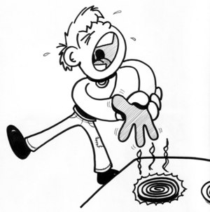
The Senses System
54

Slide 62
Mechanoreceptors
Detect changes in pressure, position, or acceleration
Specifically respond to mechanical energy, or movement
Include receptors for touch, stretch, hearing, and equilibrium
Most human mechanoreceptor cells respond to a change in external stimuli (pressure, temperature, etc.) by producing voltage pulses across neurons
Found in:
Hair cells of the inner ear
Stretch receptors within muscles
Skin
Bladder and parts of the alimentary canal (detect pressure)
55

Slide 63
Thermoreceptors
Senses System
Specialized to detect changes in temperature
Generally detect temperature variations within normal range
Help with the regulation of internal body temperature
Found in:
Skin, where they provide the brain with information about the environmental temperature
Inside the body, where they help keep the body’s temperature in balance
56

Slide 64
Chemoreceptors
Senses System
Designed to respond to chemical stimuli - detect ions or molecules
Chemoreceptors allow us to sense smell and taste
There are direct and distant chemoreceptors – all play important roles in bodily function and daily life
Found in:
Tongue – sense salty, sweet, sour, and bitter tastes
Carotid body – located at the branch of the carotid artery
Detect levels of oxygen and carbon dioxide in the blood to determine when a person needs to breathe
Nose – sense smells and detect hormones
Brain – monitor pH and alert the brain to the presence of chemicals that could indicate a problem
57

Slide 65
Photoreceptors
Senses System
Nerve cells that are sensitive to light
Three types
Rods
Cones
Ganglion cells
When a photoreceptor is exposed to light, photosensitive proteins are stimulated, triggering a series of responses which convert the light into a signal that can be read by the brain
Photoreceptors provide constant information to the brain about the visual environment
Located in the eye
58

Slide 66
Pain Receptors
Senses System
Detect severe heat and pressure
Detect chemicals released by inflamed tissue
Activated in response to a painful stimulus, usually involving tissue damage
Once activated, they release neurotransmitters to send information to the brain
Pain receptors found in tissues are called nociceptors
Found on free nerve endings located in many tissues throughout the body, including:
Skin
Muscles
Joints
Connective tissues
Internal organs
59

Slide 67
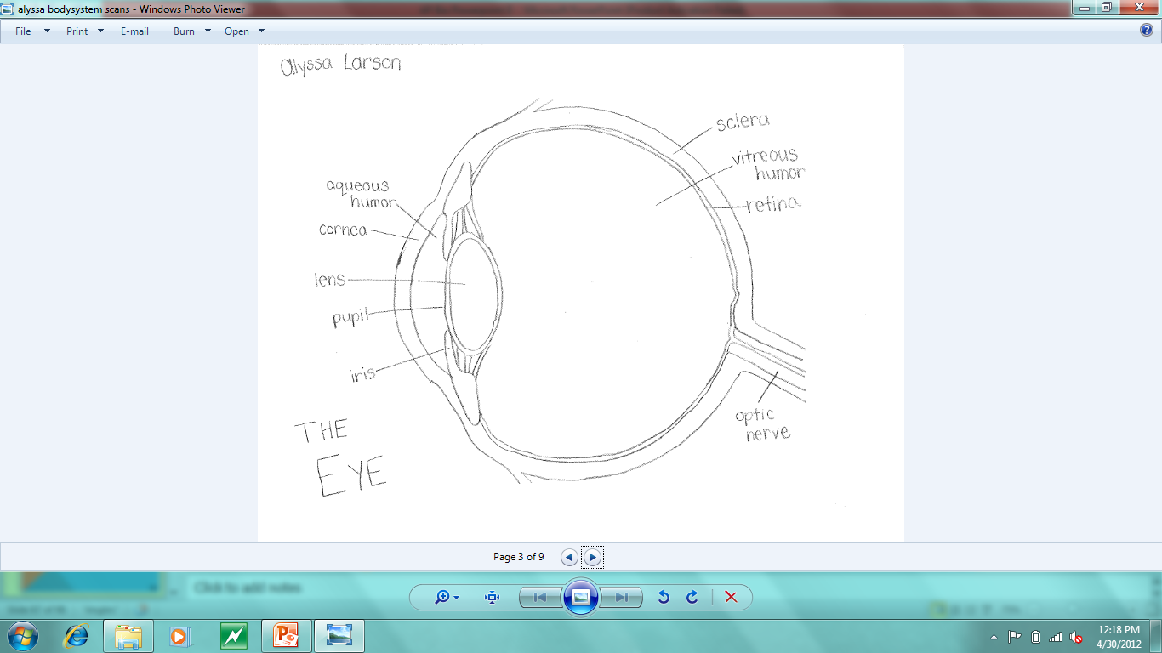
<picture of the eye>
Senses System
60

Slide 68
Rhodopsin and Cell Signaling
Senses System
Rhodopsin is a membrane protein in the retina of the eye
Located in the disc membranes of the rod outer segments
Pigment that allows us to see dim light
Exposure to light causes rhodopsin’s shape to change. The structure of the protein is changed, activating rhodopsin
Many different neurotransmitters, hormones, and drugs produce their intracellular signaling through the mediation of various G-protein coupled receptors. The binding of a hormone or neurotransmitter causes a change in the structure of the receptor which then activates the G-protein
So what?
Rhodopsin is a G-protein binding receptor. It activates a G-protein, which may stimulate the opening of K+ channels (in heart cells) or participates as a part of the signaling system
61

Slide 69
Senses System Reference Page
Senses System
http://faculty.clintoncc.suny.edu/faculty/michael.gregory/files/bio%20102/bio%20102%20lectures/sensory%20systems/sensory.htm
http://www.stanford.edu/class/me220/data/lectures/lect01/mechanorec.html
http://www.bookrags.com/research/mechanoreceptors-wap/
http://www.wisegeek.com/what-are-thermoreceptors.htm
http://www.wisegeek.com/what-are-chemoreceptors.htm
http://www.wisegeek.com/what-is-a-photoreceptor.htm
http://www.wisegeek.com/what-are-pain-receptors.htm
http://lecerveau.mcgill.ca/flash/capsules/articles_pdf/rhodopsin.pdf
Pictures:
http://thekillerj.wordpress.com/2010/04/08/jiu-jitsu-technique-checkers/
62

Slide 70
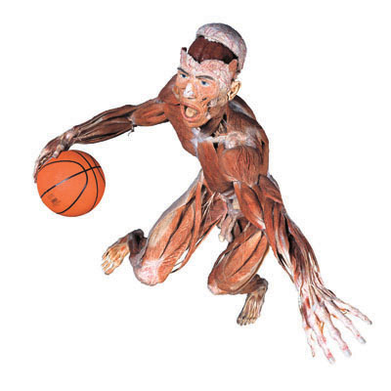
The Muscular System
63

Slide 71
Functions of the Muscular System
Muscular System
Three types of muscle tissue
Skeletal muscle
Gives us the ability to have voluntary gross and fine movements (gross movements include large movements like the ones involved in walking, while fine movements include fine motor skills such as writing and talking)
Skeletal muscles contract as a reflex to stimuli, such as pulling your hand away from a hot surface
Smooth muscle
Smooth muscles are found in the walls of the stomach and intestines. They aid digestion and help move food along the digestive tract
Smooth muscle contractions are involuntary and characterized by slow movements
Cardiac muscle
Cardiac muscle forms the walls of the heart
Contraction is involuntary and controlled by the heart’s own electrical system
Responsible for receiving blood and pumping it to the lungs and to the rest of the body
64

Slide 72
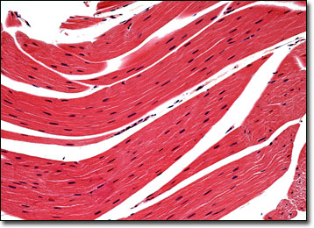
Skeletal Muscle
Muscular System
Skeletal muscle is striated, meaning the muscle fibers contain alternating light and dark bands (striations)
Striations run perpendicular to the direction of the fibers
Actin filaments make up the light bands (I-bands)
Myosin filaments make up the dark bands (A-bands)
Skeletal muscle tissue is highly organized, and each cell contains multiple nuclei
Not all skeletal muscle fibers have the same structure, because they don’t all have the same function
They vary in color, which is dependent on the amount of myoglobin in the muscle tissue
They contract with different velocities
65

Slide 73
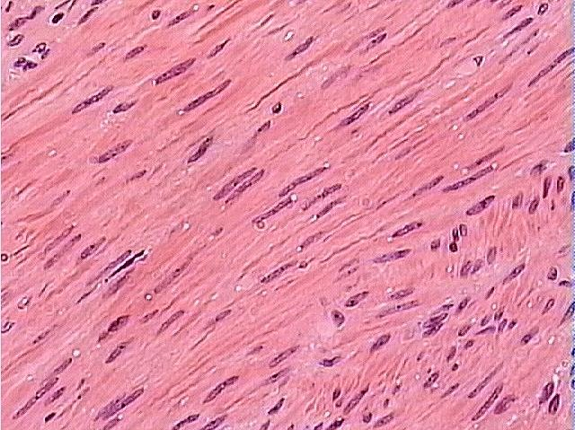
Smooth Muscle
Muscular System
Thin, elongated muscle cells
Each muscle has a single nucleus
Smooth muscle tissue is not as organized as skeletal muscle tissue. They are not arranged in a definite striated pattern
Smooth muscle fibers interlace to form layers of muscle tissue rather than bundles
66

Slide 74
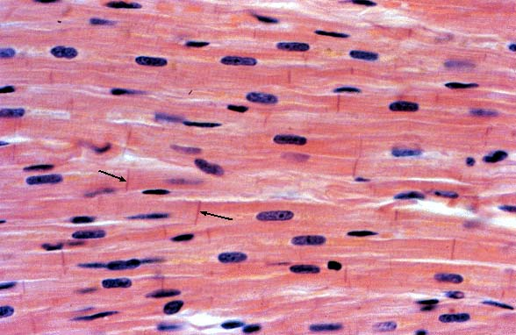
Cardiac Muscle
Muscular System
Like skeletal muscle tissue:
cardiac muscle tissue is striated
Each cell contains multiple nuclei
Cardiac muscle cells are shorter than skeletal muscle fibers, and the striations are not as obvious as the ones seen in skeletal muscle
Have intercalated disks to connect muscle fibers
Because of this, cardiac muscle cannot cramp
67

Slide 75
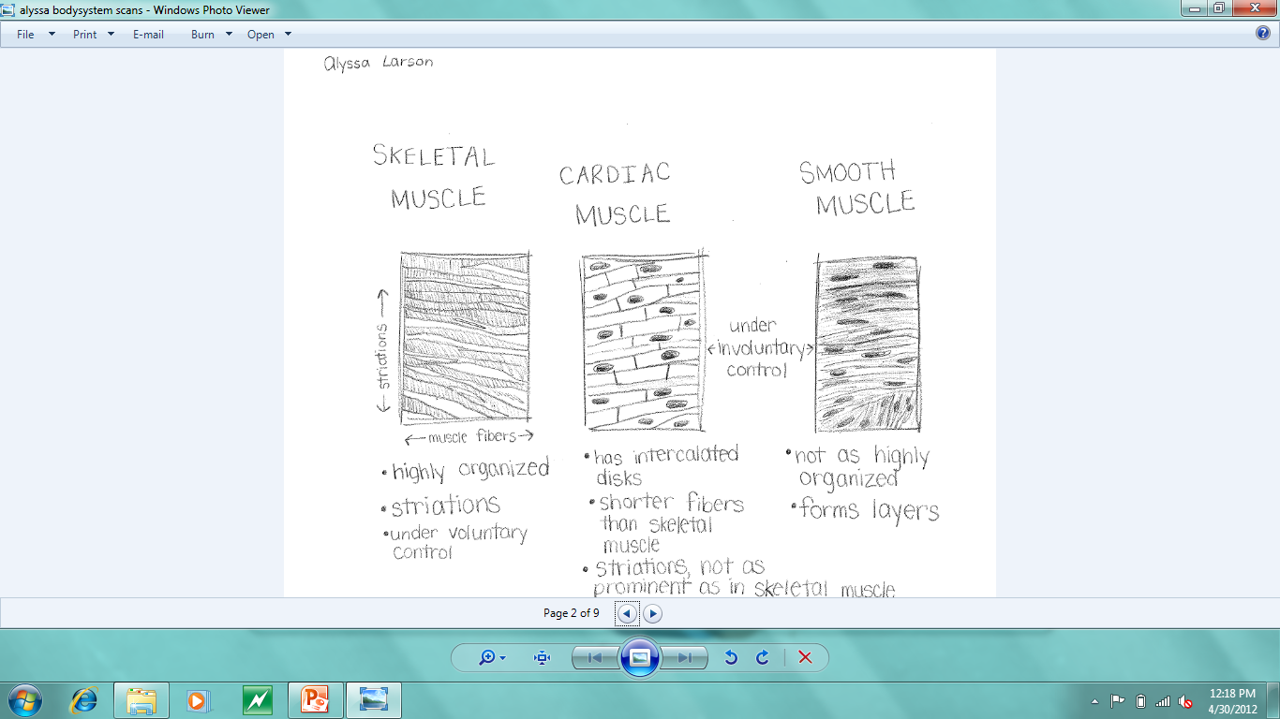
<muscle tissues drawing>
Muscular System
68

Slide 76
Muscular System
69

Slide 77
The Sliding Filament Theory
Muscular System
The sliding filament theory explains how skeletal muscles contract
Six main steps:
Influx of calcium triggers the exposure of binding sites on actin
Myosin binds to actin
The power stroke of the cross bridges causes the sliding of the thin filaments
ATP binds to the cross bridge, and the cross bridge disconnects from actin
Hydrolysis of ATP leads to re-energyzing and repositioning of the cross bridge
Calcium ions are transported back into the sarcoplasmic reticulum
70

Slide 78
The Sliding Filament Theory – Step 1
Muscular System
Acetylcholine, a neurotransmitter, crosses the neuromuscular junction and binds to an acetylcholine receptor site
Acetylcholine causes calcium pumps to pump calcium ions out of the sarcoplasmic reticulum, where they have been heavily concentrated
Calcium triggers the exposure of binding sites on actin
71

Slide 79
The Sliding Filament Theory – Steps 2 & 3
Muscular System
Once calcium has exposed the binding sites of actin, myosin and actin come into contact and bind together, forming myosin crossbridges
At this point, myosin is in a high-energy state
The binding of actin and myosin causes myosin (thick filaments) to pull actin (thin filaments), causing sliding of actin and myosin filaments
Actin and myosin will remain bound together in this state unless they are pulled apart
During this step, the shape of the myosin head changes, causing the ADP + Pi that has remained attached to the myosin head to fall out. This allows more ATP to bind to myosin
72

Slide 80
The Sliding Filament Theory – Steps 4 & 5
Muscular System
At this time, myosin is in a low-energy state
There is a low supply of ATP, and myosin needs more ATP in order to have another power stroke
The absence of ATP prevents myosin from remaining attached to actin. As a result, the myosin head falls off the actin
When the ATP is attached to the myosin head, the ATP must be hydrolyzed in order to provide energy. Once the ATP is hydrolyzed, the products (ADP + Pi) remain in the ATP-binding site
Causes myosin to be in a high-energy state once again
73

Slide 81
The Sliding Filament Theory – Step 6
Muscular System
During the final step of muscle contraction, calcium ions are actively pumped back into the sarcoplasmic reticulum
When another impulse arrives from the nervous system, calcium ions will once again leave the sarcoplasmic reticulum and start the cycle again
Also, acetylcholine is broken down by the enzyme acetylcholinesterase
Muscle fibers relax
74

Slide 82
Duchenne Muscular Dystrophy
Muscular System
A genetic disease in which muscle fibers are unusually susceptible to damage due to the absence of the muscle protein dystrophin
Muscles burst upon contraction and die
Muscle tissue is progressively replaced with scar tissue, causing death
Occurs only in boys during late childhood or early puberty
Signs and Symptoms:
Frequent falls
Difficulty getting up from a sitting position
Trouble running and jumping
Waddling
Large calf muscles
Learning disabilities
75

Slide 83
Duchenne Muscular Dystrophy
Muscular System
Prevalence:
Approximately 1 in 6,000 people in the US have Duchenne Muscular Dystrophy
Equal to 02% of the US population, or about 45,000 people
There is no cure for Duchenne Muscular Dystrophy, but medications and therapy can slow the course of the disease
76

Slide 84
Chronic Compartment Syndrome
Muscular System
Chronic compartment syndrome is an exercise-induced condition that causes pain, swelling, and sometimes even disability in affected muscles (usually the lower leg)
Anyone can develop chronic compartment syndrome
Most common in athletes who participate in sports that involve repetitive movements such as running
Caused by a high amount of pressure within a muscle compartment, which is surrounded by a thick layer of inelastic fascia
As pressure builds up, nerves and blood vessels are compressed. Blood flow decreases, and nerve and muscle tissues may sustain damage or die
77

Slide 85
Chronic Compartment Syndrome
Muscular System
Symptoms:
Aching, burning, or cramping pain in the affected limb
Tightness
Numbness or tingling in the affected limb
Weakness
Swelling or bulging as a result of a muscle hernia
The prevalence of chronic compartment syndrome is unknown, because it is likely that affected people restrict activity due to pain caused by compartment syndrome and do not seek medical attention
Treatment:
Conservative treatments sometimes help with chronic compartment syndrome
If conservative treatments fail, surgery is usually successful
78

Slide 86
Muscular System Reference Page
Muscular System
http://www.livestrong.com/article/114706-five-functions-muscular-system/
http://www.brianmac.co.uk/muscle.htm
http://faculty.stcc.edu/AandP/AP/AP1pages/Units5to9/unit8/sliding.htm
http://www.mayoclinic.com/health/muscular-dystrophy/DS00200/DSECTION=symptoms
http://www.uptodate.com/contents/chronic-exertional-compartment-syndrome
79

Slide 87
Reference Page (continued)
Muscular System
Pictures:
http://msjensen.cehd.umn.edu/webanatomy/muscular/
http://micro.magnet.fsu.edu/primer/anatomy/brightfieldgallery/frogstriatedmusclesmall.html
http://www.proprofs.com/flashcards/cardshowall.php?title=bio-2-quiz-1
http://biologyonline.us/Online%20Human%20Biology/HB%20Lab/HB%20Lab%205/28.htm
80

Slide 88
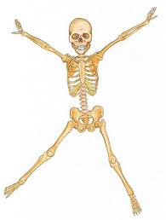
The Skeletal System
81

Slide 89
Functions of the Skeletal System
Skeletal System
Support
Provides structural support for entire body
Protection
Surrounds soft tissue (rib cage, skull)
Movement
Skeletal muscles are attached to bones, allowing for movement
Storage of minerals and fat
Yellow marrow stores fat
Storage of calcium and phosphorus
Blood cell production
Red bone marrow manufactures red and white blood cells
82

Slide 90
Roles of Bones, Ligaments, Muscles, and Tendons in Human Movement
Skeletal System
Bones
Bones fit together at joints, allowing for movement
Bones and muscles together create a lever system. They can be classified as first, second, or third class levers
Muscles
Muscles provide the power to move the bones. They are responsible for flexing and extending joints, as well as other movements such as abduction and adduction
Ligaments
Ligaments connect bones together. They are responsible for holding joints together
Tendons
Tendons attach muscles to bones. Without tendons, muscles wouldn’t be able to pull and move bones
83

Slide 91
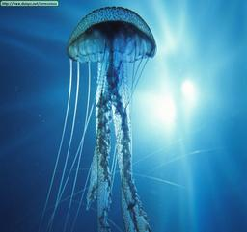
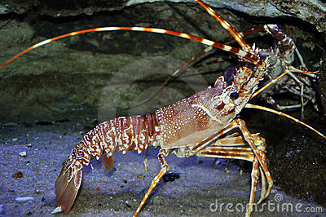
Types of Skeletons
Skeletal System
Hydrostatic skeleton
Found in soft-bodied and cold-blooded animals
Has a coelom surrounded by muscles
Includes annelids and cnidarians
Exoskeleton
Skeleton found outside of the body, forms an outer protective covering
Animals with an exoskeleton are relatively small
Found in crustaceans, including crabs and insects
Endoskeleton
Skeleton found inside the body, forms the framework of an animal
Tissues and muscles are formed around the skeletal system, muscular forces are transmitted to the skeleton
Includes mammals, fish, and birds
84

Slide 92
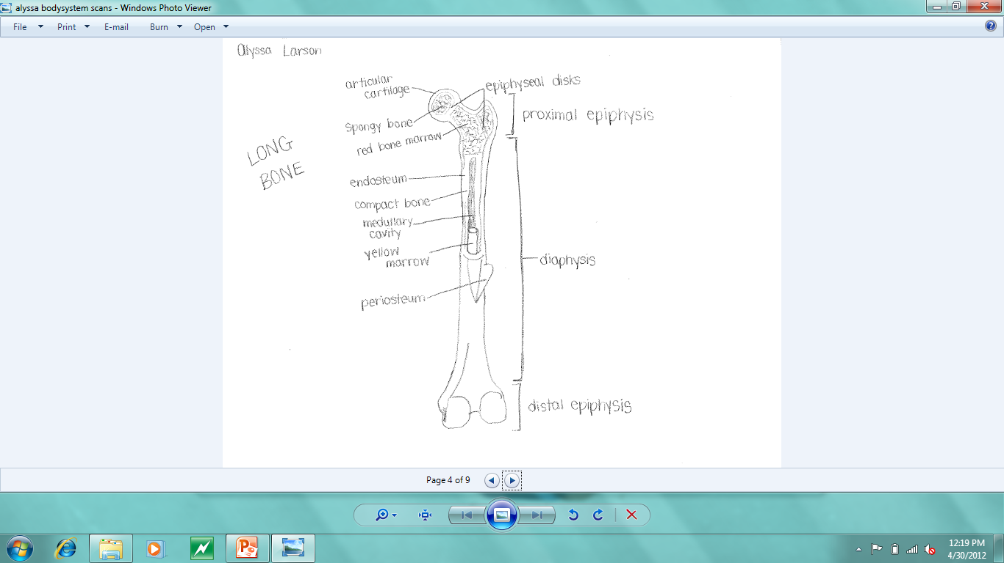
Picture of the long bone
Skeletal System
85

Slide 93
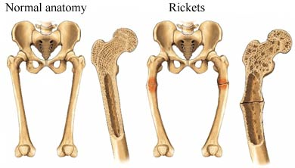
Rickets
Skeletal System
Rickets is the softening and weakening of bones in children, usually caused by an extreme and prolonged vitamin D deficiency
Without vitamin D, calcium and phosphorus are not absorbed and are not deposited in bones, causing weakness and bending of the bones
Signs and Symptoms:
Delayed growth
Pain in the spine, pelvis, and legs
Muscle weakness
Bowed legs
Abnormally curved spine
86

Slide 94
Rickets
Skeletal System
Prevalence:
In 1998 in eastern Turkey, the incidence of rickets was 6.09% in children ages 0-3 years
Treatment:
Adding vitamin D and calcium to the diet usually corrects bone problems
Some skeletal deformities caused by rickets may need corrective surgery
87

Slide 95
Osteoporosis
Skeletal System
Osteoporosis causes bones to become weak and brittle
Bones are likely to fracture. Fractures commonly occur in the hip, wrist, or spine
Occurs when the creation of new bone doesn’t keep up with the renewal of old bone. Results in a loss of bone mass
Affects men and women of all races, but white and Asian women who are past menopause are at the greatest risk
Signs and Symptoms:
Back pain
Loss of height over time
Stooped posture
A bone fracture that occurs more easily than expected
88

Slide 96
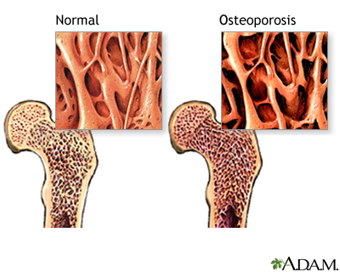
Osteoporosis
Skeletal System
Prevalence:
Estimated to be a major health threat for almost 44 million U.S. women and men aged 50 and older
By 2010, it is estimated that more than 52 million women and men aged 50 and over will be affected
Treatment:
Medications, dietary supplements, and weight-bearing exercise can help to strengthen bones
89

Slide 97
Skeletal System Reference Page
Skeletal System
http://quizlet.com/427227/6-primary-functions-of-skeletal-system-flash-cards/
http://ibbiology.wetpaint.com/page/Outline+the+roles+of+bones,+ligaments,+muscles,+tendons+%26+nerves+in+movement
http://sciencefairlady.hubpages.com/hub/What-are-the-Three-Types-of-Skeletons
http://www.mayoclinic.com/health/rickets/DS00813/DSECTION=symptoms
http://www.springerlink.com/content/5p1q726j52724706/
http://www.mayoclinic.com/health/osteoporosis/DS00128
http://www.nof.org/advocacy/resources/prevalencereport
90

Slide 98
Reference Page (continued)
Skeletal System
Pictures:
http://biologyataglance.wikispaces.com/Controlling+life
http://www.dreamstime.com/stock-image-lobster-image8417191
http://animals.nationalgeographic.com/animals/mammals/red-fox/
http://www.nlm.nih.gov/medlineplus/ency/imagepages/17156.htm
http://www.empowher.com/condition/rickets
91

