Slide 1
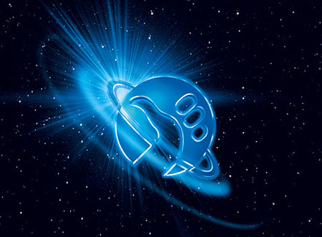
Hitchhiker’s Guide to the Excretory System
Bryce Tappan

Slide 2
Function of the Excretory System
The excretory system rids the body of waste and excess materials. There are many different waste products created within the body, and the excretory system deals with all of them.

Slide 3
Nitrogenous Wastes
The three types of nitrogenous wastes in living organisms are ammonia, uric acid and urea. Corresponding to these are the types of organisms that excrete each waste. There are ammoniotelic organisms, uricotelic organisms, and ureotelic organisms respectively.
http://www.biology-questions-and-answers.com/the-excretory-system.html

Slide 4
Animal Groups
Many aquatic animals, like crustaceans, are ammoniotelic because ammonia can diffuse easily through membranes and dissolves well in water.
http://www.biology-questions-and-answers.com/the-excretory-system.html

Slide 5
Animal Groups
Animals that excrete excess nitrogen in the form of urea are ureotelic. Many terrestrial animals are ureotelic because they do are not surrounded by water that is readily available to absorb ammonia, so they excrete the ammonia in a less toxic form called urea. Urea is released through urinating.
http://www.pinkmonkey.com/studyguides/subjects/biology-edited/chap19/b1919101.asp

Slide 6
Animal Groups
Most birds, insects and reptiles are uricotelic. Like other terrestrial animals, they convert ammonia to a less toxic form before excreting it, but the convert it to uric acid, not urea. Uric acid can be excreted from an organism using a small amount of water.
http://www.pinkmonkey.com/studyguides/subjects/biology-edited/chap19/b1919101.asp

Slide 7
Nephrons: Filtration
The nephron is a tiny filtering structure in your kidneys. They rid your blood of waste while replenishing it with nutrients. Blood runs through the glomerular capillaries in the nephrons where wastes strained out of the blood.
http://science.howstuffworks.com/environmental/life/human-biology/kidney2.htm

Slide 8
Excretory System Disorders
Nephrotic Syndrome
Nephrotic syndrome is caused by different disorders that damage the kidneys. This damage leads to the release of too much protein in the urine.
Swelling of the face, arms and legs, foamy urine, weight gain and loss of appetite are all symptoms of nephrotic syndrome.
In children, it is most common between ages 2 and 6. It occurs slightly more often in males than females.
Keep the blood pressure low, use corticosteroids, keep cholesterol levels low, vitamin D supplements.
http://www.ncbi.nlm.nih.gov/pubmedhealth/PMH0001520/

Slide 9
Excretory System Disorders
Urinary Tract Infection
a) A Urinary Tract Infection, (UTI) is the infection of the bladder and the urethra.
b) The symptoms of UTI include difficult and painful urination, abdominal pain, and fever. Sometimes even blood can be urinated.
c) UTI’s are rather common, especially in women
d) UTI’s can be treated with the use of antibiotics and drinking plenty of fluids.
http://health-conditions.factoidz.com/some-of-the-most-common-excretory-system-diseases/

