Slide 1
Hitchhiker’s Guide to the Respiratory System
Bryce Tappan

Slide 2
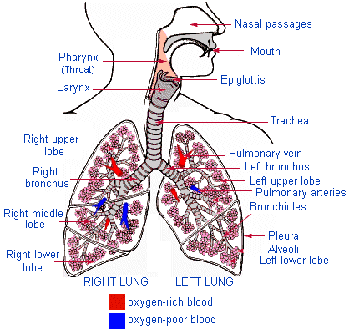
Function of the Respiratory System
The main purpose of the respiratory system is to provide the body with oxygen and to release CO2.
http://webschoolsolutions.com/patts/systems/lungs.htm

Slide 3
Alveoli
Gas exchange of oxygen and carbon dioxide takes place in the alveoli. Inhaled gas diffuses through capillaries in the alveoli to red blood cells. Alveoli’s structure serve their function well in that:
-They have thin walls
-They have a large surface area in comparison with their volume
-Gases can diffuse through the walls and dissolve into the fluids within. -They are in close proximity with capillaries, so the oxygen is absorbed easily.
http://www.curoservice.com/parents_visitors/lungs_circulation/structure_alveoli.asp

Slide 4
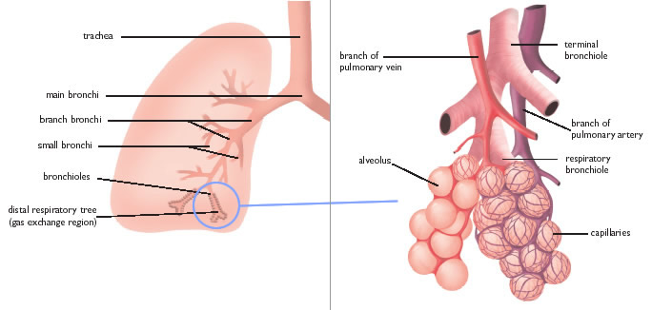
Alveoli
http://www.curoservice.com/parents_visitors/lungs_circulation/structure_alveoli.asp

Slide 5
Gas Transport
To begin with, gases are brought into the body through inhaling, the first step in ventilation. When you inhale, the oxygen fills the alveoli, which are surrounded by capillary veins. The oxygen diffuses from the alveoli to the capillaries and is absorbed by red blood cells. At the same time, CO2 diffuses back out through the capillaries to be exhaled. The oxygen-high blood then travels through the body to where it is needed.
http://www.biologyreference.com/Re-Se/Respiration.html#b

Slide 6
The path of oxygen
Oxygen starts out in the atmosphere until it is taken into the body by inhaling. It then goes down the larynx and the trachea until it enters the chest cavity. The trachea branches into two tubes called the bronchi, which then split into even smaller bronchial tubes. These tubes deposit the oxygen into the lungs and fill the small sacs that are the alveoli. From there, the oxygen diffuses into the capillaries and is picked up by red blood cells.
http://www.fi.edu/learn/heart/systems/respiration.html

Slide 7
Inhalation/Exhalation
The diaphragm allows us to inhale by creating a difference in air pressure within our lungs from the outside world. To inhale, the diaphragm pulls down and the lungs expand into the new space. Also, as the lungs take in more air, the diaphragm gets forced further down. This means that the lungs have a greater volume while breathing in, and the pressure difference is created. The pressure difference causes air to flow into the lungs from the outside, and oxygen can then be obtained. To exhale, the diaphragm relaxes back to its original position and the volume of the lungs is forced to decrease, which in turn forces air back out into the atmosphere.
http://en.wikipedia.org/wiki/Inhalation
http://en.wikipedia.org/wiki/Exhalation

Slide 8
Diseases/Disorders
COPD (Chronic obstructive pulmonary disease)
COPD is a general term for diseases that make it difficult to breathe, which includes bronchitis and emphysema.
Coughing, fatigue, numerous infections, shortness of breath
COPD is one of the most prevalent lung diseases, and is quite common among smokers
For smokers, the best treatment is to stop smoking. For others, inhalers, oxygen treatments, and preemptive measures can be used to treat COPD.
http://www.ncbi.nlm.nih.gov/pubmedhealth/PMH0001153/

Slide 9
Diseases/Disorders
Pneumonia
a) Pneumonia is the infection of the lungs by bacteria or viruses.
b) Coughing, fevers, chills, headaches, and shortness of breath are all symptoms. Pneumonia can be fatal
c) Pneumonia is a common illness that affects millions of people each year in the United States, but because we know how to treat and prevent it, it is not as common as it has been in the past.
d) Antibiotics can sometimes be used to combat bacterial infections. Also, oxygen therapy and fluids can be important in treating pneumonia.
http://www.ncbi.nlm.nih.gov/pubmedhealth/PMH0001200/

Slide 10
