Slide 1
Circulatory System
Douglas Todey

Slide 2
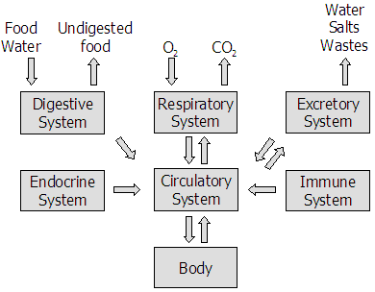
Functions
The circulatory system provides a transport system. It transports gases, nutrients to cells and waste away from cells and transports hormones
It stabilizes pH and ionic
concentration of bodily
fluids
It maintains body
temperature by
transporting heat

Slide 3
Arteries, Capillaries, and Veins
Arteries
They have a thick elastic layer allowing them to stretch and bend in response to blood pumping from the heart
Capillaries
Capillaries are the smallest blood vessel. They are so small that blood cells have to travel single file
They have very thin membranes around them, allowing an easy exchange of interstitial fluid with cells
Veins
Veins move blood back to the heart
Smooth muscle in the walls of the vein expand and contract to adjust for blood flow to the heart

Slide 4
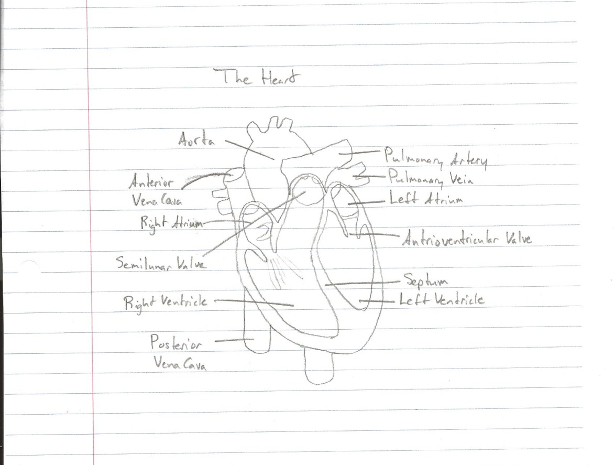
The Heart

Slide 5
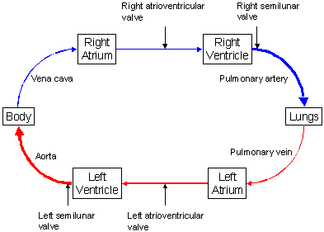
The Heart
Pulmonary Circulation
Deoxygenated blood enters the right atrium through the superior vena cava and the inferior vena cava
From the right atrium, the blood drains into the right ventricle through the right atrioventricular valve
When the right ventricle
contracts, the blood is forced
pulmonary semilunar valve and
into the pulmonary artery
The pulmonary artery carries
the deoxygenated blood into the
lungs where it becomes
oxygenated

Slide 6
The Heart
Systemic Circulation
Oxygenated blood is carried from the lungs to the heart by pulmonary veins
The pulmonary veins enter the left atrium
When it relaxes, the blood the left ventricle via the left
atrioventricular valve
The heart then squeezes the
blood is pumped into the
body’s main artery, the aorta,
through the aortic semilunar
valve
The aorta branches into other
arteries and sends blood
throughout the body

Slide 7
Blood
Human blood has two parts: plasma and cells
Plasma
Plasma contains many things including dissolved gases, nutrients, wastes, salts, and proteins
Erythrocytes
These are red blood cells that are filled with hemoglobin
Leukocytes
These are white blood cells that are part of the immune system and are used to fight infections
Platelets
These are pieces of larger cells that have been produced in bone marrow that assist in forming clots

Slide 8
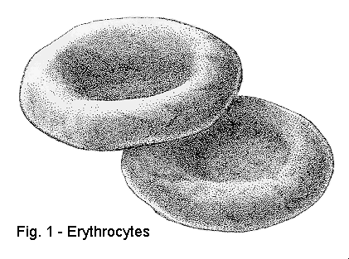
Erythrocytes
Red blood cells move
oxygen through the
blood from the lungs
to the cells
The biconcave shape
allows for maximum surface area to cytoplasmic
volume ratio
It then allows for an efficient diffusion of oxygen from the red blood cells to the cells of the body

Slide 9
Circulatory Systems
Open System – Example: Arthropods and most mollusks
The blood is pumped from the heart through the blood vessels but then it leaves the blood vessels and enters body cavities where the blood surrounds the organs
Blood flows slowly and the organism must move its muscles to move the blood in the body cavity
Closed System – Example: Vertebrates
The blood is not floating free in a cavity but is contained within blood vessels

Slide 10
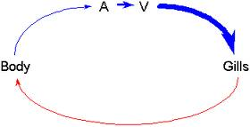
Vertebrate Circulatory System
Fish
Fish have a heart with one atrium
and one ventricle
The gills have many capillaries for maximum gas exchange so there is low blood pressure
The body has many capillaries as well so blood pressure stays low in the body
The blood then goes through the heart and is under high pressure to get it back through the gills to oxidize it

Slide 11
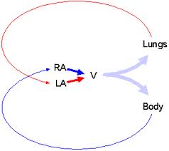
Vertebrate Circulatory System
Amphibians
Amphibians have a three chambered
heart with two atria and one ventricle
Blood from the lungs goes to the left
atrium and blood from the body goes
to the right atrium
Both atria empty into the ventricle where mixing occurs
The advantage of this system is that there is high pressure in vessels that lead to both the lungs and body.

Slide 12
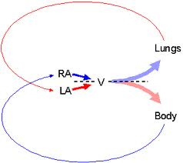
Vertebrate Circulatory System
Reptiles
In most reptiles, the ventricle is
partly divided, reducing the mixing
of oxygenated and deoxygenated
blood
Blood from the lungs goes to the left
atrium and blood from the body goes
to the right atrium
Both atria empty into the ventricle where oxygenated blood goes to the body and deoxygenated blood goes to the lungs

Slide 13
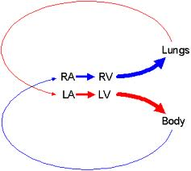
Vertebrate Circulatory System
Mammals and birds
Birds and mammals have a four
chambered heart that acts as two
separate pumps
After passing through the body,
the blood is pumped to the lungs
After returning from the lungs, it is pumped to the body

Slide 14
Angina
Angina is chest pain or discomfort that occurs if an area of your heart muscle doesn't get enough oxygen-rich blood
Pain and discomfort are the main symptoms and is often described as pressure, squeezing, burning, or tightness in the chest
9.8 million Americans experience Angina annually
Treatment includes lifestyle changes, medicines, medical procedures, cardiac rehab, and other therapies
The main goals of treatment are to reduce pain and discomfort and how often it occurs and prevent or lower your risk for heart attack and death by treating your underlying heart condition

Slide 15
Atherosclerosis
Atherosclerosis is hardening of the arteries
It occurs when fat, cholesterol, and other substances build up in the walls of arteries and form hard structures called plaques
Symptoms include chest pain, shortness of breath, and other symptoms
Atherosclerosis leads to heart disease which will occur in 2 of 3 men and 1 in 2 women after age 40
Treatment options include lifestyle changes such as fewer fatty foods, exercise, quit smoking, lower your blood pressure, or your doctor may prescribe medication for high cholesterol levels

Slide 16
Sources
http://faculty.clintoncc.suny.edu/faculty/michael.gregory/files/bio%20102/bio%20102%20lectures/circulatory%20system/circulat.htm
http://www.dummies.com/how-to/content/the-path-of-blood-through-the-human-body.html
http://www.funsci.com/fun3_en/blood/blood.htm
http://www.nhlbi.nih.gov/health/health-topics/topics/angina/

