Slide 1
Digestive System
Douglas Todey

Slide 2
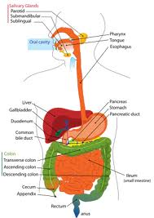
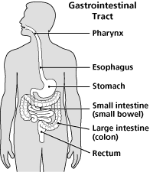
Functions
The function of the digestive system is to turn food into energy and package the waste for disposal

Slide 3
Digestive System Organs
Mouth
Chewing breaks the food into smaller, more easily digestible pieces
Saliva begins the process of breaking down the food into useable forms
Pharynx
The pharynx leads from the mouth to the esophagus and provides a path to move food through
Esophagus
The esophagus receives food from the mouth and passes it to the stomach through a process called peristalsis

Slide 4
Digestive System Organs
Stomach
The stomach holds food while it is mixed with enzymes that break it down further for use
Cells line the stomach that release a strong acid and enzymes that break the food down
Small Intestine
The small intestine breaks down food using enzymes released by the pancreas and bile from the liver
It’s broken into three segments: the duodenum, the jejunum, and the ileum
The duodenum helps the breaking-down process
The jejunum and ileum aid in absorption of nutrients into the bloodstream

Slide 5
Digestive System Organs
Large Intestine (Colon)
It is made up of the cecum, the ascending (right) colon, the transverse (across) colon, the descending (left) colon, and the sigmoid colon, which connects to the rectum
It is responsible for processing waste products
When the waste passes through the colon, the water is removed making it easier for excretion
Rectum
It is an 8-inch chamber that connects the colon to the anus
It receives stool from the colon and holds it until it can be evacuated

Slide 6
Digestive System Organs
Anus
This is the last part of the digestive tract
It is a 2-inch long canal consisting
of the pelvic floor muscles and
the two anal sphincters (internal
and external)
It tells the body when there is
stool to be excreted and controls
it if it cannot be excreted
immediately

Slide 7
Digestive System Organs – Accessory Organs
Salivary Glands
These are found around your mouth and throat
They secrete saliva into your mouth to moisten your mouth, initiate digestion, and help protect teeth from decay
Liver
The functional units are lobules with sinusoids that carry blood from the periphery to the central vein of the lobule
Liver functions include secretion, synthesis of bile salts and plasma protein, storage, detoxification, excretion, carbohydrate, lipid and protein metabolism, and filtering

Slide 8
Digestive System Organs – Accessory Organs
Pancreas
The endocrine part of the pancreas secretes glucagon and insulin into the blood
The exocrine part secrete digestive enzymes including anylase, trypsin, peptidase, and lipase
Gallbladder
It is attached to the liver by the cystic duct
The main function is to store bile produced by liver cells

Slide 9
Digestive System Organs – Accessory Organs
Sphincters
The sphincter keeps the rectum closed as stool collects in the anus
Involuntary Sphincter
Pressure from the stool eventually causes the internal sphincter to relax
Voluntary Sphincter
Conscious control on the outer sphincter allows the stool to pass through the anus when the body allows it

Slide 10
Digestion of Large Food Molecules
It’s necessary to break down food molecules for two main reasons
First, the food is made up of different compounds and must be broken down and reassembled in order for our body to be able to digest it
Second, the food molecules have to be small enough to be absorbed by the villi in the intestine so the food must be broken down

Slide 11
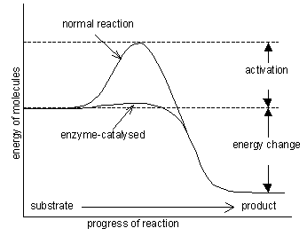
Digestive Enzymes
Enzymes are biological catalysts that increase reaction rates
Some food molecules are insoluble and need to be broken down, the enzymes increase the rate at which the molecules are broken down
into a usable form

Slide 12
Digestion
Physical Digestion
Large pieces of food are broken down physically through mastication, churning, and emulsification
Mastication is biting, grinding, and slicing with the teeth
Churning is the contraction of the stomach muscles to create turbulence to break food down further
Emulsification is the process of fat being made water soluble by bile salts allowing lipase to attack insoluble lipids
Chemical Digestion
This is the process of applying chemicals to break down the remaining food bits
Digestive enzymes increase the digestion rate
There are eight digestive enzymes responsible for chemical digestion: nuclease, protease, collagenase, lipase, amylase, elastase, trypsin, and chymotrypsin

Slide 13
Digestion, Cont.
Carbohydrate Digestion
The process of carb digestion begins immediately with salivary amylase which breaks down the carbs into oligosaccharides
Amylase is the main digestive enzyme for carbs
Protein Digestion
Protein digestion begins the stomach with the enzyme pepsin
Trypsin and chymotrypsin break down the polypeptides into oligopeptides in the small intestine
Lipid Digestion
Lipase starts breaking down lipids in the mouth
The small intestine breaks down most of the fat with pancreatic lipase

Slide 14
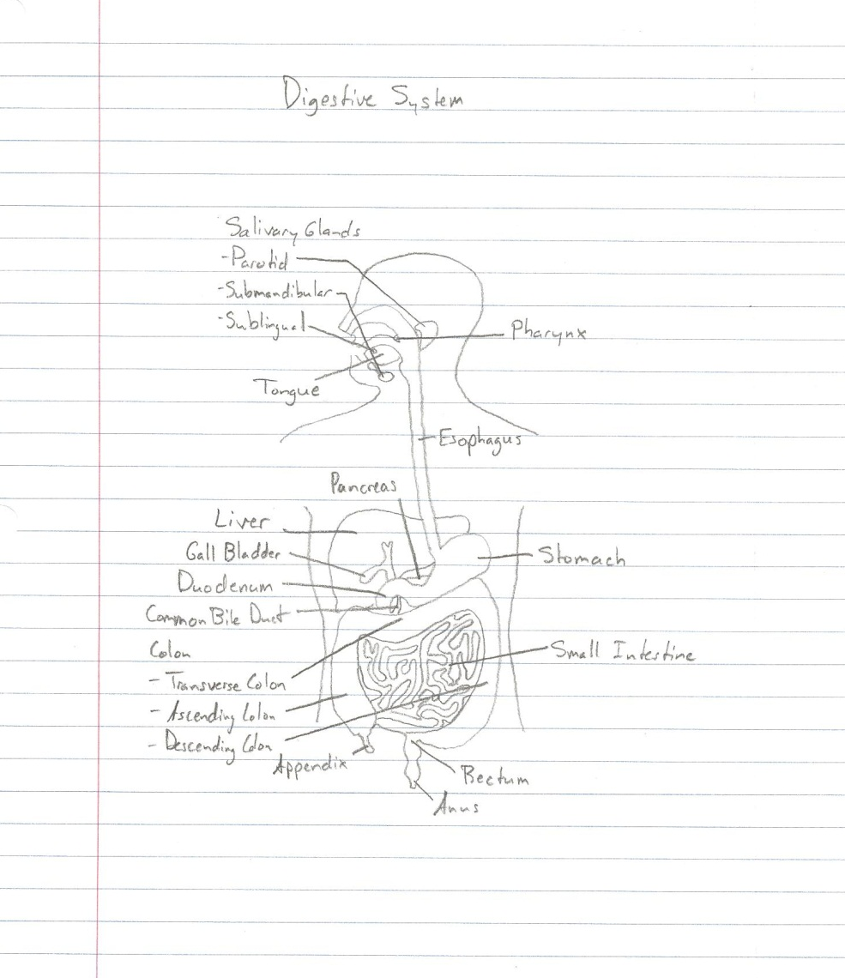
Digestive Glands

Slide 15
Lactose Intolerance
These people don’t have the enzyme needed to break down lactose
Symptoms include cramping, bloating, gas, diarrhea, and nausea and will become more severe when large amounts of milk products are consumed
Approximately 25% of whites are lactose intolerant
Treatment includes avoidance of milk and other dairy products and possibly eating specially prepared foods with digestive aids

Slide 16
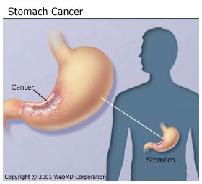
Stomach Cancer
Also called gastric cancer, it is a tumor found on the lining of the stomach
Symptoms include indigestion, mild nausea, loss of appetite and heartburn
Stomach cancer affects 21,130
Americans
Treatment includes a
combination of surgery, a
gastrectomy, chemotherapy or
radiation therapy

Slide 17
Sources
http://www.cchs.net/health/health-info/docs/1600/1699.asp?index=7041
http://www.entnet.org/HealthInformation/salivaryGlands.cfm
http://training.seer.cancer.gov/anatomy/digestive/regions/accessory.html
http://www.health.com/health/library/mdp/0,,str2218,00.html
http://www.ibguides.com/biology/notes/digestion
http://click4biology.info/c4b/6/hum6.1.htm
http://www.hsc.on.ca/moffatt/bio3a/digestive/digp6.htm
http://www.livestrong.com/article/366300-the-digestion-of-carbohydrates-lipids-and-proteins/
http://www.digestivesystemdisorders.com/
http://emedicine.medscape.com/article/187249-overview
http://www.webmd.com/cancer/stomach-gastric-cancer

