Slide 1
Endocrine System
Douglas Todey

Slide 2
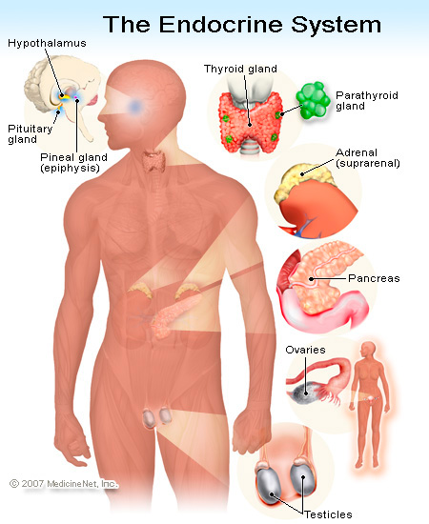
Functions
The system is made up of
glands that produce and
secrete hormones to regulate
the activity of cells and
organs
The hormones regulate
the body’s growth,
metabolism, and sexual
development and function

Slide 3
Homeostasis
Homeostasis is the regulation of body temperature in the body
A system of cycles and negative feedback maintain homeostasis
Negative feedback controls the secretion of hormones and secretion cycles maintain physiological and homeostatic control

Slide 4
Negative Feedback Mechanism
Output of the pathway inhibits the input of the pathway turning off the pathway
Once production of a hormone reaches a certain level, the hormone negatively feeds back and stops production of the hormone, until the hormone is used up and production starts again
Example: Thyroid hormone secretion

Slide 5
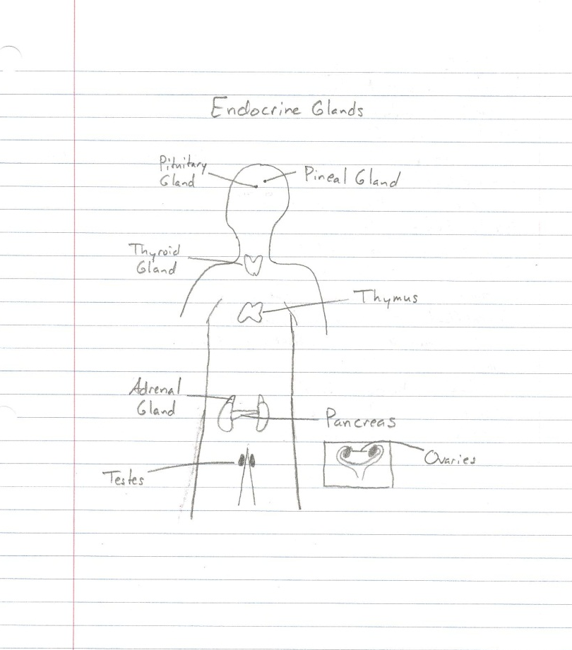
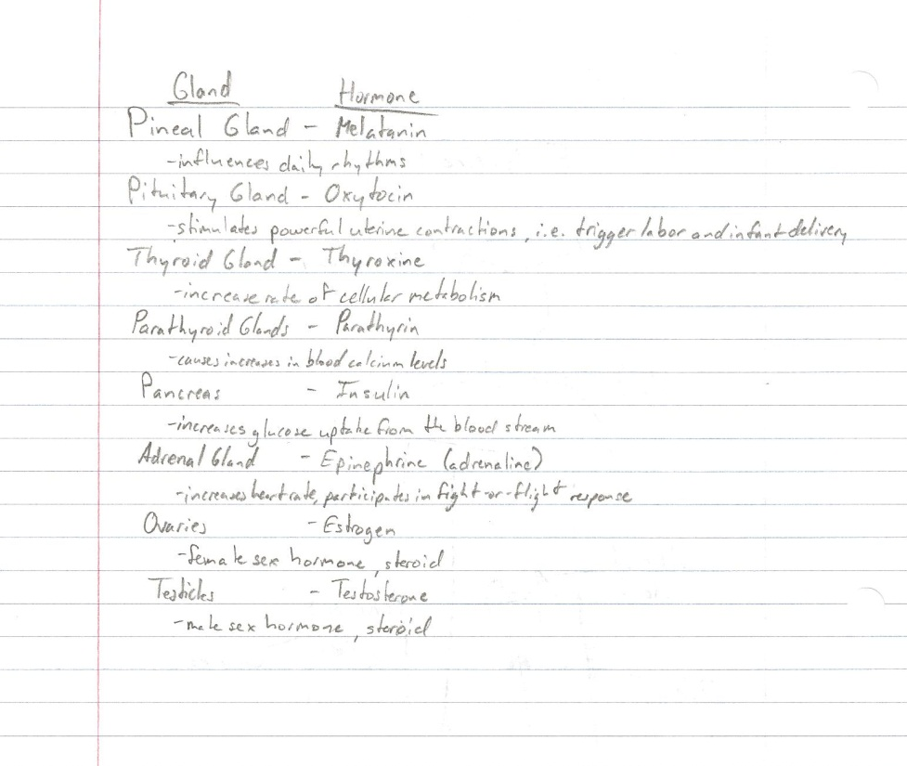
Endocrine Glands

Slide 6
Type I and Type II Diabetes
Diabetes is caused by too much blood glucose, or blood sugar, in your blood
When not enough insulin is produced by your pancreas, the glucose you eat stays in your blood
Type I
The beta cells of the pancreas can no longer make glucose because the body’s immune system has destroyed them
Type II
It typically begins with insulin resistance where the cells don’t use insulin properly. The pancreas then makes more insulin, but it loses the ability to make enough insulin in response to eating

Slide 7
Type I Diabetes
In Type I Diabetes, the body cannot produce insulin to convert consumed glucose to energy
Symptoms include increased thirst and urination, extreme hunger, weight loss, fatigue, and blurred vision
25.8 million people, or 8.3% of the population of the US have diabetes
Only about 5% of people with diabetes have Type I
Proper management of Type I Diabetes includes blood glucose control and insulin management, exercise, nutrition, and support

Slide 8
Sources
http://www.emedicinehealth.com/anatomy_of_the_endocrine_system/article_em.htm
http://www.nativeremedies.com/articles/endocrine-system-and-homeostasis.html
http://www.vivo.colostate.edu/hbooks/pathphys/endocrine/basics/control.html
http://diabetes.niddk.nih.gov/dm/pubs/type1and2/what.aspx
http://www.diabetes.org/diabetes-basics/type-1/

