Slide 1
Excretory System
Douglas Todey

Slide 2
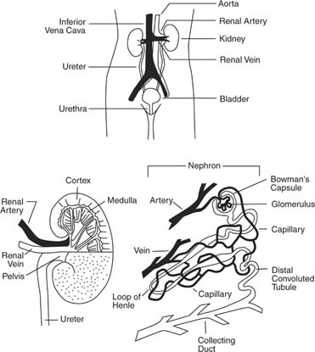
Function
The main function of the
excretory system is to rid
the body of waste
It consists of the kidney
and its functional unit,
the nephron

Slide 3
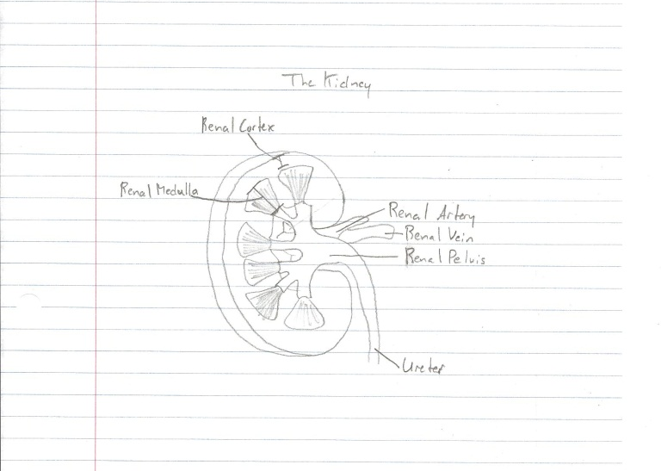
The Kidneys

Slide 4
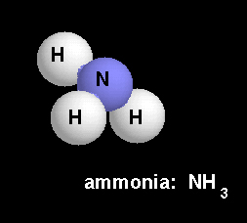
Nitrogenous Waste
Ammonia
Ammonia is very toxic and requires a large amount of water to be flushed out of the body
Therefore fish and amphibians,
which have access to water
flush the waste primarily as
ammonia

Slide 5
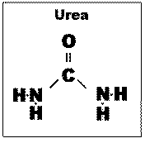
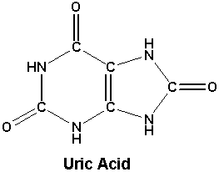
Nitrogenous Waste
Urea
Since terrestrial animals have less access to water, they need to package their waste with less toxic molecules and excrete it with less water
By having two nitrogen atoms to the ammonia, even though it requires metabolic energy to make, the less toxic urea is flushed out with less water
Mammals excrete the less toxic urea
Uric Acid
Reptiles and birds go one step farther and add two more nitrogen atoms on ammonia, bringing the total to four
The four nitrogens require more metabolic energy, but it makes the ammonia much less toxic and requires even less water to excrete

Slide 6
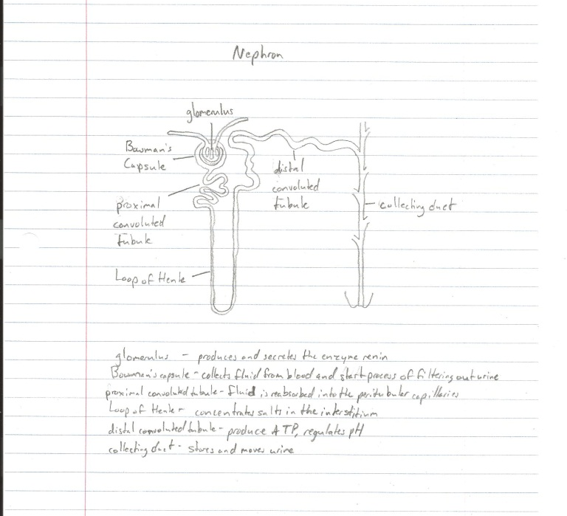
Nephrons

Slide 7
Nephrons
Filtration
Glomerular filtration is the process that goes on in the renal corpuscles in which blood flows through the glomeruli, much of its fluid, soaks out of the blood through membranes where it is filtered into the Bowman’s capsule
The products that have been filtered out are called glomerular filtrate. It consists of water, excess salts, glucose, and urea

Slide 8
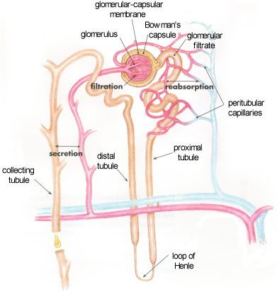
Nephrons
Reabsorption
This is the movement of
substances out of the renal
tubules back into the blood
capillaries surrounding the
peritubular capillaries
Water, glucose and other
nutrients, and sodium and other ions are reabsorbed
Reabsorption begins in the proximal convoluted tubules and continues in the loop of Henle, distal convoluted tubules, and collecting tubules

Slide 9
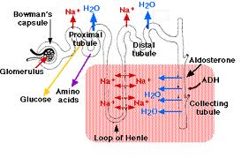
Nephrons
Secretion
This is the process by which substances move into the distal and collecting tubules from blood in the capillaries around these tubules
Secretion moves substances out of the blood and into the tubules where they
mix with other wastes and
are converted into urine

Slide 10
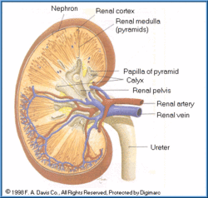
Nephrons
Excretion
Excretion is handled jointly by the kidney and nephrons
The nephrons are contained inside the kidney, who’s main purpose is to excrete bodily wastes and harmful chemicals
Excretion is mainly handled
by the nephrons where the
toxins are eliminated in the
urine

Slide 11
Kidney Stones
Kidney stones are hard masses that form in the urinary tract from crystals separated from the urine
The most common type is formed of calcium
Symptoms of kidney stones include extreme pain, cramping in the back and lower abdomen, nausea and vomiting
Kidney stones affect up to 5% of the population
Most stones can be passed by increasing fluid intake to two to three quarts of water a day, but if they are too big to pass, then surgery is required to break them up

Slide 12
Urethritis
This is an inflammation of the urethra caused by a bacterial or viral infection
Symptoms vary between men and women
Men
Symptoms in men include blood in the urine or semen, burning during urination, discharge, frequent urination, pain and swelling of the penis and pain during ejaculation
Women
Symptoms in women include abdominal pain, pain during urination, fever, chills, frequent urination, pain in the pelvis and vaginal discharge
Urethritis accounts for approximately 3-4 million clinic visits per year
Treatment includes antibiotics or anti-viral medication
Pain medication may be used to treat associated symptoms

Slide 13
Sources
http://www.cliffsnotes.com/study_guide/Human-Excretory-System.topicArticleId-8741,articleId-8714.html
http://www.bio.miami.edu/dana/dox/nitrogenouswaste.html
http://www.nsbri.org/humanphysspace/focus4/ep-urine.html
http://www.eoearth.org/article/Excretion_of_toxicants
http://www.livestrong.com/article/185871-common-excretory-system-diseases/

