Slide 1
Immune System
Douglas Todey

Slide 2
Functions
The main function is to use many different types of cells to protect the body from bacterial, parasitic, fungal and viral infections and prevent the growth of tumors
These cells can engulf bacteria, kill parasites and tumor cells, and kill viral-infected cells

Slide 3
Major Organs
Bone Marrow
Hematopoiesis forms all of the cells of the immune system from bone marrow
Thymus
Produce mature T cells
Spleen
Provides a filter for blood
Lymph Nodes
Functions as a filter for the bodily fluid, lymph

Slide 4
Pathogens
The body recognizes pathogens by recognizing molecules unique to groups of related microorganisms and are not associated with human cells
These unique microbial molecules are called pathogen-associated molecular patterns or PAMPs
Additionally, unique molecules displayed on stressed, injured, infected, or transformed human cells also be recognized as a part of innate immunity
These are often referred to as damage-associated molecular patterns or DAMP

Slide 5
Pathogens
Antigens
This is often used to describe something that has infected the body
It is also often named as a molecule (protein, glycoprotein, lipoprotein or polysaccharide) on the outer surface of a cell
Antibodies
Antibodies are proteins secreted from lymphocytes that destroy pathogen and antigen infections
They bind specifically to an antigen

Slide 6
Immunity
Innate Immunity
This prevents the entry of microorganisms into tissue, or if they have gained entry, destroying them before the disease occurs
Examples of this include skin, mucous membranes, coughing and vomiting
Acquired Immunity
This is also called adaptive immunity because the immune system adapts to certain infections
Examples include immunological recognition, self/non-self discrimination, immunological specificity, and immunological memory

Slide 7
Immunity
Active Immunity
This is the process of injecting dead or weakened antigens into the body. The body kills the pathogens and stores the T cells as memory cells to prevent the body from being infected by that antigen again
Example: vaccines
Passive Immunity
This is immunity to particular pathogens that has been passed on from parent to offspring
Example: antibodies in mother’s milk and placenta passed on to the baby

Slide 8
Immunity
Humoral Immunity
This deals with infections in the blood and body tissue
It’s managed mainly by B cells with help from T cells
It is also called the antibody-mediated system because it uses antibodies
Cell-mediated Immunity
This deals with already infected body cells
It’s managed by T cells
Cytotoxic T cells recognize infected cells and destroy it

Slide 9
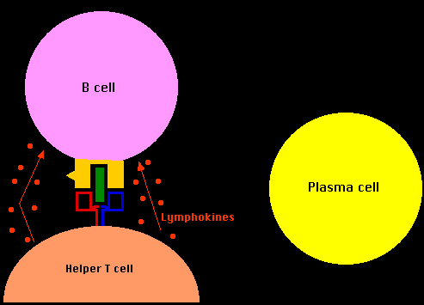
Lymphocytes
B Lymphocytes
The B cell searches for an
an antigen matching its
receptors and when it
connects, a signal is set off
When it also finds proteins produced by helper T cells, it becomes fully activated and divides creating plasma cells and B memory cells
The plasma cell releases antibodies to destroy invaders
The memory cell has a longer life span allowing it to “remember” certain invaders providing for a faster response time to destroy the invader the second time

Slide 10
Lymphocytes
T Lymphocytes
T cells are produced in the bone marrow and move to the thymus where they mature
T cells form two types of cells: Helper T cells and Killer T cells
Helper T cells
Helper T cells are the regulators of immune defense
The T cells are activated by a macrophage or dendritic cell which has eaten an invader
They then activate B cells and the Killer T cells
Killer T cells
These cells attack and destroy cells infected by viruses

Slide 11
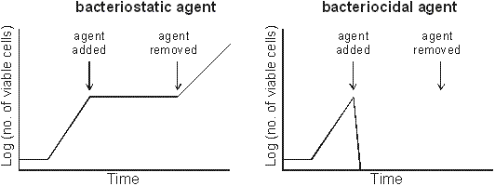
Antibiotics
Bacteria
Some antibiotics kill
microbes while other simply stop their growth
Antibiotics target the bacterial cell wall, 70S ribosomes, and enzyme specific bacteria thus leaving the eukaryotic cells unaffected
Viruses
Viruses are unaffected by antibiotics since they do not have metabolic pathways
They can only be treated by a specific anti-microbial agent

Slide 12
HIV/AIDS
HIV damages the immune system and reduces the body’s ability to fight infection
Symptoms include fever, rashes, headache, sore throat, joint pain, night sweats or diarrhea
Approximately 34 million people worldwide have HIV/AIDS
There is no cure for HIV/AIDS, but drugs can be used to control the virus
Anti-HIV drugs include Non-nucleoside reverse transcriptase inhibitors (NNRTIs), Nucleoside reverse transcriptase inhibitors (NRTIs), Protease inhibitors (PIs), Entry or fusion inhibitors, and Integrase inhibitors

Slide 13
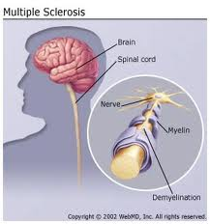
Multiple Sclerosis
This is an autoimmune disorder that causes damage to the myelin sheath, the protective covering surrounding nerve cells. When they are damaged, nerve signals slow down or stop
Symptoms vary according to what nerves are damaged
They can include muscle spasms, double vision, facial pain, numbness, tingling, hearing loss or slurred speech
MS affects over 350,000 people in the US
There is no known cure for MS
Therapies can slow the disease
The main function of treatment is to
control symptoms and lead a normal
lifestyle

Slide 14
References
http://www.thebody.com/content/art1788.html
http://faculty.ccbcmd.edu/courses/bio141/lecguide/unit4/innate/pamps.html
http://click4biology.info/c4b/6/hum6.3.htm
http://www.biology-online.org/1/11_cell_defense_2.htm
http://library.thinkquest.org/C004367/be7.shtml
http://www.nobelprize.org/educational/medicine/immunity//immune-detail.html
http://www.ncbi.nlm.nih.gov/pubmedhealth/PMH0001747/
http://www.mayoclinic.com/health/hiv-aids/DS00005

