Slide 1
Muscular System
Douglas Todey

Slide 2
Functions
The three main functions of the muscle system are to produce motion, provide stability, and generate heat
The three different types of muscle each have unique functions to help the body

Slide 3
Three Types of Muscle Tissue
Cardiac Muscle
It’s found in the heart and is used to move blood throughout the body
Smooth Muscle
It’s found primarily in the digestive system and is used in involuntary motions and actions
Skeletal Muscle
It’s found attached to bones and is used to move the body

Slide 4
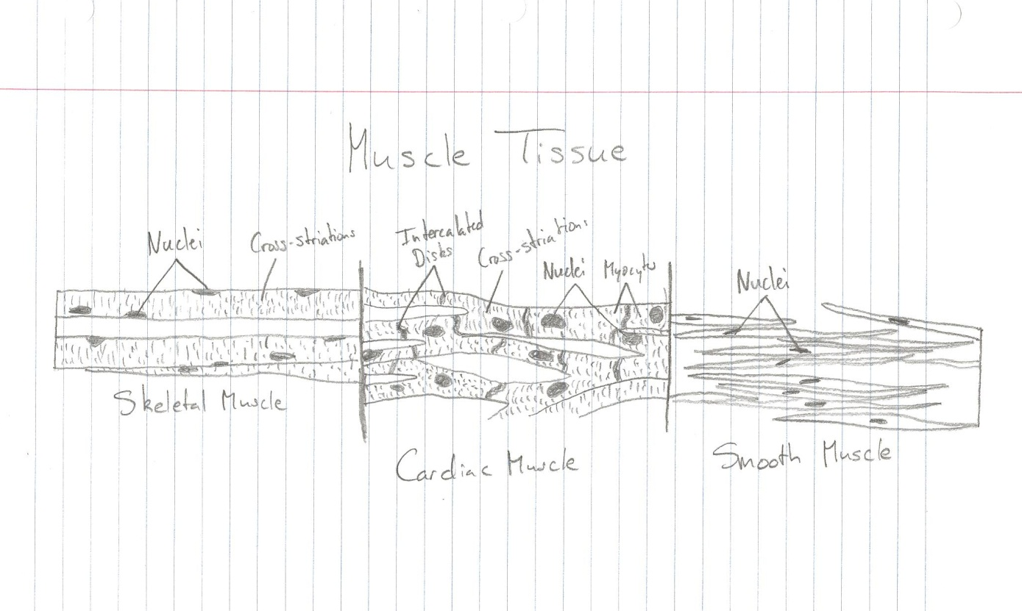
Muscle Tissue

Slide 5
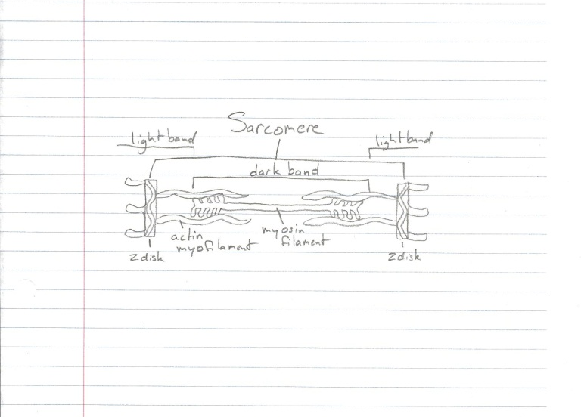
Sarcomere

Slide 6
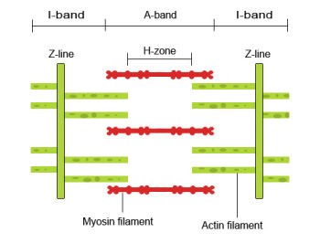
The Sliding Filament Model
Acetylcholine is released when a nervous impulse is detected at a junction
This then causes the depolarization of the motor end plate which causes Calcium ions to be released from the sarcoplasmic reticulum
The Calcium binds to the
Troponin and moves
Tropomyosin from the Actin
active site allowing Myosin
filaments to attach to the
Actin, forming cross-bridges

Slide 7
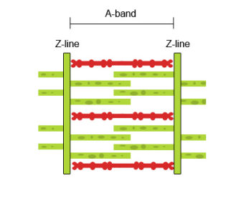
The Sliding Filament Model
ATP then releases energy enabling the Myosin to pull the Actin filaments inward and shorten the muscle
The Myosin detaches from the Actin and breaks the cross-bridge when an ATP binds to the Myosin
The ATP is then broken down, allowing the Myosin to reattach to the Actin binding site along the Actin filament and repeat the stroke
The repeated pulling of the Actin
is often know as the ratchet
mechanism

Slide 8
Muscular Dystrophy
It is an inherited muscle disorder in which your muscles gradually deteriorate and become weaker
Symptoms include a lack of coordination, a stiffness around your joints, and an inability to move your body
It affects less than 200,000 people in the US
Physical therapy, medications such as mexiltine, and surgery to release muscular contractions are a few treatment options

Slide 9
Amyotrophic Lateral Sclerosis
It’s also known as Lou Gehrig’s Disease
The nerve cells of your spinal cord and brain become damaged and eventually affects voluntary movement
Symptoms include muscle cramps and weakness, paralysis, trouble breathing, difficulty swallowing (dysphagia), voice changes and hoarseness
There are approximately 30,000 cases in the US
There is currently no known cure but physical therapy and leg braces can help aid people living with the disease

Slide 10
Sources
http://shs.westport.k12.ct.us/mjvl/anatomy/MandalaWeb/muscular.htm
http://www.teachpe.com/anatomy/sliding_filament.php
http://www.livestrong.com/article/72452-disorders-muscular-system/

