Slide 1
Skeletal System
Douglas Todey

Slide 2
Functions
Give shape to the human body
Support the body and hold internal organs in their place
Work with the muscular system to create bodily movement
Protect vital organs
Store and produce red blood cells

Slide 3
Human Movement
Bones
Support, protect, and allow the body to move about
Allow red blood cells to form
Osteocytes release calcium into the blood and build bone matrix from excess blood calcium
Ligaments
These are tough fibrous bands of tissue that connect bones together and stabilize joints
They also prevent excessive movement of joints

Slide 4
Human Movement
Muscles
Skeletal muscle are attached to bone and allow the body to move
Muscles generate the force for movement
Tendons
Tendons connect the end of a muscle to the bone
They sometimes run across joints and contribute to the range of movement of the joint

Slide 5
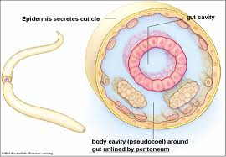
Hydrostatic Skeleton
This is a water-based skeleton
These do not have hard structures, instead, the muscles surround a fluid-filled body cavity
Example: worms

Slide 6
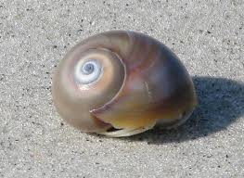
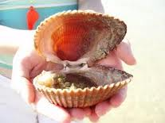
Exoskeleton
This is a hard, protective covering that covers the entire organism
Example: clams

Slide 7
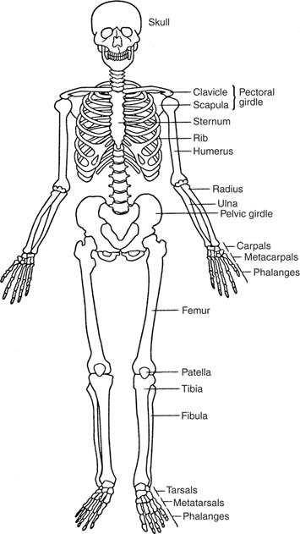
Endoskeleton
This system is a framework of
bones and cartilage that is
inside the organism
Example: humans

Slide 8
Long Bone

Slide 9
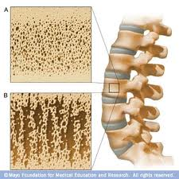
Osteoporosis
This is a condition in which bones
become brittle and weak due to
extensive loss of bone tissue
In the early stages, there are no symptoms, but in later stages symptoms include bone tenderness, fractures, loss of height, low back pain and neck pain
1 out of 5 women in the US have osteoporosis
Treatment options include some types of medication, exercising more and eating foods high in calcium and Vitamin D

Slide 10
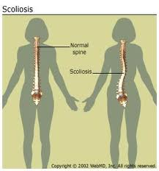
Scoliosis
This is a sideways curvature of the
spine that normally occurs during
the growth spurt before puberty
Symptoms include uneven shoulders,
uneven waist, or one hip being higher than the other
Approximately 2-4% of people worldwide have scoliosis
Most cases will have mild curves and will only require a brace, but sometimes surgery will be needed to straighten the spine. The most common form of surgery is spinal fusion

Slide 11
Sources
http://www.livestrong.com/article/115165-functions-skeleton/
http://diane-ursu.suite101.com/functions-of-bone-a158878
http://www.brianmac.co.uk/physiol.htm
http://www.sportingperformance.co.uk/skeletalandmuscular.htm
http://www.cliffsnotes.com/study_guide/Skeletons-in-Animals.topicArticleId-8741,articleId-8716.html
http://www.ncbi.nlm.nih.gov/pubmedhealth/PMH0001400/
http://www.mayoclinic.com/health/scoliosis/DS00194

