Slide 1
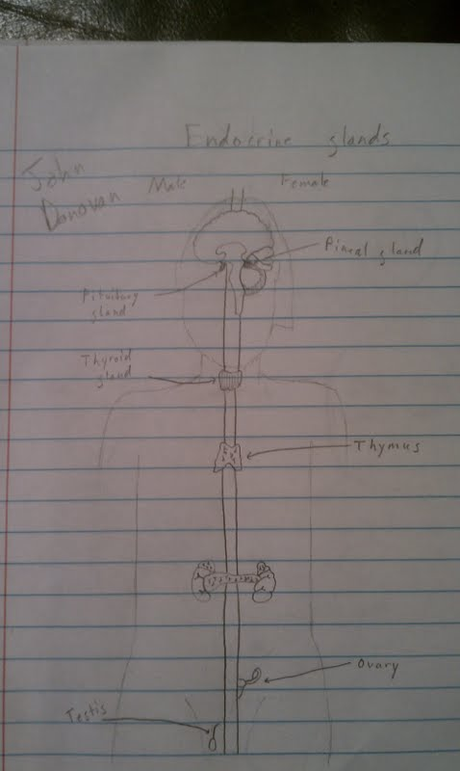
Endocrine System John Donovan
4/9/12

Slide 2
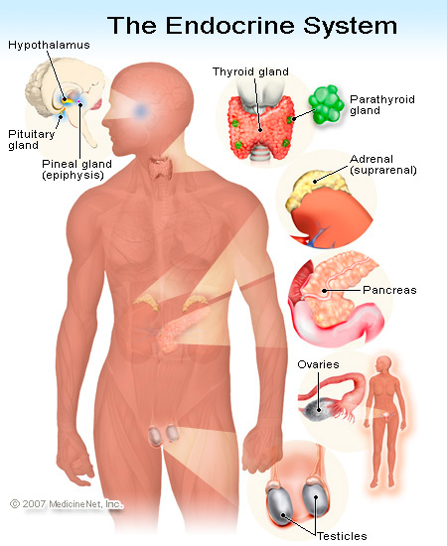
Endocrine System
The function of this system is to secrete a hormone into the blood, this hormone circulates in blood and acts at target organs where the hormone receptor is expressed.

Slide 3
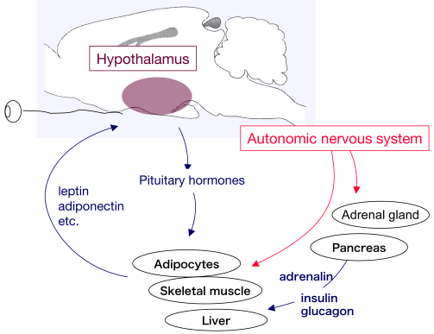
Homeostasis
The endocrine system and the nervous system work individually to maintain homeostasis.
The endocrine system maintains homeostasis through sending hormones to different parts of the body to keep the body going.
The endocrine system also performs this through negative feedback.

Slide 4
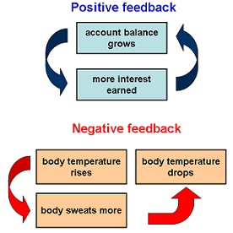
Negative Feedback Mech
Negative feedback regulates the secretion of relevant hormones.
Secretion cycles are used to maintain physiological and homeostatic control.
Example:

Slide 5
Action of Hormone
Chemical messages, this system is sometimes compared to the nervous system because of the signals that the hormones transport.
Hormones are extra-cellular signaling molecules that are carried through the blood or work upon neighboring tissues.

Slide 6
Diabetes 1 & 2
In type 1 diabetes, the person's own body has destroyed the insulin-producing beta cells in the pancreas. This is also called an autoimmune disease.
In type 2 diabetes, there is one of two problems, and sometimes both:
1. Not enough insulin is being produced.
2. The insulin is not working properly, also called insulin resistance.
People who have type 2 is because of being unhealthy and overweight.

Slide 7
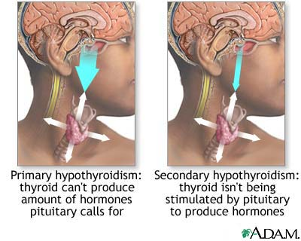
Hypothyroidism
Hypothyroidism is where your thyroid gland doesn't produce enough important hormones.
Hypothyroidism upsets the normal balance of chemical reactions in your body.
Over time this can lead to health problems, such as obesity, joint pain, infertility and heart disease.

Slide 8
References
http://www.hormone.org/Endo101/page2.cfm
http://www.google.com/imgres?imgurl=http://images.emedicinehealth.com/images/illustrations/endocrine_system.jpg&imgrefurl=http://www.emedicinehealth.com/anatomy_of_the_endocrine_system/article_em.htm&h=550&w=450&sz=82&tbnid=XgwldHBwFlgcUM:&tbnh=90&tbnw=74&zoom=1&docid=4ZpNQLAPdUxomM&hl=en&sa=X&ei=rjCcT9ioKsvbggfvx6GGDw&sqi=2&ved=0CFQQ9QEwAw&dur=972
http://www.medicalnewstoday.com/articles/7504.php
http://www.mayoclinic.com/health/hypothyroidism/DS00353
http://www.google.com/imgres?um=1&hl=en&sa=N&biw=1366&bih=649&tbm=isch&tbnid=di-pDnA-2jp0JM:&imgrefurl=http://www.umm.edu/imagepages/17126.htm&docid=XilCYLfU1Nd-SM&imgurl=http://www.umm.edu/graphics/images/en/17126.jpg&w=400&h=320&ei=ujicT9LWOYiTgwep3u2dDw&zoom=1&iact=hc&vpx=416&vpy=173&dur=1648&hovh=201&hovw=251&tx=119&ty=114&sig=106529015298774878259&page=1&tbnh=121&tbnw=160&start=0&ndsp=23&ved=1t:429,r:2,s:0,i:88
http://www.biotopics.co.uk/humans/hormon.html
http://www.nativeremedies.com/articles/endocrine-system-and-homeostasis.html
http://www.google.com/imgres?um=1&hl=en&biw=1366&bih=649&tbm=isch&tbnid=06zwGotMVg__9M:&imgrefurl=http://www.ncdc.noaa.gov/paleo/abrupt/story2.html&docid=kUPmT0oRrZuRhM&imgurl=http://www.ncdc.noaa.gov/paleo/abrupt/images/story2-feedbacks.png&w=276&h=276&ei=JT-cT8WPH8HZgQe13M31Dg&zoom=1&iact=hc&vpx=579&vpy=137&dur=550&hovh=220&hovw=220&tx=110&ty=61&sig=106529015298774878259&page=1&tbnh=140&tbnw=140&start=0&ndsp=18&ved=1t:429,r:2,s:0,i:72

