Slide 1
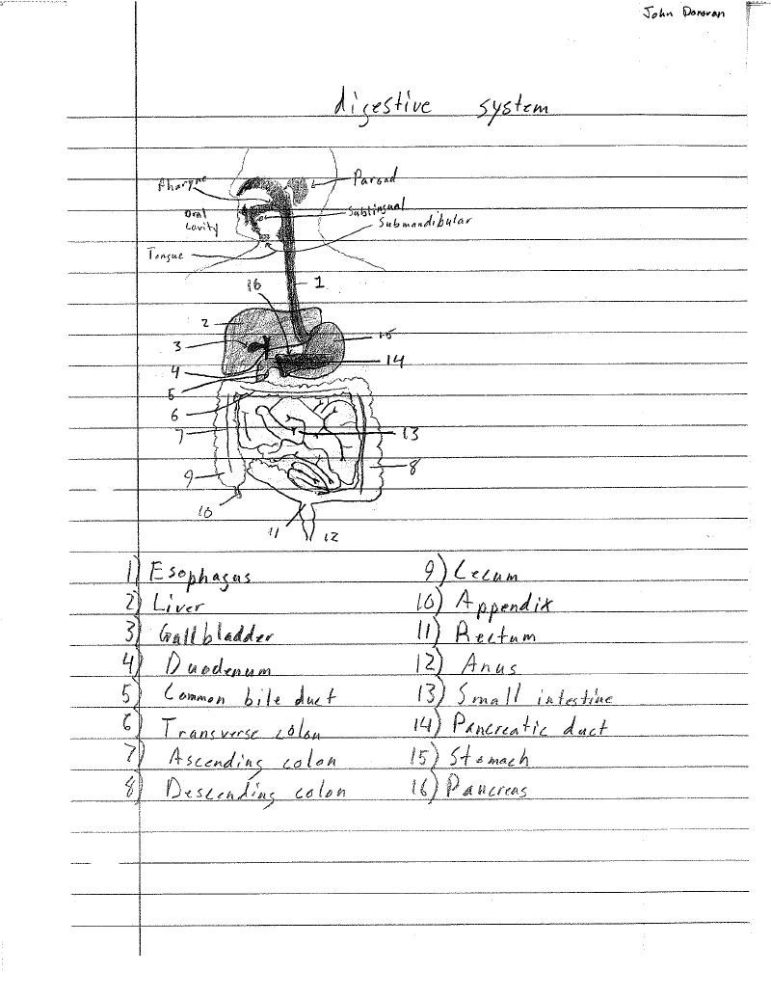
The Excretory System John Donovan 4/9/12

Slide 2
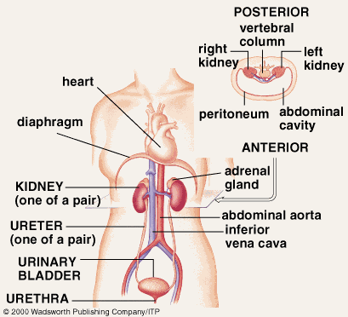
Excretory System
The function of the excretory system is to transport the waste from the food that we got energy from to outside of the body.

Slide 3
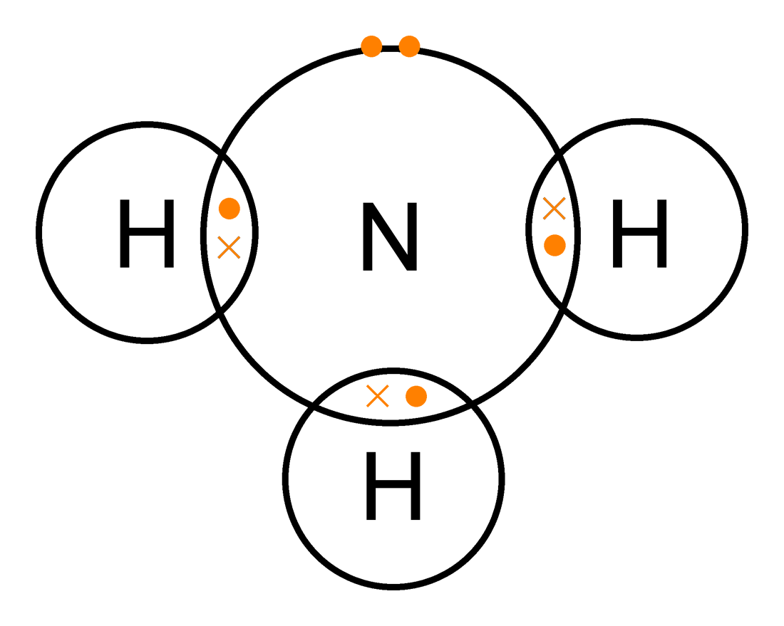
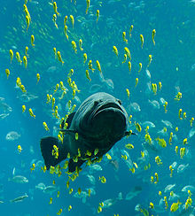
Ammonia
Takes a lot of water to excrete from the body.
This is very toxic and is mainly excreted by amphibians and fish.

Slide 4
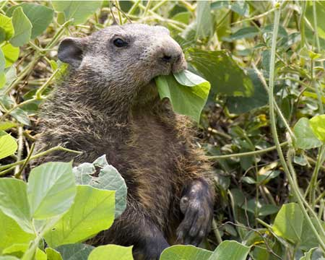
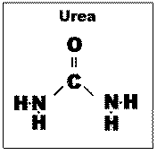
Urea
Mammals metabolize ammonia into urea.
This is less toxic than ammonia and takes less water to excrete.

Slide 5
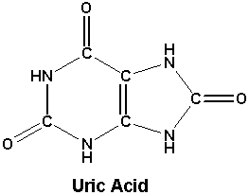
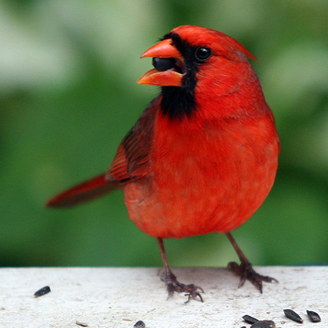
Uric acid
Uric acid contains four nitrogen atoms per molecule.
Takes a lot less of water to excrete and is quite non-toxic.
Mainly reptiles along with birds excrete uric acid.

Slide 6
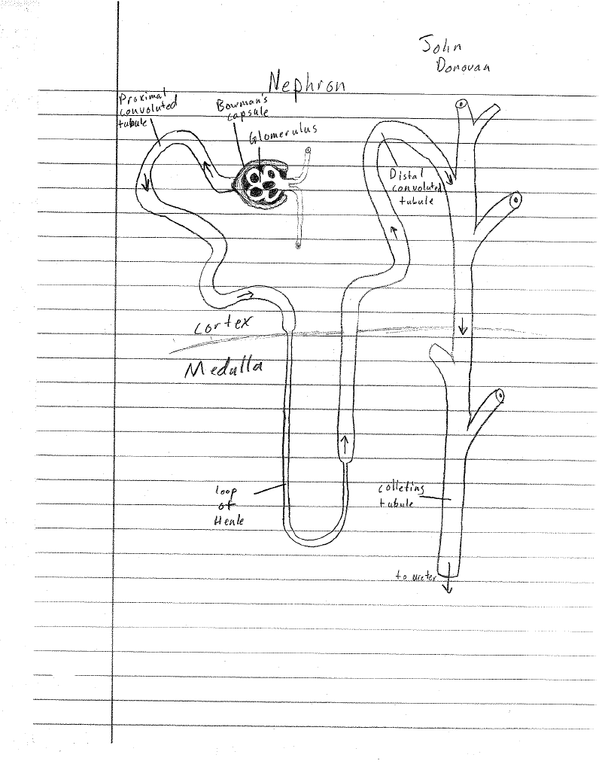
The nephron is the basic structural and functional unit of the kidney.
Its purpose is to regulate the water and other liquids by filtering the blood.

Slide 7
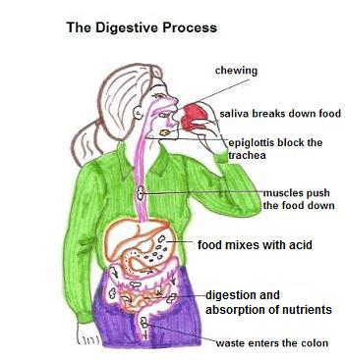
Excretory processes
The excretory system gets rid of waste and materials that the body does not need or has any use for.
Our waste comes in two forms: urine and poop.
Urine is the liquid that you drink and is the liquid that the body does not need and goes to the bladder and then out of your body. Poop is the solid waste that comes from your food, and from the large and small intestine and then out of your body.
Other processes of how the food and liquid go down are shown at the right in the picture.

Slide 8
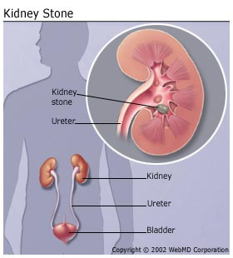
Kidney Stones
Kidney stones are formed by crystals that separate from the urine and from into clumps such as Calcium build up.
Kidney stones cause great pain and discomfort and vomiting.
If a kidney stone is too large to pass, then surgery maybe need to take place to split the kidney stone.

Slide 9
Urethritis
Urethritis is inflammation in the urethra caused by a bacterial or viral infection.
Caused by the same microbes that cause urinary tract infections.
This disorder or disease affects you going to the bathroom and also makes you go on frequent trips to go to the bathroom.
I’ll spare you the pictures of this disorder and or disease…

Slide 10
References
http://www.emc.maricopa.edu/faculty/farabee/biobk/biobookexcret.html
http://www.bio.miami.edu/dana/dox/nitrogenouswaste.html
www.googole.com
http://www.google.com/imgres?q=ammonia&um=1&hl=en&sa=N&biw=1311&bih=623&tbm=isch&tbnid=IfDIgXl-pr43sM:&imgrefurl=http://commons.wikimedia.org/wiki/File:Ammonia-2D-dot-cross.png&docid=moiDl4E4ouE7xM&imgurl=http://upload.wikimedia.org/wikipedia/commons/9/96/Ammonia-2D-dot-cross.png&w=1100&h=879&ei=Is-MT7HMMc3qgQfv99DjCQ&zoom=1&iact=rc&dur=214&sig=106529015298774878259&page=1&tbnh=116&tbnw=153&start=0&ndsp=23&ved=1t:429,r:5,s:0,i:145&tx=93&ty=56
http://www.google.com/imgres?q=fish&um=1&hl=en&biw=1311&bih=623&tbm=isch&tbnid=hvjIe8uXf3z7aM:&imgrefurl=http://en.wikipedia.org/wiki/Fish&docid=5pS1YV4mZyJr8M&imgurl=http://upload.wikimedia.org/wikipedia/commons/thumb/2/23/Georgia_Aquarium_-_Giant_Grouper_edit.jpg/220px-Georgia_Aquarium_-_Giant_Grouper_edit.jpg&w=220&h=244&ei=YM-MT-qMKoT-ggeehIXeCQ&zoom=1&iact=hc&vpx=185&vpy=175&dur=639&hovh=195&hovw=176&tx=98&ty=95&sig=106529015298774878259&page=1&tbnh=121&tbnw=109&start=0&ndsp=20&ved=1t:429,r:0,s:0,i:146
http://www.google.com/imgres?q=mammals&um=1&hl=en&biw=1311&bih=623&tbm=isch&tbnid=qAjGN37OBWYUlM:&imgrefurl=http://www.outdooralabama.com/photos/oaphotos/07winners/07mammals1.cfm&docid=YZhi110mDvdRnM&imgurl=http://www.outdooralabama.com/photos/images/07Mammals1.jpg&w=450&h=360&ei=UNCMT8roEYjcgQetnaW9CQ&zoom=1&iact=hc&vpx=176&vpy=324&dur=354&hovh=201&hovw=251&tx=172&ty=144&sig=106529015298774878259&page=2&tbnh=131&tbnw=166&start=20&ndsp=24&ved=1t:429,r:12,s:20,i:207
http://www.livestrong.com/article/185871-common-excretory-system-diseases/
http://www.google.com/imgres?q=kidney+stones&um=1&hl=en&sa=N&biw=1366&bih=649&tbm=isch&tbnid=a0RFNUn17iOIpM:&imgrefurl=http://www.webmd.com/kidney-stones/understanding-kidney-stones-basics&docid=2mBFxI0qux-okM&imgurl=http://img.webmd.com/dtmcms/live/webmd/consumer_assets/site_images/articles/health_and_medical_reference/miscellaneous/kidney_stone.jpg&w=280&h=310&ei=UVuPT8TFH8vegQeEyPmKBQ&zoom=1&iact=hc&vpx=547&vpy=291&dur=2886&hovh=236&hovw=213&tx=132&ty=122&sig=106529015298774878259&page=2&tbnh=138&tbnw=130&start=21&ndsp=25&ved=1t:429,r:8,s:21,i:202
http://wiki.answers.com/Q/What_is_the_main_function_of_nephron

