Slide 1
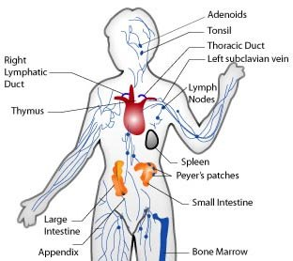
Immune System 4/9/12
John Donovan

Slide 2
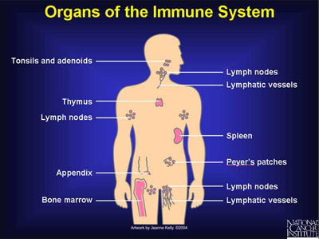
Immune System
The function of the immune system is to fight off different diseases that you encounter throughout our life.
The major organs of the immune system are:

Slide 3
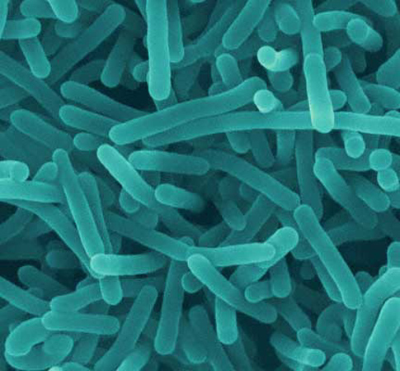
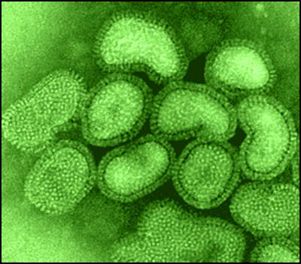
Pathogens
The immune system recognizes them by an alarm that is sent off when you get cut from something and when the infection enters your body.
The white blood cells then go to the cite of the cut and battle the infection.
The white blood cells are made in our bone marrow.

Slide 4
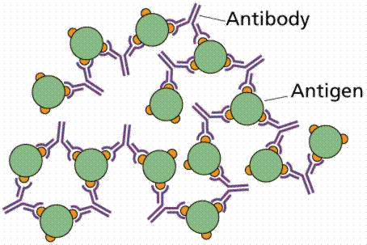
Antigens and Antibodies
An antibody is a protein produced by the body's immune system when it detects harmful substances, called antigens.
Also antibodies are produced when the immune system mistakes healthy tissue for an infection.

Slide 5
Innate and Acquired
Innate: The innate immune system is activated by chemical properties of the antigen. This is system refers to nonspecific defense mechanisms that come into play immediately or within hours of an antigen’s appearance.
Acquired: The acquired immune system is designed to recognize infections and make specific immune sells to attack the infection. This system refers to antigen-specific immune response.

Slide 6
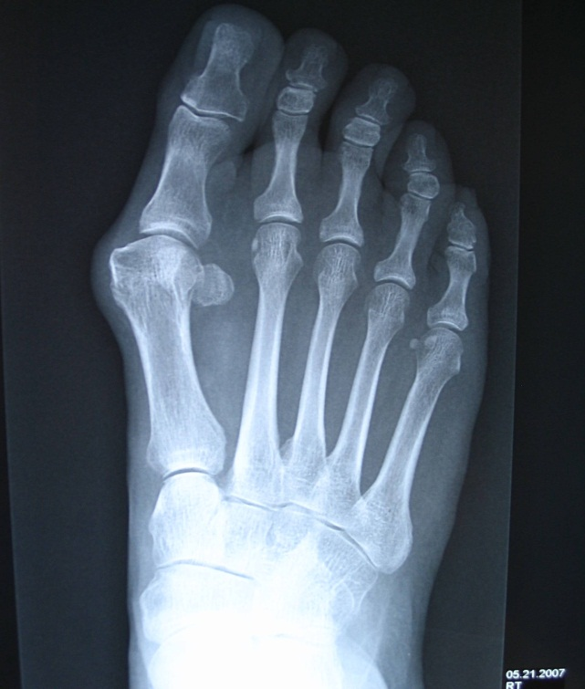
Active Immunity
Active immunity is where you are exposed to an infection and you produce antibodies for that disease and or infection and you are then protected for an amount of time from that specific disease.
Example: HAV →

Slide 7
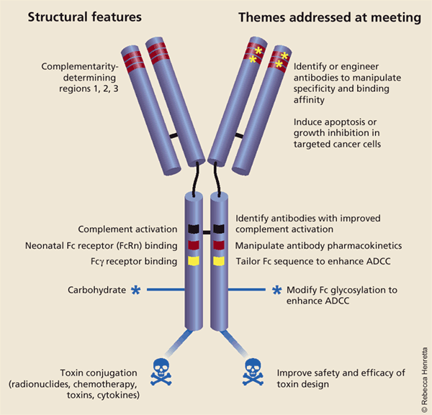
Passive Immunity
Passive immunity is where you are provided antibodies to fight infection. Such as when babies are first born they are provided with lgG and once they are gone the baby then has active immunity.
Example: lgG antibodies →

Slide 8
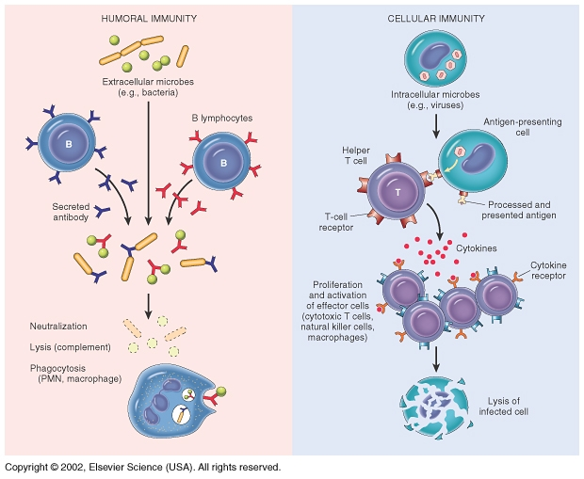
Humoral vs. Cell-mediated
The humoral immune response is the immunity that is mediated by secreted antibodies produced in the cells of the B lymphocyte lineage.
Cell-mediated immunity is an immune response that does not involve antibodies but instead involves the activation of macrophages antigen-specific cytotoxic T-lymphocytes, and the release of cytokines in response to an antigen.

Slide 9
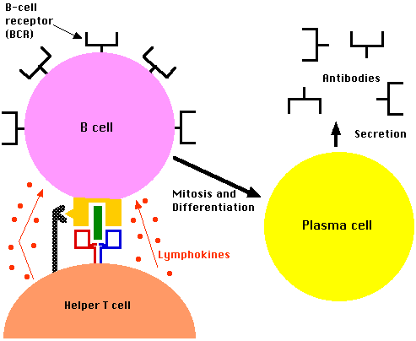
B vs. T Lymphocytes
B cells are made by the bone marrow.
B cells bind to the antigen and then engulf them and then is digested into fragments. Then are put on the cells surface to create anti bodies.
The precursors of T cells are also produced in the bone marrow but leave the bone marrow and mature in the thymus.
T cells (of alpha/beta) binds a bimolecular complex displayed at the surface of some other cell called an antigen-presenting cell. Then they destroy the infection by secreting molecules that destroy the infection.

Slide 10
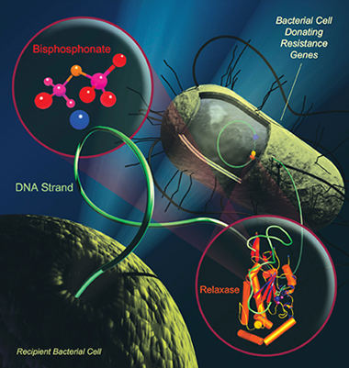
Antibiotics and bacteria
Antibiotics are used and prescribed to people with infections (bacteria).
Antibiotics are specifically used for a certain bacteria to fight and fend off from a person that has the bacteria that is causing them to be sick.

Slide 11
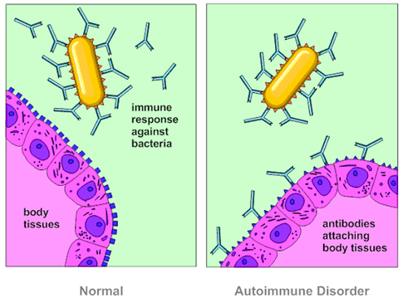
Autoimmune Disease
Autoimmune diseases arise from an inappropriate immune response of the body against substances and tissues normally present in the body.
So this disease attacks regular cells that are normally in our body.

Slide 12
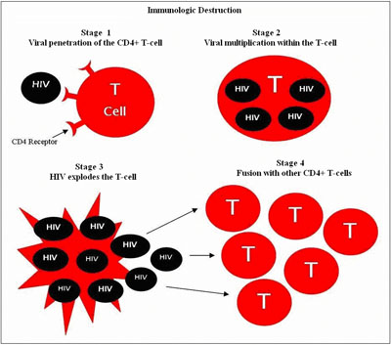
HIV/AIDS
This disease destroys lymphocytes which is one of the main parts of your immune system for fighting off diseases. Therefore, you will get infections that your immune system would usually destroy.

Slide 13
References
http://www.google.com/imgres?q=Immune+system&um=1&hl=en&biw=1441&bih=571&tbm=isch&tbnid=N6Cy8mTlkqhyHM:&imgrefurl=http://www.the-immune-system.org/&docid=YPq5voDJxXmd9M&imgurl=http://www.the-immune-system.org/images/immune-system.jpg&w=312&h=278&ei=fzyLT5PoJoeZgwfQifnnCQ&zoom=1&iact=hc&vpx=329&vpy=257&dur=2075&hovh=212&hovw=238&tx=120&ty=220&sig=106529015298774878259&page=1&tbnh=151&tbnw=169&start=0&ndsp=13&ved=1t:429,r:8,s:0,i:150
http://www.google.com/imgres?q=major+organs+of+the+immune+system&um=1&hl=en&sa=N&biw=1441&bih=571&tbm=isch&tbnid=w91Kk3XAtnxL8M:&imgrefurl=http://www.aids.gov/hiv-aids-basics/diagnosed-with-hiv-aids/hiv-in-your-body/immune-system-101/&docid=BgkhXPVLLxj8BM&imgurl=http://www.aids.gov/images/immune-system-101.jpg&w=400&h=299&ei=kT-LT67xJdHTgAfP4tjeBg&zoom=1&iact=hc&vpx=487&vpy=134&dur=4664&hovh=194&hovw=260&tx=115&ty=93&sig=106529015298774878259&page=1&tbnh=110&tbnw=147&start=0&ndsp=26&ved=1t:429,r:2,s:0,i:73
http://wiki.answers.com/Q/How_does_the_immune_system_respond_to_the_pathogen
http://www.google.com/imgres?q=pathogens&um=1&hl=en&biw=1441&bih=571&tbm=isch&tbnid=IvzdcEmYQbr2rM:&imgrefurl=http://www.dogexpert.com/Epidemiologic%2520abstracts/Pathogens%2520dog%2520cat%2520bites.html&docid=hS-dte4sUv2lSM&imgurl=http://www.dogexpert.com/images/Pathogens.jpg&w=485&h=449&ei=DlKLT5v_C5PW9QTjp7nPCQ&zoom=1&iact=hc&vpx=539&vpy=187&dur=2933&hovh=216&hovw=233&tx=108&ty=85&sig=106529015298774878259&page=1&tbnh=157&tbnw=170&start=0&ndsp=13&ved=1t:429,r:2,s:0,i:137
http://www.google.com/imgres?q=pathogens&um=1&hl=en&biw=1441&bih=571&tbm=isch&tbnid=9oIwcUXfQknAZM:&imgrefurl=http://searchforbetterhealth.wikispaces.com/Pathogens%2B%2526%2BTheir%2BSpread&docid=fNiEcFoZNWeW1M&imgurl=http://searchforbetterhealth.wikispaces.com/file/view/Pathogens.jpg/116973965/Pathogens.jpg&w=400&h=351&ei=DlKLT5v_C5PW9QTjp7nPCQ&zoom=1&iact=hc&vpx=348&vpy=189&dur=3027&hovh=210&hovw=240&tx=148&ty=101&sig=106529015298774878259&page=1&tbnh=158&tbnw=180&start=0&ndsp=13&ved=1t:429,r:1,s:0,i:135
http://www.nlm.nih.gov/medlineplus/ency/article/002223.htm
http://www.google.com/imgres?q=antibodies+and+antigens&um=1&hl=en&biw=1441&bih=571&tbm=isch&tbnid=Z6cypxnzUa8cXM:&imgrefurl=http://www.cartage.org.lb/en/themes/sciences/lifescience/generalbiology/physiology/LymphaticSystem/Antibodymediated/Antibodymediated.htm&docid=eAl1k0HjABxNZM&imgurl=http://www.cartage.org.lb/en/themes/sciences/lifescience/generalbiology/physiology/LymphaticSystem/Antibodymediated/antigenAB.gif&w=454&h=303&ei=h1OLT6WOIYn88gTipbi-CQ&zoom=1&iact=hc&vpx=918&vpy=202&dur=2605&hovh=183&hovw=275&tx=136&ty=90&sig=106529015298774878259&page=1&tbnh=145&tbnw=217&start=0&ndsp=12&ved=1t:429,r:4,s:0,i:102
www.google.com
http://www.biology.arizona.edu/immunology/tutorials/immunology/page3.html
http://occmed.oxfordjournals.org/content/57/8/552.full
http://www.google.com/imgres?q=HAV+disease&hl=en&gbv=2&biw=1441&bih=571&tbm=isch&tbnid=TMa7MJ1okwz4kM:&imgrefurl=http://foothealth.about.com/od/bunions/ig/Photos-Bunions-HAV/Right-Foot-Xray-with-Bunion.htm&docid=tvXmOfVoimYuwM&imgurl=http://0.tqn.com/d/foothealth/1/0/j/-/-/-/Xray.jpg&w=1536&h=2048&ei=GnWLT771DMaWgwfFnPH5CQ&zoom=1&iact=hc&vpx=1041&vpy=193&dur=2886&hovh=259&hovw=194&tx=96&ty=166&sig=106529015298774878259&page=1&tbnh=118&tbnw=77&start=0&ndsp=25&ved=1t:429,r:14,s:0,i:96
http://www.google.com/imgres?q=lgG+antibodies&hl=en&gbv=2&biw=1441&bih=571&tbm=isch&tbnid=5_LSW970KwPBXM:&imgrefurl=http://www.nature.com/nbt/journal/v21/n5/fig_tab/nbt0503-510_F1.html&docid=ADjG51n2ldcL_M&imgurl=http://www.nature.com/nbt/journal/v21/n5/images/nbt0503-510-F1.gif&w=600&h=577&ei=mXaLT_DLJ8fagQehjYXvCQ&zoom=1&iact=hc&vpx=161&vpy=121&dur=874&hovh=220&hovw=229&tx=152&ty=80&sig=106529015298774878259&page=1&tbnh=110&tbnw=114&start=0&ndsp=27&ved=1t:429,r:0,s:0,i:67
http://www.youtube.com/watch?v=cSkS_uhSHOg
http://www.google.com/imgres?q=autoimmune+disease&um=1&hl=en&sa=N&biw=1441&bih=571&tbm=isch&tbnid=IZ29LwRcx-leBM:&imgrefurl=http://drpinna.com/auto-immune-diseases-15353&docid=Uya8lLN5Uo4PRM&imgurl=http://drpinna.com/wp-content/uploads/2011/02/AutoimmuneDisorder.jpg&w=500&h=372&ei=d3iLT6u6LcWIgweLxrjGCQ&zoom=1&iact=rc&dur=296&sig=106529015298774878259&page=1&tbnh=166&tbnw=221&start=0&ndsp=13&ved=1t:429,r:6,s:0,i:109&tx=142&ty=108
http://www.google.com/imgres?q=hiv/aids&um=1&hl=en&sa=N&biw=1441&bih=571&tbm=isch&tbnid=mnsOYNIA7jqpIM:&imgrefurl=http://www.buckscounty.org/government/departments/humanservices/healthdepartment/PersonalHealth/HIVFactsFAQs.aspx&docid=TUMT7FDkGhgVUM&imgurl=http://www.buckscounty.org/Images/government/DeptofHealth/PersonalHealth/BCHDHIVGraph.jpg&w=400&h=353&ei=OnmLT9ftNs2-gAel3PyFAw&zoom=1&iact=hc&vpx=191&vpy=242&dur=780&hovh=211&hovw=239&tx=76&ty=147&sig=106529015298774878259&page=1&tbnh=163&tbnw=185&start=0&ndsp=16&ved=1t:429,r:8,s:0,i:152
http://kidshealth.org/teen/sexual_health/stds/std_hiv.html
http://bacteriamuseum.org/cms/How-We-Fight-Bacteria/antibiotics.html
http://www.google.com/imgres?q=antibiotics+and+bacteria&um=1&hl=en&sa=N&biw=1249&bih=495&tbm=isch&tbnid=IpoY5ie4CcEVBM:&imgrefurl=http://www.nationalreviewofmedicine.com/issue/2007/07_30/4_advances_medicine_13.html&docid=_j-Ta_D1WePFQM&imgurl=http://www.nationalreviewofmedicine.com/images/issue/2007/jul30/4_AntibioticResistantBacteria_13.jpg&w=380&h=401&ei=A3yLT7GUHceBgAeYyYTACQ&zoom=1&iact=hc&vpx=600&vpy=136&dur=1592&hovh=231&hovw=219&tx=110&ty=146&sig=106529015298774878259&page=1&tbnh=141&tbnw=134&start=0&ndsp=13&ved=1t:429,r:3,s:0,i:73
http://en.wikipedia.org/wiki/Humoral_immunity
http://en.wikipedia.org/wiki/Cell-mediated_immunity
http://www.google.com/imgres?q=humoral+and+cell+mediated+immunity&um=1&hl=en&sa=N&biw=1441&bih=571&tbm=isch&tbnid=uk-nsGsb_Y6KaM:&imgrefurl=http://mol-biol4masters.masters.grkraj.org/html/Cell_And_Molecular_Immunology2-Innate_Humoral_And_Cell_Mediated_Immunity.htm&docid=4xNv47l148LXRM&imgurl=http://mol-biol4masters.masters.grkraj.org/html/Cell_And_Molecular_Immunology2-Innate_Humoral_And_Cell_Mediated_Immunity_files/image032.jpg&w=620&h=509&ei=c36LT6byN8HSgQfszNTqCQ&zoom=1&iact=hc&vpx=480&vpy=134&dur=390&hovh=203&hovw=248&tx=116&ty=110&sig=106529015298774878259&page=1&tbnh=119&tbnw=145&start=0&ndsp=24&ved=1t:429,r:2,s:0,i:73
http://www.google.com/imgres?q=b+and+t+lymphocytes&um=1&hl=en&sa=N&biw=1441&bih=571&tbm=isch&tbnid=zUwGyYi9LZRvrM:&imgrefurl=http://users.rcn.com/jkimball.ma.ultranet/BiologyPages/B/B_and_Tcells.html&docid=1BMFQoY-BMBSrM&imgurl=http://users.rcn.com/jkimball.ma.ultranet/BiologyPages/T/Th_Lymphokines.gif&w=493&h=404&ei=OX-LT9aJOMSSgwfE5YzDCQ&zoom=1&iact=hc&vpx=269&vpy=132&dur=2590&hovh=203&hovw=248&tx=129&ty=110&sig=106529015298774878259&page=1&tbnh=115&tbnw=140&start=0&ndsp=25&ved=1t:429,r:1,s:0,i:71

