Slide 1
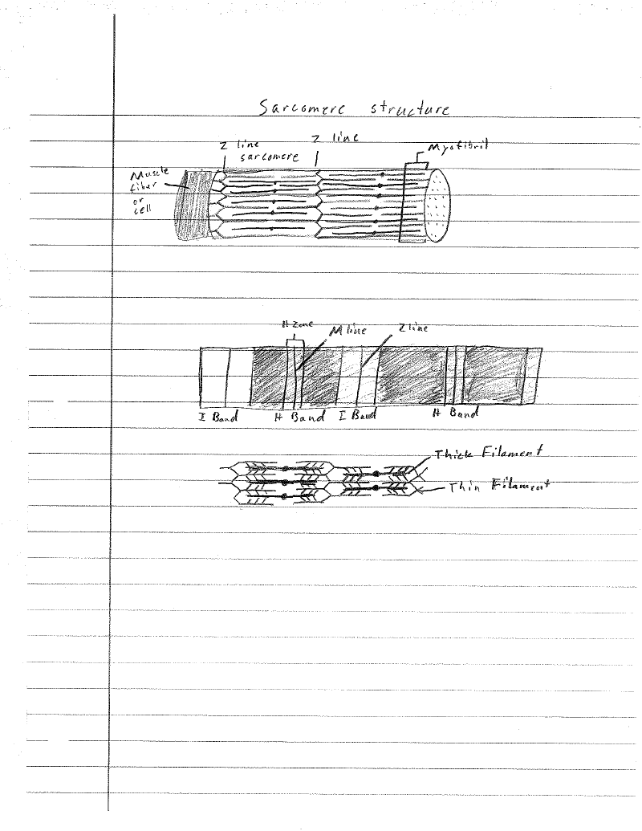
Muscular System John Donovan 4/20/12

Slide 2
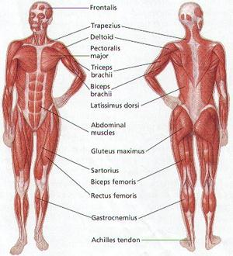
Muscular System
The muscular system’s function is producing motion, providing stabilization, and generating heat for the body.
This system lets you move and perform different taskes.

Slide 3
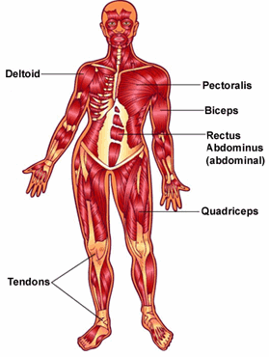
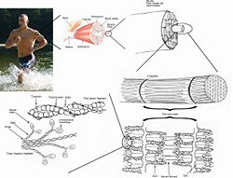
Skeletal Muscle
Skeletal muscles move and support your skeleton.
The skeletal muscles make up fifty percent of your body weight.

Slide 4
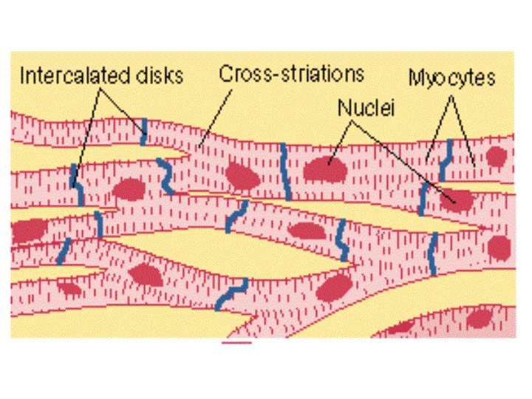
Cardiac Muscle
Cardiac muscles cells are striped, like skeletal muscle cells.
Cardiac muscles contract automatically to squeeze the walls of the heart inward.
The heart beats about 100,000 times each day by cardiac muscles.

Slide 5
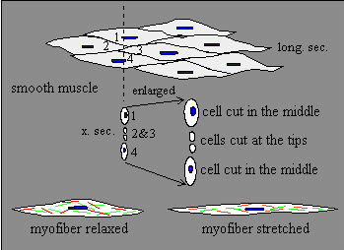
Smooth Muscle
Smooth muscle is responsible for the contractility of hollow organs, such as blood vessels, the gastrointestinal tract, the bladder.
The speed of contacting of the smooth muscle is only a small fraction of that of skeletal muscle.

Slide 6
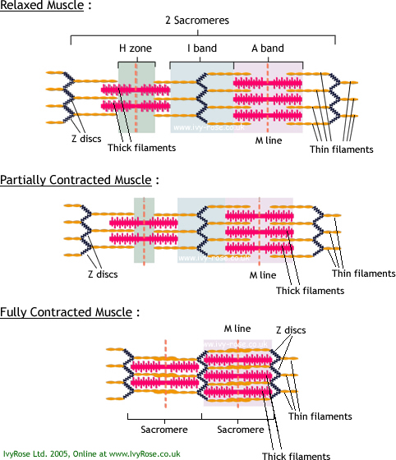
Sliding Filament Model
The contractions of muscle, through its pulling on bones, are responsible for all voluntary movements.
We generally refer to as muscle, for example the biceps brachii, is actually the largest member of a hierarchy of smaller and smaller organizational units.

Slide 7
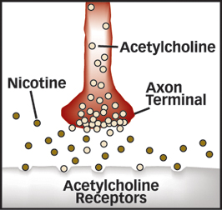
Acetylcholine
Acetylcholine is a neurotransmitter in both the peripheral nervous system and central nervous system in many organisms.
Acetylcholine is one of many neurotransmitters in the autonomic nervous system and the only neurotransmitter used in the motor division of the somatic nervous system.

Slide 8
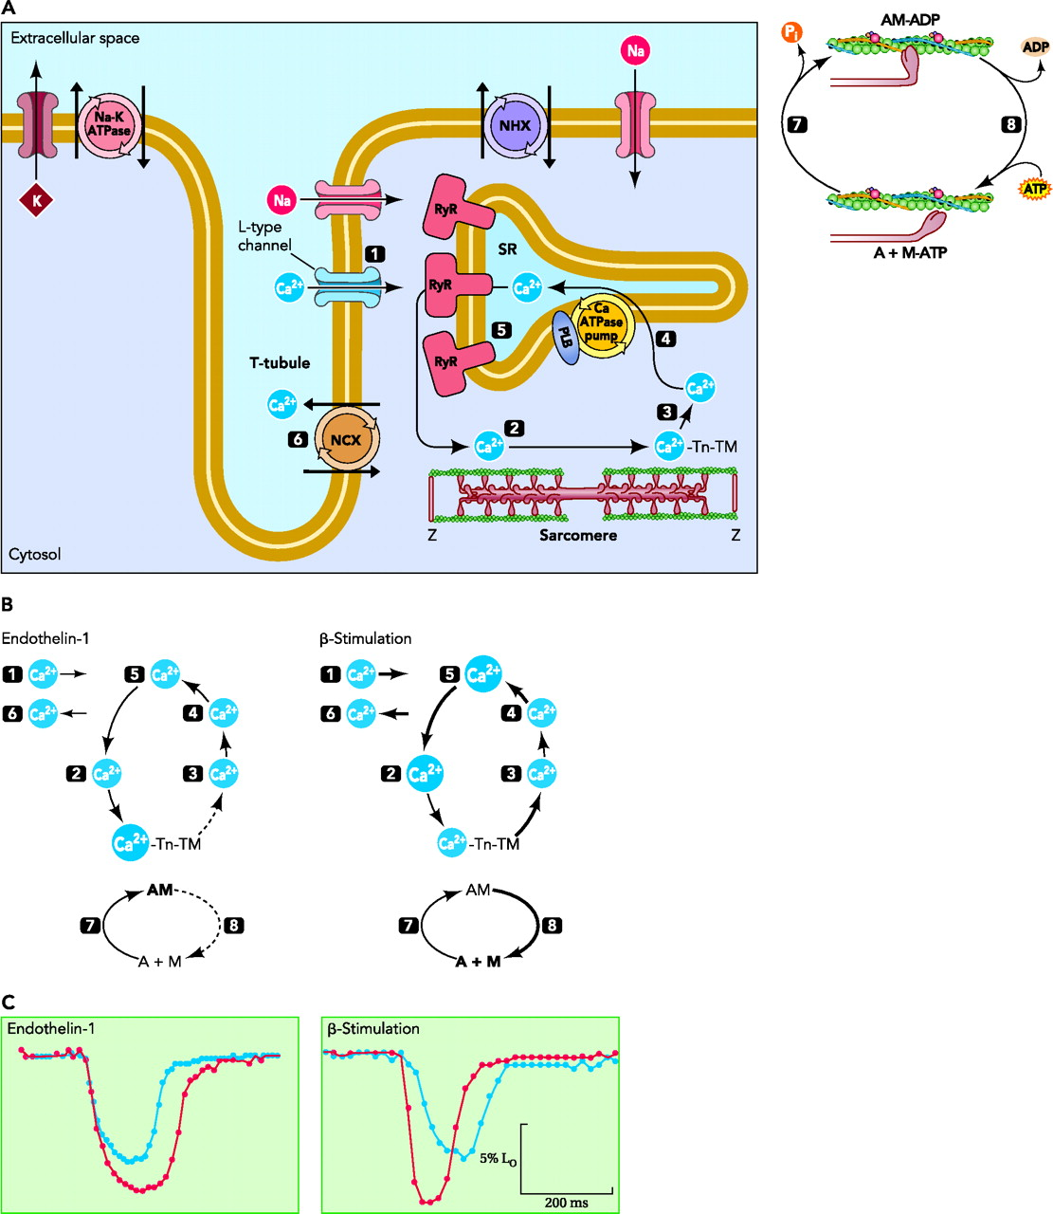
Ca and Cross Bridges
An influx of Ca²⁺ through the L-type channel during the action potential triggers a global release of Ca²⁺ through the SR resident ryanodine receptor.
Then, this binds to and activates the troponin-tropomyosin complex to allow cross-bridge cycling, force generation, and shortening of sarcomeres.
Cross-bridge cycling involves alternating attachment and detachment of myosin and actin.

Slide 9
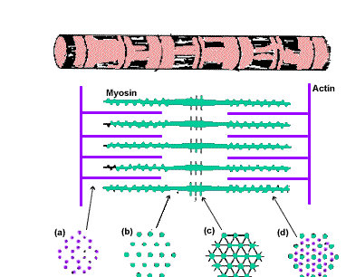
Actin and Myosin
Myosin and actin are filamentous protein molecules contained in muscles.
In the presence of calcium ions, myosin and actin will slide past each other and form cross-bridges, and then contract the muscle.

Slide 10
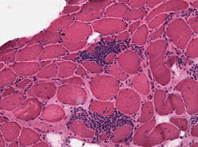
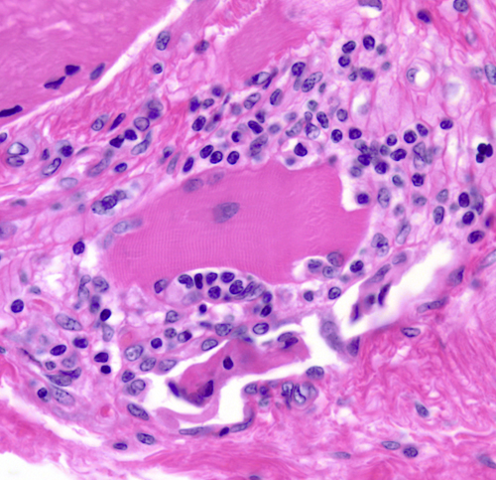
Polymyositis
Polymyositis is one of a group of muscle diseases known as the inflammatory myopathies.
These are characterized by chronic muscle inflammation accompanied by muscle weakness.
Polymyositis affects skeletal muscles on both sides of the body.

Slide 11
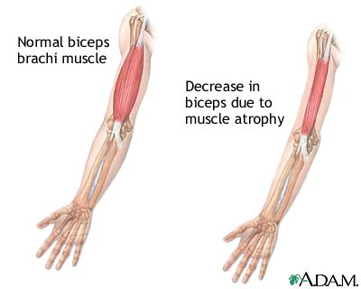
Muscular Dystrophy
Muscular dystrophy is a genetic disorder that weakens the muscles that helps the body move.
This is a genetic disorder in which the coding for a protein is missing that they need to make healthy muscles.

Slide 12
References
www.google.com
http://www.google.com/imgres?q=muscular+system&um=1&hl=en&sa=N&biw=1366&bih=649&tbm=isch&tbnid=IhaYNv0J_eq7wM:&imgrefurl=http://www.medicalook.com/human_anatomy/systems/Muscular_system.html&docid=z2nGnJJnIii4uM&imgurl=http://www.medicalook.com/systems_images/Muscular_System.jpg&w=300&h=330&ei=r_2VT5P6HcfFgAe21PD3DQ&zoom=1&iact=hc&vpx=414&vpy=161&dur=100&hovh=235&hovw=214&tx=135&ty=133&sig=106529015298774878259&page=1&tbnh=131&tbnw=119&start=0&ndsp=28&ved=1t:429,r:2,s:0,i:126
http://kidshealth.org/teen/diseases_conditions/bones/muscular_dystrophy.html
http://www.google.com/imgres?q=muscular+dystrophy&um=1&hl=en&sa=N&biw=1441&bih=685&tbm=isch&tbnid=pTJIY2s5A5-E9M:&imgrefurl=http://www.beltina.org/health-dictionary/muscular-dystrophy-symptoms-treatment.html&docid=Be4w2oe5XyjspM&imgurl=http://www.beltina.org/pics/muscular_dystrophy.jpg&w=400&h=320&ei=KAOWT_KVCMbDgAefybDZDQ&zoom=1&iact=hc&vpx=849&vpy=184&dur=136&hovh=201&hovw=251&tx=111&ty=143&sig=106529015298774878259&page=1&tbnh=144&tbnw=180&start=0&ndsp=22&ved=1t:429,r:5,s:0,i:145
http://library.thinkquest.org/5777/mus3.htm
http://www.google.com/imgres?um=1&hl=en&sa=N&biw=1366&bih=649&tbm=isch&tbnid=WwmCWNma2tfbHM:&imgrefurl=http://en.wikipedia.org/wiki/Skeletal_striated_muscle&docid=ivQcaZw7VOJfRM&imgurl=http://upload.wikimedia.org/wikipedia/commons/thumb/c/c0/Skeletal_muscle.jpg/250px-Skeletal_muscle.jpg&w=250&h=191&ei=Ji-bT4XrPK7H6AGlqqHuDg&zoom=1&iact=hc&vpx=394&vpy=199&dur=1396&hovh=152&hovw=200&tx=120&ty=80&sig=106529015298774878259&page=1&tbnh=124&tbnw=162&start=0&ndsp=19&ved=1t:429,r:1,s:0,i:138
http://www.google.com/imgres?hl=en&biw=1366&bih=649&gbv=2&tbm=isch&tbnid=30w8JoOD9-2WBM:&imgrefurl=http://www.ucl.ac.uk/~sjjgsca/MuscleCardiac.html&docid=C12dIhIE6AhtcM&imgurl=http://www.ucl.ac.uk/~sjjgsca/MuscleCardiacCells.gif&w=720&h=540&ei=my-bT73_FM_eggfyzcSbDw&zoom=1&iact=hc&vpx=573&vpy=181&dur=478&hovh=194&hovw=259&tx=80&ty=107&sig=106529015298774878259&page=1&tbnh=129&tbnw=212&start=0&ndsp=19&ved=1t:429,r:2,s:0,i:140
http://library.thinkquest.org/5777/mus5.htm
http://www.google.com/imgres?q=smooth+Muscle&hl=en&gbv=2&biw=1366&bih=649&tbm=isch&imgrefurl=http://www.mhhe.com/biosci/ap/histology_mh/nonstria.html&tbnid=aI-XIF3d4lVBJM&docid=KGJy7hJZTEgFnM&ved=0CEEQhRYoAA&ei=SjKbT_39NImlgwe0g8zkDg&dur=7309
http://www.uic.edu/classes/phyb/phyb516/smoothmuscleu3.htm
http://www.google.com/imgres?hl=en&gbv=2&biw=1366&bih=649&tbm=isch&tbnid=P0HKUwnxVBKp8M:&imgrefurl=https://ehumanbiofield.wikispaces.com/musclehomeworking&docid=Dj0wqmtqC0VfuM&imgurl=https://ehumanbiofield.wikispaces.com/file/view/Sliding-Filament_Theory.jpg/40116156/Sliding-Filament_Theory.jpg&w=482&h=560&ei=PTSbT-L3IYSZgwfv1ODwDg&zoom=1&iact=hc&vpx=357&vpy=274&dur=2100&hovh=242&hovw=208&tx=107&ty=155&sig=106529015298774878259&page=1&tbnh=132&tbnw=114&start=0&ndsp=21&ved=1t:429,r:8,s:0,i:112
http://163.16.28.248/bio/activelearner/38/ch38c1.html
http://physiologyonline.physiology.org/content/22/3/174/F3.expansion
http://www.google.com/imgres?um=1&hl=en&sa=N&biw=1366&bih=649&tbm=isch&tbnid=EjNerMEO0w1fnM:&imgrefurl=http://click4biology.info/c4b/11/hum11.2.htm&docid=H8qjwbvjrVarvM&imgurl=http://click4biology.info/c4b/11/11.2/mfiber.gif&w=382&h=306&ei=ejybT-XkCI7AgAf57tWADw&zoom=1&iact=hc&vpx=453&vpy=333&dur=3804&hovh=201&hovw=251&tx=138&ty=186&sig=106529015298774878259&page=1&tbnh=128&tbnw=158&start=0&ndsp=20&ved=1t:429,r:15,s:0,i:168
http://www.niaaa.nih.gov/Resources/GraphicsGallery/CardiovascularSystem/Pages/MyosinandActin.aspx
http://www.google.com/imgres?hl=en&gbv=2&biw=1366&bih=649&tbm=isch&tbnid=l30IsKHh4HzfUM:&imgrefurl=http://en.wikipedia.org/wiki/Polymyositis&docid=7r0gdTeSMkTKHM&imgurl=http://upload.wikimedia.org/wikipedia/commons/thumb/a/a2/Polymyositis_HE.jpg/230px-Polymyositis_HE.jpg&w=230&h=171&ei=4z-bT_3xAYfZgAfMg82jDw&zoom=1&iact=hc&vpx=216&vpy=210&dur=1901&hovh=136&hovw=184&tx=150&ty=73&sig=106529015298774878259&page=1&tbnh=129&tbnw=180&start=0&ndsp=21&ved=1t:429,r:0,s:0,i:82
http://www.ninds.nih.gov/disorders/polymyositis/polymyositis.htm
http://www.google.com/imgres?um=1&hl=en&sa=N&gbv=2&biw=1366&bih=649&tbm=isch&tbnid=d2NocgQLcUdrXM:&imgrefurl=http://neuropathology-web.org/chapter13/chapter13eInflammatory.html&docid=cN8Ncak4gVFUxM&imgurl=http://neuropathology-web.org/chapter13/images13/13-polymyositis.jpg&w=500&h=483&ei=y0GbT-7sGcu-gAepi4mWDw&zoom=1&iact=hc&vpx=445&vpy=307&dur=2959&hovh=221&hovw=228&tx=116&ty=90&sig=106529015298774878259&page=1&tbnh=127&tbnw=132&start=0&ndsp=21&ved=1t:429,r:9,s:0,i:103

