Slide 1
Reproductive System and Development John Donovan
4/9/12

Slide 2
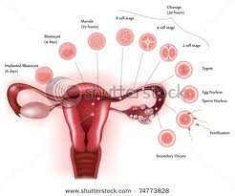
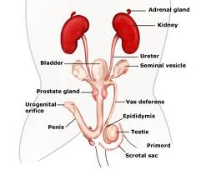
Reproductive System and Development
The function of this system is to have offspring and to reproduce fertile offspring for later generations.

Slide 3
Sexual vs Asexual reproduction
Sexual: Involves 2 parents in which they mate and create an offspring that shares half of the fathers genes and half of the mothers genes.
Asexual: Involves only one parent in which the parent produces an offspring that is genetically identical as the parent.

Slide 4
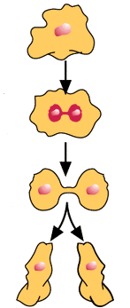
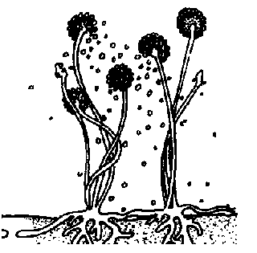
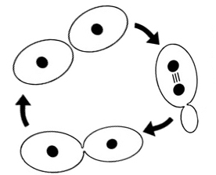
Asexual Examples:
Sporulation:
Binary fission:
Budding:

Slide 5
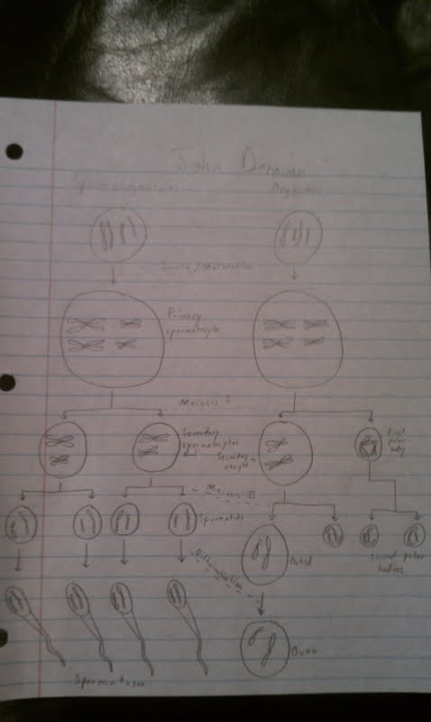
Spermatogenesis Oogenesis

Slide 6
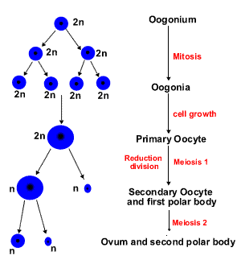
Oogenesis (unequal division of cytoplasm)
The cells divide asymmetrically to preserve as many nutrients as possible for the one egg that will go on and have a chance to be fertilized.
The cell divides so that most of the nutrients and cytoplasm will end up in one egg.

Slide 7
Menstrual vs Estrous cycle
The estrous cycle comprises the recurring physiologic changes that are induced by reproductive hormones in most mammalian placental females, while humans undergo the menstrual cycle.
The estrous cycle starts after puberty in sexually mature females. Estrous cycles usually continue until death.
Some animals may display bloody vaginal discharge, often mistaken for menstruation.

Slide 8
Hormonal Control
Hormones are produced in one cellular location in an organism, and their effects are seen in another tissue or cell type.
In mammals hormones can be proteins or steroids.
Protein hormones bind to receptors in the cell membrane and mediate gene expression through intermediate molecules.
Steroids enter the cell and interact with steroid receptor proteins to control gene expression.

Slide 9
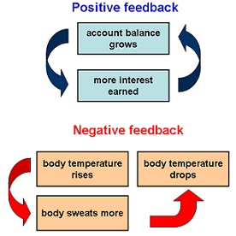
Feedback Mech
Positive and negative feedback refer to characteristics of complex systems.
Negative feedback systems are referred to as deviation inhibiting systems.
An example is at the right and another example is maintaining the temperature in a room or in our house.

Slide 10
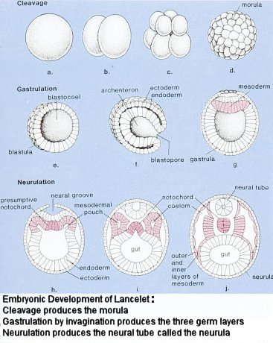
Cleavage and Gastrulation
Cleavage through Gastrulation:
Cleavage is a series of mitotic divisions in which a large egg is divided into many smaller nucleated cells called blastomeres.
Cytoplasmic volume decreases no growth occurs between these divisions.
In most species these early cell divisions are under the control of proteins and mRNAs stored in the oocyte.

Slide 11
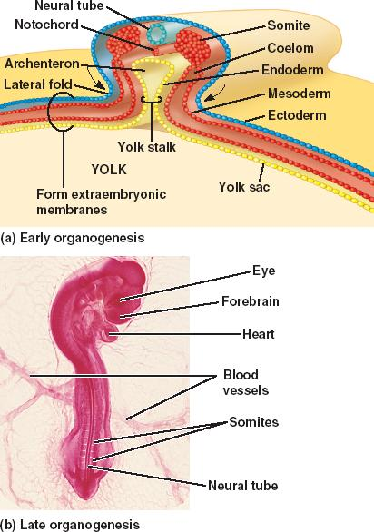
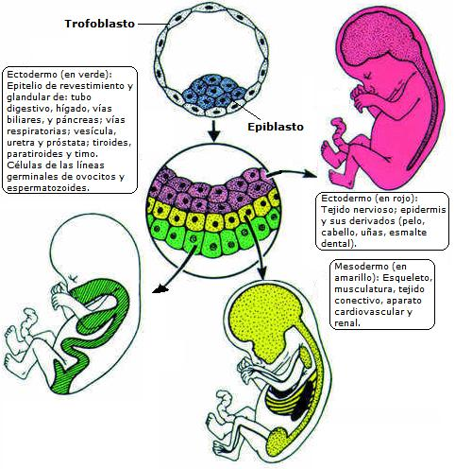
Organogenesis
This is the process of the mesoderm, the ectoderm ,and the endoderm developing into the internal organs of organisms.

Slide 12
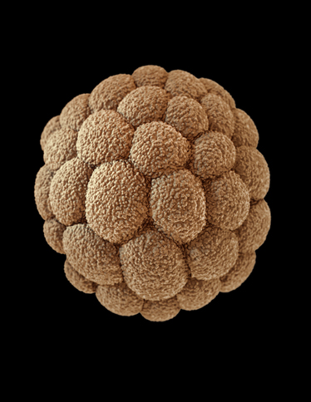
Morula, Blastula, and Gastrula
The blastula turns into the gastrula after gastrulation (Both pictured below). The morula (Pictured at the right) is an embryo in the early embryonic development.

Slide 13
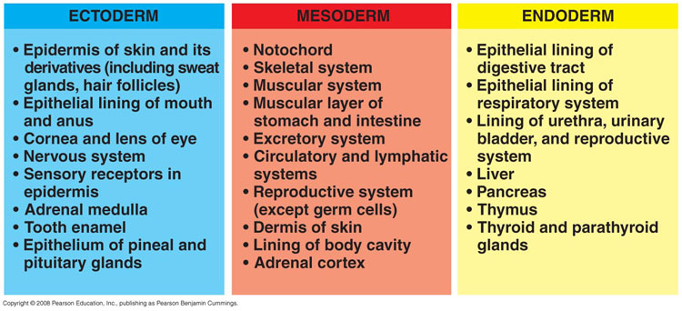
Germ Layers
I couldn’t explain it better. ☺

Slide 14
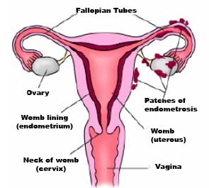
Endometriosis
Endometriosis is an often painful disorder in which tissue that normally lines the inside of your uterus grows outside your uterus.
This involves the ovaries, bowel or the tissue lining your pelvis.

Slide 15
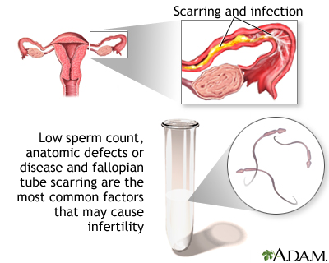
Infertility
This disorder is when a female cannot get pregnant from either because of the father or the mother.

Slide 16
References
www.google.com
http://www.google.com/imgres?um=1&hl=en&biw=1366&bih=649&tbm=isch&tbnid=06zwGotMVg__9M:&imgrefurl=http://www.ncdc.noaa.gov/paleo/abrupt/story2.html&docid=kUPmT0oRrZuRhM&imgurl=http://www.ncdc.noaa.gov/paleo/abrupt/images/story2-feedbacks.png&w=276&h=276&ei=JT-cT8WPH8HZgQe13M31Dg&zoom=1&iact=hc&vpx=579&vpy=137&dur=550&hovh=220&hovw=220&tx=110&ty=61&sig=106529015298774878259&page=1&tbnh=140&tbnw=140&start=0&ndsp=18&ved=1t:429,r:2,s:0,i:72
http://www.google.com/imgres?um=1&hl=en&biw=1366&bih=649&tbm=isch&tbnid=9v06r-urJ6kBUM:&imgrefurl=http://regentsprep.org/regents/biology/units/reproduction/asexual.cfm&docid=thWf0sS_N0XbPM&imgurl=http://regentsprep.org/regents/biology/units/reproduction/moldspores.gif&w=320&h=315&ei=K1GcT-uzIMLBgAfT1PGBDw&zoom=1&iact=hc&vpx=541&vpy=137&dur=4501&hovh=223&hovw=226&tx=123&ty=118&sig=106529015298774878259&page=1&tbnh=143&tbnw=139&start=0&ndsp=20&ved=1t:429,r:2,s:0,i:72
Myself
http://answers.yahoo.com/question/index?qid=20070828195917AAE6j0y
http://www.google.com/imgres?um=1&hl=en&biw=1366&bih=649&tbm=isch&tbnid=MCniFE05Yuj87M:&imgrefurl=http://smabiology.blogspot.com/2009_04_01_archive.html&docid=MSAc7N1vRX-03M&imgurl=http://universe-review.ca/I10-55-gastrulation.jpg&w=367&h=460&ei=62ScT8TUA4_TgQeXwKDpDg&zoom=1&iact=hc&vpx=353&vpy=123&dur=385&hovh=251&hovw=200&tx=130&ty=146&sig=106529015298774878259&page=1&tbnh=143&tbnw=113&start=0&ndsp=20&ved=1t:429,r:1,s:0,i:70
http://en.wikipedia.org/wiki/Organogenesis
http://www.google.com/imgres?um=1&hl=en&sa=N&biw=1366&bih=649&tbm=isch&tbnid=JAW3R0x-BDnaBM:&imgrefurl=http://bio1152.nicerweb.com/Locked/media/ch47/organogenesis-chick.html&docid=aLIzUlrneyZ7IM&imgurl=http://bio1152.nicerweb.com/Locked/media/ch47/47_15ChickOrganogenesis.jpg&w=412&h=586&ei=kGicT8W-BYbJgQfwl_CBDw&zoom=1&iact=hc&vpx=172&vpy=145&dur=352&hovh=268&hovw=188&tx=103&ty=138&sig=106529015298774878259&page=1&tbnh=131&tbnw=92&start=0&ndsp=21&ved=1t:429,r:0,s:0,i:110
http://www.google.com/imgres?um=1&hl=en&sa=N&biw=1366&bih=649&tbm=isch&tbnid=6TCgAS0ybuEL4M:&imgrefurl=http://grupos.emagister.com/imagen/histologia_embrionaria_organogenesis/2038-239774&docid=zcmVQ9m61XFVQM&imgurl=http://cdn2.grupos.emagister.com/imagen/histologia_embrionaria_organogenesis_239774_t0.jpg&w=482&h=496&ei=kGicT8W-BYbJgQfwl_CBDw&zoom=1&iact=hc&vpx=597&vpy=165&dur=5773&hovh=228&hovw=221&tx=132&ty=93&sig=106529015298774878259&page=1&tbnh=131&tbnw=127&start=0&ndsp=21&ved=1t:429,r:3,s:0,i:116
http://www.google.com/imgres?um=1&hl=en&biw=1366&bih=649&tbm=isch&tbnid=AGnsI5e7kOjqGM:&imgrefurl=http://www.flashcardmachine.com/bio-120-1.html&docid=EUOL0DQjSlnl6M&imgurl=http://www.bio.miami.edu/~cmallery/150/devel/c8.47x14.germ.layer.jpg&w=750&h=342&ei=J2mcT82GIofEgQeq_92BDw&zoom=1&iact=hc&vpx=576&vpy=171&dur=1105&hovh=151&hovw=333&tx=114&ty=56&sig=106529015298774878259&page=1&tbnh=86&tbnw=189&start=0&ndsp=19&ved=1t:429,r:2,s:0,i:72
http://www.google.com/imgres?um=1&hl=en&biw=1366&bih=649&tbm=isch&tbnid=pK5v-jtWuaxIrM:&imgrefurl=http://thebrain.mcgill.ca/flash/i/i_09/i_09_cr/i_09_cr_dev/i_09_cr_dev.html&docid=VFfSJw8W8BJ4dM&imgurl=http://thebrain.mcgill.ca/flash/i/i_09/i_09_cr/i_09_cr_dev/i_09_cr_dev_1c.jpg&w=550&h=160&ei=MGqcT47uH8nYgQebp4CJDw&zoom=1&iact=hc&vpx=100&vpy=187&dur=20434&hovh=121&hovw=417&tx=272&ty=45&sig=106529015298774878259&page=1&tbnh=52&tbnw=180&start=0&ndsp=18&ved=1t:429,r:0,s:0,i:68
http://www.google.com/imgres?um=1&hl=en&biw=1366&bih=649&tbm=isch&tbnid=xYTrnyJD0vffrM:&imgrefurl=http://www.anatomyblue.com/illus_09.html&docid=Oq5eM2XwS2xLAM&imgurl=http://www.anatomyblue.com/images/illus_morula.jpg&w=374&h=484&ei=h2ucT_WlEYT0ggf6_cyRDw&zoom=1&iact=hc&vpx=315&vpy=296&dur=994&hovh=255&hovw=197&tx=128&ty=151&sig=106529015298774878259&page=1&tbnh=135&tbnw=117&start=0&ndsp=21&ved=1t:429,r:8,s:0,i:125
http://www.mayoclinic.com/health/infertility/DS00310
http://www.mayoclinic.com/health/endometriosis/DS00289
http://www.google.com/imgres?um=1&hl=en&sa=N&biw=1366&bih=649&tbm=isch&tbnid=DkfJjVfGROrV5M:&imgrefurl=http://www.nlm.nih.gov/medlineplus/ency/imagepages/17074.htm&docid=y9Pr-zmGh8afaM&imgurl=http://www.nlm.nih.gov/medlineplus/ency/images/ency/fullsize/17074.jpg&w=400&h=320&ei=-W2cT6zVA4nqgQeqmsjyDg&zoom=1&iact=hc&vpx=353&vpy=176&dur=8245&hovh=201&hovw=251&tx=134&ty=79&sig=106529015298774878259&page=1&tbnh=127&tbnw=159&start=0&ndsp=21&ved=1t:429,r:1,s:0,i:151
http://www.google.com/imgres?um=1&hl=en&biw=1366&bih=649&tbm=isch&tbnid=3VC_KKzfo5hsPM:&imgrefurl=http://www.whathealth.com/awareness/event/endometriosis.html&docid=Exza7CjCklZyZM&imgurl=http://www.whathealth.com/awareness/images/endometriosis.jpg&w=295&h=265&ei=1nCcT8asKtHOgAfn8_DnDg&zoom=1&iact=hc&vpx=516&vpy=144&dur=7900&hovh=212&hovw=236&tx=88&ty=94&sig=106529015298774878259&page=1&tbnh=146&tbnw=163&start=0&ndsp=18&ved=1t:429,r:2,s:0,i:72
http://www.google.com/imgres?um=1&hl=en&sa=N&biw=1366&bih=649&tbm=isch&tbnid=UdA1nzgEW3cGPM:&imgrefurl=http://click4biology.info/c4b/11/hum11.4.htm&docid=iFSX_c0lHVXO2M&imgurl=http://click4biology.info/c4b/11/11.4/OOgenesis.gif&w=300&h=323&ei=BIacT7WFGMbOgAeU4rmkDw&zoom=1&iact=hc&vpx=380&vpy=133&dur=2142&hovh=233&hovw=216&tx=129&ty=87&sig=106529015298774878259&page=1&tbnh=144&tbnw=133&start=0&ndsp=20&ved=1t:429,r:2,s:0,i:74

