Slide 1
Human Body Systems
By Laurelle Anderson

Slide 2
Body Systems
Digestive system
Circulatory system
Respiratory system
Excretory system
Immune system
Endocrine
Skeletal system
Muscular system
Senses system
Reproductive system
Nervous system

Slide 3
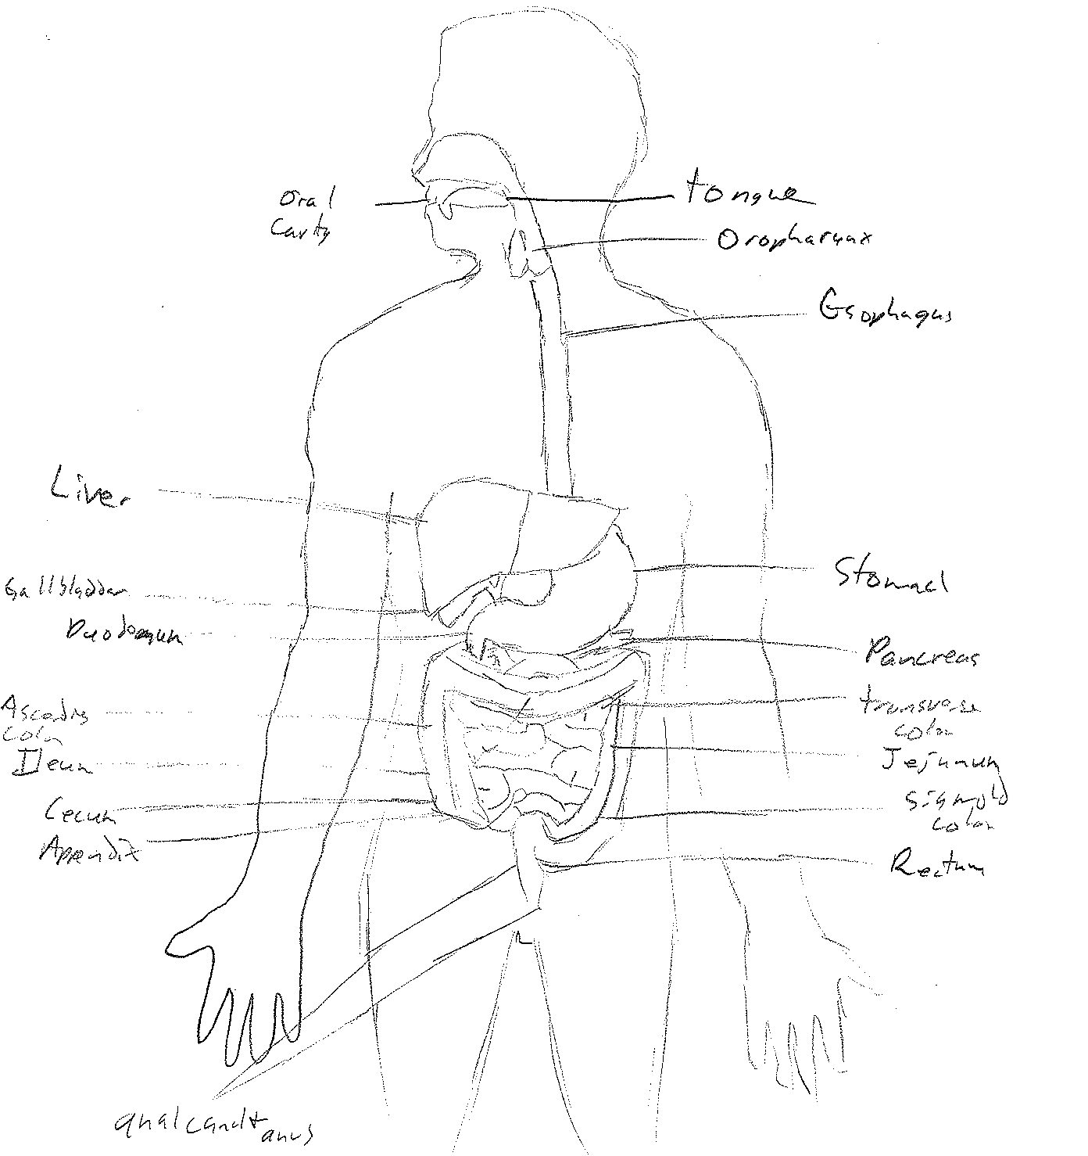
Digestive System
The digestive system breaks down the food particles humans ingest into usable forms.

Slide 4
Organs of the Digestive System
Mouth, Esophagus
Stomach
Liver, Gallbladder
Pancreas
Small Intestine
Large Intestine
NEXT SLIDE

Slide 5
Mouth and Esophagus
As one eats saliva builds up
Chewing grinds the pieces of food and mix it with an enzyme called salivary
amylase
Tongue pushes particles into esophagus into the stomach
Back

Slide 6
Stomach
Takes food from the esophagus
Mixes it with enzymes (pepsins and hydrochloric acid) until it is a liquid called chyme
Stomach is the main digester of proteins such as meat and diary products
Back

Slide 7
Liver and Gallbladder
The liver secretes bile into the small intestine to digest fats
The liver also breaks down proteins and carbohydrates, stores glycogen, makes a stuff to clot blood, makes vitamin A and recycles red blood cells
The Gallbladder also makes bile that is secreted into the small intestine
Back

Slide 8
Pancreas
Secretes pancreatic fluids (enzymes with sodium bicarbonate) to stop the pepsins from digesting any more
The pancreas also makes insulin to regulate blood sugar
Back

Slide 9
Small Intestine
Divided into three parts: duodenum, jejunum and ileum (major areas where digestion and absorption happen)
Main purpose if to absorb food into the blood stream (then into the cells)
Back

Slide 10
Large Intestine
Divided into three parts: cecum, colon and rectum
Completes the absorption of food and processes the waste into feces
Makes vitamin B and vitamin K
Back

Slide 11
Alimentary vs. Accessory Organs
Alimentary organs are a continuous tube the digests and absorbs food particles
Accessory organs physically break down food with teeth and secrete enzymes into the GI track to break down the food particles

Slide 12
Disease of the Digestive System
Celiac Disease
Barrett’s Esophagus

Slide 13
Celiac Disease
It is an autumnal response to gluten (a protein in wheat, barley, and rye) damaging the small intestine villi affecting a persons ability to absorb nutrients
Symptoms: constipation, diarrhea, intestinal swelling, fatty stool and weight loss
Back

Slide 14
Barrett’s Esophagus
When the lining of the esophagus becomes like the lining of the intestines
Home Page

Slide 15
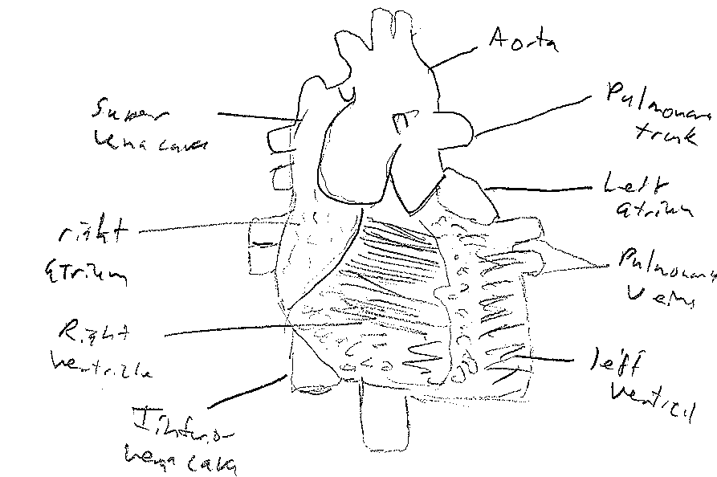
Circulatory system
From the heart blood takes oxygen and nutrients to the body and returns with carbon dioxide and other waste products

Slide 16
Structure and Function of Blood Vessels
To move blood from heart to body and back to heart
Three types of blood vessels: Arteries (carry blood away from heart), Capillaries (connects arteries to veins), and Veins (take blood back to heart)

Slide 17
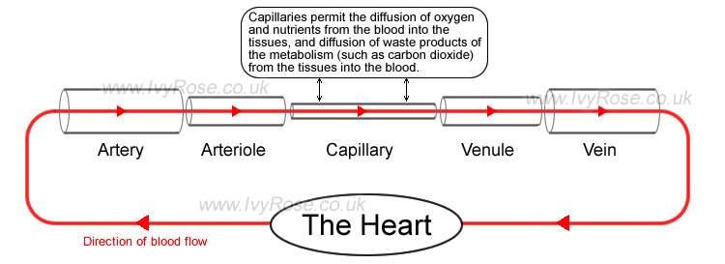
The Movement of Blood
Blood starts in the heart then moves threw the pulmonary vain into the lungs. Back into the heart and into arteries then smaller tubes called arteriole. Arteriole into capillaries. From the capillaries to venule which leads to the veins and back into the heart

Slide 18
What Blood is Made of
When blood is sent threw a centrifuge (spin) three layers are formed
Plasma: straw colored liquid about 55%
Buffy coat (white blood cells and platelets): cream colored
Red blood cells: heaviest portion 45%

Slide 19
Erythrocytes (Red Blood Cells)
They are flat disks with indents on both sides with an outer membrane made of lipids
Does not have a nucleus
Carries oxygen to cells for their repertory needs

Slide 20
Open vs. Closed Systems
Open: when the blood goes from the heart but leaves the blood vessels and enters body cavities, blood moves slower and muscles must contract to move the blood.
Ex: spiders
Closed: blood is contained in vessels, valves prevent blood moving backward in vessels.
Ex: octopi

Slide 21
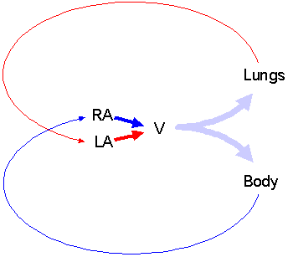
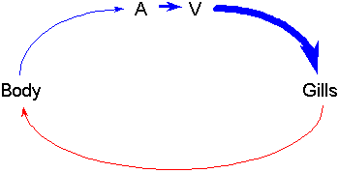
Fish and Amphibian Circulation
Fish: two chambered heart (atrium and ventricle) blood moves from heart to gills then body and back to heart
Amphibians: blood flows from lungs to heart, atria move into ventricle, this system keeps high pressure leading to lungs and the body.

Slide 22
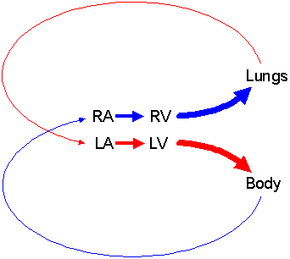
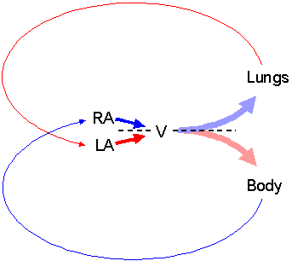
Reptile and Mammal Circulation
Reptile: ventricles are separated making it so oxygenated blood and deoxygenated blood do not mix
Mammal: have four chambered heart with two pumps, blood stays at a high pressure which allows for mammals to have a high activity rate

Slide 23
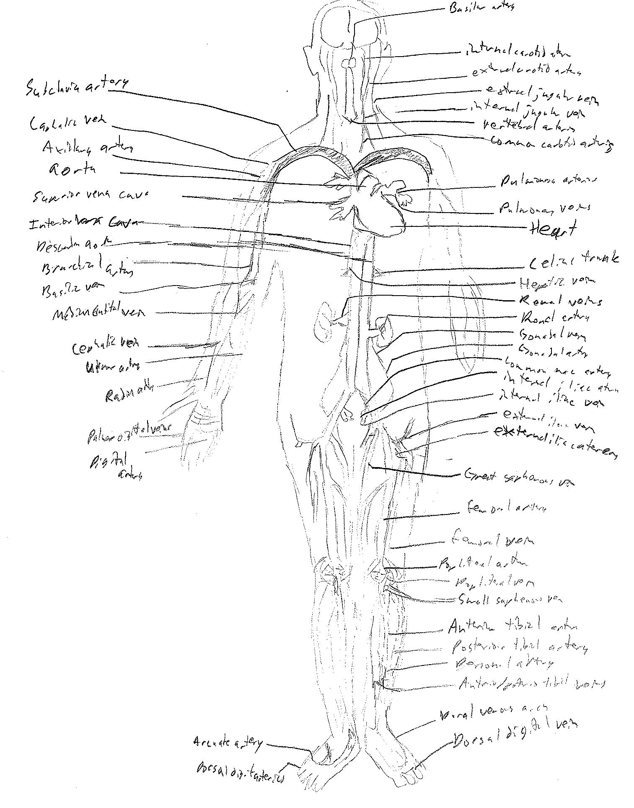
Circulatory Disorders
Atherosclerosis
Aneurysm

Slide 24
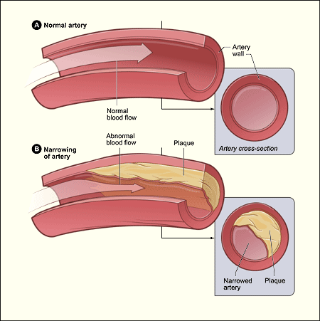
Atherosclerosis
The build up of plaque in arteries
Plaque (fat, cholesterol, calcium, and other particles found in the blood).
Plaque hardens over time causing the arteries to narrow making blood flow harder
Back

Slide 25
Aneurysm
Abnormal bulge in blood vessel wall
Small aneurysms are not life threatening at all
Plaque can build up at the site of an aneurysm
If the aneurysm is large it can press on the organs
The aneurysm thins the wall of the vessel which may cause it to burst… life threatening
Home Page

Slide 26
Respiratory System
To provide oxygen to the cells and organ systems of the body
To rid the body of carbon dioxide

Slide 27
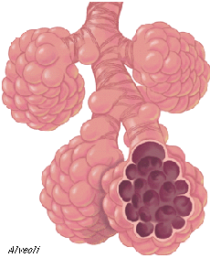
Alveoli
Primary gas exchange in the lung
Oxygen diffuses through the aveloar epithelium (thin space in alveoli)
CO2 follows the same path backwards

Slide 28
Carbon Dioxide Transport
Carbon dioxide starts in the tissue then moves into capillary vessels after that into the venula then the veins
After the veins it goes into the vena cava superior/inferior then the right atrium then right ventricle
after that it moves into the pulmonary arteries then lungs' alveoli then breathed out into the environment

Slide 29
Oxygen Transport
A human breathes in air from the environment then moves into the lungs’ alveoli then into the pulmonary arteries
It goes into the right ventricle then the right atrium after that it moves into the vena cava superior/inferior then out to the veins
Oxygen goes from the veins to the venula into capillary vessels then out to the tissue cells

Slide 30
Oxygen from air to hemoglobin
Lungs remove oxygen from air
Oxygen combines with the heme (iron) part of hemoglobin
The more oxygen molecules the higher the likelihood of them binding to hemoblobin
cyanide (CN) and carbon monoxide (CO) are competitive inhibitors of oxygen to the active site on hemoglobin.

Slide 31
Inhalation
taking air into the lungs
Air will flow from high pressure to low pressure so the pressure in the lungs must be less than in the atmosphere
Relaxing the diaphragm and opening the ribcage creates a greater volume in the lungs
All of this creates a low pressure system in the lungs causing the air to flow in

Slide 32
exhalation
Sending air out of the body
To push the air out the body needs to create a high pressure system in the lungs to do this the diaphragm tightens and the ribs come in
Making a smaller volume in the lungs pushes the air out

Slide 33
Lung cancer
It is a cancer that begins in the lungs
Mainly caused by smoking
It can be treated by radiation, chemotherapy, or surgery

Slide 34
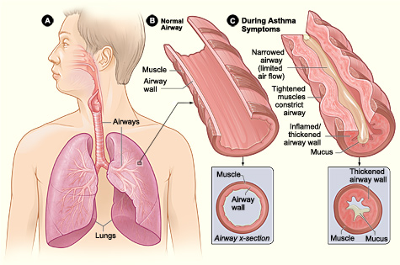
asthma
Chronic disease where air ways are inflamed and narrowed
Symptoms- wheezing, chest tightness, shortness of breath, and coughing (mainly in the morning or at night).
airways get smaller causing the muscles that surround them to tighten. Less air to the lungs
Mucus build up
Home Page

Slide 35
Excretory system
Removes wastes from our bodies
Several organs remove the waste ( sweat glands, kidneys, lungs)

Slide 36
Nitrogenous wastes
Urea (100,000 times less toxic than ammonia less allows a more efficient use of water to discard nitrogenous wastes, produced in liver by the metabolic cycle)
Uric acid (allows for minimal water loss, not very soluble in water)
Creatinine (produced in the muscles and removed by kidneys)
Animals such as snails, insects and some birds dispose of nitrogenous wastes with uric acid

Slide 37
Nephron
Bowman’s capsule
Juxtamedullary nephron

Slide 38
Bowman’s capsule
Filters organic wastes, inorganic salts and water
Back

Slide 39
Juxtamedullary nephron
Develops osmotic gradients and renal medulla and concentrates urine.

Slide 40
Excretory process
Blood moves to the kidneys and filtered by pressure
The substances filtered from the blood is sent threw the ureters to the bladder where they are then expelled threw the urethra

Slide 41
Kidney infection
Bacteria travel from the bladder threw the ureters and into the kidneys. Can also come from the blood
Symptoms (Painful urination, mid back pain, fever nausea/vomiting)

Slide 42
Kidney stones
They are hard build up of saults in the kidneys
Cause pain the abdomen and groin
To get rid of kidney stones one must pass it threw their urinary tract and pretty much pee it out
Home Page

Slide 43
Immune system
Defends the body against diseases
Attacks organisms that invade the body by going threw the immune response steps

Slide 44
Major immune organs
Bone Marrow (creates all the cells of the immune system)
Thymus Gland (sight where cells from the bone marrow are matured)
Spleen (destroys old red blood cells, filters blood for foreign materials)
Lymph Nodes (filter and drain lymph from body systems)

Slide 45
Pathogens and Antigen
Antigen- specific meaning it reacts to specific things on the surface of a pathogen
The antibody then remembers the pathogen for future activation and destruction
Antigens are molecules on the surface of pathogens that the immune system recognizes and takes out

Slide 46
antibodies
Immunoglobins (antibodies) are divided into five classes by their function and structure
They are the key components to fighting pathogens

Slide 47
Innate vs. acquired
Innate (non-specific) immunity responds quickly and to any antigen but causes no immunologic memory, ex: stomach acid
Acquired immunity responds slower but is antigen specific and causes immunologic memory to the specific antigen, ex: once a person get chicken pox they don’t get it again because they now have antibodies against it

Slide 48
Active vs. passive
Active: defense against pathogens that the body has personally developed, ex: diphtheria
Passive: passing of antibodies from an immune host that is only temporary, ex: flu shots

Slide 49
Humoral vs. cell-mediated
Humoral: acquired immunity that circulates antibodies, ex: hepatitis B vaccine
Cell-mediated: acquired immunity were the T lymphocytes are dominant, ex: Delayed-Type Hypersensitivity (DTH) (tuberculin test)

Slide 50
B vs. t lymphocytes
B lymphocytes: immune cells that are made in bone marrow
T lymphocytes: attact any cells that are harmful to the body they are a type of white blood cell

Slide 51
Antibiotics
Help a body defend against bacteria
Bacteria can develop a resistance to antibiotics when they are not properly taken

Slide 52
Aids
Symptoms are fever, sore throat, sore muscles, and swollen glands
Spread by bodily fluids
Test the blood to find if a person has it

Slide 53
allergies
When pollen or other allergens enter the body it causes a reaction where the immune system starts attracting the body and cause inflammation dry eyes and other problems
Home Page

Slide 54
Endocrine system
Controls hormones
Hormones are the bodies way to send messages and telling cells to grow or have the body start sweating or salivating

Slide 55
Homeostasis
Hypothalamus is the control center of the endocrine system and regulates interactions between the endocrine and nervous system
To keep the internal environment stable there are several subconscious reactions that happen with in the endocrine system

Slide 56
Negative feedback
Regulates the secretion of hormones keeping body in homeostasis
There are secretion cycles to keep physiological and homeostatic control
Secretion of one gland is maintained by the secretion of another gland, ex: pituitary and thyroid gland

Slide 57
Diabetes I vs. II
In type 2 diabetes the body either ignores or cannot make insulin. Causes a build up of glucose that may cause harm to vital organs
In type 2 diabetes also the body either ignores insulin or cannot make it, also causes a build up of glucose that can damage organs but it can be managed with diet and exercise

Slide 58
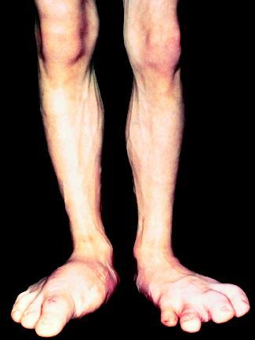
Acromegaly
Too much growth hormone causing tissues to become enlarged and misshappen
Home Page

Slide 59
Skeletal system
Support the body
Store minerals
Help in movement
Protection
Made blood cells
Store chemical energy

Slide 60
Movement
Bones only move at joints
Tendons are attached to muscles which contract pulling the tendon away from the bone causing movement .
Ligament stabilise joints by holding the bones steady

Slide 61
Types of skeletons
Hydrostatic skeleton: fluid filled chambers held under pressure found in worms and other such animals
Exoskeleton: hard shell on the outside of insects and crustaceans
Endoskeleton: skeleton on the inside found in mammals and other animals

Slide 62
Osteophytes
Bit of bone that pops out of the side the bond into the joint

Slide 63
Porotic hyperostosis
Makes the bones soft
Marrow in skull becomes over grown
Causes thinning of bones
Home Page

Slide 64
Muscular system
Protects organs
Pumps blood in the heart
Smooth muscle helps digests food
Smooth muscle helping with blood flow

Slide 65
Types of muscle
Skeletal muscle: muscle used in movement like walking or lifting
Cardiac muscle: muscle around the heart and near large veins
Smooth muscle: powers organs and is controled by the nervous system

Slide 66
Sliding filament model
Muscle fibers contract and slide against each other to create movement
Acetylcholine: neuron transmission that causes contraction
Actin and Myosin: the moving parts in myofilaments that aid in contraction

Slide 67
CA and cross-bridges
Bond helps in contraction of muscles and movement of the body

Slide 68
Duchenne Muscular Dystrophy
Starts at 2-6 years old
Muscle fatigue starting in the hip area
Passed on by X-linked recessive

Slide 69
polymyositis
Inflamed muscles
Onset in later life
Tired and burning feeling in muscles
Home Page

Slide 70
Senses system
System used to interoperate the outside world

Slide 71
Mechanoreceptors
Senses touch, pressure, stretching, sound waves, and motion
Used to detect sound, motion, and the position of the bones and muscles

Slide 72
thermoeceptors
Detects the temperature of the inside and outside environment

Slide 73
chemoreceptors
Sense of taste and smell
A body’s response to chemicals in the environment
Some chemicals cause a response in cells

Slide 74
photoreceptors
Sight
Cones see colour
Rods see intensity of light
Retina makes the image

Slide 75
Pain receptors
Also known as a nociceptor
Feel pain from an injury or other reasons

Slide 76
rhodopsin
Chromoprotien
Responds to lights to help the eye adjust to changes
Pigment

Slide 77
Cell signaling
Mechanisms that cells use to respond to outside stimuli
Home Page

Slide 78
Reproductive system and development
Make gametes that combine to make babies

Slide 79
Sexual vs. asexual
Asexual reproduction means that it reproduces with one organism, ex: yeast, green algae, thermophiles, and molds
Sexual reproduction: between two organisms of the same species

Slide 80
Spermatogenesis
The production of sperm in male reproductive organs

Slide 81
oogenesis
The production of eggs in the female reproductive organs
It creates polar bodies because with thee eggs with just the bare minimum it can make one egg that is most adapted to survive

Slide 82
Menstrual vs. estrous cycle
Estrous: in mammals like cats and dogs, no blood, when it happens the female is in heat, hormones controlled by ovaries, feedback controlled by steroids in the ovaries
Menstrual: in mammals like humans and some primates, monthly bleeding cycle, female can receive male at any time, hormones controlled by the ovaries, feedback controlled by steroids

Slide 83
Gastrulation
Cleavage is the first step in gastrulation when the egg first splits
Gastrulation is the process were the egg develops the into the anus and mouth
Organogenesis: the development of organs
Morula: spherical mass that happens after the first clevage
Blastula: sphere of cells with fluid filled cavity in the center
Gastrula: hallow two layered sac

Slide 84
Germ layers
Ectoderm: turns into epidermis, brain and nervous system
Endoderm: digestive tract, inner respiratory tissues, and glands
Mesoderm: notocord, dermis, circulatory system, bones, cartilage, muscles, excretory system, outer covering of internal organs
Home Page

Slide 85
Nervous system
Function: send signals from one cell to another

Slide 86
Cns and pns
Central nervous system: inner brain and spinal cord, sending original messages
Peripheral nervous system: Ganglia, outer bran, and spinal cord, Connects CNS to limbs and organs

Slide 87
Nerve impulse
Sends electrical impulses from the brain to the rest of the body
K+ passes into cell
Cl- and Na+ cross over also
Negatively charged protein molecules can’t pass in neuron
Energy is used
Potential difference is made

Slide 88
neurotransmitters
Transmissions signals across synapses
They are also found at the axon endings to send stimuli to muscles

Slide 89
influences
EPSP: (Excitatory postsynaptic potential) depolarization of postsynaptic membrane in response to a neurotransmitter;
IPSP: (Inhibitory postsynaptic potential) change of hyperpolarization of the postsynaptic membrane of a neuron responding to an inhibitor
BIBLIOGRAPHIES

Slide 90
Bibliography Digestive System
http://digestive-system.emedtv.com/digestive-system/function-of-the-digestive-system.html
http://hepatitis.about.com/od/overview/ig/Organs-of-Digestive-System/
http://classes.midlandstech.com/carterp/Courses/bio211/chap23/chap23.htm
http://digestive.niddk.nih.gov/ddiseases/pubs/celiac/
http://digestive.niddk.nih.gov/ddiseases/pubs/barretts/
http://www.ama-assn.org/ama/pub/physician-resources/patient-education-materials/atlas-of-human-body/digestive-system.page

Slide 91
Bibliography Circulatory System
http://yucky.discovery.com/flash/body/pg000131.html
http://en.wikipedia.org/wiki/Circulatory_system
http://www.fi.edu/learn/heart/vessels/vessels.html
http://www.ivy-rose.co.uk/HumanBody/Blood/Blood_Vessels.php
http://www.dummies.com/how-to/content/the-path-of-blood-through-the-human-body.html
http://chemistry.about.com/cs/5/f/blbloodcomp.htm
http://faculty.clintoncc.suny.edu/faculty/michael.gregory/files/bio%20102/bio%20102%20lectures/circulatory%20system/circulat.htm
http://www.nhlbi.nih.gov/health/health-topics/topics/atherosclerosis/
http://www.medicinenet.com/vascular_disease/page2.htm#aneurysm

Slide 92
Respiratory System Bibliography
http://library.thinkquest.org/5777/resp1.htm
http://oac.med.jhmi.edu/res_phys/Encyclopedia/Alveoli/Alveoli.HTML
http://www.biology-online.org/biology-forum/about2856.html
http://biology.kenyon.edu/slonc/bio3/Hemoglobin_CO2.pdf
http://www.uic.edu/classes/bios/bios100/lecturesf04am/lect20.htm
http://wiki.answers.com/Q/What_happens_during_inhalation_and_exhalation
http://www.idph.state.il.us/about/womenshealth/factsheets/lung.htm
http://www.nhlbi.nih.gov/health/health-topics/topics/asthma/

Slide 93
Excretory system bibliography
http://www.unit5.org/ncwhsimc/Hotlists/excretory_system.html
http://library.thinkquest.org/10348/find/content/excretory.html
http://www.biologycorner.com/worksheets/rat_urogenital.html
http://ex-anatomy.org/nitro.html
http://bio1152.nicerweb.com/Locked/media/ch44/nephron.html
http://en.wikipedia.org/wiki/Creatinine
http://groups.molbiosci.northwestern.edu/holmgren/Glossary/Definitions/Def-B/Bowmans_capsule.html
http://en.wikipedia.org/wiki/Juxtamedullary_nephron
http://www.sciencedaily.com/articles/e/excretory_system.htm
http://www.medicinenet.com/kidney_stone/article.htm#tocb

Slide 94
Immune system bibliography
http://kidshealth.org/parent/general/body_basics/immune.html
http://www.buzzle.com/articles/organs-of-the-immune-system.html
http://ar.iiarjournals.org/content/29/11/4855.full.pdf
http://www.uta.edu/chagas/html/biolImmu.html
http://pathmicro.med.sc.edu/ghaffar/innate.htm
http://www.medterms.com/script/main/art.asp?articlekey=26309
http://www.biology-online.org/dictionary/Active_immunity
http://armymedical.tpub.com/MD0587/MD05870014.htm
http://en.wikipedia.org/wiki/Immunity_(medical)
http://medical-dictionary.thefreedictionary.com/humoral+immunity
http://users.rcn.com/jkimball.ma.ultranet/BiologyPages/C/CMI.html
http://www.cancer.gov/dictionary?cdrid=467345
http://www.drreddy.com/antibx.html#abxwhat
http://www.medicinenet.com/human_immunodeficiency_virus_hiv_aids/article.htm

Slide 95
Endocrine system bibliography
http://kidshealth.org/teen/your_body/body_basics/endocrine.html
http://www.nativeremedies.com/articles/endocrine-system-and-homeostasis.html
http://www.diabeticcareservices.com/diabetes-education/types-of-diabetes

Slide 96
Skeletal system bibliography
http://www.ivy-rose.co.uk/HumanBody/Skeletal/Skeletal_System.php
http://www.tutorvista.com/content/biology/biology-iv/locomotion-animals/movements.php
http://en.mimi.hu/biology/hydrostatic_skeleton.html
http://www.thefreedictionary.com/exoskeleton
http://en.wikipedia.org/wiki/Bone_spur
http://en.wikipedia.org/wiki/Porotic_hyperostosis

Slide 97
Muscular system bibliography
http://www.livestrong.com/article/114706-five-functions-muscular-system/
http://www.medterms.com/script/main/art.asp?articlekey=5502
http://medical-dictionary.thefreedictionary.com/cardiac+muscle
http://163.16.28.248/bio/activelearner/38/ch38c1.html
http://www.mdausa.org/disease/40list.html
http://www.angelfire.com/in2/mandy2/

Slide 98
Senses system bibliography
http://users.rcn.com/jkimball.ma.ultranet/BiologyPages/M/Mechanoreceptors.html
http://www.newworldencyclopedia.org/entry/Thermoreception
http://www.britannica.com/EBchecked/topic/109023/chemoreception
http://en.wikipedia.org/wiki/Sensation_(psychology)#Photoreceptors
http://medical-dictionary.thefreedictionary.com/nociceptor
http://www.britannica.com/EBchecked/topic/501725/rhodopsin
http://www.sysbio.org/sysbio/cellsignaling.stm

Slide 99
Reproductive system bibliography
http://www.livestrong.com/article/37137-reproductive-system-functions/
http://www.buzzle.com/articles/organisms-that-reproduce-asexually.html
http://users.rcn.com/jkimball.ma.ultranet/BiologyPages/S/Sexual_Reproduction.html
http://www.rci.rutgers.edu/~uzwiak/HumanSexuality/HSSpringLect3.html
www.strathmorehighschool.com/.../...
http://www.britannica.com/EBchecked/topic/375300/menstruation/75986/Hormonal-control-of-menstrual-cycle
http://humupd.oxfordjournals.org/content/12/5/557.full
http://en.wikipedia.org/wiki/Estrous_cycle
http://medical-dictionary.thefreedictionary.com/organogenesis
http://medical-dictionary.thefreedictionary.com
http://www.luc.edu/faculty/wwasser/dev/layer.htm

Slide 100
Nervous system bibliography
http://www.news-medical.net/health/Function-of-the-Nervous-System.aspx
http://labs.ansci.illinois.edu/novakofski/bse/human_cns_structure_function.htm
http://en.wikipedia.org/wiki/Peripheral_nervous_system
http://www.biologymad.com/nervoussystem/nerveimpulses.htm
http://webspace.ship.edu/cgboer/genpsyneurotransmitters.html
http://medical-dictionary.thefreedictionary.com/EPSP
http://medical-dictionary.thefreedictionary.com/inhibitory+postsynaptic+potential

