Slide 1
Human Body Systems
By Marie Gengler

Slide 2
Table of Contents
Nervous System
Muscular System
Skeletal System

Slide 3
Nervous System

Slide 4
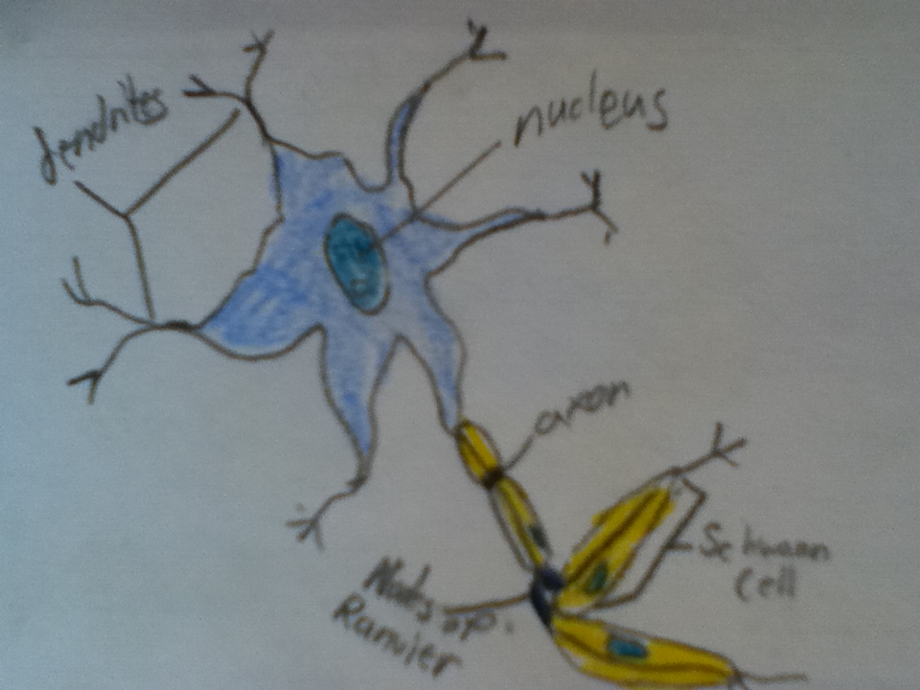
Nervous System
The function of the nervous system is to nourish neurons and send and receive messages.
The central nervous system is the part that interprets, creating sensations.
Brain
Spinal Cord
The peripheral nervous system is the part that brings in messages.
Nerves

Slide 5
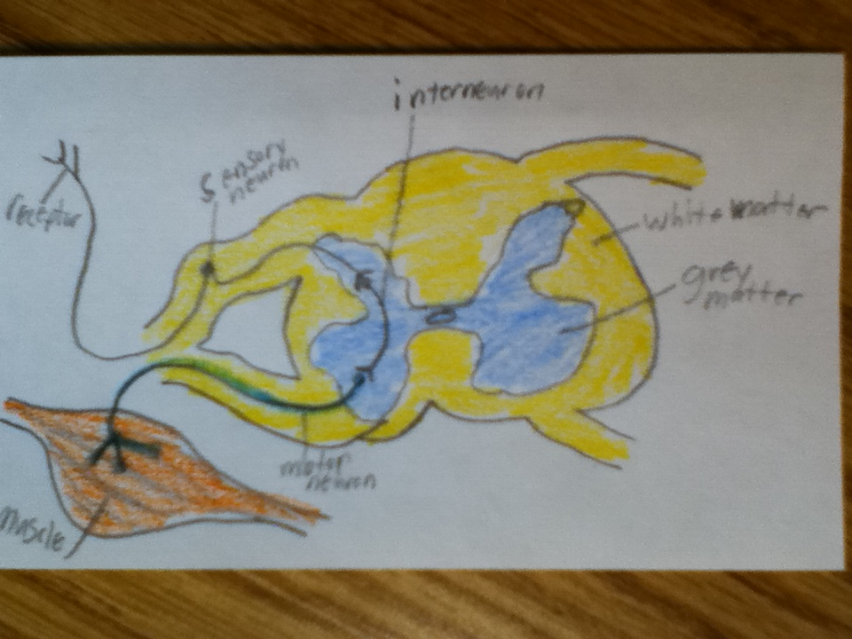
Nervous System
A reflex arc has a receptor that sends responses to sensory neuron.
Then it is sent through the Interneuron and is taken by a motor neuron to muscles needed in movement/reaction.

Slide 6
Nervous System
The cerebral hemispheres make up the cerebrum.
The brain Stem makes up the pons, medulla oblongata, and midbrain.
The cerebellum coordinates skeletal muscle movements.
The diencephalon contains the thalamus and hypothalamus.

Slide 7
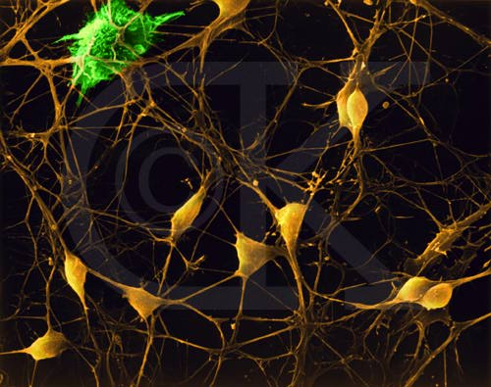
Nervous System
Neuron impulses pass neuron to neuron at synapses.
A membrane is depolarized when it becomes less negative.
The membrane potential of a neuron is the difference across the cell.
When the membrane does not have any impulses it is in resting potential.
When threshold is reached active potential occurs.
The active potential is when there are nerve impulses.
The refractory period is when Na+ changes permeability to reestablish resting potential.

Slide 8
Nervous System
Neurotransmitters are chemicals that neurons produce to communicate with the cell that they control.
It influences neurons by being a space that neurons messages can pass through.

Slide 9
Nervous System
Parkinson's Disease
Parkinson’s disease is the loss of brain cells.
Symptoms of it are memory loss and the loss of function.
It occurs between the ages of fifty and over.
Treatment options include medicines that can delay symptoms.

Slide 10
Nervous System
Multiple Sclerosis
Multiple Sclerosis is an autoimmune disease that effects the brain and spinal cord.
Symptoms include fever, numbness, loss of balance, and loss of muscle functioning.
It is more common in woman between the ages of twenty and forty.
It is treated with medications, but it can not be cured.

Slide 11
Muscular System

Slide 12
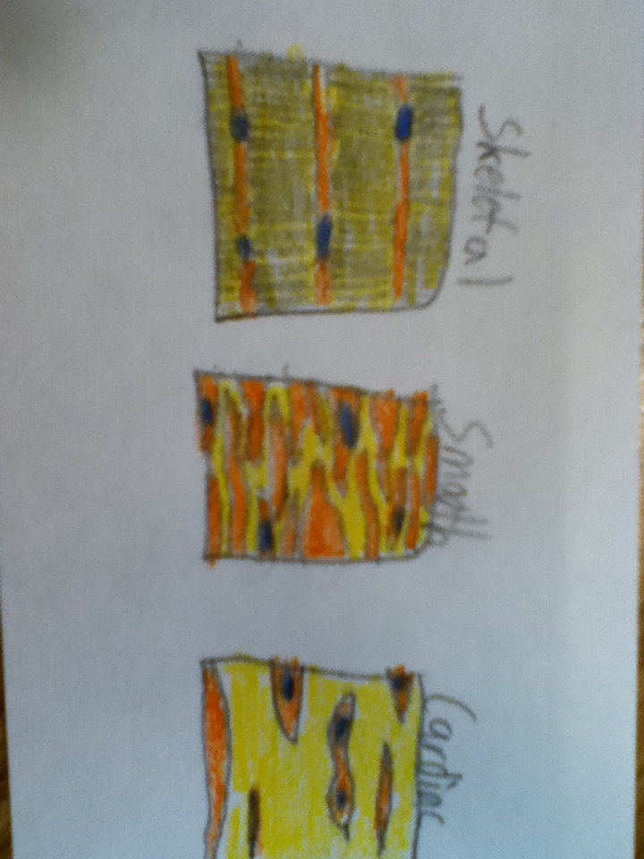
Muscular System
The function of the muscular system is to move the body, produce heat, and aid in digestion.
Three types of muscle tissue are smooth, skeletal, and cardiac.

Slide 13
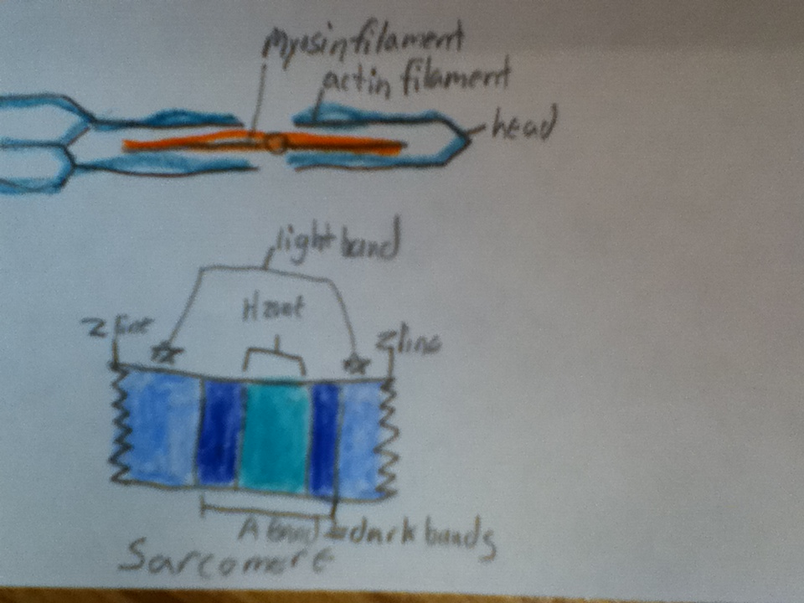
Muscular System
Motor neurons release acetylcholine which then binds to receptors.
Through action potential calcium ions from the sarcoplasmic reticulum to bind troponin causing it to change shape, exposing the active site.
Myosin catalyzes ATP into ADP + P causing myosin head to bind forming a cross bridge.
The myosin head then releases ADP+P causing cross bridges to flex. The muscle then contracts.

Slide 14
Muscular System
Muscular Dystrophy
Muscular Dystrophy is the loss of muscle tissue making it susceptible to damage.
Symptoms are muscle weakness and mental retardation.
Most severe forms happen in early childhood.
Treatments include physical therapy and Corticosteroids, there is no cure.

Slide 15
Muscular System
Myasthenia Gravis
Myasthenia gravis is a neuromuscular disorder.
Symptoms include any weakness in the skeletal muscles.
It occurs more often in young women and older men.
Treatments for it include lifestyle changes and medications.

Slide 16
Skeletal System

Slide 17
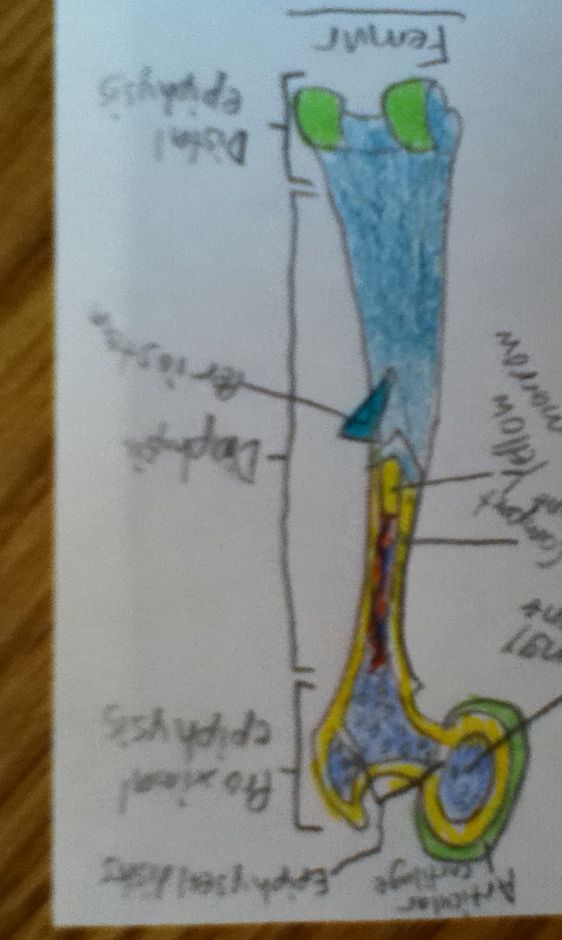
Skeletal System
The function of the skeletal system is to support and protect organs.
Bones are the framework.
Ligaments restrict to stop dislocation.
Muscles move the bones during movements of the body.
Tendons connect muscle to bone, moving the bones.

Slide 18
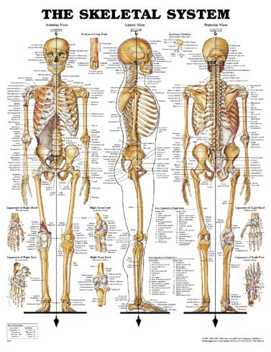
Skeletal System
Animal skeletal systems protect the animals tissues and aid in movement.
There are three different kinds.
Hydrostatic skeletons have fluid filled chambers, jellyfish.
The exoskeleton is a hard outside, spiders.
The endoskeleton is an internal skeleton, humans.

Slide 19
Skeletal System
Osteoporosis
Osteoporosis is the loss of bone tissue over time.
Symptoms include back pain, stooped posture, and bone pain.
Over the age of fifty, one in every five women has it.
Treatments include life style changes, drinking milk at a young age and medications.

Slide 20
Skeletal System
Leukemia
Leukemia is the cancer of the blood cells.
Risk factors are radiation, down syndrome, chemicals, and smoke.
Symptoms include fever, swelled lymph nodes, bruising, and infections.
Treatments include therapy, stem cell transplant, radiation, and chemotherapy.

Slide 21
Works Cited
Human Anatomy Textbook
http://www.ninds.nih.gov/disorders/parkinsons_disease/parkinsons_disease.htm
http://www.ncbi.nlm.nih.gov/pubmedhealth/PMH0001747/
http://www.emc.maricopa.edu/faculty/farabee/biobk/biobooknerv.html
http://www.ncbi.nlm.nih.gov/pubmedhealth/PMH0002172/
http://www.ncbi.nlm.nih.gov/pubmedhealth/PMH0001731/
http://www.ncbi.nlm.nih.gov/pubmedhealth/PMH0001400/
http://www.webmd.com/cancer/tc/leukemia-topic-overview?page=2
http://www.exrx.net/Store/Other/SkeletalSystem.html

